Slide 1
Race Condition Vulnerability

Slide 2
Outline
What is Race Condition?
Race Condition Problem
Race Condition Vulnerability
How to exploit?
Countermeasures

Slide 3
Race Condition
Happens when:
Multiple processes access and manipulate the same data concurrently.
The outcome of execution depends on a particular order.
If a privileged program has a race condition, the attackers may be able to affect the output of the privileged program by putting influences on the uncontrollable events.

Slide 4
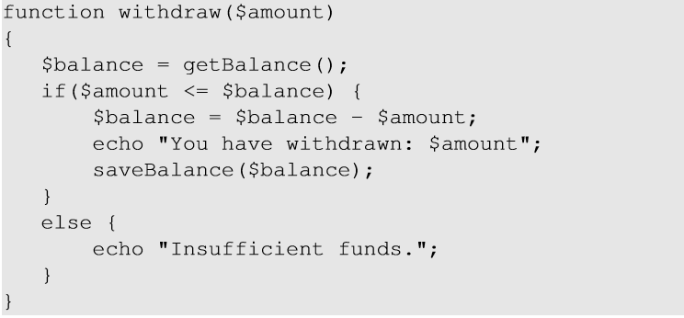
Race Condition Problem
When two concurrent threads of execution access a shared resource in a way that unintentionally produces different results depending on the timing of the threads or processes.
Race Condition can occur here if there are two simultaneous withdraw requests.
The code performs withdrawal transaction from a bank. The function checks if the amount to be withdrawn is less than the balance. If yes, it authorizes the withdraw and updates the balance. If there are two simultaneous withdraw requests, a race condition may occur. Example, Current balance = $100. Request 1 to withdraw $90. Before the server updates the balance, request 2 tries to withdraw $90 which will approved as current balance is still $100. Hence, $180 will be withdrawn with $10 in the account as balance. (Statement $balance=$balance-$amount is not atomic, so each thread may read $balance to be 100, enter the true branch, then each assign $balance=10.)

Slide 5
A Special Type of Race Condition
Time-Of-Check To Time-Of-Use (TOCTTOU)
Occurs when checking for a condition before using a resource.

Slide 6
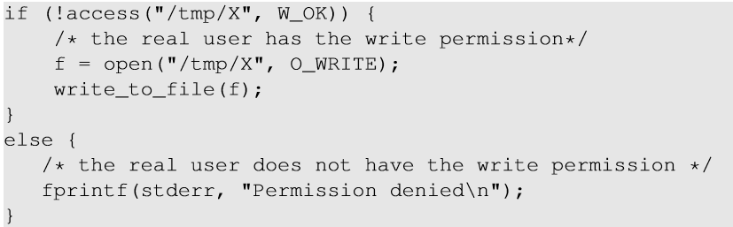
Race Condition Vulnerability
Root-owned Set-UID program.
Effective UID : root
Real UID : seed
The above program writes to a file in the /tmp directory (world-writable)
As the root can write to any file, the program ensures that the real user has permissions to write to the target file
System call access()checks if the Real UID, which is seed, has write access to /tmp/X (returns 0 if check passes)
If check access()passes, system call open()checks the Effective UID, which is root (0), and hence file will be opened.

Slide 7
Race Condition Vulnerability
Goal : To write to a protected file like /etc/passwd.
To achieve this goal we need to make /etc/passwd as our target file without changing the file name in the program.
Symbolic link (soft link) helps us to achieve it.
It is a special kind of file that points to another file.

Slide 8
Race Condition Vulnerability
Create a regular file X inside /tmp directory
Pass the access() check
Issues :
As the program runs billions of instructions per second, the window between the time to check and time to use lasts for a very short period of time, making it impossible to change to a symbolic link
If the change is too early, access() will fail.
If the change is too late, the program will finish using the file.
Change “/tmp/X” to symbolic link pointing to “/etc/passwd”
open() checks the EID, which is root.
Open password file for write.

Slide 9
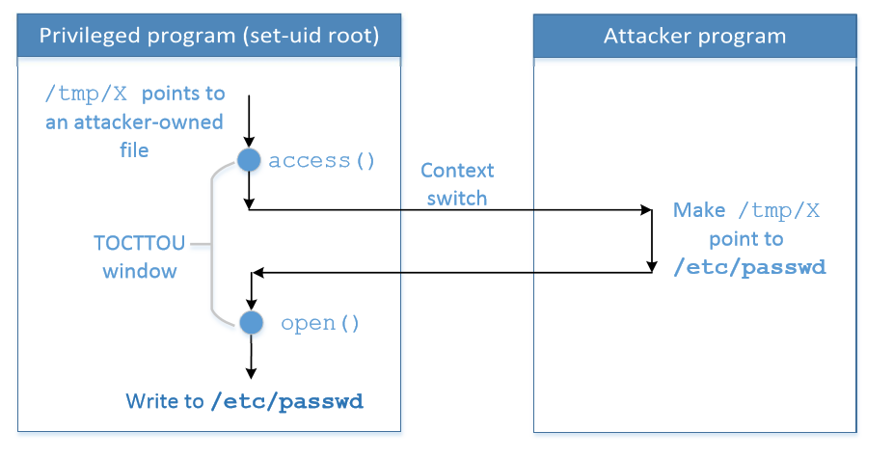
Race Condition Vulnerability
To win the race condition (TOCTTOU window), we need two processes :
Run vulnerable program in a loop
Run the attack program
Notes:
The above figure shows the TOCTOU window to change the link to /etc/passwd

Slide 10
Understanding the attack
Attack program runs: A1,A2,A1,A2…….
Vulnerable program runs : V1,V2,V1,V2…..
As the programs are running simultaneously on a multi-core machine, the instructions will be interleaved (mixture of two sequences)
A1, V1 , A2, V2 : vulnerable prog opens /etc/passwd for editing.
Let’s consider steps for two programs :
A1 : Make “/tmp/X” point to a file owned by us
A2 : Make “/tmp/X” point to /etc/passwd
V1 : Check user’s permission on “/tmp/X”
V2 : Open the file

Slide 11
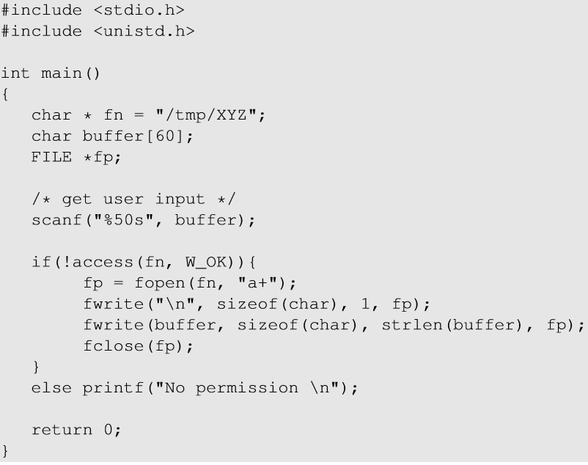

Vulnerable Program
Make the vulnerable program Set-UID :
Unlink /tmp/XYZ and relink it to /etc/passwd between access() and fopen() to overwrite /etc/passwd.

Slide 12
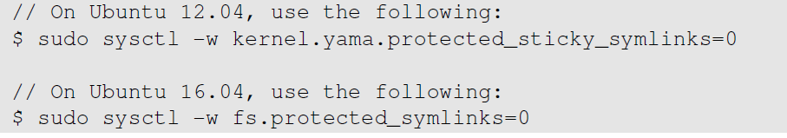
Experiment Setup
Disable countermeasure: It restricts the program to follow a symbolic link in world-writable directory like /tmp.

Slide 13
How to Exploit Race Condition?
Choose a target file
Launch Attack
Attack Process
Vulnerable Process
Monitor the result
Run the exploit

Slide 14
Attack: Choose a Target File
Add the following line to /etc/passwd to add a new user
test:U6aMy0wojraho:0:0:test:/root:/bin/bash
Username
UID (0 means root)
Hash value for empty password

Slide 15
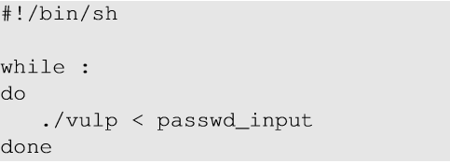
Attack: Run the Vulnerable Program
Two processes that race against each other: vulnerable process and attack process
Run the vulnerable process
Vulnerable program is run in an infinite loop (target_process.sh)
passwd_input contains the string to be inserted in /etc/passwd [in previous slide]

Slide 16
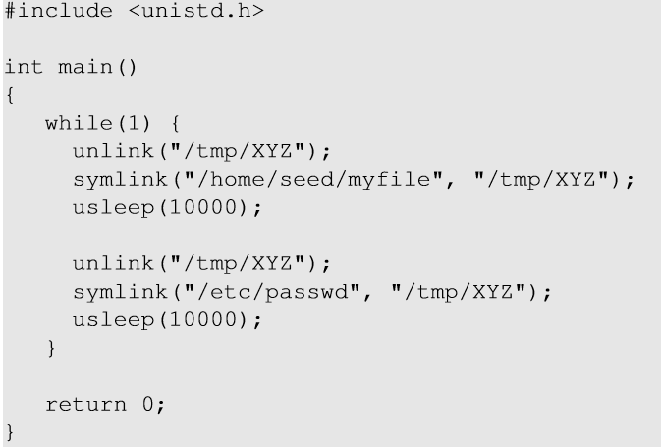
Attack: Run the Attack Program
Create a symlink to a file owned by us. (to pass the access() check)
Sleep for 10000 us to let the vulnerable process run.
Unlink the symlink
Create a symlink to /etc/passwd (this is the file we want to open)

Slide 17
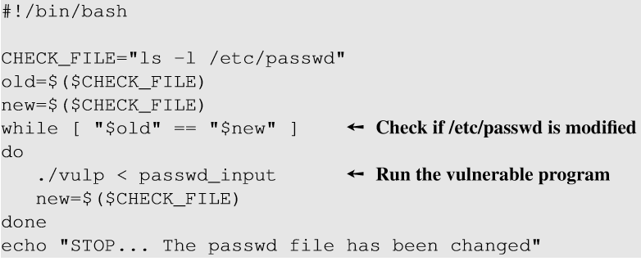
Monitor the Result
Compare the old and new timestamps of /etc/passwd to see whether it has been modified.
The ls -l command prints out the timestamp.

Slide 18
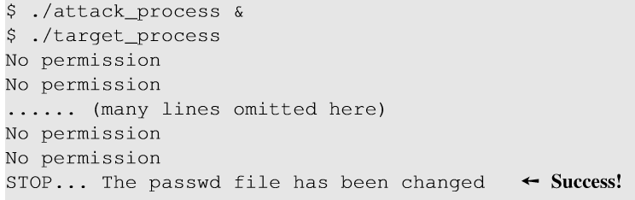
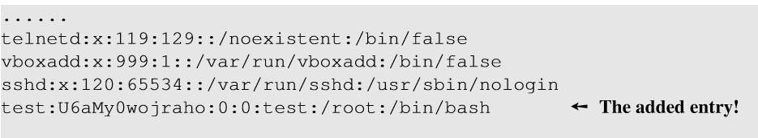
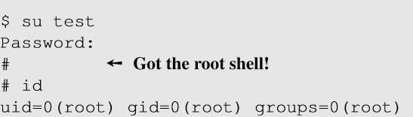

Running the Exploit
Run both attack and vulnerable programs to start the “race”.
Added an entry in /etc/passwd
We get a root shell as we log in using the created user.
Notes:
No permission : access() check failure
Success : Attack process wins the race and /etc/passwd is modified.

Slide 19
3.2 An Undesirable Situation
Attack Program
Target Set-UID Program
Blue arrows: successful attack. Red arrows: Attack program is context switched out right after unlink() and before symlink(). Target Set-UID program gets a chance to run fopen(fn, "a+"), which creates a new file /tmp/XYZ with owner root. Attacker cannot remove the file, hence attack fails.

Slide 20
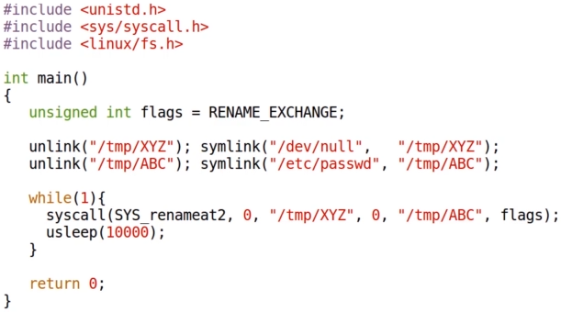
3.2 An Undesirable Situation: Solution (try it if your attack is always unsuccessful)
If your attack always fails due to the problem in previous slide, try the code below (linking to /dev/null has similar effect as linking to /home/seed/myfile.)
SYS_renameat2 is a system call that atomically renames two files by swapping their names, thus removing the problem. (If your attack is successful, you can skip this step.)

Slide 21
Countermeasures
Atomic Operations: To eliminate the window between check and use
Sticky Symlink Protection: To prevent creating symbolic links.
Principles of Least Privilege: To prevent the damages after the race is won by the attacker.

Slide 22
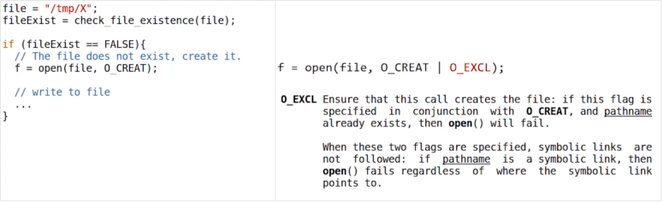
Atomic Operations
f = open(file, O_CREAT | O_EXCL)
These two options combined makes (existence check + open) atomic, i.e., it will not open the specified file if the file already exists.
(Not in the lab assignment, but feel free to try yourself.)
Notes:
Guarantees the atomicity of the check and the use.

Slide 23
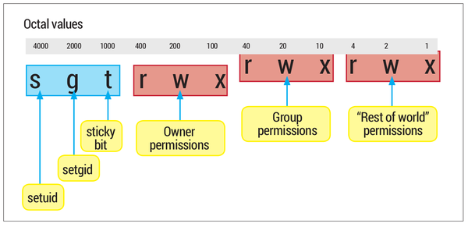
The Sticky Bit
Sticky Directory : A directory has a special bit called sticky bit (the 3rd bit after setuid and setgid bits). When this bit is set, a file inside the directory can be renamed or deleted by the file’s owner, the directory owner or root user. If the bit is not set, any user with write and execute permissions for the directory can rename or delete the file. A directory’s sticky bit is set to prevent a normal user from renaming and deleting other users’ files inside it.

Slide 24
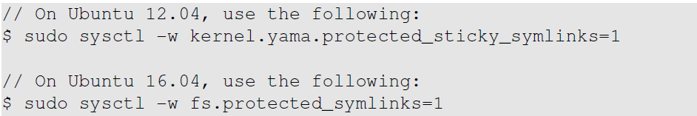
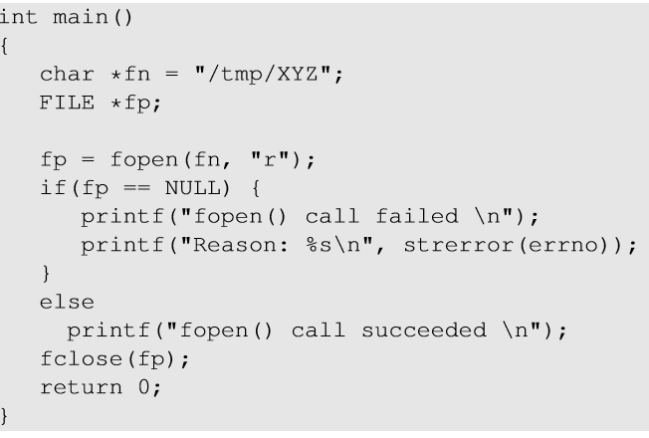
Sticky Symlink Protection
To enable the sticky symlink protection for world-writable sticky directories:
A test program for understanding sticky symlink protection.
Notes:
Run it with different user IDs (seed and root), experiments were conducted to understand the protection.

Slide 25
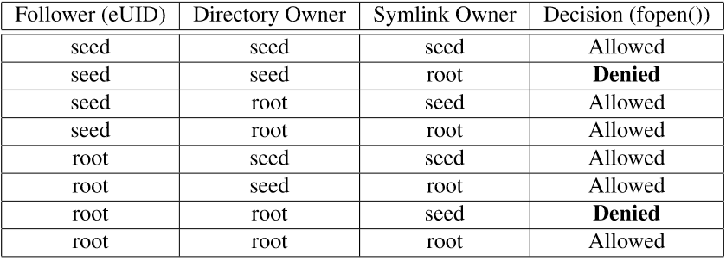
Sticky Symlink Protection
When the sticky symlink protection is enabled, symbolic links inside a sticky directory (/tmp) can only be followed when the owner of the symlink is either the link follower (EID of the target program) or the directory owner.
Owner of symlink to /etc/passwd is seed, which created the symlink;
The link follower (target program) has EUID=root;
Directory owner of /tmp is root.
Base on the table, the target program is not allowed to follow the symlink to /etc/passwd, so fopen() fails.
Notes:
Symlink protection allows fopen() when the owner of the symlink is either the follower (EID of the process) or the directory owner.

Slide 26
Principle of Least Privilege
Principle of Least Privilege:
A program should not use more privilege than what is needed by the task.
Our vulnerable program has more privileges than required while opening the file.
seteuid() and setuid() can be used to discard or temporarily disable privileges.

Slide 27
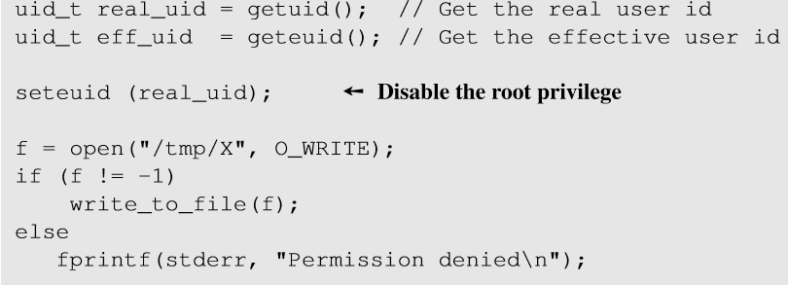
Principle of Least Privilege
Right before opening the file, the program should drop its privilege by setting EID = RID
After writing, privileges are restored by setting EUID = root

Slide 28
Quiz
Q: The least-privilege principle can be used to effectively defend against the race condition attacks discussed in this chapter. Can we use the same principle to defeat buffer-overflow attacks? Why or why not? Namely, before executing the vulnerable function (e.g., strcpy()), we disable the root privilege; after the vulnerable function returns, we enable the privilege back.
A: No. For buffer-overflow attack or other code injection attacks, attacker is running her own program, and can always turn back on root privilege. (It is useful to permanently drop the root privilege.) In contrast, for race condition attack, attacker does not run her own program, hence she cannot set privileges at all.

Slide 29
Summary
What is race condition
How to exploit the TOCTTOU type of race condition vulnerability
How to avoid having race condition problems

