Slide 1

Kick-Off Presentation
Tobias Masiak
Aditya Gulati
ZeMA - Zentrum für Mechatronik und Automatisierungstechnik gemeinnützige GmbH
Saarbrücken, 07.05.2018

Slide 2
Agenda
1
4by3 Scenario3 PAG
2
Masterthesis
3
Vorgehensweise
4
Zeitplan

Slide 3
Agenda
1
4by3 Scenario3 PAG
2
Masterthesis
3
Vorgehensweise
4
Zeitplan

Slide 4
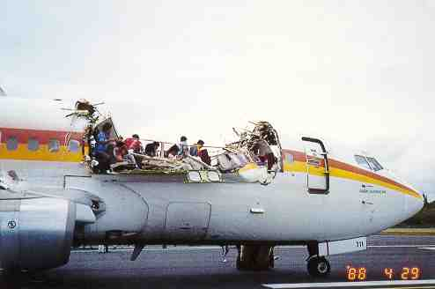
4by3 PAG Project Overview
Notes:
riveting is a vital process in airplane assembly. and our project essentially focus in bulkhead assembly.

Slide 5
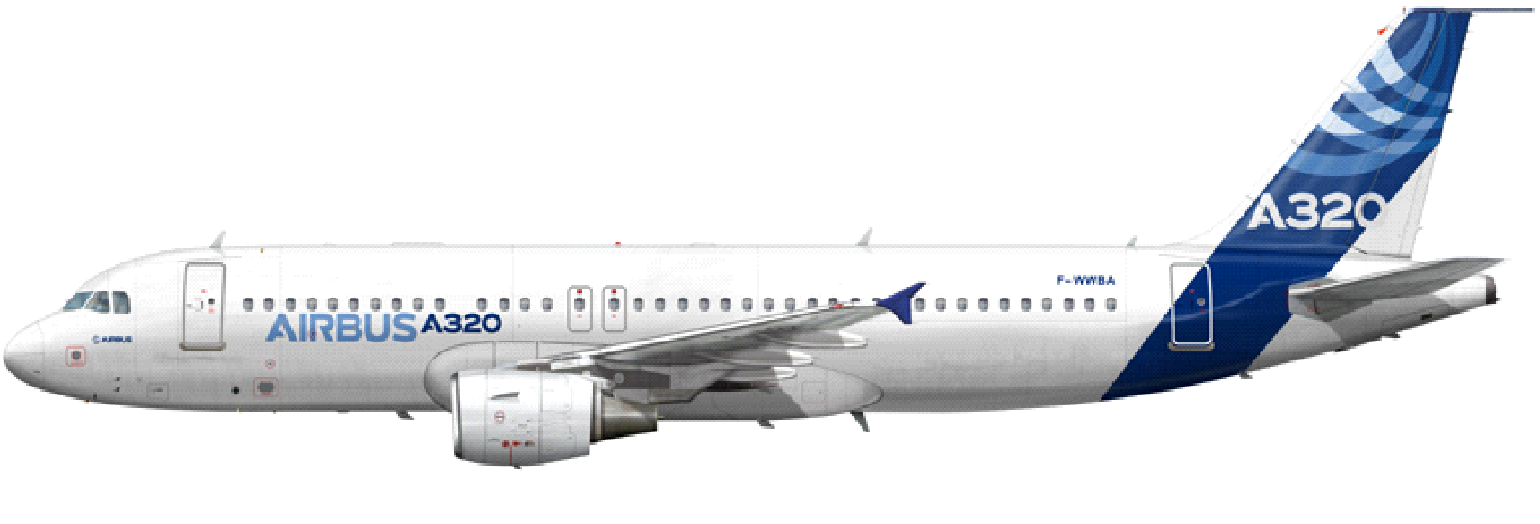
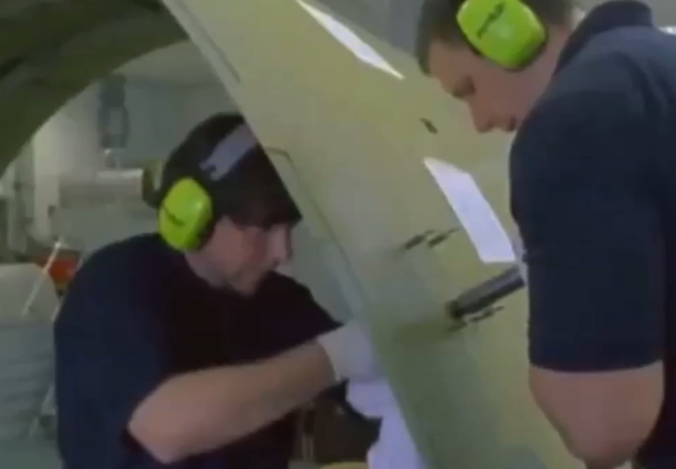
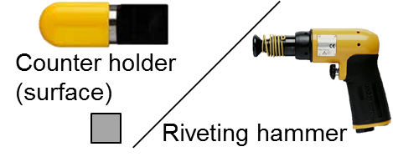
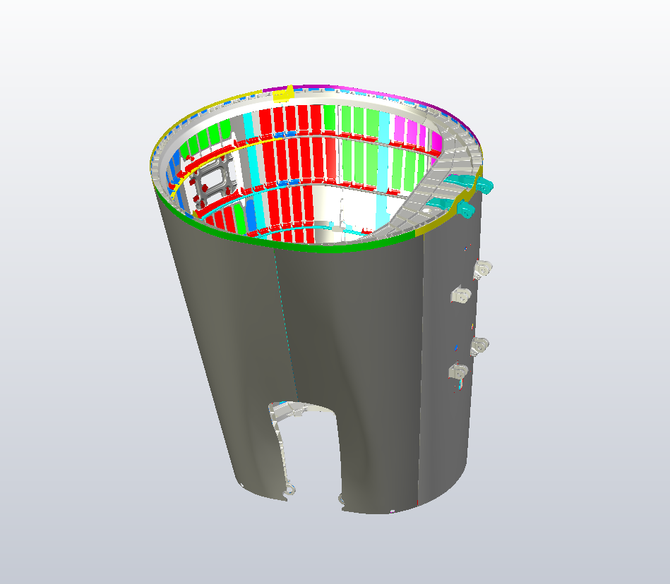
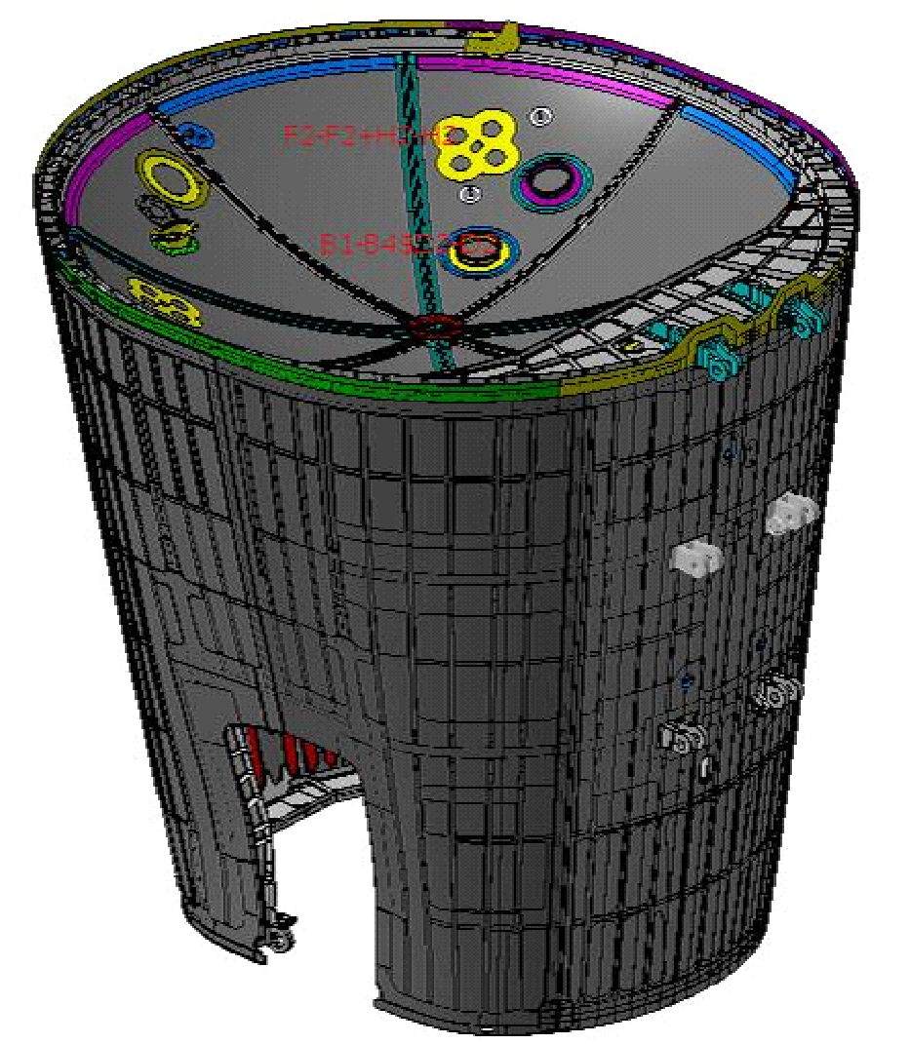
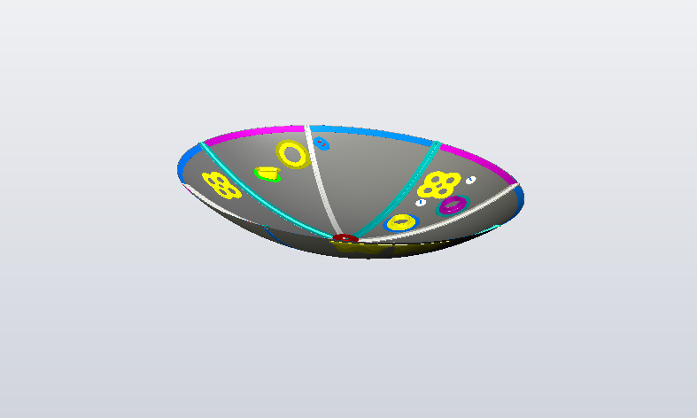
Produkt
Prozess
Betriebsmittel
Dolly
+
=
Montage der Druckkarlotte
In the section assembly of airplanes (Airbus Sec. 19) a high number of rivets are needed to be mounted on the pressure bulk head

Slide 6
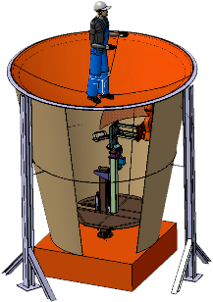
Production Process
Current Industry Process
Future Industry Process
Notes:
At present there are 2 workers with one holding the dolly as a base and other hammering the rivet from the other side. where as our project proposes the use of a robot holding the dolly making the whole process more efficient and fast , hence also arising the need of work on human robot interaction front

Slide 7
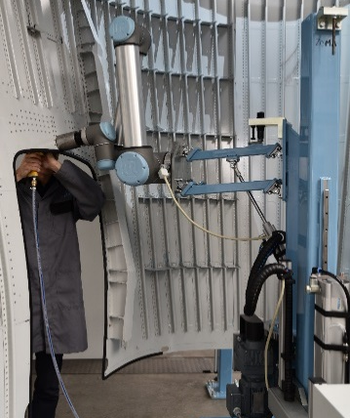
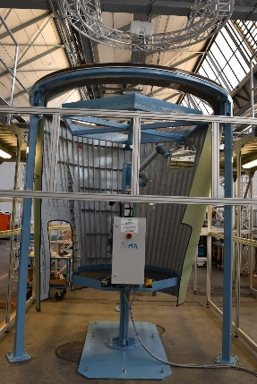
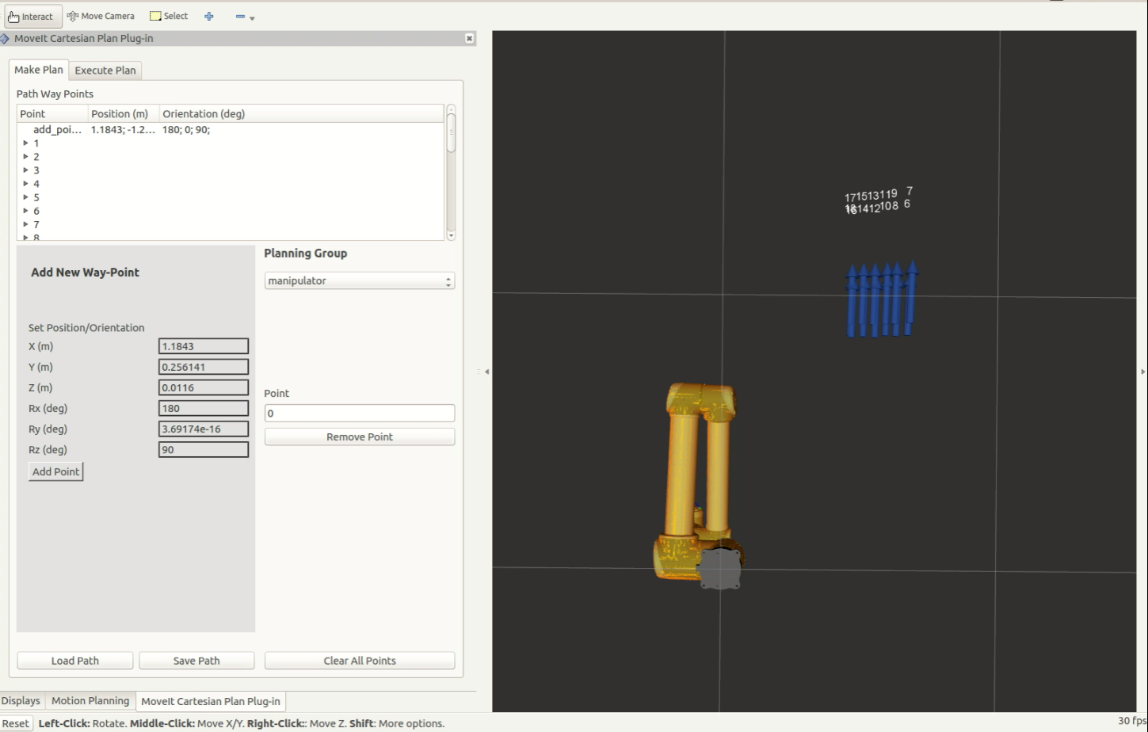
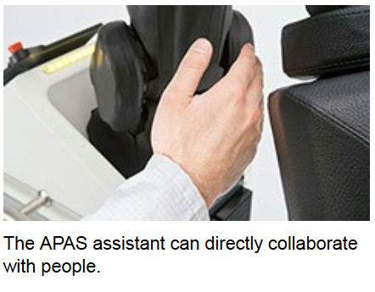
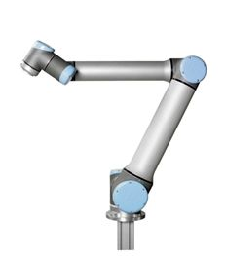

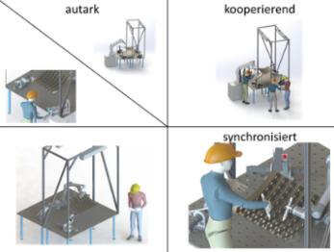
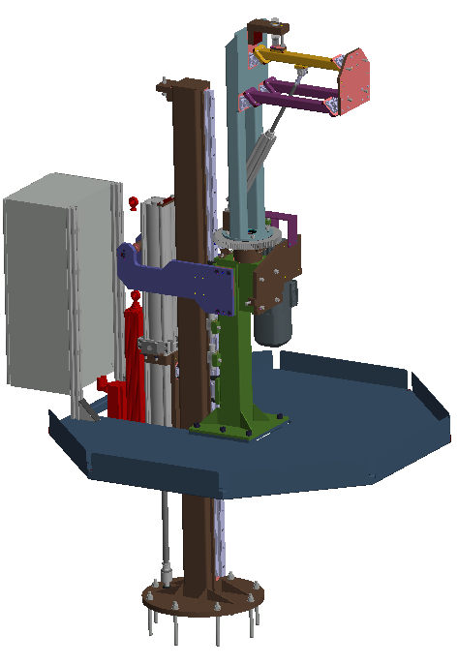
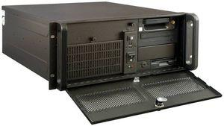
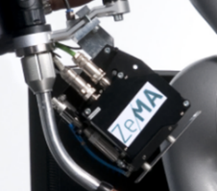


MRK als Ansatz für einen Nietprozess in der Montage einer Druckkarlotte mit der Sektionstonne
Teilautomatisiertes Nietsystem
Bedien-methode
Sicherheit
Roboter
Steuerung
Sensorik
Werkzeug
Konfiguration
Das halbautomatisierte Nietsystem enthält viele wichtige Komponenten – hier liegt der Fokus auf dem Roboter, der Steuerung und der Sensorik.
Abbildungen: Universal Robots, Bosch, ROS, ZeMA
Notes:
Semi-automated riveting system
Operating method
Robot
Safety:
Safe robots
Tactile switching elements for detection of a collision
Robot:
Roboter
Hubeinheit
Controller:
ROS I-PC
Robot Controller
Peripherie
Mesurement concept:
- Linienlasertriangulationssensor
Process tool:
- Dolly
Configuration:
Kollaboration
Operating Method:
Operating method
Smartwatch, HoloLens, GOS GUI, Video projectors

Slide 8
MRK als Ansatz für einen Nietprozess in der Montage einer Druckkarlotte mit der Sektionstonne
Teilautomatisiertes Nietsystem
Bedien-methode
Sicherheit
Roboter
Steuerung
Sensorik
Werkzeug
Konfiguration
Das halbautomatisierte Nietsystem enthält viele wichtige Komponenten – hier liegt der Fokus auf dem Roboter, der Steuerung und der Sensorik.
Abbildungen: Universal Robots, Bosch, ROS, ZeMA
Notes:
Semi-automated riveting system
Operating method
Robot
Safety:
Safe robots
Tactile switching elements for detection of a collision
Robot:
Roboter
Hubeinheit
Controller:
ROS I-PC
Robot Controller
Peripherie
Mesurement concept:
- Linienlasertriangulationssensor
Process tool:
- Dolly
Configuration:
Kollaboration
Operating Method:
Operating method
Smartwatch, HoloLens, GOS GUI, Video projectors

Slide 9
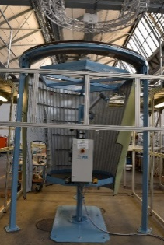
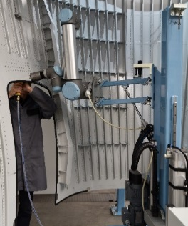

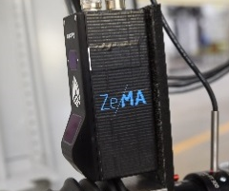
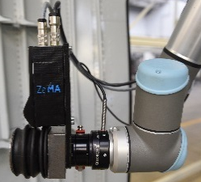

Approach for a riveting process in the mounting of the pressure bulk head to the section barrel using Human-Robot-Collaboration
Safety
Semi automated riveting system
Operating method
Robot
Controller
Measurement concept
Process tool
Configuration
While the semi-automated riveting system has many important components, we will focus on the controller, measurement concept, process tool and the operating method.
Figures: Universal Robots, Bosch, ROS, ZeMA
Notes:
there are many aspects of the whole project but we will be concentrating on quality assurance and human robot collaboration of the process

Slide 10
Components of PAG
Safety
Semi automated riveting system
Operating method
Robot
Controller
Measurement concept
Process tool
Configuration
While the semi-automated riveting system has many important components, we will focus on the controller, measurement concept, process tool and the operating method.
Figures: Universal Robots, Bosch, ROS, ZeMA
Notes:
there are many aspects of the whole project but we will be concentrating on quality assurance and human robot collaboration of the process

Slide 11
Components of PAG
Safety
Semi automated riveting system
Operating method
Robot
Controller
Measurement concept
Process tool
Configuration
While the semi-automated riveting system has many important components, we will focus on the controller, measurement concept, process tool and the operating method.
Figures: Universal Robots, Bosch, ROS, ZeMA
Notes:
there are many aspects of the whole project but we will be concentrating on quality assurance and human robot collaboration of the process

Slide 12
Agenda
1
4by3 Scenario3 PAG
2
Masterthesis
3
Vorgehensweise
4
Zeitplan

Slide 13
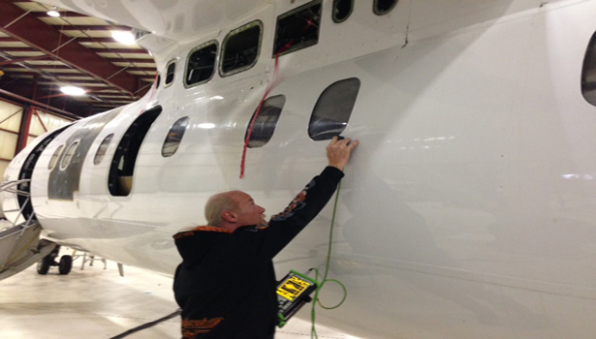
Topic Masterthesis
Problem:
There is no automatic real time rivet quality assurance hence making it more tedious, expensive and time consuming.
Visualization : Real time responsive control supporting interactive environment
Notes:
Eliminating the need of tedious visual inspection.

Slide 14
Agenda
1
4by3 Scenario3 PAG
2
Masterthesis
3
Methodology
4
Timeline

Slide 15
Proposed Solution
Automatic Real Time Quality Check:
Use of Convolution Neural Network for categoriaze between a good and faulty rivet point (eliminating the need of visual inspection)
Measure rivet thickness and angle from the plate
Finding correlation between and experience force measurement and rivet quality
Human Machine interaction
Ubiquitous robot control using hololens
Real time visualisation
Current robot position and pose
Current status of the rivet process
Highlighting attention points
Notes:
Aneignung des benötigten Wissens
Einlesen in „KDARo“ und „Robotix“ – Vorlesung
Erlernen von ROS (Grundlagen, URDF)

Slide 16
Proposed Execution Plan
Create minimum 1000 data points
Build classification model:
Machine learning: Use supervised learning to classify good and bad: camera
Classification based on
Cracked surface
uneven rivet surface
shape of the rivet
damage to the base material
Consider laser line senor measurement
from the back
angle
thickness
diameter
Expert confirmation the riveting quality
Simultaneously Record force torque sensor data
Find correlation between force torque data and the quality of the rivets

Slide 17
Execution Flow
Include the data flow using diagrams

Slide 18
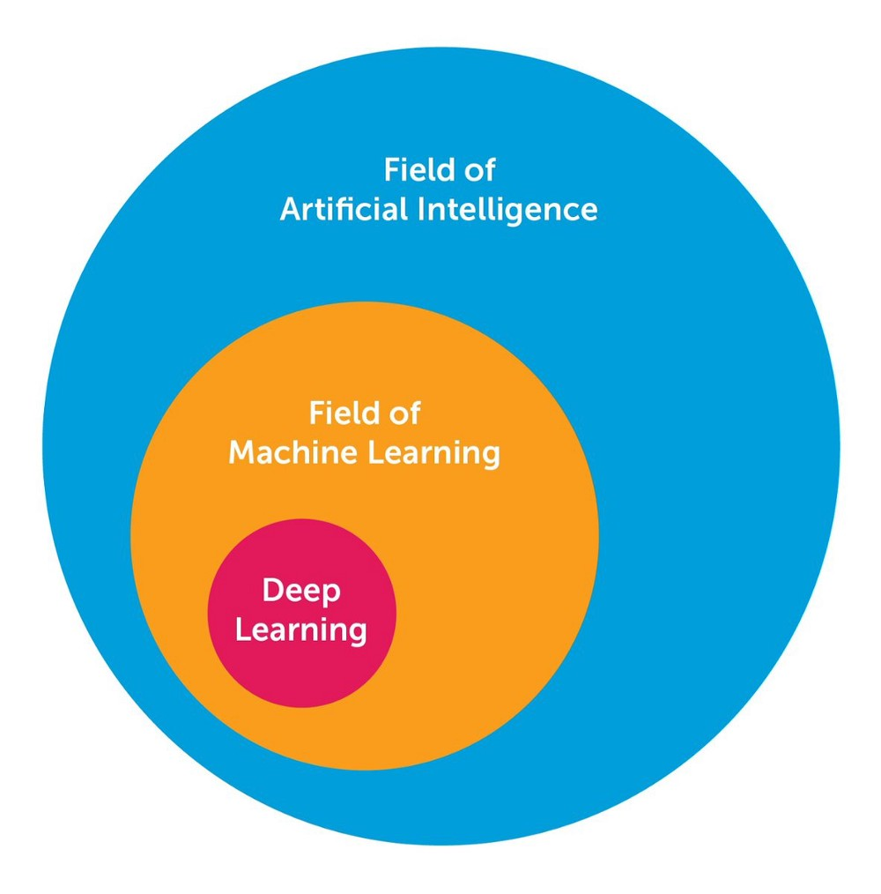
Current Progess (HoloLens)
Definition: machine learning, supervised learning, deep neural networks, concept
Sketch

Slide 19
Agenda
1
4by3 Scenario3 PAG
2
Masterthesis
3
Vorgehensweise
4
Zeitplan

Slide 20
Time schedule
Aufgaben | Juni | Juli | August | September | Oktober | November
Einarbeitung
Konzept-entwicklung
Entwicklung des Modells
Ansteuerung Hubeinheit + Antriebe
Theorie Online Anpassung
Online Anpassung des lokalen KOS
Validierung/ Fertigstellung/ Abgabe
Dokumentation
Konzept
Zwischenpräsentation
Abschlusspräsentation
Projektabschluss 4by3
Fertigstellung Hubeinheit
Abgabe Masterthesis

