Slide 1

Future Average Credit Card Spends
Common man bank LTD

Slide 2
Problem Statement Credit Card consumption patterns are a gold mine for financial institutions. The customers’ consumption patterns allow bank to build financial gain products and devise plans to reward and retain customers
Predicting the average credit card spends for a given set of customers of Common Bank Ltd
Target: cc_cons : average credit card spend for next 3 months
cc_cons_apr(may,jun): credit card spends in Apr, May and June
dc_cons_apr(may,jun): debit card spends in Apr, May and June
debit_amount_apr(may,jun): Total debit amount for Apr, May and June
credit_amount_apr(may,jun):Total credit amount for Apr, May and June
max_credit_amount_apr(may,jun): Maximum amount that can be credited in Apr, May and June
gender: gender of the customer
age: age of the customer
region_code: code assigned to region of residence

Slide 3
Potential Business Problems
Identify the potential repeat customers with predicted high spends on credit cards
Identifying opportunities to upsell other products like loans, deposits, etc to good repaying, less risky, credit worthy customers
Identifying opportunities for potential business partnerships with brands offering discounts
Creating a strong base of loyal, satisfied and engaged customers.

Slide 4
How does our prediction benefit
Better predictions would ensure approaching right vendors for appropriate discounts and plans to reward and retain customers
Better predictions would help tailor financial gain products and loans and pitch those to the appropriate customers

Slide 5
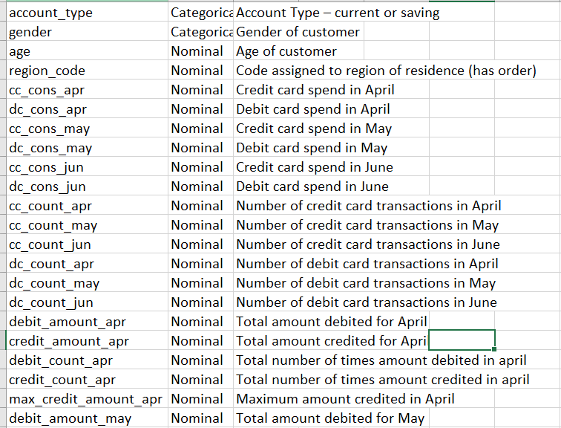
Dataset Explained Here is a snapshot of some of the features of the data:
- There are around 15000 clients’ data, with 44 features.
- Target Variable: cc_cons
- We will continue to see how we identify 39 predictors out of given 44 features to arrive at a solution.

Slide 6
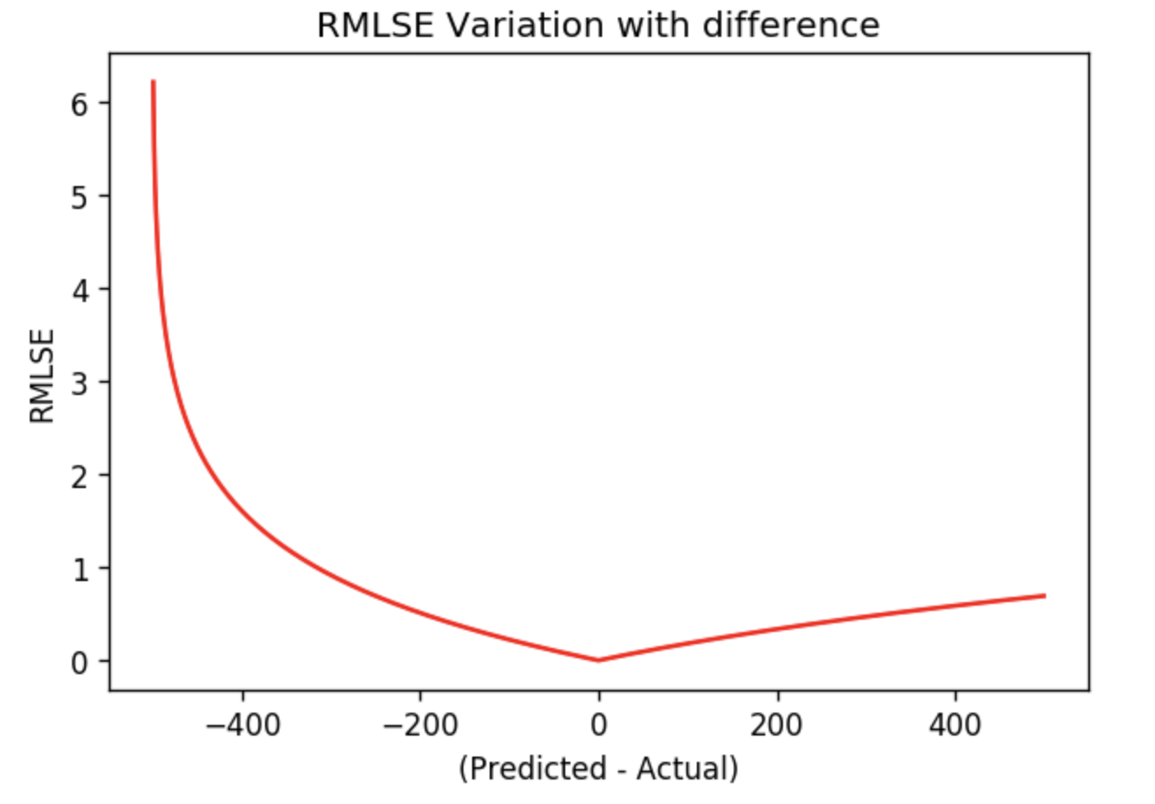
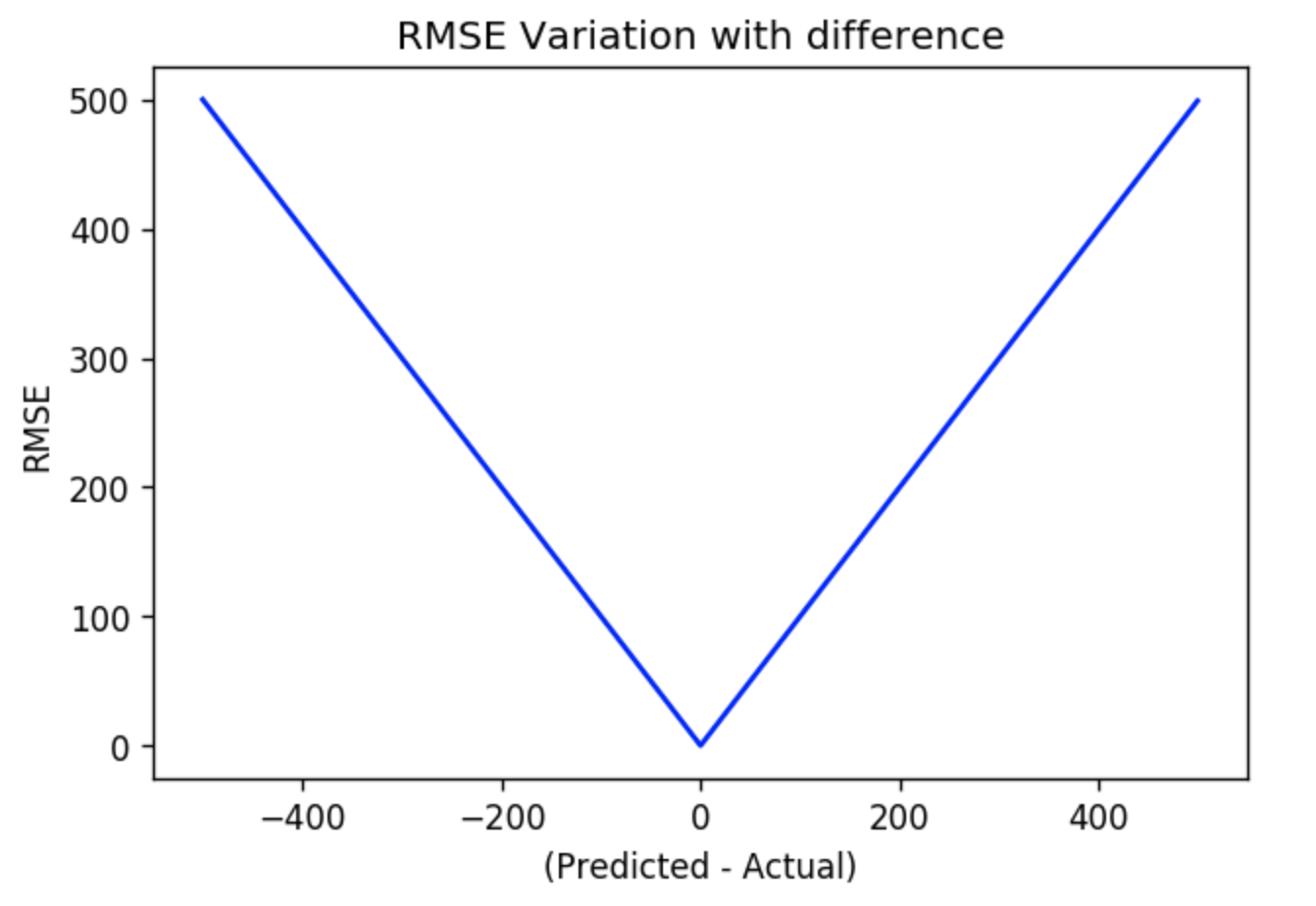
Evaluation Metric We are using RMSLE (root mean squared log error) as out Evaluation Metric
Why we are using what we are using?
RMSLE incurs a large penalty for the underestimation of the Actual variable than the Overestimation.
* Assume actual y is 500, X-axis has the predicted values.

Slide 7
Evaluation Metric We are using RMSLE (root mean squared log error) as out Evaluation Metric
In a business scenario this means, the underestimation of the target variable is not acceptable but overestimation can be tolerated.
CMB might miss out on high spenders if our predictions underestimate. Simpy put, it is more penalising to predict lower average spend values for a high spending customer , than predicting higher average spend values for a low spending customer.

Slide 8
Exploratory Data Analysis (EDA)
First steps

Slide 9
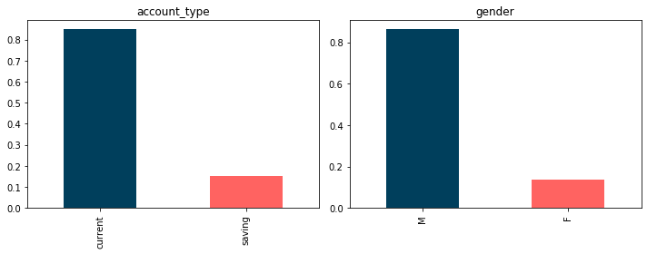
Univariate Analysis: Categorical
High count of data with Account Type: Current and Gender: Male

Slide 10
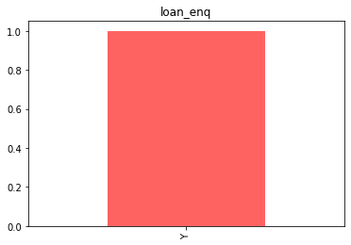
Univariate Analysis: Categorical
There is no variance in the data of the customers who have made a Loan Enquiry. (Is this going to help us predict? )

Slide 11
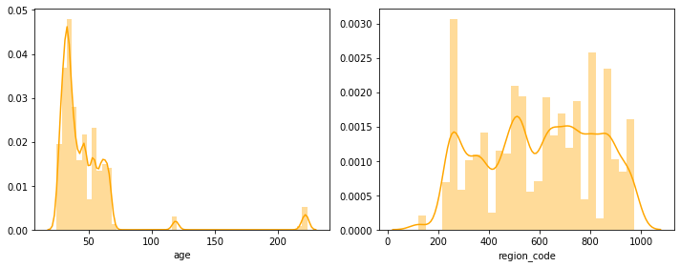
Univariate Analysis: Continuous
Plots for Age (right skewed or outliers?) and Region

Slide 12
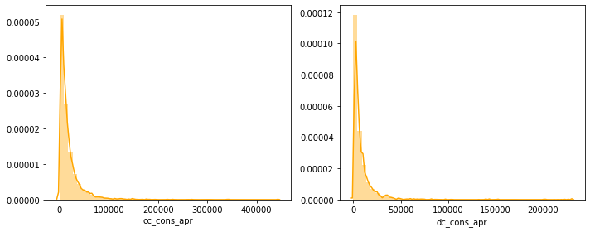
Univariate Analysis: Continous
On the left is the Credit Card Transaction Amount in Apr, and right is Debit Card Transaction Amount in April Both the data is heavily right skewed

Slide 13
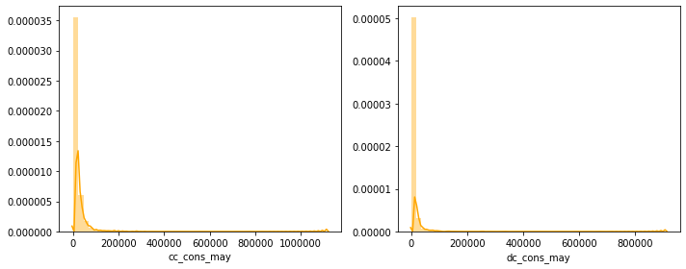
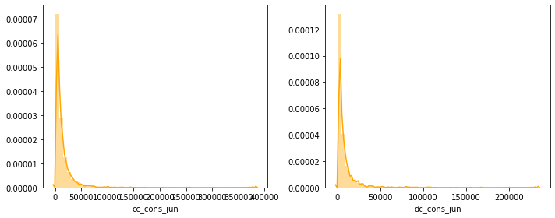
Univariate Analysis: Continuous
Similar distribution is observed in Credit Card and Debit Card Transaction amounts in May and Jun

Slide 14
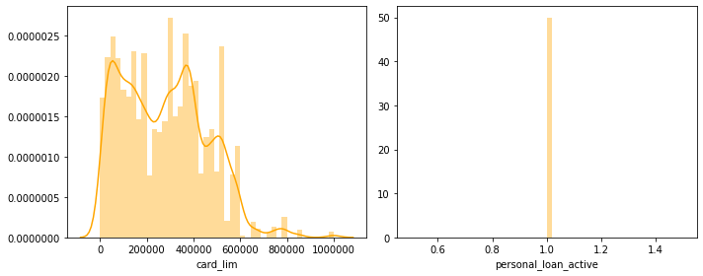
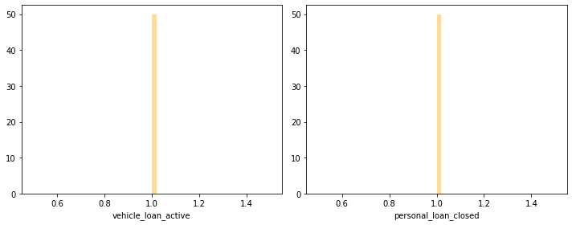
Univariate Analysis: Continuous
The features, personal_loan_active, vehicle_loan_active, personal_loan_closed and vehicle_loan_closed have 0 variance.

Slide 15
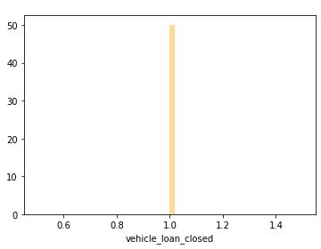
Univariate Analysis: Continuous

Slide 16
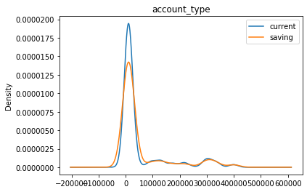
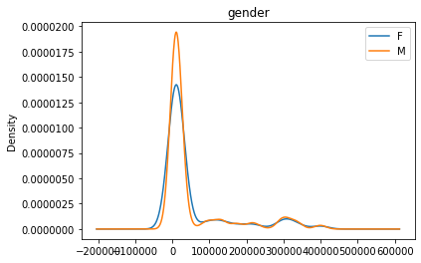
Bivariate Analysis: Categorical
The plot shows kernel density function for categorical variables, Account type and Gender against target variable cc_cons.

Slide 17
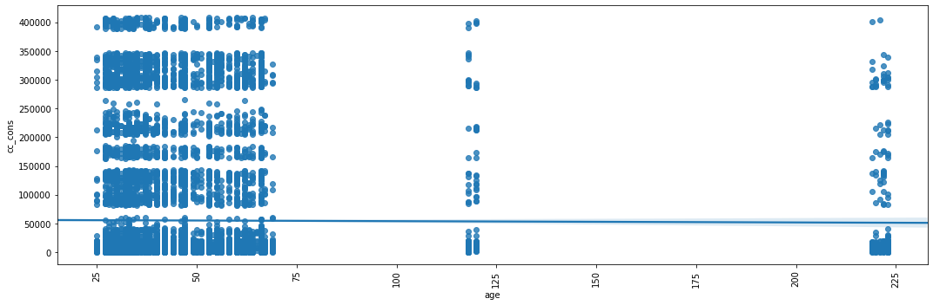
Bivariate Analysis: Continuous
Scatter plot for Age vs Target (cc_cons)

Slide 18
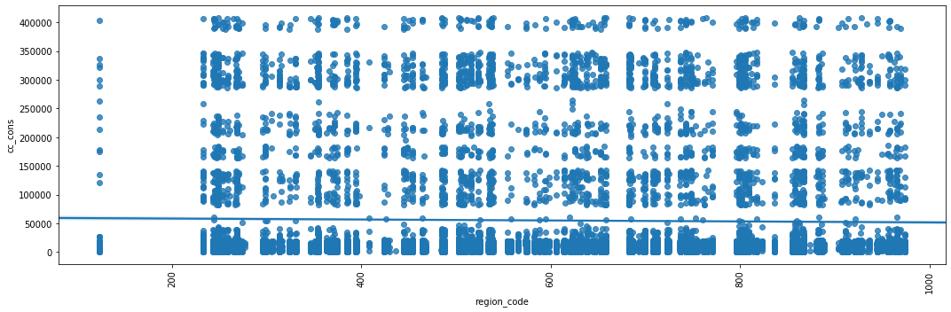
Bivariate Analysis: Continuous
Scatter plot for Region vs Target (cc_cons)

Slide 19
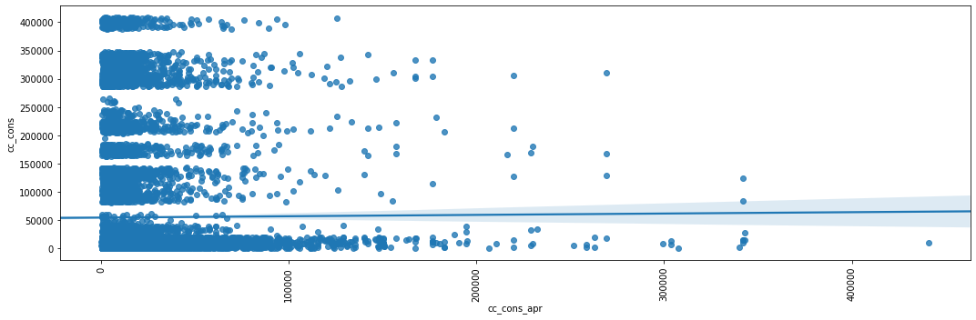
Bivariate Analysis: Continuous
Scatter plot for Credit Card Spend April (cc_cons_apr) vs Target (cc_cons)

Slide 20
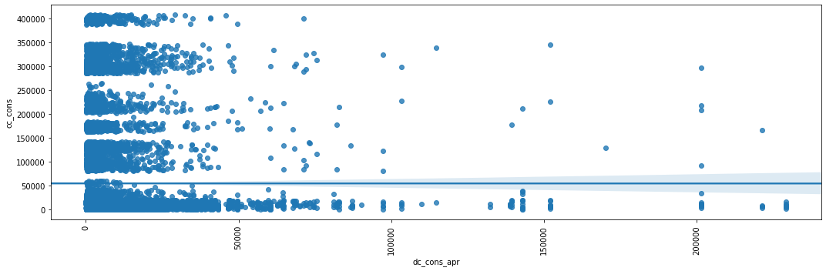
Bivariate Analysis: Continuous
Scatter plot for Debit Card Spend April (dc_cons_apr) vs Target (cc_cons)

Slide 21
Workflow Pipeline
Data Cleaning and reaching to models

Slide 22
High Level View
Info results: 3 object type features, 40 continuous features
No null values in any feature
ID column removed, shouldn’t be used as predictors

Slide 23
Feature Engineering
As the first part of data cleaning process, we treated data for below data discrepancies
The card_lim, that denotes maximum credit card limit allocated for a customer, was less than the credit card spend for at least 1 out of 3 months for 863 rows.
We handled them by replacing card_lim with maximum of credit card amount spends in April, May and June
The total debit amount for a April was less than the total amount spent by credit card and debit card in April, for 3865 rows. We updated the total debit amount (debit_amount_apr) by the sum of credit and debit card spends (cc_cons_apr + dc_cons_apr).
We handled similarly (point 3) for May and June that had 3730 and 2503 rows respectively with such discrepancy
We also saw that 9244 rows had credit_amount_apr greater than max_credit_amount_apr. We updates such rows by replacing credit_amount_apr with max_credit_amount_apr
May and June had similar data issues with 9274 and 9344 rows respectively

Slide 24
Feature Engineering
We see that certain rows have 0 values, which can be studied basis other features and replaced with the appropriate value
For example when debit_count_jun is given as 0, but cc_count_jun and dc_count jun are given, we replace debit_count_jun with the sum of total credit-card and debit-card transactions for that month.
As there were no identifiable patterns between the feature and target, we averaged (cc_cons_apr cc_cons_may and cc_cons_jun) and created a new features as cc_cons_avg
We performed similar engineering for dc_cons_apr, dc_cons_may and dc_cons_jun

Slide 25
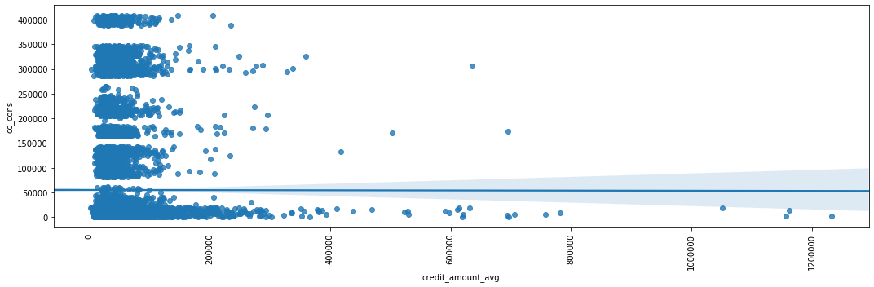
Feature Engineering

Slide 26
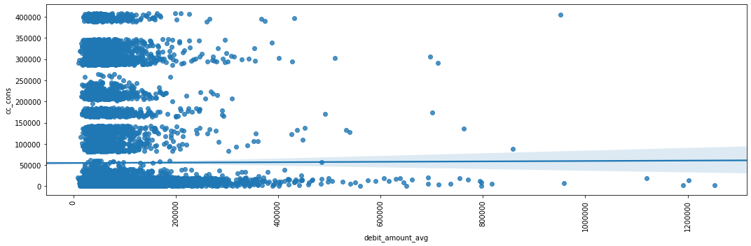
Feature Engineering

Slide 27
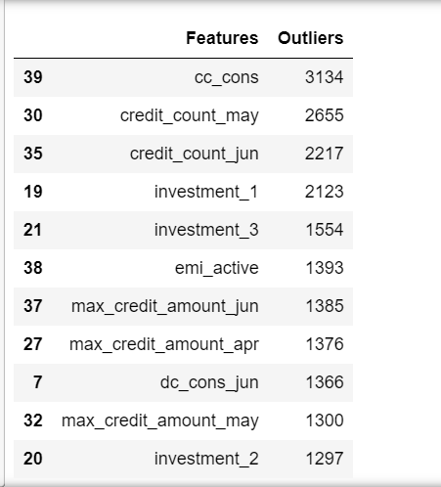
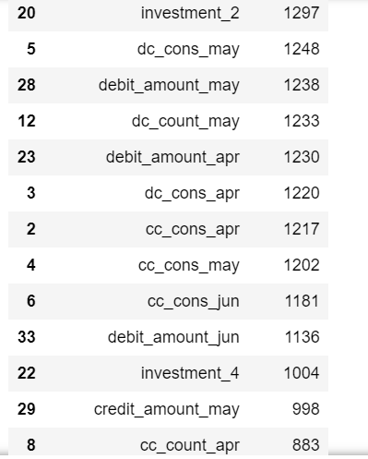
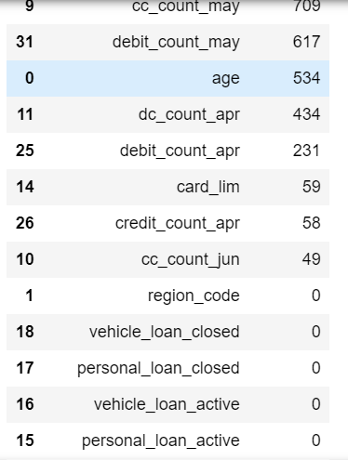
Identifying Outliers
We identified the outliers based on the quantiles and IQR.

Slide 28
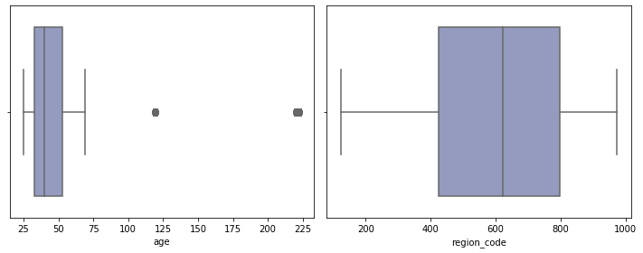
Identifying Outliers
Since there are a huge number of outliers, removing them would cause a loss of information.
We will further see what data points are worth treating and what should remain as is.
Age has values such as 125, 225 which seem incorrect

Slide 29
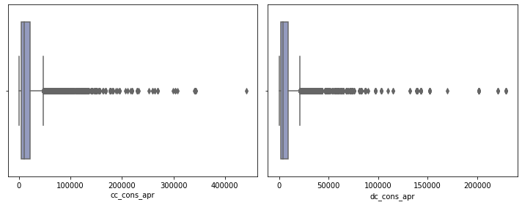
Identifying Outliers
Box Plot for cc_cons_apr and dc_cons_apr

Slide 30
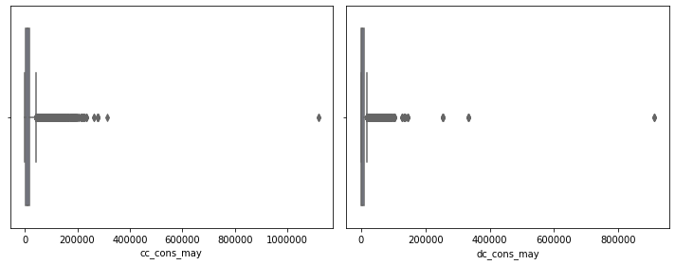
Identifying Outliers
Box Plot for cc_cons_apr and dc_cons_apr
Points far off are potential outliers

Slide 31
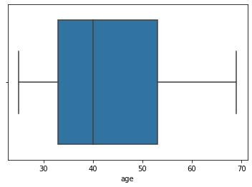
Handling Outliers
We similarly figured out such outliers points and treated them manually
Age was replaced by median of age for the data points that fall outside the value 75

Slide 32
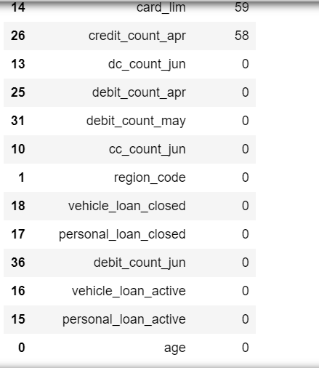
Handling Outliers
We similarly defined thresholds for features with such outliers and treated them by replacing them with median.
After treatment we were able to handle outliers for 4 additional features. The table below shows removed outliers.

Slide 33
Removing zero variance
As seen in the Visualizations, we had 5 features with 0 variance, and hence they cannot be considered as predictors.
The features with zero variance, personal_loan_active,vehicle_loan_active, personal_loan_closed, vehicle_loan_closed and loan_status were removed
We have also identified negative values in the the feature ‘Investment_4’
Negative Investment Values
Deleting rows
Replacing them with 0
Adding (1 – min(value))

Slide 34
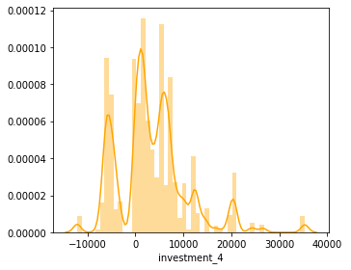
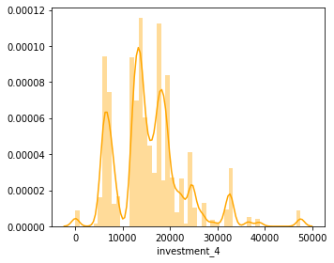
Handling negative values
The data distribution did not change by selecting the third method

Slide 35
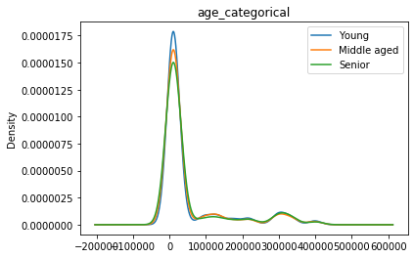
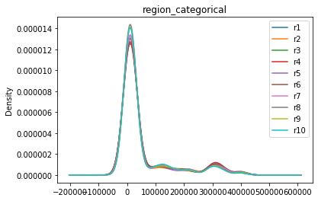
Convert to category and bin
We converted age and region_code into categorical variables and performed binning to see their effect on the target variable (cc_cons)
We see that the different bins do not have any significant impact on how the data is distributed

Slide 36
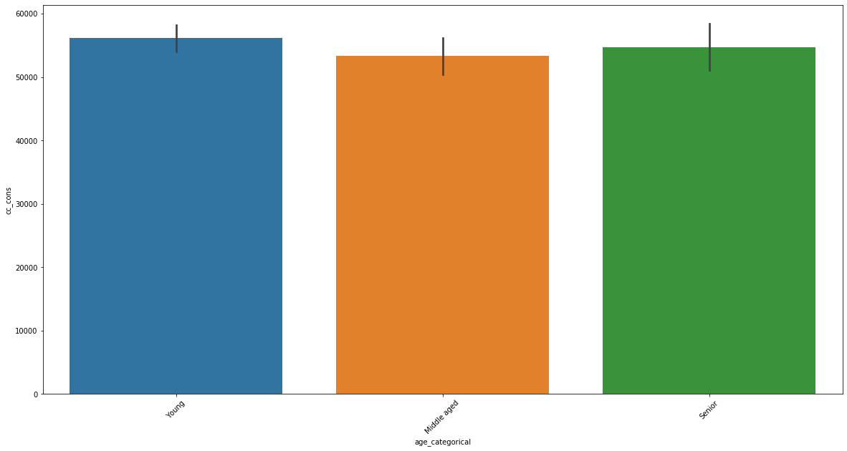
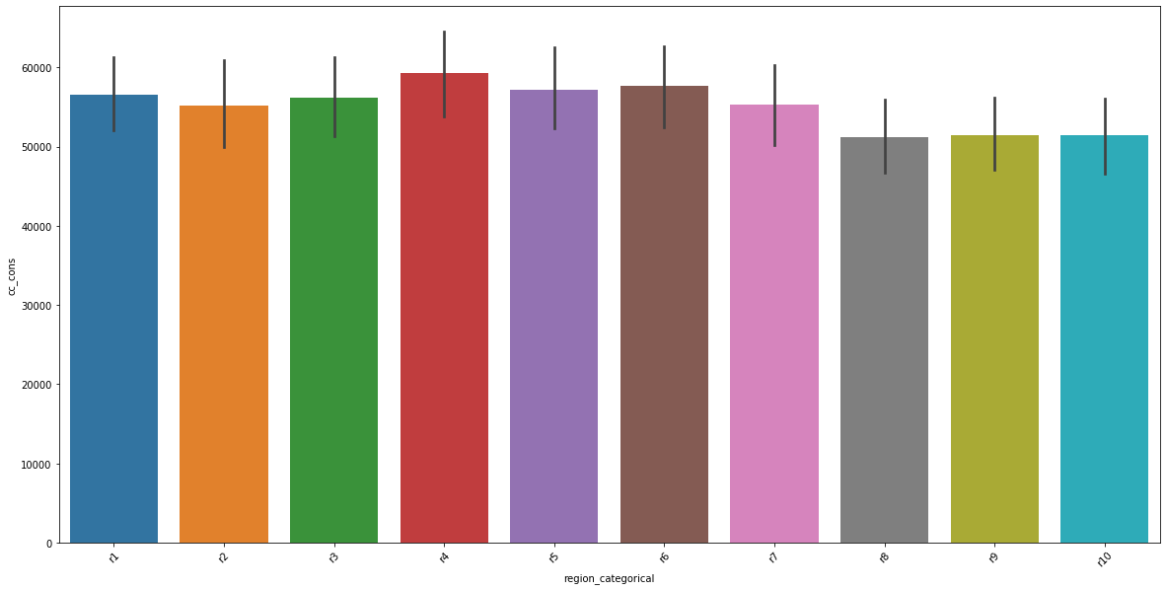
Convert to category and bin
Left: Age
Right: region_code
We see that the different bins do not have any significant impact on how the data is distributed

Slide 37

Skewness
Skewness identification and removal:
We see that most of the data is right skewed (skew >1), and therefore we had below options to treat them
Sqrt transform
Log 1p transform (Used when values are 0)

Slide 38
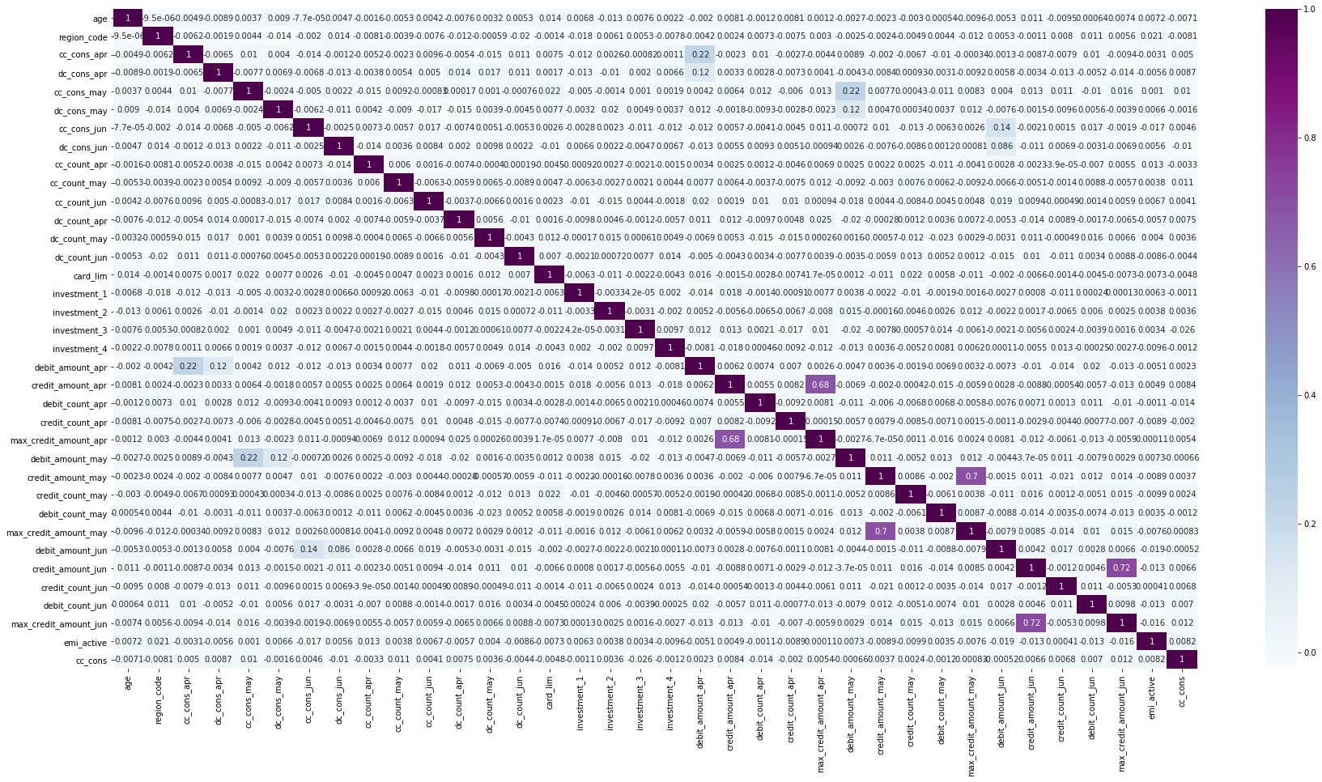
Correlated Features
After cleaning the data we now see if there are any correlated features, and remove them to avoid multicollinearity

Slide 39
Prepare for Modelling
Encoding, Feature Selection

Slide 40
Encoding Categories
Label Encoder
Assigns labels as 1,2,3.. to the categorical values
Might assign weightage based on values and introduce bias in regression
Label Binarizer
Assigns binaries (0,1) to the categorical values.
Might also add weightage based on 1’s and introduce bias
One Hot Encoder/ Get dummies
Converts each categorical value into a feature and assigns 1 to true rows
Preferred method to encode in regression problems

Slide 41
Scaling Data
Standard Scaler
Scales the data based on unit Variance.
Min Max Scaler
Each value in the column proportionally within the range [0,1].
Transforms data around the mean 0 and standard deviation 1
Preferred method as it retains the shape of the data

Slide 42
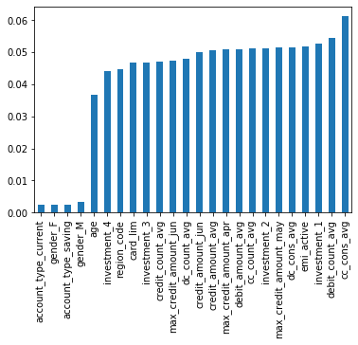
Feature Selection using Random Forest
Random Forest can returns a list of features using feature_importances_. method

Slide 43
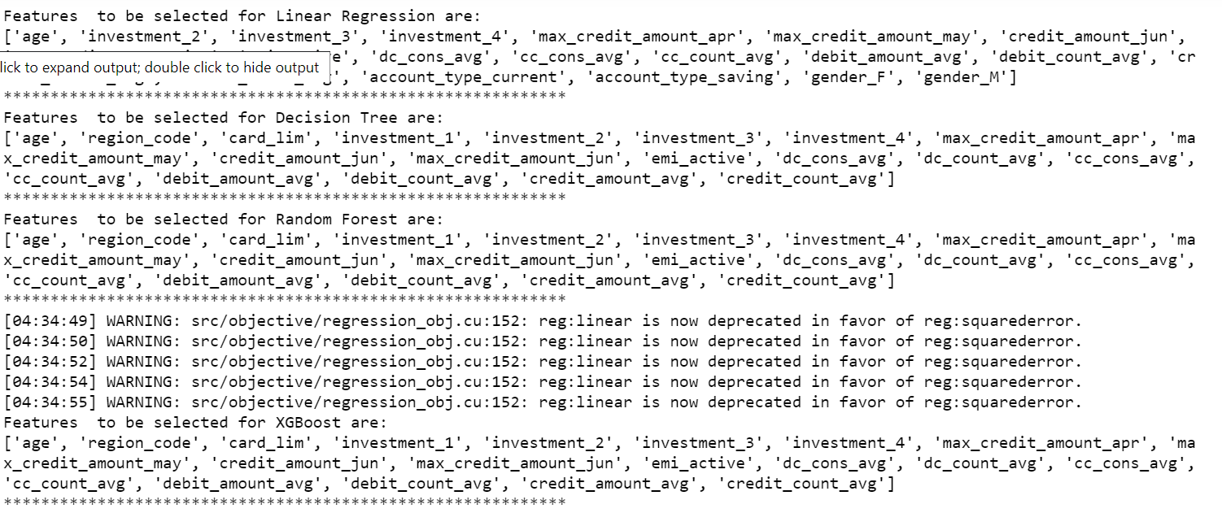
Feature Selection using RFE

Slide 44
Modelling
Various Models and selection based on RMSLE

Slide 45
RMSLE Scores – Vanilla Models (train_test_split)
Models | RMSLE
Linear Regression | 0.08410209
Ridge Regression | 0.08410096
Lasso | 0.08413105
Decision Tree | 0.11404584
Random Forest | 0.0875003
XGBoost | 0.08783858

Slide 46
RMSLE Scores – Vanilla Models cross_validate
Models | RMSLE
Linear Regression | 0.0718572589099447
Ridge Regression | 0.07185640801131223
Lasso | 0.0718143576559435
Decision Tree | 0.10426989149624201
Random Forest | 0.08412472485923697
XGBoost | 0.07991065128215628

Slide 47
RMSLE Score – Tuned Models
Models | RMSLE
Linear Regression using features from Feature Selection | 1.83065903
Random Forest using Feature Selection, train_test_split | 0.08215822
Random Forest using Grid Search Best_parameters_are : {'bootstrap': True, 'max_depth': 4, 'max_features': 10} | 0.08125183
XGBoost with hyperparamters olsample_bytree=0.4, gamma=0, learning_rate=0.07, max_depth=3, n_estimators=100 | 0.0840507

Slide 48
Insights
The data currently shows no fixed pattern between the predictors and target variables. However we can make certain insights from the data.
The age of the customers vary between 25-70, however there spends do not vary with age.
Similarly, the there was no difference of spends between males and females
Assuming current account users are owners of business, and saving account users are salaried users, the CMB has more data for Business owners and hence can tailor the product based on their income source.
All the customers have enquired about loans, so pitching them loans based on the predictions can be a good call.

