Slide 1
NumPy Library for Scientific Computing
It offers:
  N-dimensional array object
    representing vectors, matrices, tensors etc.
  Tools for integrating C/C++ and Fortran code
  Useful linear algebra, Fourier transform, and random number capabilities

Slide 2
Numpy N-dim. Arrays Are Different from Python Lists
Size (shape) is fixed when created
All elements are of the same type
  Enables efficient, simple code => fast!
  Floating point numbers by default
Can convert from list to ndarray and vice versa
  array = numpy.array(list)
+ operator functions differently
  list1 + list2 concatenates the lists
  array1 + array2 performs element-wise addition
Indexing N-d arrays is more flexible due to [ , ] syntax

Slide 3
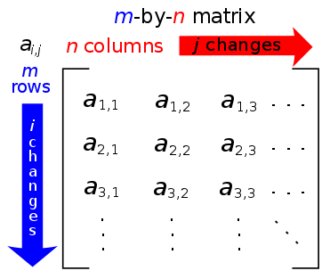
Matrices (Python indices start from 0)

Slide 4

Matrix Operations

Slide 5



Matrix Multiplication

