Slide 1
Guided Capstone
Big Mountain Resort
What opportunities exist for the Big Mountain Resort to increase the revenue by 1.5M through increasing the facilities and setting the ticket price considering the market segment.
Shiva Bhattarai
Data Scientist

Slide 2
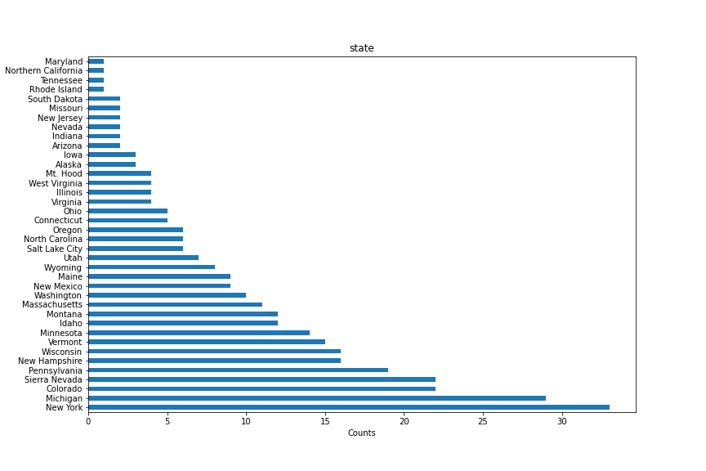
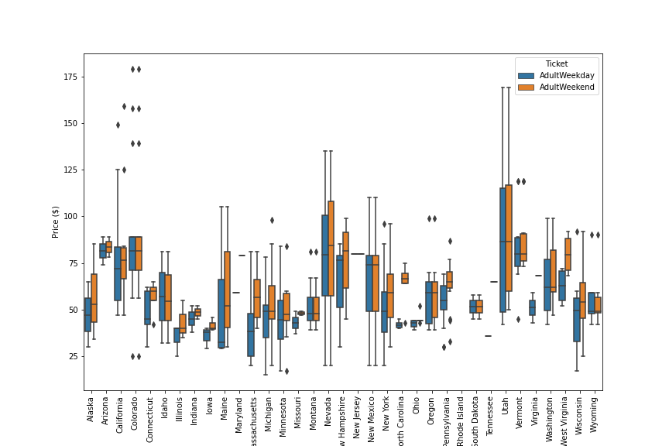
Average price variation of different states
We use the national data for different skiing resorts.
We see the huge variation in number of ski-resorts at different states like maximum in New York and Montana like less than half of New York.
The average price for different sates is confine between $50-100 with some exception.

Slide 3
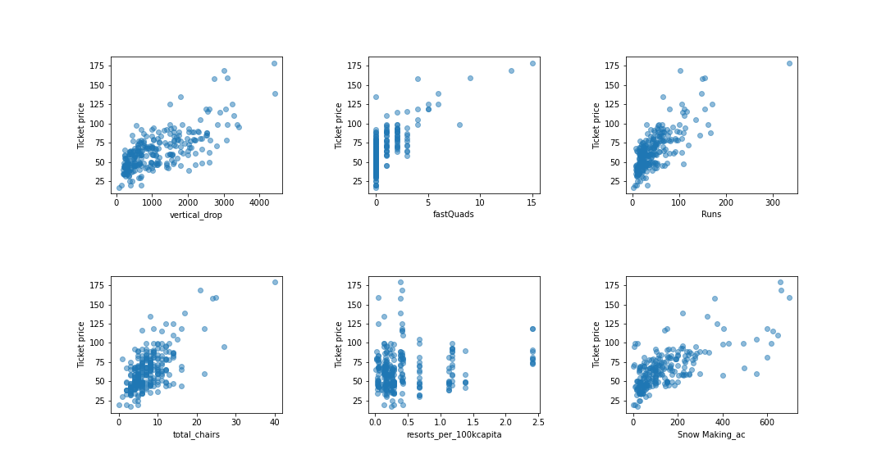
Find features with high positive correlation
We find the best 8 features that influence the model.
Runs and Total Chairs has positive highest correlation.

Slide 4
Price Prediction using different model and change in revenue
Dummy regressor predicts the price of Montana to be $63.8 (average price of state).
Linear Regression predicts about $100 higher than the original price of $81.
Finally, from Random Forest classifier predicts the price to be $91 which is our best model with mean absolute error is $10.42 .
The ticket price can be predicted if any changes to the facilities. For example, with expected visitors of 350k visiting 5 days in a year, with increase in runs by 1-mile, vertical drop by 150 and total chairs by 1 will add the total revenue by 15.1 million.

Slide 5
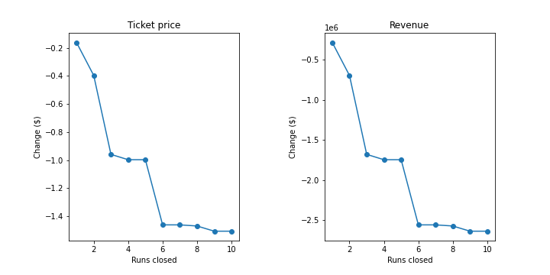
Prediction of change in revenue and ticket price with runs closed
The first mile close has huge impact in the revenue
However, the 2 miles, 3 miles , 4 miles closed wouldn’t impact on the ticket and revenue price.

Slide 6
Conclusion
This model can be used to predict the price if any facilities is added or subtracted.
Also, further data can be analyzed to reduce the operational cost by reducing facilities that doesn’t influence in price like Snow Area

