Slide 1
BOOK LOAN SYSTEM GROUP 9

Slide 2
Group Members
Student ID | Name-Surname | E-Mail
21328026 | Gülendam Buket Gündüz | gulendambuketgunduz@gmail.com
21328337 | İrem Özen | iremozeen@gmail.com
21327953 | Gülşah Erdoğan | gulsaherdogan_@hotmail.com

Slide 3
Project Organization
Position | Leader | Helper
Project Manager | İrem Özen
Project Plan and Vision | Gülşah Erdoğan | Gülendam Buket Gündüz
Requirement | Gülendam Buket Gündüz | Gülşah Erdoğan
Development | İrem Özen
Architecture | Gülşah Erdoğan | İrem Özen
Test | Gülendam Buket Gündüz | Gülşah Erdoğan

Slide 4
Technologies
Our project is developed as desktop application using C#.
We use MySQL database management system and .Net Framework 4 to do our database operations
We designed the interfaces in Windows Form Application.

Slide 5
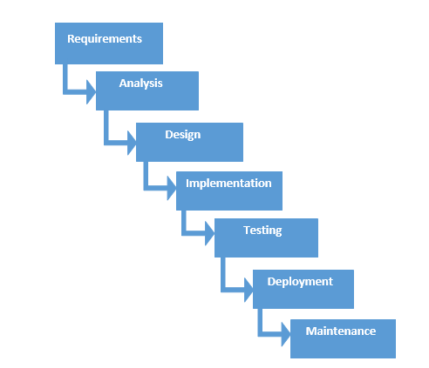
Development Model
We use Waterfall Development Model in our project.

Slide 6
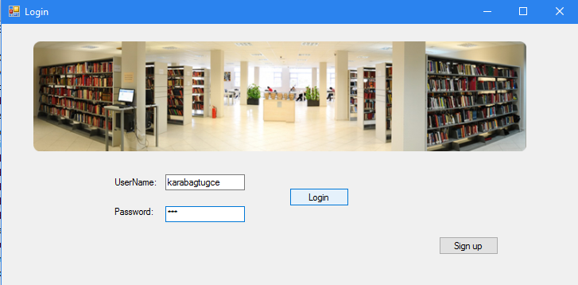
Process

Slide 7
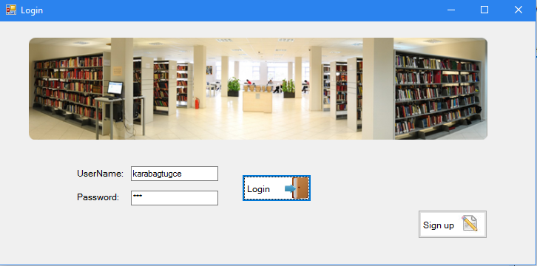

Slide 8
Thank you!

