Slide 1
Naïve Bayes

Slide 2
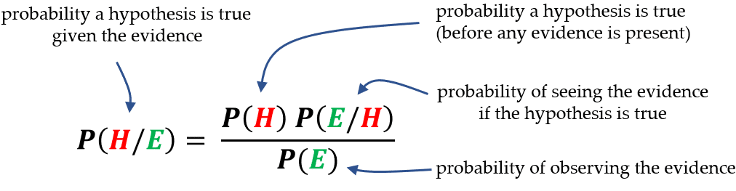
Back to Bayes
Recall Bayes’ Theorem on conditional probability.
Bayes’ allows us to update the probability of something happening as we gain information.
Think – Bayes’ tables from stats.

Slide 3
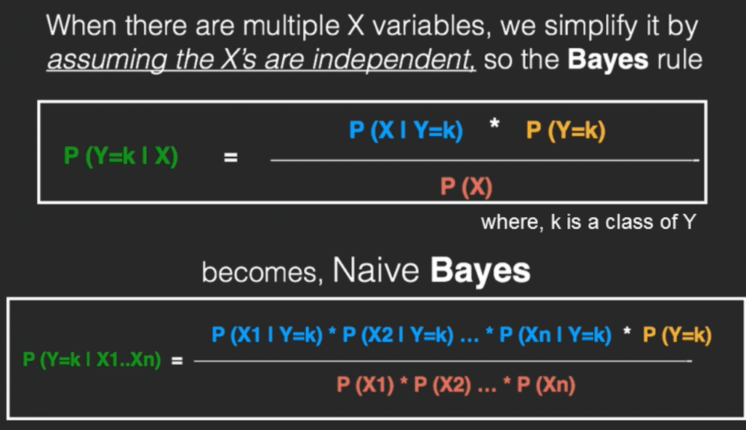
Naïve Bayes
Naïve bayes is an algorithm that is built on the Bayes’ Theorem calculation.
Naïve – each feature is treated as independent.
Bayes – uses Bayes’ Theorem.
Classifier is a “Big Bayes’ Theorem” where each feature is another term.

Slide 4
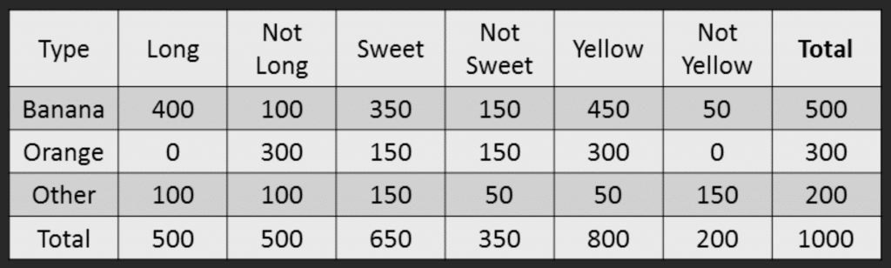
Example by Hand
A fruit is Long, Sweet, and Yellow – what fruit is it?
Below is our training data.

Slide 5
Naïve Bayes Process
Calculate prior probabilities:
P (Banana) = .5
P (Orange) = .3
P (Other) = .2
Compute denominator:
P (Long) = .5
P (Sweet) = .65
P (Yellow) = .8
P(L)*P(S)*P(Y) = .26
This is needed for the full calculation, but doesn’t matter in the prediction.

Slide 6
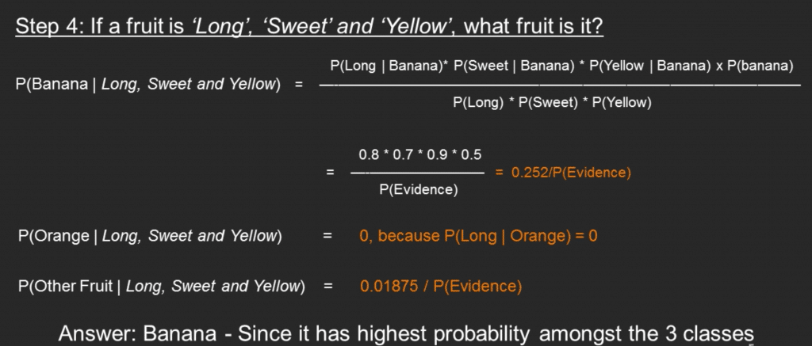
Naïve Bayes Process 2
Calculate numerator:
P (Long | Banana) = .8
P (Sweet | Banana) = .7
P (Yellow | Banana) = .9
P (Banana) = .5
Product = .252
Classify – Calculate probability for all potential classes.
P (Banana | Long, Sweet, Yellow) = .252/.26
P (Orange | Long, Sweet, Yellow) = 0 (There are no long oranges)
P (Other | Long, Sweet, Yellow) = .01875/.26

Slide 7
Naïve Bayes
Those final probabilities could be normalized to get the probability on a percentage scale.
As we did with the Bayesian tables in stats.
As a classifier, Bayes is:
Interpretable – we can illustrate how predictions are made.
Simple – the math is just what we did by hand.
Fast – due to the simplicity, training and predicting are usually fast.
However, Bayes is also:
Limited – the independence assumption is often untrue. Making its applications limited.
Probability estimates aren’t reliable, even if classifier is accurate.

Slide 8
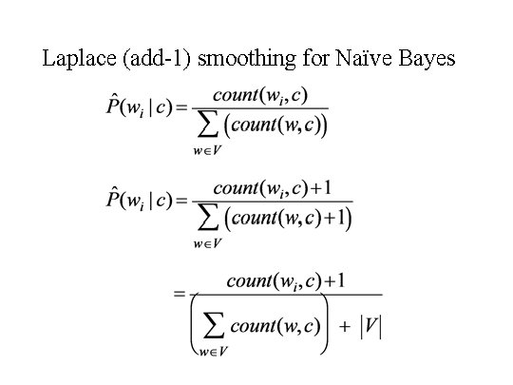
Smoothing
One issue Bayes can have is if there is an example to predict that was not in the training data.
E.g. what if a fruit is green?
This introduces a divide by 0, which is impossible.
Laplace smoothing is the solution:
Add 1 (or another value) to the observations.
Built into any implementation, usually as a parameter.

Slide 9
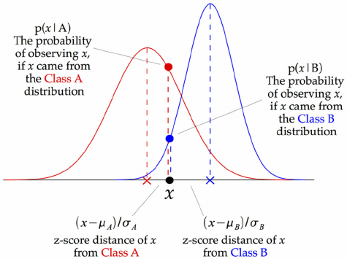
Flexible Bayes
By default, Bayes only works with categorical features.
When dealing with numerical features we need to adapt the algorithm.
Gaussian Bayes does so by replacing the probability calculation with a probability calculation based on a gaussian distribution.
These probabilities replace the probabilities in Bayes and everything else works in the same way.

Slide 10
Naïve Bayes Conclusion
Bayes is one of the more simple classifiers that we can create.
Bayes regression exists, but is not super common.
Bayes is often used in things like spam detection, the speed helps here.
When Bayes works well for a dataset, it can be very good, but if it doesn’t there is limited ability to tune it to be better.

