Slide 2
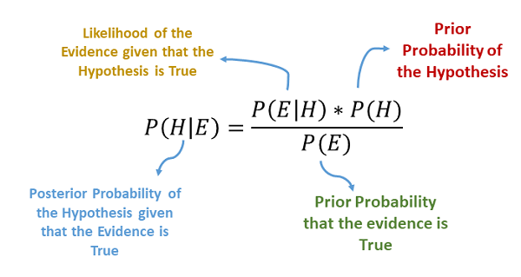
Bayes Theorem
Recall Bayes and his theorem.

Slide 3
So Naïve…
Naïve Bayes is a type of classification algorithm based on Bayes.
The naïve part comes from the assumption that the features are independent.
This likely isn’t true, but it keeps things simple and works.
Types of Naive Bayes Classifiers:
Multinomial: Feature vectors represent the frequencies with which certain events have been generated by a multinomial distribution. For example, the count how often each word occurs in the document. This is the event model typically used for document classification.
Bernoulli: Like the multinomial model, this model is popular for document classification tasks, where binary term occurrence(i.e. a word occurs in a document or not) features are used rather than term frequencies(i.e. frequency of a word in the document).
Gaussian: It is used in classification and it assumes that features follow a normal distribution.

Slide 4

Smoothing
One issue that Bayes has is if there is a term that is in the test set, but not in the train.
This will have a probability of 0.
This is called the Zero Frequency Problem.
Smoothing, specifically Laplace Smoothing, combats this.
A small corrective term, a pseudo-count is added to the probability estimates.
This term is alpha, defined as a hyperparameter.

Slide 5
Dimension Reduction
Feature sets for text can get massive! Probably excessively so:
# of features is often > # of rows -> trends towards overfitting.
Common sense – only a subset of words really define meaning.
Processing time can grow to be unreasonable.
Some caps can be placed on size during vectorization:
Limit max features.
There has to be a better way!

Slide 6
Truncated SVD and LSA
LSA is latent semantic analysis. LSA attempts to:
Extract meaning from large amounts of text.
LSA follows a couple of assumptions:
Meaning of Sentences or Documents is a sum of the meaning of all words occurring in it. Overall, the meaning of a certain word is an average across all the documents it occurs in.
semantic associations between words are present not explicitly, but only latently in the large sample of language.
Latent Semantic Analysis (LSA) comprises of certain mathematical operation to get insight on a document. This algorithm forms the basis of Topic Modeling. The core idea is to take a matrix of what we have — documents and terms — and decompose it into a separate document-topic matrix and a topic-term matrix.

Slide 7
Truncated SVD – Singular Value Decomposition
Truncated SVD is the mathematical mechanics used for LSA.

Slide 8
NLP in Practice
NLP is an area that is very quickly developing.
More data makes a big difference!
Language has subtleties, massive datasets allow those subtleties to become patterns.
Preprocessing choices can make massive differences:
Stemming, lemmatization, stop words, and n-gram size all vary widely depending on context.
E.g. the word “lit” has a different lemma on Twitter, in a college English dept, or for wildfires.

Slide 9
More advanced NLP
Many NLP tools are used in concert with neural networks.
We’ll revisit some later on towards the end.
NNs “suit” the challenge of extracting patterns from large datasets.

