Slide 1
Logistic Regression and Classification

Slide 2
Classification
Classification puts records into groups.
We examined logistic regression through the logit function.

Slide 3
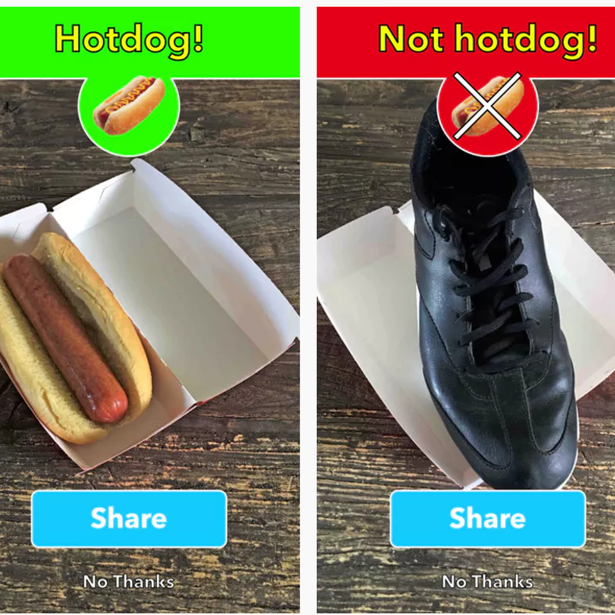
Multi-way Classification
Many problems aren’t simple A/B, e.g. image recognition.
We can also classify into an arbitrary number of classes.
The logit only works two ways, so we have a few approaches.

Slide 4
Multiway Classification
One vs rest/all:
One classifier is created for each class.
Every record is tested for each class, yes/no, one by one.
One vs one:
One classifier for each pair of classes.
Selects class by looking at which one wins the most votes.
Multinomial:
A score for each class is calculated.
The highest score class wins.

Slide 5
Entropy, the Crossed Kind

