Slide 1
Project Hints
From instructions – “A comment can belong to any number of classes, including none.”
I.e. each prediction is independent.
IDs in the output should be 1,2,3,4,5… in the order of the original data in the test file.
Final output data is just a compilation of predictions:
Predict each value of the test set.
Combine text and predictions into dataframe, according to instructions.
You are effectively adding 6 target columns – each filled with predictions.
Print to csv.
Check formatting to make sure file runs.
Overall accuracies will probably be pretty high, score grades distributed logarithmically.
Tip - think about why we train/test split, what the accuracies mean, the names of the two files you’re provided, and what we’d want to do to predict real new data most accurately.

Slide 2
Today:
Saving trained models.
More clustering.
Gaussian Mixtures
Generating data
Clustering assignment intro.

Slide 3
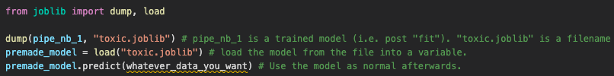
Saving a trained Model
Some models take a long time to train.
Doing this over and over can be wasteful.
We can save a model to disk and load it without redoing the training.
The common library “pickle” does similar things, but sklearn recommends joblib.

Slide 4
Clustering 2

Slide 5
Agglomerative Clustering
An alternative approach to clustering is agglomerative clustering.
Starts with clusters of n = 1.
Merges clusters until the specified # of clusters is reached.
Most similar clusters merge to one cluster.

Slide 6
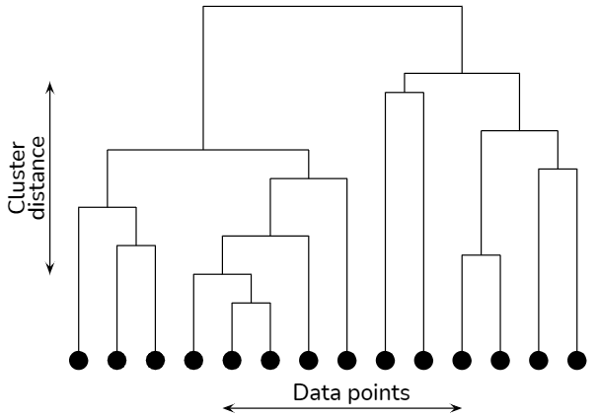
How many Clusters
Like with k-means, we can perform calculations to advise us on the best number of clusters.
A dendrogram is a way to visualize agglomerative clustering.
Graph measures the number of clusters vs distance.

Slide 7
Cluster my Features
One thing that AC can do is act as a feature selection.
Sklearn library is FeatureAgglomeration.
Features can be merged for similarity, resulting in a smaller feature set.
Alternative approach reduce dimensions of data.

Slide 8
Agglomerative Clustering +/-
AC is relatively simple to understand, but can be slow.
Cluster distances need to be constantly recalculated.
Visualization with the dendrogram becomes difficult as data size increases.
Clustering relationships different from k-means can be accommodated.

Slide 9
Clustering as Preprocessing
Clustering (of any variety) can also be used in preprocessing for supervised learning.
Process:
Cluster data into clusters of similar points.
Use those clusters as feature set for classification or regression.
Example (in workbook) – classifying digits:
Group digits into similar groups.
Predict number value from the groups.
In cases where we only know SOME of the labels, this can help us by propagating those labels.
Cluster items, spread the known labels to rest of clusters, predict with full label set.

Slide 10
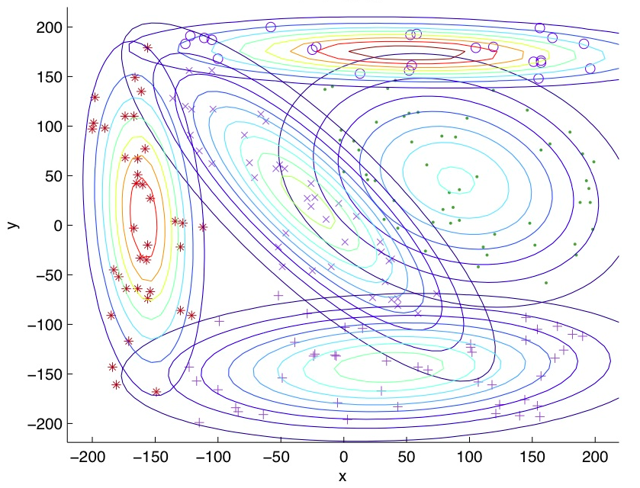
GMM – Gaussian Mixture Models
GMM is another clustering technique.
GMM is probability based:
Data is more likely to be located in the middle of a cluster.
Data is less likely to be located around the edge of a cluster.
The distribution is Gaussian, or normal, lots of results in the middle of the distribution, less at the tails.
Can accommodate different shapes vs k-means which is circular.

Slide 11
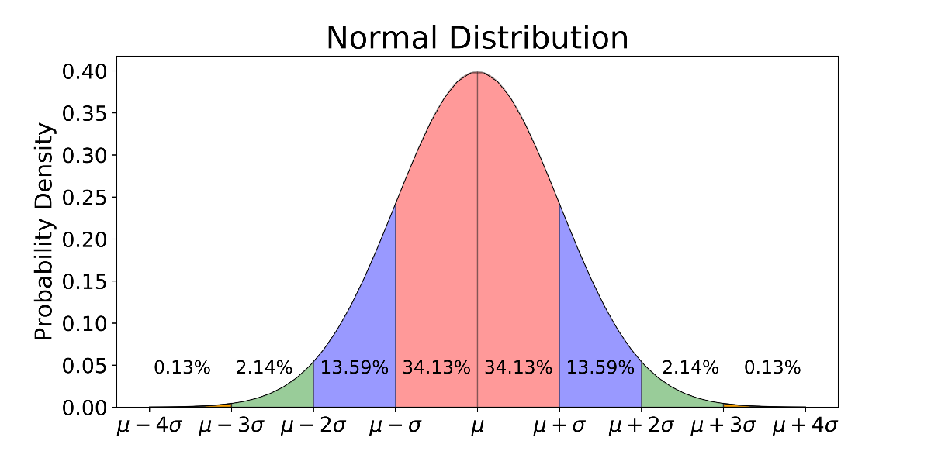

Slide 12
GMM Uses
Anomaly detection:
GMM is commonly used to identify anomalies.
The idea is similar to outliers in a stats distribution.
We expect data to be clustered according to a distribution, we can set a threshold of how far out something needs to be to be an outlier/anomaly.
Useful in things like fraud detection.
Generative:
Due to the probability aspect, GMM is Generative.
If we have a probability distribution of the data, we can create data that fits that distribution.

Slide 13
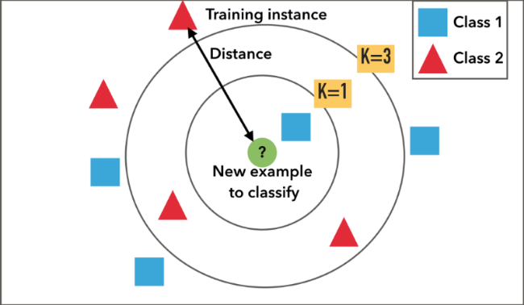
Clustering’s Buddies - kNN
K Nearest Neighbors is an algorithm that is not k-means clustering, but is similar.
kNN is a supervised algorithm that does classification and regression.
kNN works by finding the k data points that are closest to the new point:
For classification, most frequent class wins.
For regression, mean of the class.
Most useful for things like recommendations – if someone wants Movie X, which others are close?

Slide 14
kNN and Imputation
One good application of kNN is imputation.
We can replace the mean/median strategy of generating a value with kNN.
The imputed value is determined by kNN. For example:
Data is census type data of the population – age, salary, kids, address, etc…
Some income data is missing.
Median imputation puts in the median value for every record.
kNN imputation puts in the mean of the most similar records, based on the other features.
I.e. what is the average salary for people in similar locations, of similar age, etc…
Can be a smarter and more targeted method of imputing data.

