Slide 1
Error, Bias, Variance

Slide 2
Error in predictive modeling
Bias Error:
Error due to assumptions made in the modelling process.
Generally results in underfitting.
E.g. assuming a linear relationship.
Variance Error:
Error due to variations in the training data.
Generally results in overfitting.
E.g. different training sets for trees generate very different models.
Irreducible Error:
Error that we can’t fix through modeling, it in inherent in the data.
May be able to fix it by cleaning data (removing outliers, correcting missing data, etc…)

Slide 3
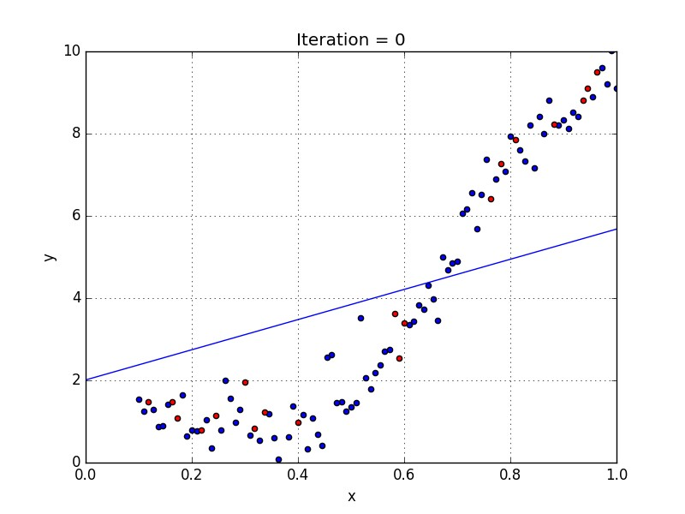
Bias Error – Model Assumes Linear Model is Underfitted

Slide 4
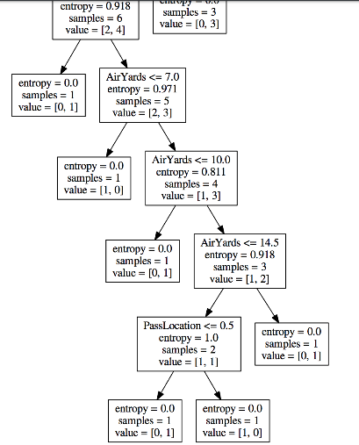
Variance Error – Tree that is Overfitted

Slide 5
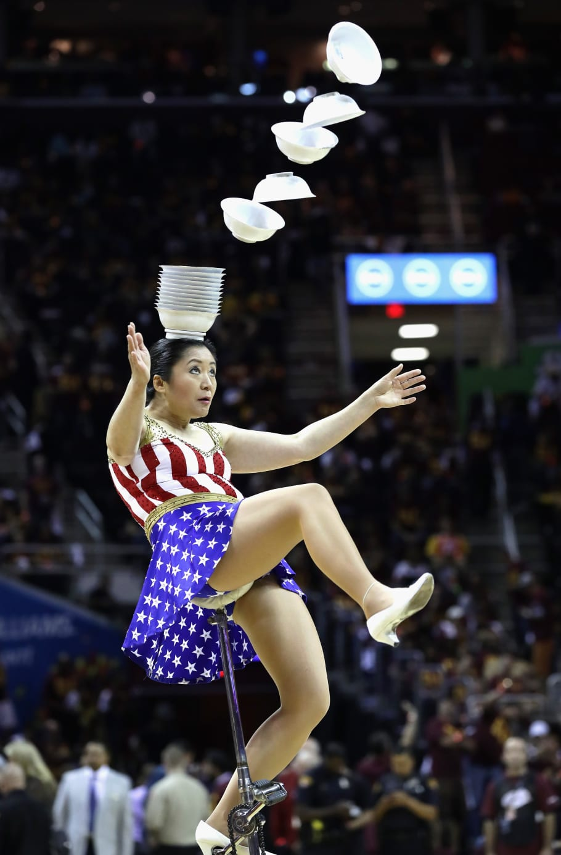
Balancing Act
A good model requires a balance between Bias and Variance.
If we have too much bias our model won’t be adequately tailored to the data.
Simple models have high bias.
If we have too much variance, the specific training sample data would impact the model’s predictions too much, and it may be wrong with different data.
Complex models have high variance.

Slide 6
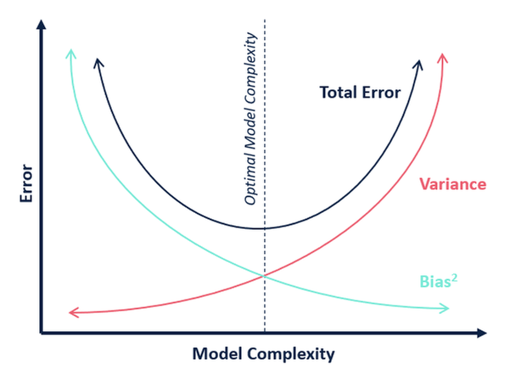
Bias Variance Tradeoff

Slide 7
Finding the balance
ML algorithms are generally “greedy” – they’ll try to get as accurate as possible.
E.g. a tree, without any limits, will try to make a model that perfectly fits training data.
Our goal is a model that is both accurate and generalizable.
We want this accuracy, but limit it to try to achieve the sweet spot.
How?
Cross validation.
Hyperparameter values with grid searching.
Early stopping (big in neural networks).
Regularization. (E.g. tree pruning and regularization in linear regression)

