Slide 1
Gradient Descent

Slide 2
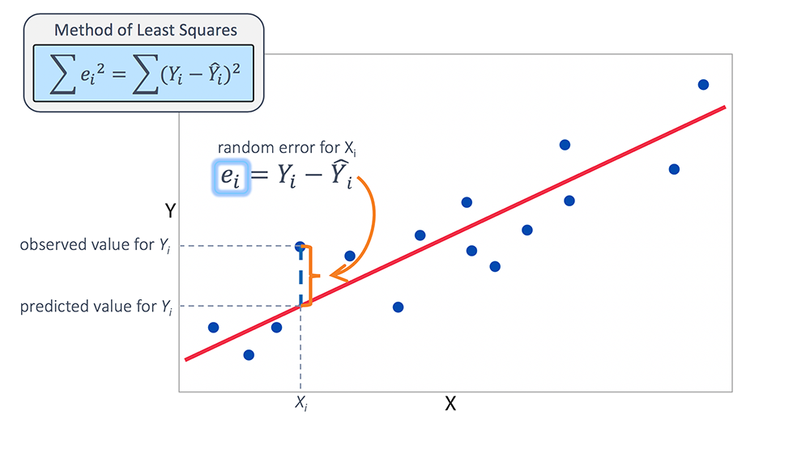
Linear Regression Error
In linear regression we normally take the mean squared error – the linear regression model is calculated by getting the linear least squares.
If we were to move our model around (up/down/angle), we’d get worse errors – the LLS point is optimal.
Think about if we were to plot that amount of error – there’d be a minimum at the current spot, and everywhere else would have slightly more error…

Slide 3
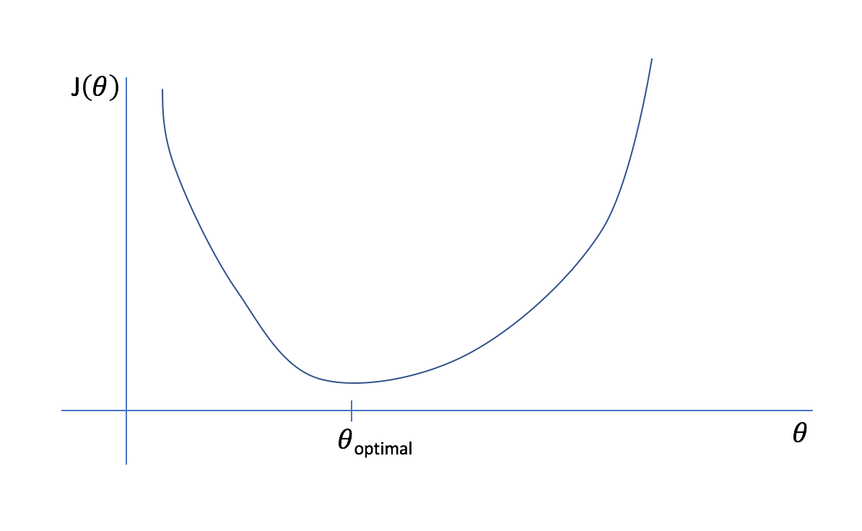







Plot of MSE of Linear Regression vs Coefficient
Other linear models have more error.
Y = m*x + b with different m and b values.
LLS model has the lowest error.

Slide 4
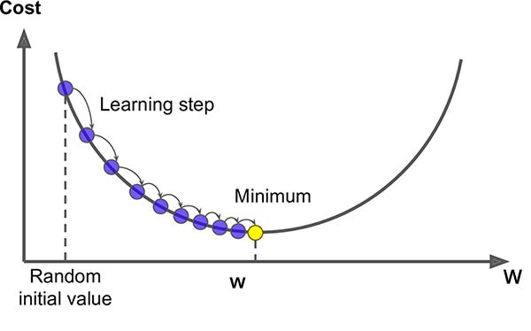
Gradient Descent Basics
Gradient descent is one, common and effective, method of optimizing.
We use it to optimize the cost function (more in a second).
The idea of gradient descent if very simple:
Make a guess.
Calculate the gradient (the slope of the cost curve).
Move to make that cost lower (down the curve)
Repeat until you’re at the bottom.
Each move gives a slightly more accurate model.

Slide 5
Cost Function
Gradient descent depends on the idea of a cost function.
A cost function is just a function that calculates “cost” for a model – or error.
The best model has the lowest cost, or the least error.
Common cost functions:
Regression – mean squared error, mean absolute error.
Categorical – cross entropy, hinge.
Anything could be a cost function, if you had weird needs!
Cost functions are often called loss functions. Loss is technically for one input, cost is for all. 99% of the time they are interchangeable.

Slide 6
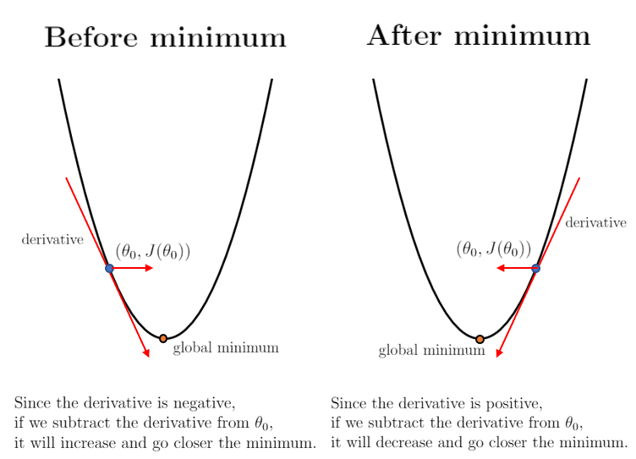
Linear Regression Cost and Descent
For linear regression the cost is normally just MSE.
So doing gradient descent we:
Calculate the cost for where we are.
Calculate the gradient, or the slope of the cost curve.
Move so that we are going down the slope.

Slide 7
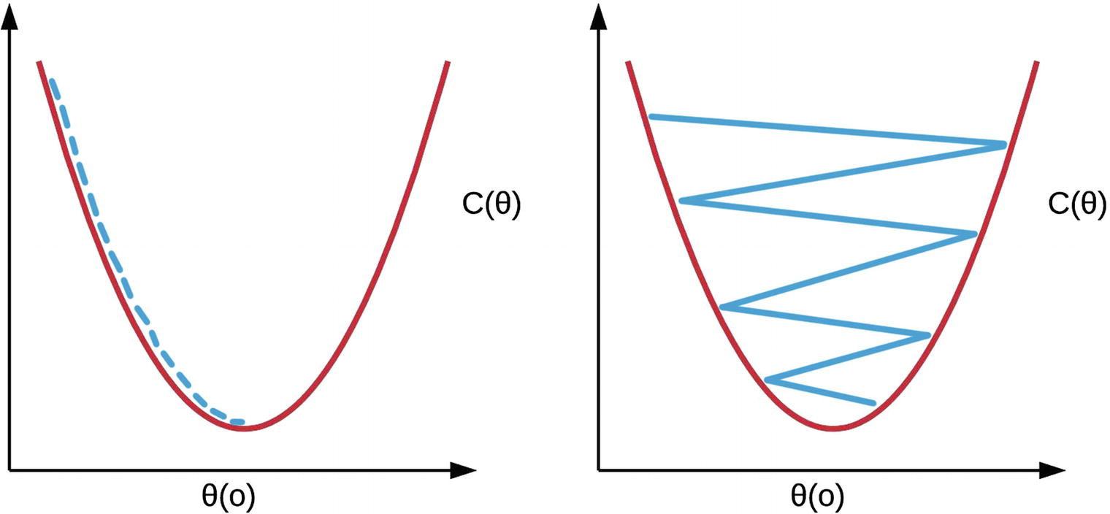
Learning Rate
In gradient descent we also have a learning rate.
The LR determines how big the jumps are.
Small LR – slow changes, unlikely to “skip around”.
Large LR – large changes, unlikely to “get stuck”.
In practice (sklearn) start big, and slow down as we converge on an answer.

Slide 8
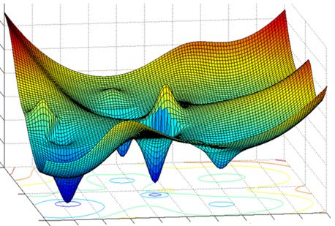
Skip Around?
With more complex data, with many features, the cost isn’t a simple curve.
There may be local minima – places where the cost dips low, but not the lowest points.
The LR needs to be high enough that we don’t get stuck.
Sklearn – jump around initially, scale down when close.

Slide 9
Shortcuts and Stochastic GD
There are a few shortcuts that we can take to save time:
Calculating all of those derivatives can be slow!
Enter Stochastic, or random, Gradient Descent.
Instead of calculating all of the gradients, stochastic just randomly does one.
More ’randomness’ in finding a solution, but faster iterations.
Sklearn’s implementation is Stochastic Gradient Descent (SGD).
There is also mini-batch GD, which randomly chooses a group.
Stochastic can be better when cost curves are not simple curves, as the randomness can avoid minima.

Slide 10
Conclusion and Use
Gradient descent is an excellent method for finding an optimal solution.
For linear regression, we can calculate solutions, but this is often not true.
As long as we can define a cost function, we can optimize to it.
Applications:
Regularization (next time) – add a penalty to a cost function to combat overfitting. Use SGD to optimize that new cost function.
Neural networks – SGD is commonly used in neural networks to find solutions.
Using NN in particular is big on incremental improvement while minimizing costs.

