Slide 1
Logistic Regression and Images

Slide 2
Logistic Regression – What’s New?
Regularization
Multiple Classification

Slide 3
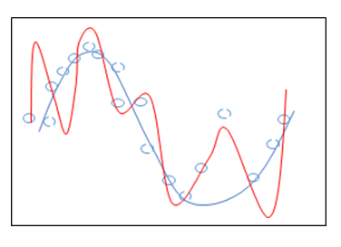
Regularization
Logistic regression is a linear model.
Regularization is (generally) applied to linear models by default.
We can define the type with the HP: penalty

Slide 4
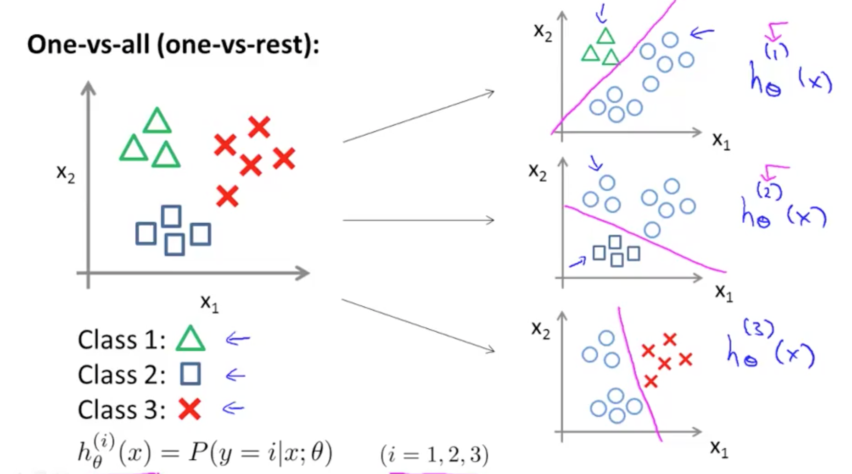
Multiple Classification
We can also predict things into multiple classes.
Sklearn does this by default by doing 1 vs rest.
Build 1 classifier per class, making a yes/no for that class.

Slide 5
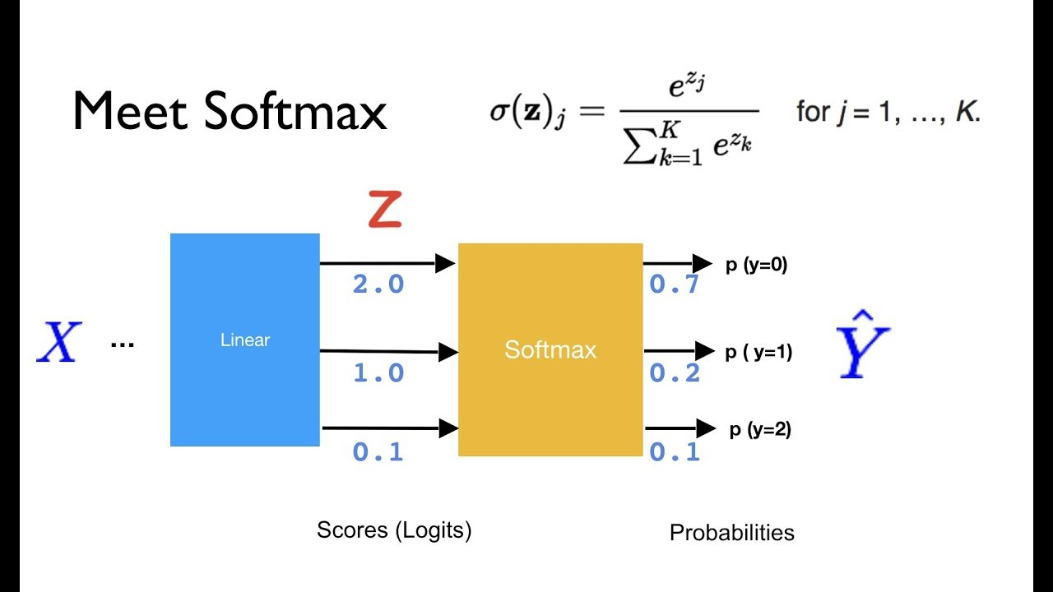
Softmax
Softmax allows us to directly predict class probabilities with one classifier.
The output of Softmax is a probability (0 to 1) that the instance is in that class.

Slide 6
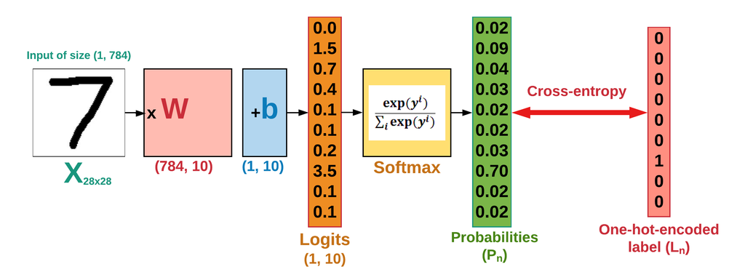
Cross Entropy
Cross Entropy is a common cost function for classification.
Cross entropy translates the softmax probabilities into a label, and calculates the cost.

Slide 7
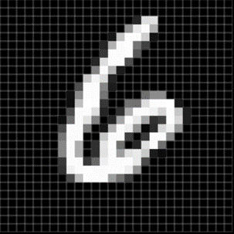
Images
Images are basically 2D (for now) grids of pixels.
Your 1080p screen is 1920 x 1080 pixels.
Each pixel is an integer value.
0-255 for darkness
Images are normal data, and we can treat them like any other data.
This allows us to, pretty easily, do image recognition!

Slide 8
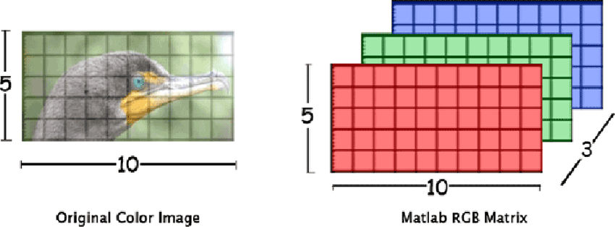
Better Images
Our images are simple – 1 color.
No depth - we only need an array with depth of 1.
More complex images add pixels and additional layers for more color.
These are tensors – multidimensional arrays.

