Slide 1
Today:
Asn 1 Tree:
Sample solution is up. There aren’t any major themes to discuss, most did it pretty well.
Key is constraining overfitting – HP tuning through grid search and/or regularization via ccp.
Asn 2 Questions:
Post sample sol on Thursday.
Most common theme is trying to do too much in one step.
More NLP – Truncated SVD and Word2Vec

Slide 2
NLP Part 2

Slide 3
Dimension Reduction
Feature sets for text can get massive! Probably excessively so:
# of features is often > # of rows -> trends towards overfitting.
Common sense – only a subset of words really define meaning.
Processing time can grow to be unreasonable.
Some caps can be placed on size during vectorization:
Limit max features.
There has to be a better way!

Slide 4
Truncated SVD and LSA
LSA is latent semantic analysis. LSA attempts to:
Extract meaning from large amounts of text.
LSA follows a couple of assumptions:
Meaning of Sentences or Documents is a sum of the meaning of all words occurring in it. Overall, the meaning of a certain word is an average across all the documents it occurs in.
Semantic associations between words are present not explicitly, but only latently in the large sample of language.
Latent Semantic Analysis (LSA) comprises of certain mathematical operation to get insight on a document. This algorithm forms the basis of Topic Modeling. The core idea is to take a matrix of what we have — documents and terms — and decompose it into a separate document-topic matrix and a topic-term matrix.

Slide 5
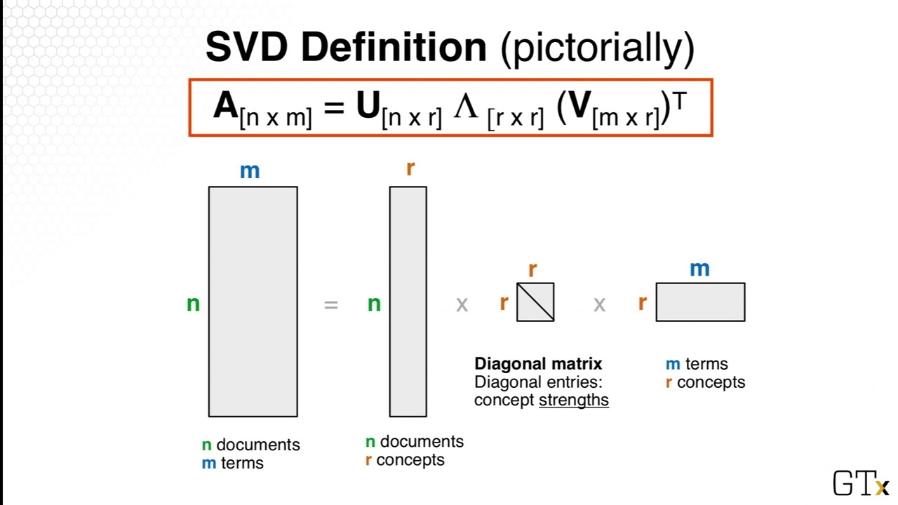
Truncated SVD – Singular Value Decomposition
Truncated SVD is the mathematical mechanics used for LSA.
SVD breaks the original data into 3:
Documents x concepts.
Strength of concepts.
Concepts x terms.
Concepts are represented as patterns of words that usually appear together in documents. For example “leash”, “treat”, and “obey” might usually appear in documents about dog training.

Slide 6
Truncated SVD - Results
SVD aims to capture the maximum meaning with the minimum amount of data.
Only the strongest concepts are kept.
Feature set can be massively reduced.
We don’t know a good number of components going in – we need to tune it.
Prediction accuracy is usually “close”, but with a far smaller feature set.
Accuracy won’t (likely) increase – you are tossing data.
Can’t reliably separate different meanings of one word.

Slide 7
Word2Vec and Alternate encodings
There are lots of other NLP libraries out there that take different approaches to dealing with text.
One library we can use is Word2Vec, originally developed by Google.
Word2Vec transforms words into vector representations using a neural network.
Word2Vec looks at words and their surroundings in sentences (documents) to generate the encoding.
Each word gets a vector of values that encodes it, not just one number.

Slide 8
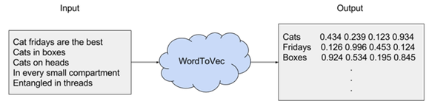
Word2Vec

Slide 9
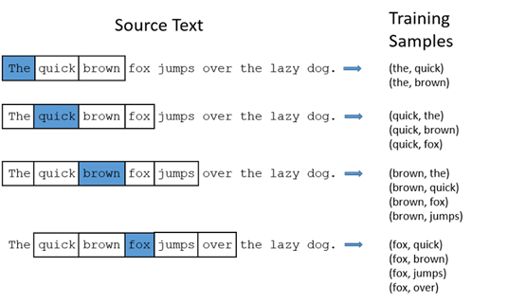

Slide 10
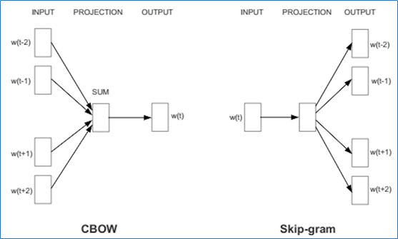

Slide 11
NLP in Practice
NLP is an area that is very quickly developing.
More data makes a big difference!
Language has subtleties, massive datasets allow those subtleties to become patterns.
Preprocessing choices can make massive differences:
Stemming, lemmatization, stop words, and n-gram size all vary widely depending on context.
E.g. the word “lit” has a different lemma on Twitter, in a college English dept, or for wildfires.

Slide 12
More advanced NLP
Many NLP tools are used in concert with neural networks.
We’ll revisit some later on towards the end.
NNs “suit” the challenge of extracting patterns from large datasets.

