Slide 1
Basic Text Processing and NLP

Slide 2
NLP – Natural Language Processing
Free text doesn’t really make for good material for machine learning.
E.g. “FreeMsg Hey there darling it's been 3 week's now and no word back! I'd like some fun you up for it still? Tb ok! XxX std chgs to send, å£1.50 to rcv ”
For computers to learn to listen and speak, we need to make text computer friendly.
NLP is a field of study and set of tools to do this.
Goal: take in free text, generate data that can be processed (for ML for us)
For example, can we filter spam messages from not spam?

Slide 3
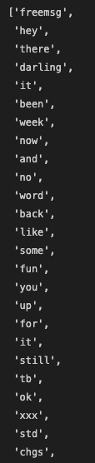
Tokenization
Tokenization is the base of simple text processing.
Tokenization transforms free text into a collection of component words.
The tokenization process usually also strips things like punctuation, converts all text to lower case, and may remove stop words.
Stop words – stuff that isn’t useful:
E.g. it, a, an, the, etc…
Terms:
Document - each row of text in dataset.
Corpus – entire dataset of text.
Ngrams – a token, or “word (kinda)”

Slide 4
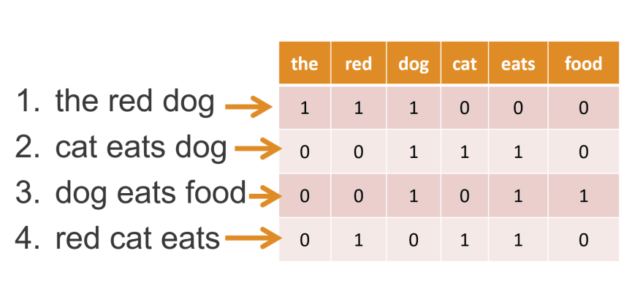
Vectorization
Vectorization is basically ”tokenization+”.
Text is tokenized, then placed into a data structure along with some “weight” of the value.
Count vectorization:
Count vectorization is the most simple vectorization.
Produces a list of words, and number of times they occur.
Results in “Bag of Words”.
Can be structured into a dataframe.
The collection of all words is the vocabulary.

Slide 5
TF-IDF Vectorization
Term Frequency - the number of times a word appears in a document divided by the total number of words in the document.
Inverse Document Frequency - the log of the total number of documents divided by the number of documents that contain the word.
Rather than simple count, the score is a product of TF and IDF.
Goal is to reduce weight of rare words (not frequent enough to establish a pattern) and very frequent words (so ubiquitous they don’t help discriminate).

Slide 6
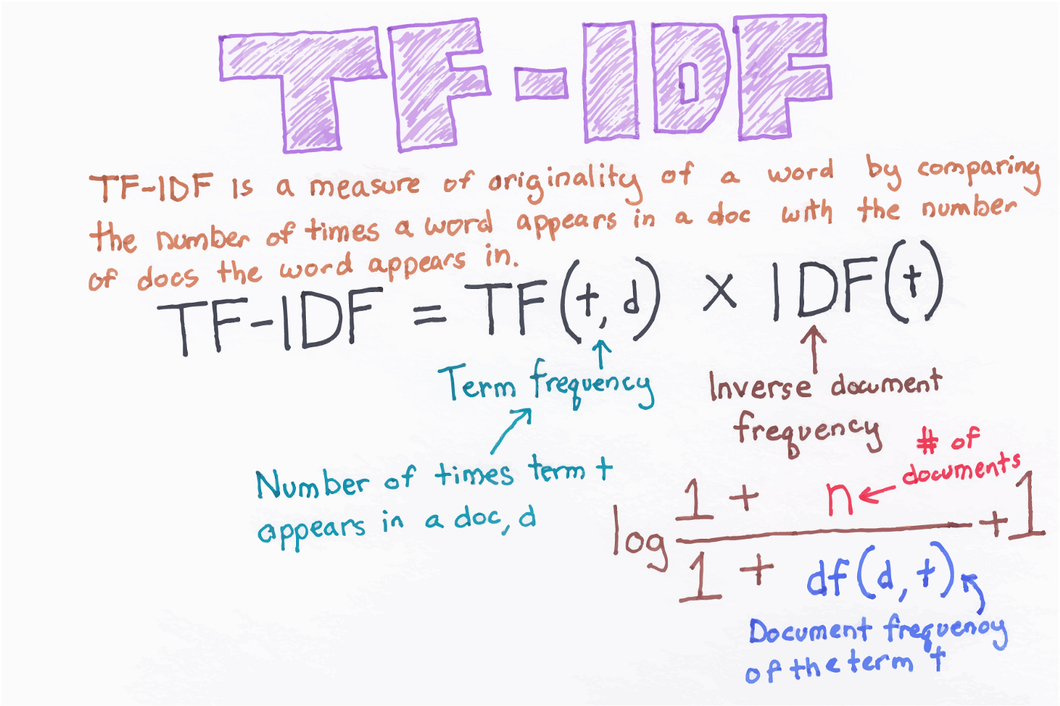

Slide 7
Stems and Lemms
Stemming and lemmatization both seek to trim words back to their “root”.
Stemming:
More simple, just chops word down to root by removing prefix and suffix.
E.g. “climbing” becomes “climb”.
Lemmatization:
Lemmatization simplified words to their “lemma”, the “root meaning”.
E.g. “better” becomes “good”.
Each of these can help our model understand text better:
“I went climbing” has a similar meaning to “I did a climb”.

Slide 8
Ngram Range
The ngram range is basically the number of words allowed in a token.
Take the sentence: ”I like downhill skiing”:
There are 4 “1-grams”, each word.
There are 3 2-grams: “I like”, ”like downhill”, and “downhill skiing”.
There are 2 3-grams: “I like downhill” and “like downhill skiing”.
There is one 4-gram: “I like downhill skiing”.
Allowing for sizes >1 can often help the algorithm better “understand” meaning.
E.g. Suppose you make a classifier to identify if text was about downhill skiing, waterskiing, or cross-country skiing. Allowing for 2-grams better captures context.

Slide 9
Lots of Features and Sparse Matrices
A result of vectorization is usually a wide matrix, with lots of features.
This matrix is almost always very sparse.
We can limit the number of features with a parameter, or…
We can use “Dimensional Reduction” to reduce the number of features.
We’ll do this next week.
Look up Truncated Single Value Decomposition (SVD) if you’re jumping ahead.

