Slide 1
PCA and Dimensionality Reduction

Slide 2
Truncated SVD Review and PCA
In processing text we looked at Truncated SVD.
TSVD took high dimension features (from text) and transformed it to a much lower dimension feature set.
Truncated SVD is one algorithm for dimensional reduction.
PCA – Principal component analysis is another dimensionality reduction method that is very common in general predictive modelling.

Slide 3
Unsupervised vs Supervised
PCA (and SVD) are both examples of Unsupervised Learning.
Classification and regression are examples of Supervised Learning.
Supervised learning has labeled training data, unsupervised does not.
Unsupervised learning classes:
Dimensional reduction (SVD and PCA).
Clustering (next class)
Association (e.g. market basket, such as Target’s pregnancy scoring)
Unsupervised learning generally looks to discover the underlying structure in data.

Slide 4
Principal Component Analysis
PCA is a general method of dimensional reduction.
Data is broken down into “principal components”, and only the most influential are kept.
Principal components are linear combinations of original variables.
The components are uncorrelated with each other.
The first ”few” components contain most of the information.
Components are orthogonal to each other.

Slide 5
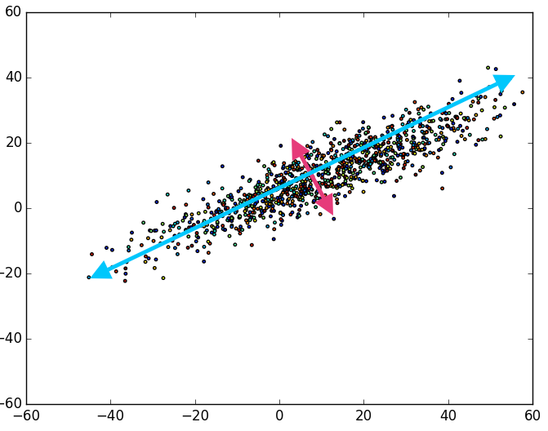
PCA Example
The points here have 2 features – X and Y.
There are two principal components – Blue and Pink.
Each is a combination of X and Y.
The blue component contains most of the variability in the data.
The pink contains much less.
The two represent the same thing as X and Y, but ”puts” more info in Blue than X.
These components are called Eigenvectors.

Slide 6
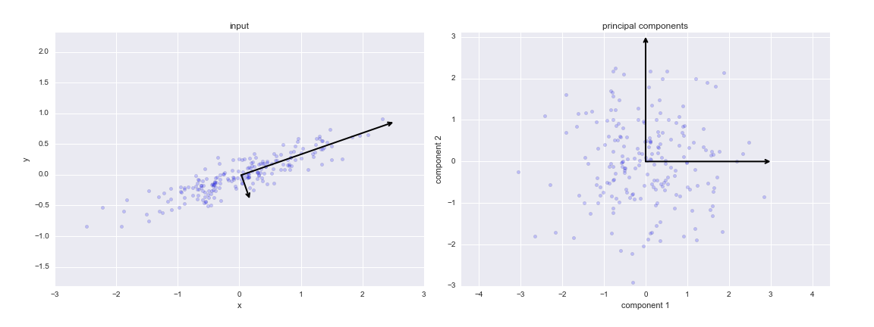
PCA Transformation
We can plot data on an axis of its components.

Slide 7
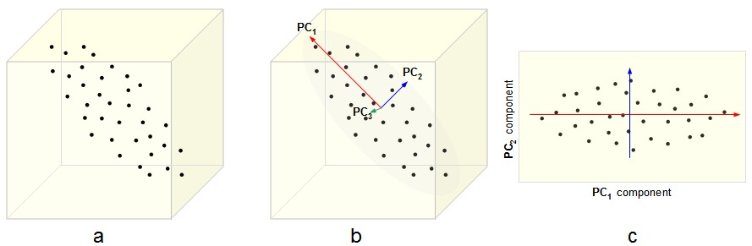
In 3D

Slide 8
Animated and Interactive
Check: https://setosa.io/ev/principal-component-analysis/

Slide 9
PCA and Variance
PCA frequently refers to variance.
Each feature “explains” some amount of the variance in a target.
The more a target varies with a feature, the more that feature explains it.
Think of correlation.
PCA takes the components that explain most of the variance, and ditches those that explain only a small amount.
Result – we can find most of the info on our target, with fewer inputs to a model.

Slide 10
PCA and Feature selection
PCA reduces dimensionality, just like feature selection.
PCA isn’t feature selection:
Feature selection removes features.
PCA removes components that are created from a mixture of those features.
With PCA the features themselves aren’t removed.
In general:
Feature selection is still good, especially if there are features that are minimally helpful.
PCA is most useful when the dimensionality is very high.
One, the other, or both may be useful - it depends on the scenario.

Slide 11
PCA Conclusion
PCA is quite common, especially when there are a lot of features.
PCA does not work with categorical variables.
PCA needs scaling to be reliable.
PCA is susceptible to outliers.

