Slide 1
Pipelines

Slide 2
TodaY
Quick revisit on trees and pruning.
Pipelines.
If time, grid searches, hyperparameters, cross validation part 1.

Slide 3
Pipelines
Most data requires some preprocessing before modelling:
Categorical data usually needs to be encoded.
Numerical data usually needs to be scaled.
Creating long series of steps to prep data can be cumbersome.
Sklearn’s pipeline can simplify and condense data prep into one function.
Create a “pipe” where each step of prep and modelling is specified and executed together:
Fit the data to the pipe instead of the model.
The model is the last step of the pipe, the prep steps are listed in order.

Slide 4
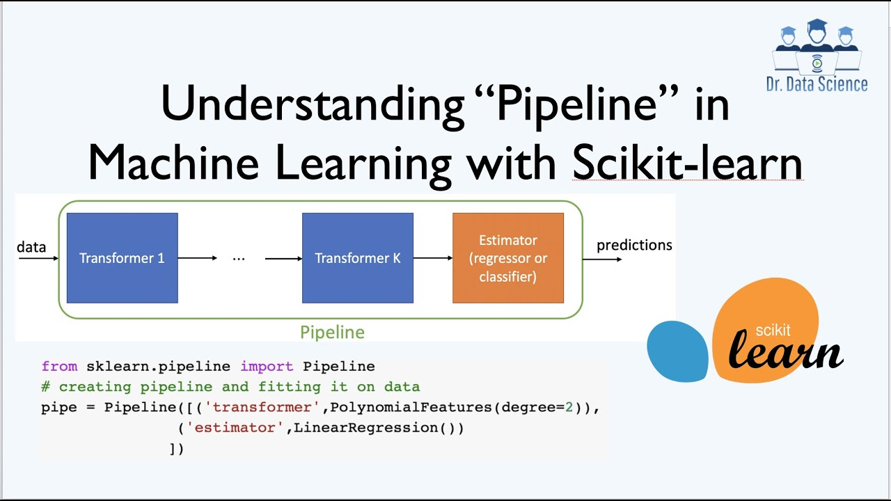

Slide 5
Using Pipelines
Pipelines can contain most or all of our prep steps.
Makes code easier to read and maintain.
Can create custom transformers (later in course) to apply other transformations.

