Slide 1
SVM Classification

Slide 2
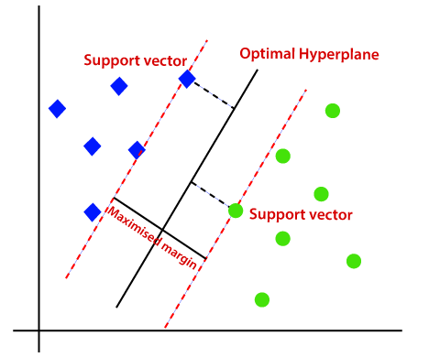
Support Vector Machines
A support vector machine is easiest to understand by picturing it.
It attempts to separate classes by drawing a division (a hyperplane) between two sets.
The points that define the separation are called the support vectors.
Everything on one side gets one label, everything on the other side gets the other.
The algorithm maximizes these margins – leading to the best possible separation.
Only the support vectors matter!

Slide 3
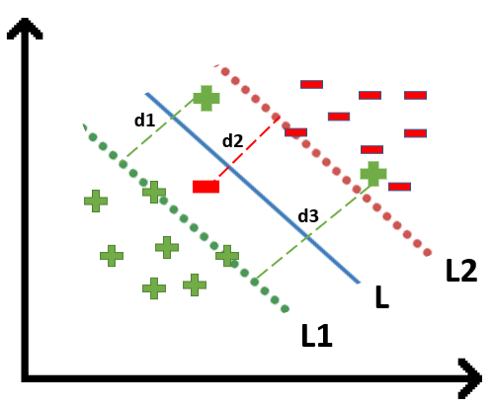
What if there’s not a Perfect lane?
Much of our data doesn’t have a perfect gap to divide on.
We can “soften” the margin for the SVM, or allow some misses.
This is done by hyperparameter C. More C, more fitted, smaller margins.
Less C, less fitted, more tolerant of violations of the margin.

Slide 4
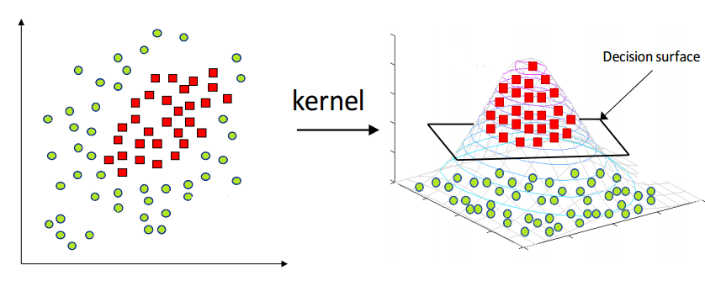
What if the split isn’t a Line?
As well, lots of data isn’t split by a nice simple line.
We can use a kernel – similar to a basis function in linear regression.
Transformation raises data to a higher degree (like a basis), and allows for different ways to draw the hyperplane.

Slide 5
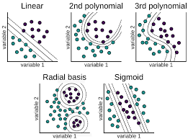
Kernels and their tricks
This is called the Kernel Trick, and it allows us to make separations of non-linear data.
We can specify as a HP:
Linear
Radial
Sigmoid
Polynomial
After the kernel trick, the sets become linearly separable.

Slide 6
SVM – So Hot Right Now
Multiple classes – One vs rest, or one vs one.
Pros:
Can be really accurate.
Good with small-ish datasets, especially those with many features.
Stable – only different if the support vector change.
Cons:
May be slow on large datasets.
Noise and messy data may hurt accuracy.
Correct kernel requires testing.
Uses:
Often used in “natural” stuff – text, images, bioinformatics, geospatial.

