Slide 1
Curse of Dimensionality

Slide 2
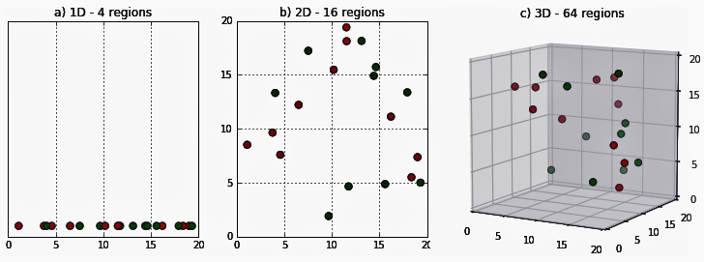
What is it?
Think about some data projected into 1, 2, or 3 dimensions.
As the dimensions increase, the data becomes more sparse.
ML is all about detecting patterns in the data. If it is just a bunch of points in free space, pattern recognition becomes hard.
Overfitting is more likely with high dimension data.

Slide 3
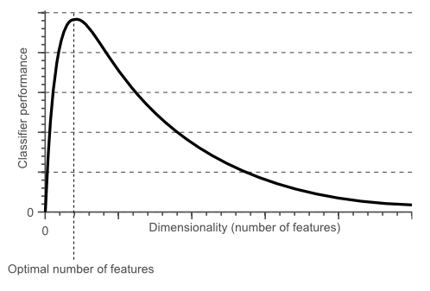
Hughes Phenomenon
“with a fixed number of training samples, the average (expected) predictive power of a classifier or regressor first increases as the number of dimensions or features used is increased but beyond a certain dimensionality it starts deteriorating instead of improving steadily”.
After a certain point, more features aren’t helping, they’re hurting.

Slide 4
Enter Dimensional Reduction
We have a few tools to deal with this – we want to cut back the number of features.
We want to keep the most useful stuff, so we can predict.
These all have the same broad goal – reduce our feature set to the important stuff.
Current Tools:
Feature selection.
Regularization.
LSA
PCA
t-SNE (today)

Slide 5
Feature Selection
Feature selection gets rid of features.
Very understandable and explainable.
Can be automated by regularization or pipelines.
Most useful when:
Some data is “bad” – e.g. missing values, high correlation, lack of variance.
We can stop getting that data. E.g. if we no longer need a sensor to collect some value.
Loose 100% of the info from the subset of eliminated features.
E.g. when feature selecting pixels for digits, some pixels (around the edge) are just gone.

Slide 6
Regularization
Regularization selects out features during training.
Effectively “built in” feature selection.
Big changes in training data may cause different selection.
Largely fights overfitting by deemphasizing or negating some features.

Slide 7
PCA and LSA (And other Matrix Decomp)
PCA and LAS both use matrix decomposition to create new components.
These new components are “made of” the original features.
The most useful components are then kept.
Loose some of the information from all of the features – e.g. when PCA is used on faces, the whole face is there, but it gets ”worse”.
Most useful when:
Information is spread across many features.
No clear features to eliminate. (Pretty common)
Dimensionality is really high, e.g. NLP, images, etc…

Slide 8
T-SNE and Manifold Learning
tSNE is a type of manifold learning, or basically an equivalent to PCA that is not linear.
Often used to visualize high dimension data in 2D.
Can be used just like PCA as well.
Can capture patterns in data differently than PCA/SVD due to the non-linear basis.

Slide 9
What to Use
The goal of all these things is the same – reduce dimensions to get to the “good stuff”.
How well any one works depends on the data.
E.g. in a loan application “phone number” should be selected out. Credit history may have lots and lots of data, roughly equally important, that is better for PCA.
We don’t need to combine all of these, we use 1 or 2, usually. In most cases we shouldn’t expect massive differences.
Guidelines:
If there’s something that is likely to not be relevant – select it out.
If there’s lots of features – PCA.
If you’re visualizing or PCA doesn’t work well (e.g. non linear relationships) – tSNE.
Free text – LSA
If we research and others say that method X works well with data type Y, do that.

