Slide 1
Machine Learning Basics

Slide 2
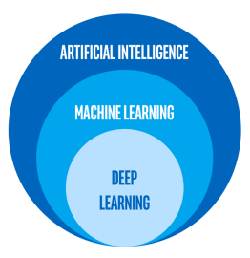
What Is Machine Learning?
Machine learning (aka predictive analytics) is one part of artificial intelligence.
ML is a way to build models* that can help make predictions about the future.
We build these models by letting a computer learn from old data, and learning how to predict new data.
* A model, in this context, is something that translates inputs into some output. The spreadsheet calculations we did before this are models – they translate the things we know, into what we want to know.

Slide 3
Machine Learning Process
The concepts behind ML are not all that complex, there are two key portions:
Training a model:
This is where the computer learns to make predictions from old data.
We provide training data which contains features (the variables that we can track) and a target, the thing you want to predict. We know the target for all this data because it is old.
The algorithm processes the data, does some math, and learns some way to make predictions of what the target will be.
The end result of this is a model – we can enter inputs, and get a prediction of a target.
Using a model:
The training part is all behind the scenes, using old data. That part is strictly creating a model.
To use a model, we plug in the features and get a prediction.
An example…

Slide 4
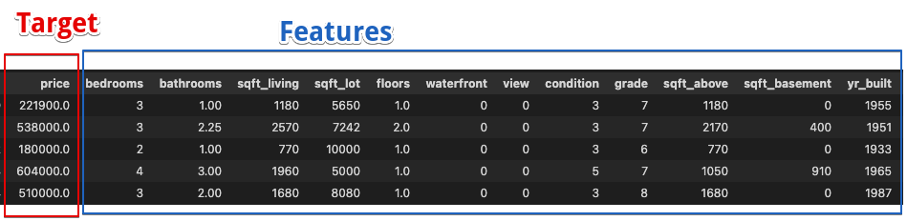
Machine Learning Example
Suppose we are real estate investors who want to make predictions about house prices.
If we can predict which houses are actually worth more we can buy them and make money!
Step 1 – get old data on house prices.
We want the target, the house prices, and the features, the things that we can know ahead of time.
We can always get data like sqft or year built, we want to accurately predict price.

Slide 5
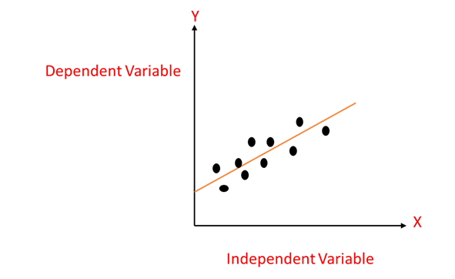
Machine Learning Example
Step 2 – feed data to the algorithm so it can learn to make predictions.
There are many algorithms, they all work slightly differently, but all do the same thing.
Ideally we have a lot of data here so the algorithm has a lot to learn from.
The algorithm will find a way to make predictions for the target, based on the features.
This will produce a model that can translate features to a prediction for the output.
This process can be though of like a line of best fit, or a linear regression.
The reality is it is a larger version, with more than one input.
The line of best fit is a model, if we enter an input (x), we get a prediction (y).

Slide 6

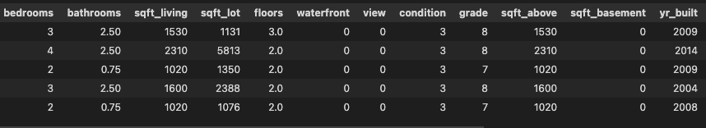
Machine learning Example
Once a model is created and trained, we can use it to make predictions.
In real usage, we can know the features, we can’t know the target, so we predict it.
For houses, we can know all the features (size, bedrooms, etc…) and we can use that info to make a prediction for the correct price.
We can gather data that we want to predict (one per row).
This data has all of the features, but not the target – that’s what we are predicting!

Slide 7

Machine Learning is Easy!
ML is really just that simple!
We can make things more large and more complex, but the core is just that process.

Slide 8
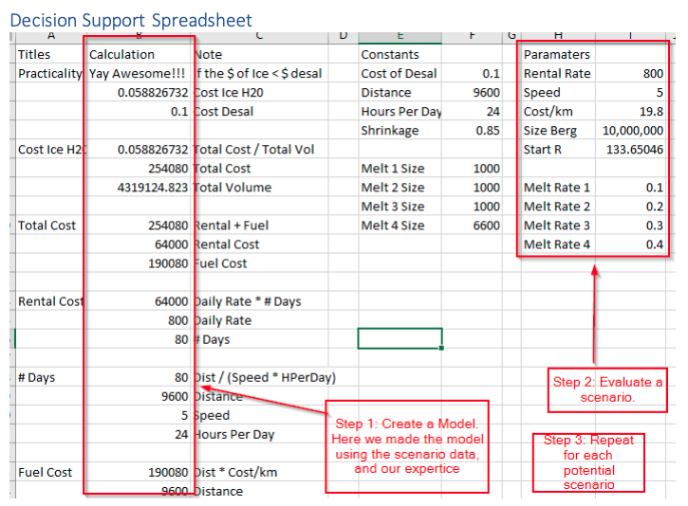
From DSS to ML

Slide 9
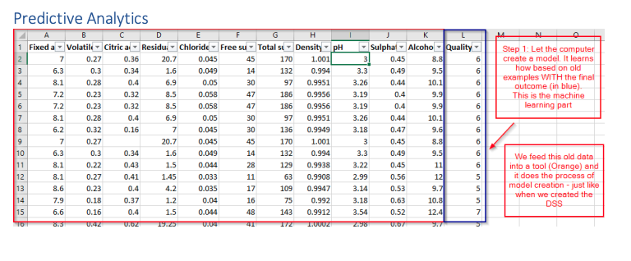
From DSS to ML

Slide 10
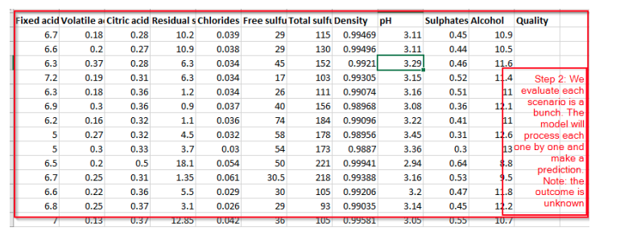
From DSS to ML

Slide 11
Types of predictions
When we are doing ML there are two main types of predictions that we will look at:
Regression: regression is when we are predicting a raw value, like the house example.
Classification: classification is when we are predicting a discrete value, like true/false.
E.g. will someone be a customer or not, is this image a cat or not.
Which one we are doing depends only on the output.
The steps are almost entirely the same between the two, except…

Slide 12
How much can the Predictions be Trusted?
… the measurements of error.
When we build models we need some way to evaluate their accuracy.
The more accurate the model, the more we can trust it.
Think about the time series stuff, we can compare models and select the best.
The error metrics we use are different between regression and classification:
Regression: RMSE and R2
Classification: Accuracy.

Slide 13
Determining Errors
As part of the training process the algorithm also produces an estimate of error.
During the training the system does something called cross validation:
Take all the training data and split it into two sets, roughly 70/30.
Use the 70% to train the model, hold the 30% aside.
Take the features from the saved 30% (remember, we know the target) and make dummy predictions with the model that was just trained.
Compare those predictions to the real values to calculate error.
Repeat this process several times and average the error rates.

Slide 14
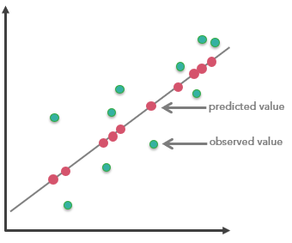
Regression Errors
Regressions have two error metrics to monitor.
RMSE is root mean squared error:
The same error we explored doing time series in Excel.
The amount of error we expect in an average prediction.
Lower RMSE is less error in prediction, which means predictions are close to real values, which means better predictions.
R2 is R squared:
R2 is a measure of completeness.
It estimates how much of the variation in the data is captured by the model. If we capture most, that’s good. If we aren’t capturing it, bad.
It is between 0 and 1, close to 1 is better.

Slide 15
Classification Errors
Classification error is more simple, at least for now, it is the accuracy.
The accuracy is just what percentage of the predictions we got right.

