Slide 1
Recurrent Neural Networks

Slide 2
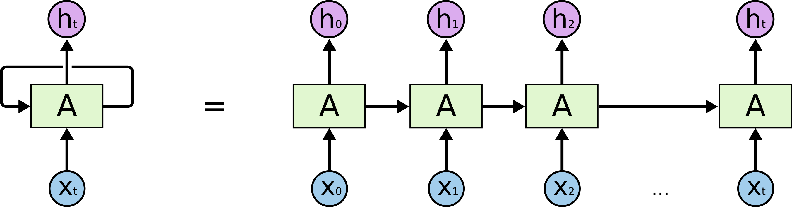
RNN Basics
In looking at a CNN we saw a neural network that can deal with spatial relationships.
RNNs can handle temporal relationships – looking through time.

Slide 3
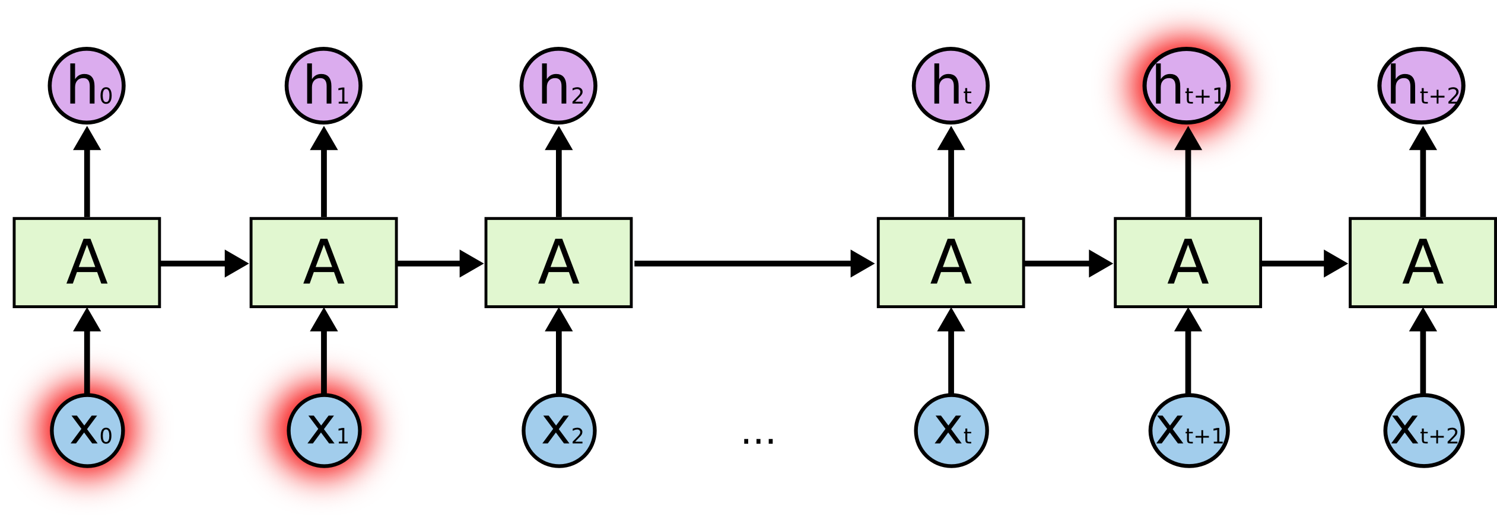
Mo’ Gradients, Mo’ Problems
RNNs can run into issues with the gradients getting too large or too small.
Exploding or vanishing gradients.
Vanishing gradients commonly occur with deeper models.
As gradients get extremely small, learning updates stop.
Solution – Long Short-Term Memory

Slide 4
Long Short-Term Memory
LSTM models are a commonly used type of RNN.
LSTMs can avoid the gradient issues.
LSTMs retain a bunch of data – their long memory.
“Look back” period of N previous records.
At a basic level, the output of an LSTM at a particular point in time is dependent on three things:
The current long-term memory of the network — known as the cell state.
The output at the previous point in time — known as the previous hidden state.
The input data at the current time step

Slide 5
Forget Gate
The forget gate decides what information should be thrown away or kept.
Information from the previous hidden state and information from the current input is passed through the sigmoid function.
Values come out between 0 and 1. The closer to 0 means to forget, and the closer to 1 means to keep.

Slide 6
Input Gate
To update the cell state, we have the input gate.
We pass the previous hidden state and current input into a sigmoid function.
Decides which values will be updated by transforming the values to be between 0 and 1.
Also pass the hidden state and current input into the tanh function to squish values between -1 and 1 to help regulate the network.
Multiply the tanh output with the sigmoid output. The sigmoid output will decide which information is important to keep from the tanh output.

Slide 7
Cell State
The forget and input results are combined to generate a current state.

Slide 8
Output Gate
Output gate decides what the next hidden state should be.
Pass the previous hidden state and the current input into a sigmoid function.
Pass the newly modified cell state to the tanh function.
Multiply the tanh output with the sigmoid output to decide what information the hidden state should carry.
The output is the hidden state.

Slide 9
LSTM In Effect
LSTM can “hold” information from the past.
During training, the model keeps things that are useful and forgets things less useful.
Important previous information is held.
Temporal awareness!
LSTMs are very good at many scenarios:
Time series applications.
Speech and NLP applications – e.g. translation, Google’s phone answer AI, chatbots.
Generative models (thing GMM) – creating text from a model.

Slide 10
