Slide 1
Tensorboard and Pretraining

Slide 2
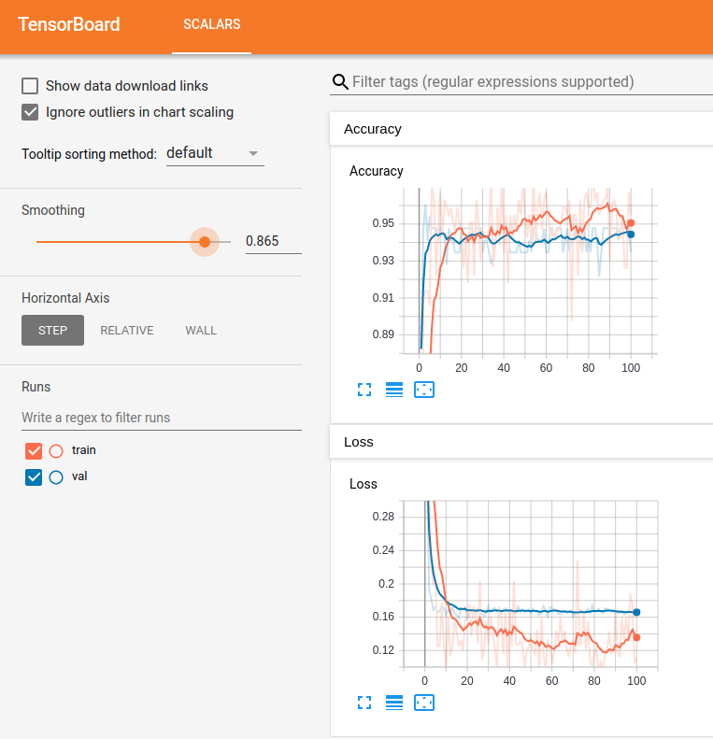
Tensorboard Monitoring
We are used to using several tools to monitor network results.
Epoch by epoch text printouts.
Plotting of loss from history.
Tensorboard is a tool from Keras that makes this process nicer.
We can use Tensorboard to get a “modern” dashboard to monitor training results.

Slide 3
What does Tensorboard Offer?

Slide 4
Launching Tensorboard
There is a vscode tensorboard plugin that allows tb to load in a tab.
The data displayed in the tensorboard pages comes from log files.

Slide 5
Using Tensorboard

Slide 6
CNN Optimizations

Slide 7
Data Augmentation
As we saw previously, we can augment our dataset easily when using images.

Slide 8
Conclusion

