Slide 1
Transfer Learning

Slide 2
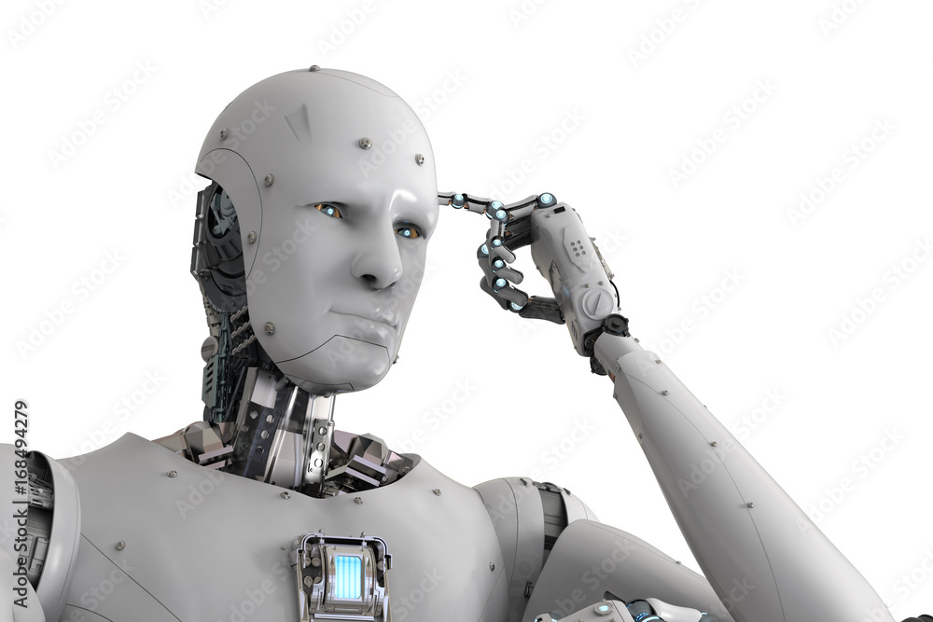
Model Training
As we’ve seen, training models can be time consuming.
For something like image recognition or language processing the dataset of stuff is immense.
Training state of the art models isn’t possible without serious resources.
Most people, including us, don’t have that.
What to do?

Slide 3
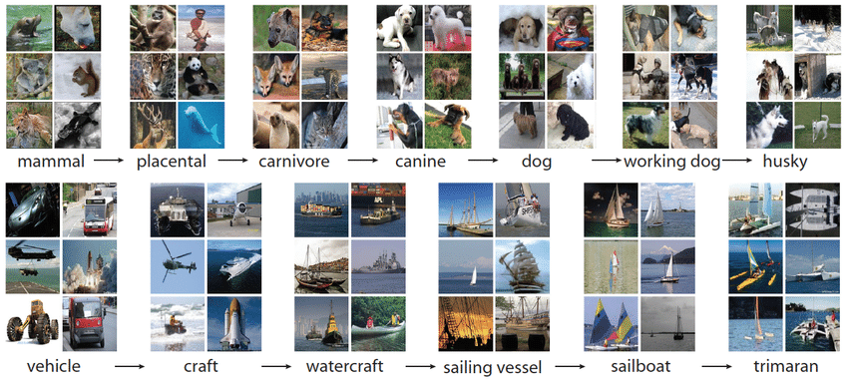
Big Data - Imagenet

Slide 4
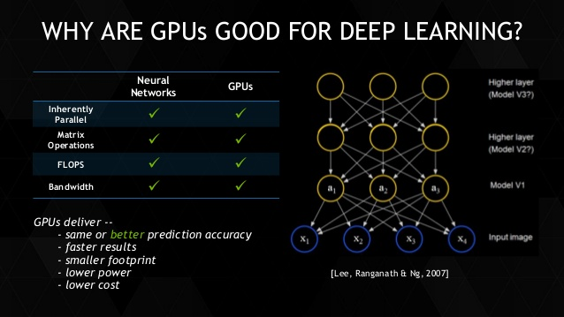
Big Processors

Slide 5
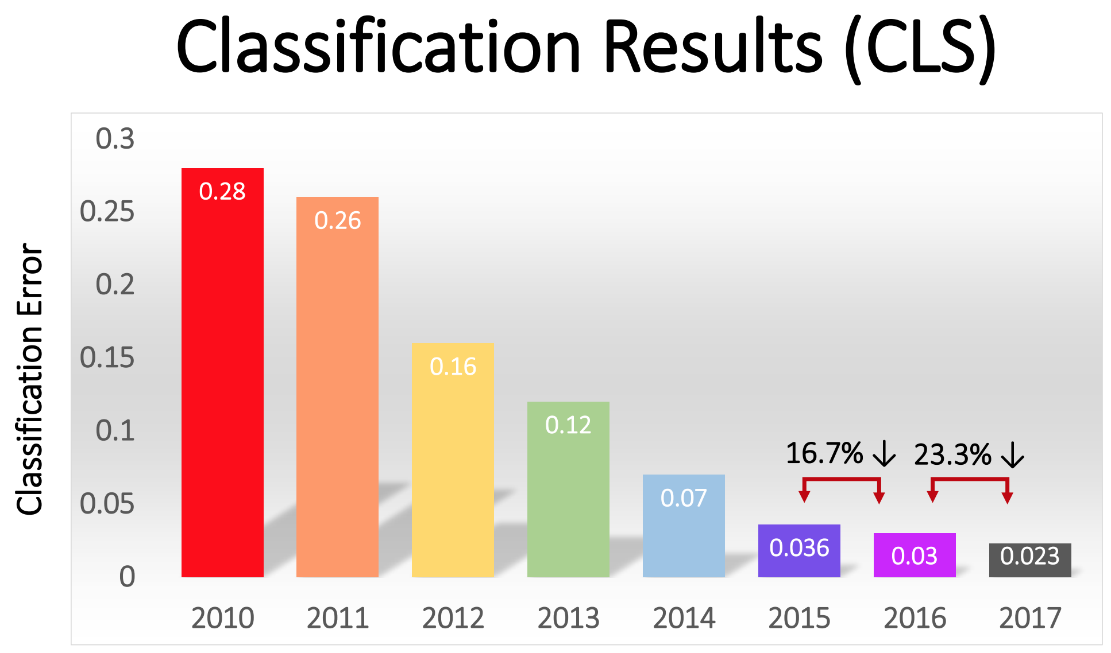

Slide 6
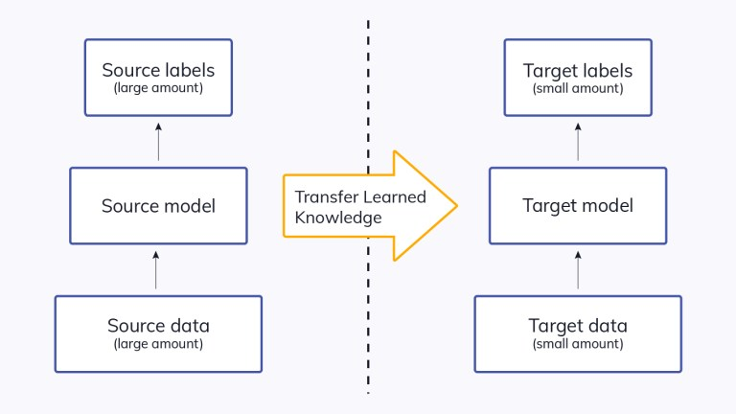
Transfer the Learning
Enter transfer learning!
We can use the training of other models and borrow those models for our applications.
Idea – many tasks are very similar, if a model is good at one thing, it will probably be good at something similar.
In the real world – I could ski before I could waterski. The idea of carving on an edge, balancing, weight transfer all help learning to water ski.

Slide 7
Pretrained Image Models
Image recognition models are trained on large datasets like ImageNet, which has over 1000 classes.
Massive dataset + large model + fast processor = accurate model.
“Seeing” objects is what the model is trained to do.
We can repurpose it to use those skills for other types of objects.
Keras packages many pretrained models that we can download and use.
The pretrained model’s abilities to extract features are well developed through training.
We aim to combine that feature detection with our specific challenge.

Slide 8
When does it work (or not)?
To no one’s surprise, the more similar the datasets, the better the transfer.
Common use cases are image recognition and language.
Natural Language Processing:
Language structure, word meanings, etc... are all very generalizable to other problems.
Word2Vec was a transfer learning application.
Image Processing:
Multiple pretrained models in tensorflow.
Datasets and complexity make training a model like this at home impractical.
Allows us to leverage similar scenarios to learn more quickly – like real life!

Slide 9
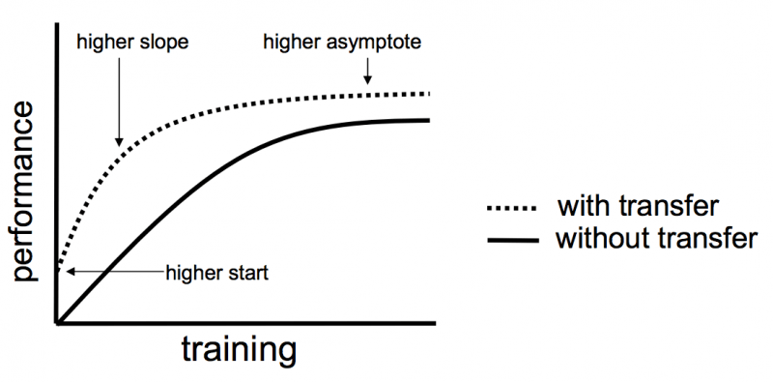

Slide 10
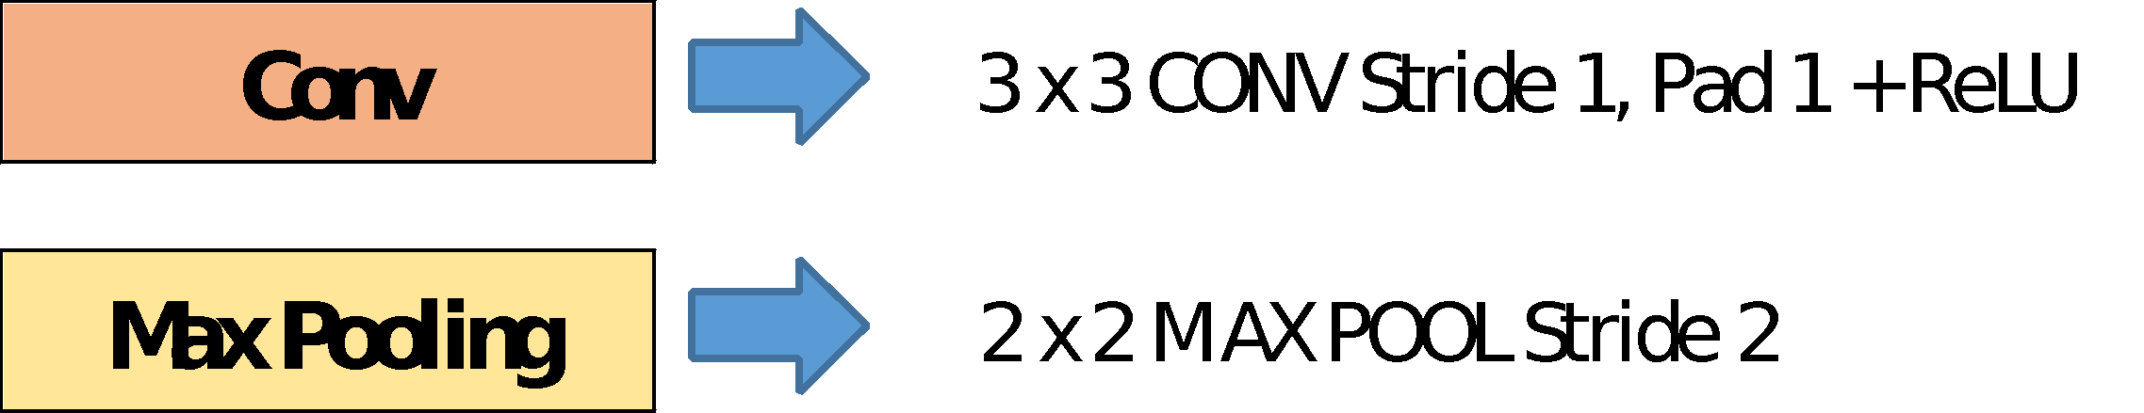
VGG16
VGG 16 patterned the general form of the models we typically use.
Contains 16 (“real”) layers.
Larger models, with 100s of layers, have surpassed in accuracy.
Trained on the very large Imagenet database.

Slide 11
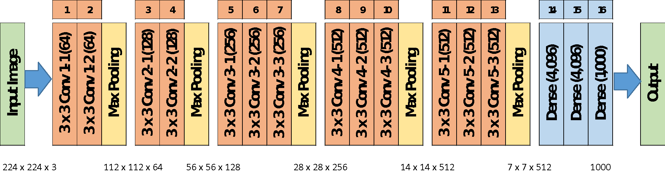
VGG16

Slide 12
Implementing Transfer Learning
Using transfer learning is relatively simple:
Load the pretrained model.
Remove the classification layer.
Download the pretrained weights for the model.
Set the layers to not be trained.
Adapt data, if needed, in preprocessing.
Attach our own classification layers.
Output layer + preceding dense layers.
Train on our data.
Only the added layers learn in training.
Optional – unlock and retrain to fine tune.
Gently adjust the model to more closely match our data.

Slide 13
Implementing Transfer Learning
Load pretrained model:
There are many well trained image recognition models that are shared, vgg is one.
When loading it we need to ensure we load the old weights.
We remove the “top” and set the model to not update its weights.
Add our own classifier:
The imagenet data is classified into ~1000 classes.
Our data has 5 classes.
After the trained model does the feature extraction, we want to classify those features into one of 5 classes.
This part does get trained – it learns how to use VGG’s features to make classifications.

Slide 14
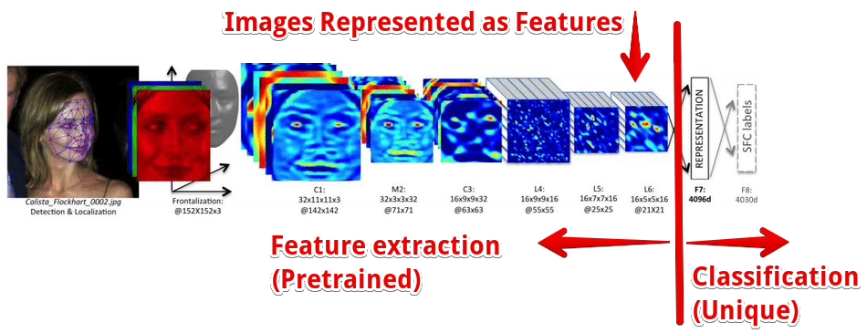

Slide 15
Fine Tuning
The fine-tuning step needs a bit more exploration.
When we initially use our transfer model we end up with:
Convolutional layers that are trained on the pretrained data.
Classification layers that have trained on our data.
Fine tuning updates the entire model to fit our data better:
Unlock the entire model, so it all learns in training.
Set the learning rate extremely low.
Retrain on all the data.
Result is that the entire model is slightly adjusted through some small training.

Slide 16
More Retraining
In addition to just removing the output bits, we can allow for retraining of other layers of the network.
This removes some of the existing training, making the model adapt more to our data.
If our dataset is more different from the original, this may help.
I.e. use the pretrained layers to extract image features at a higher level.
Train layers ourselves to bend the model towards our data.
We are removing some of the pretrained intelligence:
If our training set is small, we might end up behind where we started.

Slide 17
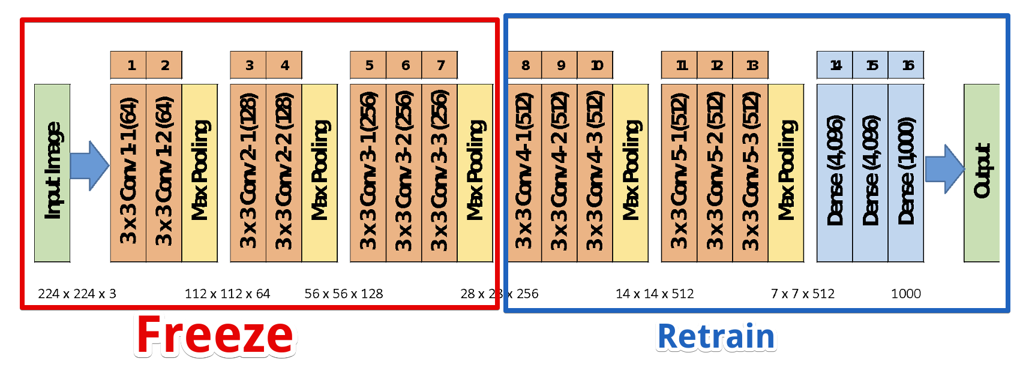
E.g. Freeze Part, retrain Part

Slide 18
Practical Applications
Transfer learning can help in many real-world scenarios.
Many problems are similar – image recognition, text processing.
Other problems are very large – self driving car.
In either of these scenarios, being able to build on the learning of other models can both speed and improve performance.

Slide 19
NLP - Word2Vec
Word2Vec is an example of transferred learning.
Other NLP models such as Glove do similar things.
Utilizes pretrained models on massive amounts of text.
Google’s News dataset has over 100 billion words.
Language is pretty repetitive, so models can learn on massive sets of training data.
This super smart model can help us by applying that knowledge:
Better understanding of language, so better vectorization.
Ability to evaluate sentiment or similarity based on large dataset of training.

Slide 20
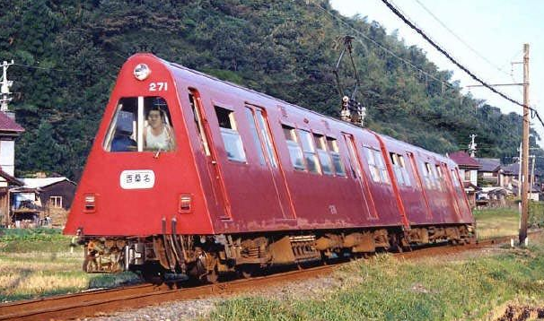
Image recognition
Image recognition is a massive application of transfer learning.
Images are large, so the processing required for accurate models is massive.
There is a large amount of transferability of skill.
E.g. you can recognize a dog you’ve never seen before as a dog.
You can recognize a weird train car as a train, and as a method of transport.
The CNN models used in images act to extract features, then predict based on those features.
Inherently splitable.
Kreas pretrained models: https://keras.io/api/applications/

Slide 21
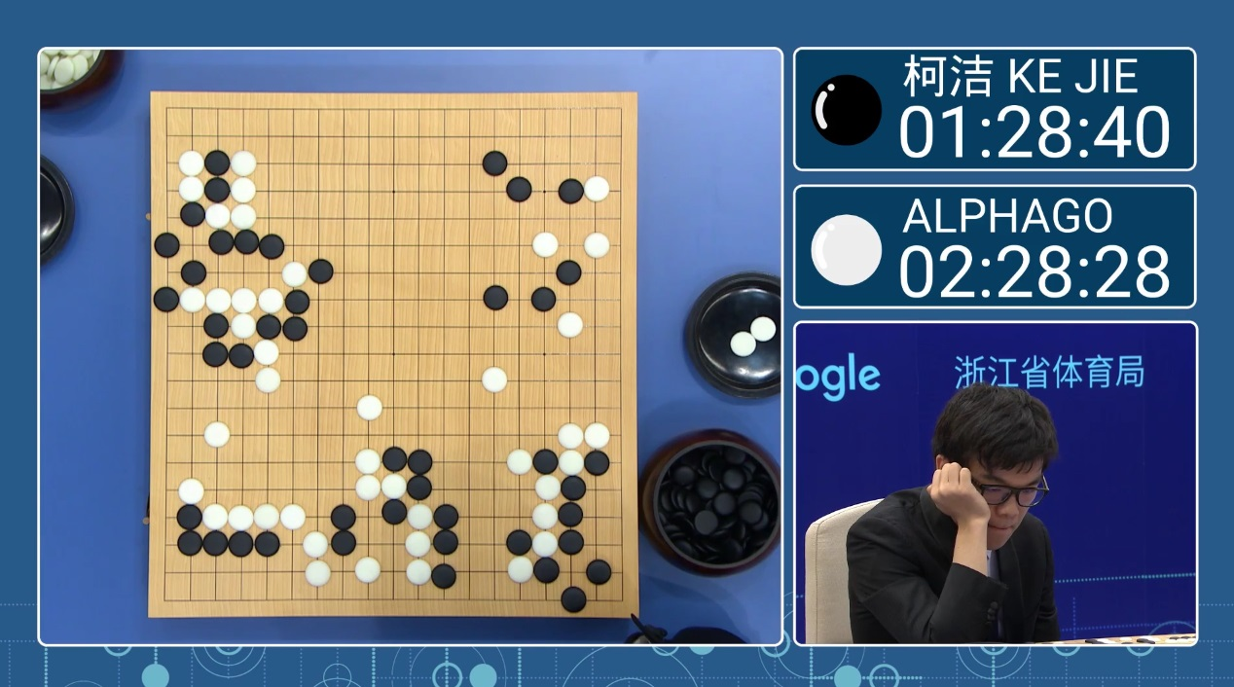
Gaming
A classic and old way to train game AI is to have it play itself.
Early machine learning was an IBM guy training a checkers machine.
One application of transfer learning is video gaming.
Watch AlphaGo: https://www.youtube.com/watch?v=WXuK6gekU1Y
The learning from one game can be applied to others.
Researchers are teaching AI system to learn games, based on other games:
https://www.wired.co.uk/article/deepmind-atari-learning-sequential-memory-ewc
"Previously, DQN had to learn how to play each game individually," the paper says. "Whereas augmenting the DQN agent with EWC allows it to learn many games in sequence without suffering from catastrophic forgetting."

