Slide 1
Ranking clues in sudoku solvers
By Gulfaraz Rahman & Tharangni H Sivaji

Slide 2
Abstract
The aim of this paper is to analyze the variations of clues in terms of orientation, existence, arrangement and position. It discusses about the parameters of the initial sudoku state which is achieved by running it through PycoSAT in non-deterministic mode. The metrics generated by PycoSAT are used to rank each variation of the given sudoku.
Insert hypothesis here

Slide 3
Assumptions
The following assumptions are made before the experimental setup for implementing the project.
Input sudokus used are minimal
Equal weights are assigned to the metrics generated as outputs
Metrics for multiple solutions of a given variation are aggregated as averages.

Slide 4
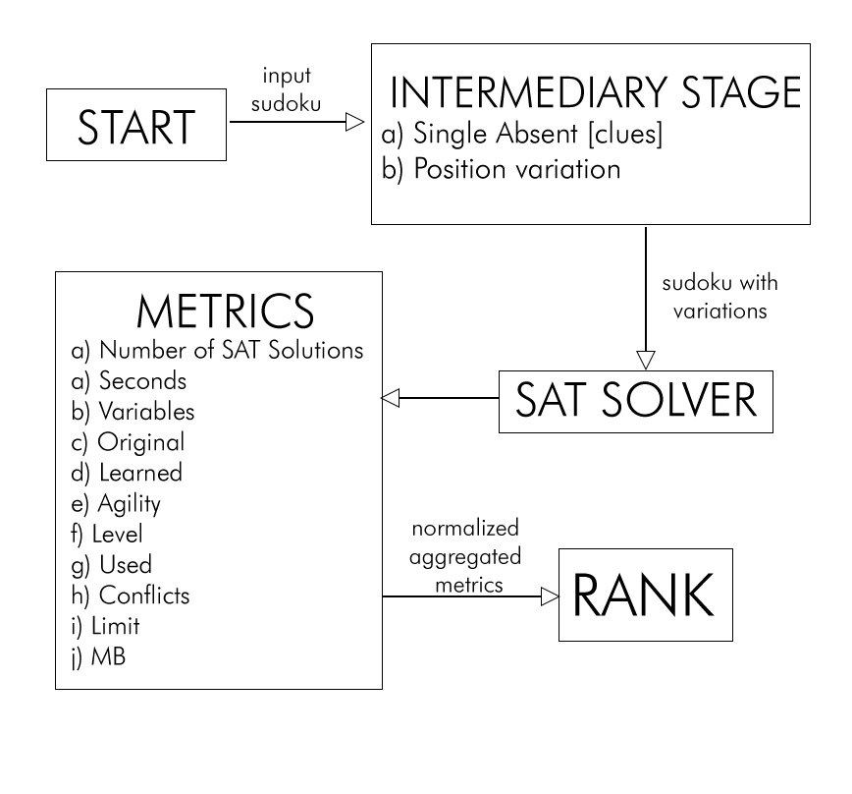
Experimental Setup
Assigning the ranks begins with getting an input sudoku as a sequence of 81 digits with 0 denoting an empty cell. For ex: 007000000500000006000920300098000005700200900000800470009305007640is an input sudoku

Slide 5
Metrics

