Slide 1
Bucket Sort Algorithm

Slide 2
How it Works
Bucket sort is a sorting algorithm that works by inserting the elements of the sorting array into buckets, then, each bucket is sorted individually.
The idea behind bucket sort is that if we know the range of our elements to be sorted, we can set up buckets for each possible element, and place elements into their corresponding buckets.
Elements are placed in buckets according to bucket characteristics, e.g. numbers between 1-10 in bucket 1, 11-20 in bucket 2 and so on.
For every bucket that contains more than one number a linear algorithm is typically used e.g. an insertion or quick sort.
Finally the buckets are emptied in order, and the result is a sorted list.

Slide 3
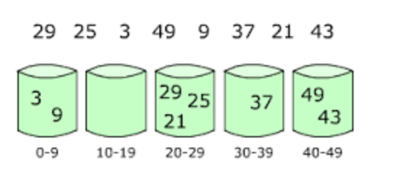
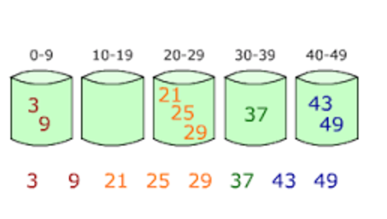
Example:
Before
After

Slide 4
Points to Note
As with other linear sorting algorithms, bucket sort efficiency depends on the input. The main thing to be aware of is the way the input data is dispersed over an interval.
The number of buckets that can dramatically improve or worse the performance of the algorithm.
This makes bucket sort ideal in cases we know in advance that the input is well dispersed i.e. how far each element is from some measure of central tendency (average).

Slide 5
Complexity
The complexity of bucket sort is not constant and depends on the input.
In the average case the complexity of the algorithm is O(n + k) where n is the length of the input sequence, while k is the number of buckets.
The problem is that its worst-case performance is O(n^2) which makes it as slow as bubble sort.

Slide 6
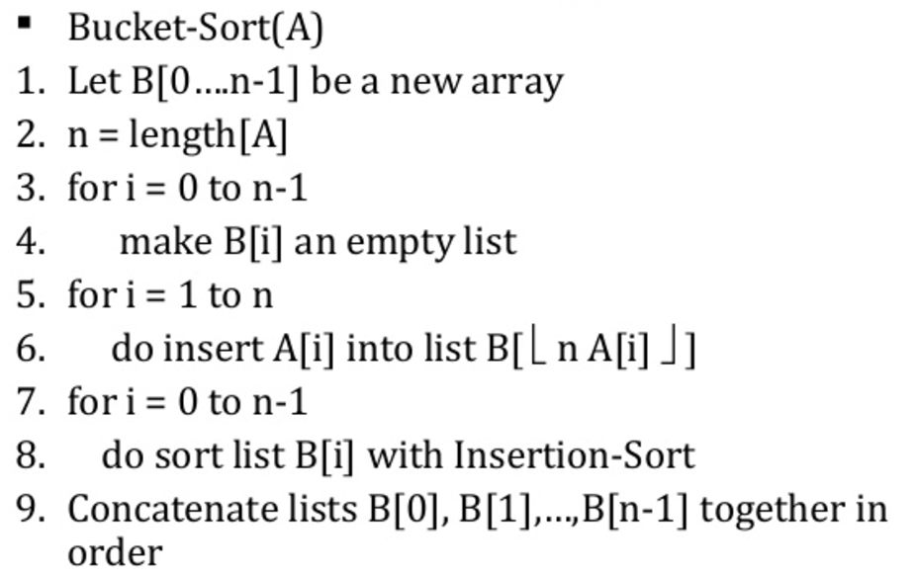
Typical Algorithm

