Slide 1
Bayesian Networks
CS 271: Fall 2007
Instructor: Padhraic Smyth

Slide 2
Logistics
Remaining lectures
  Bayesian networks (today)
  2 on machine learning
  No lecture next Tuesday Dec 4th (out of town)
Homeworks
  #5 (Bayesian networks) is due Thursday
  #6 (machine learning) will be out end of next week, due end of the following week
Extra-credit projects
  If you have not heard from me, go ahead and start working on it (I have only emailed people who needed to revise their proposals)
Final exam
  2 weeks from Thursday
    In class, closed-book, cumulative but with emphasis on logic onwards

Slide 3
Today’s Lecture
Definition of Bayesian networks
  Representing a joint distribution by a graph
  Can yield an efficient factored representation for a joint distribution
Inference in Bayesian networks
  Inference = answering queries such as P(Q | e)
  Intractable in general (scales exponentially with num variables)
  But can be tractable for certain classes of Bayesian networks
  Efficient algorithms leverage the structure of the graph
Other aspects of Bayesian networks
  Real-valued variables
  Other types of queries
  Special cases: naïve Bayes classifiers, hidden Markov models
Reading: 14.1 to 14.4 (inclusive) – rest of chapter 14 is optional

Slide 4
Computing with Probabilities: Law of Total Probability
Law of Total Probability (aka “summing out” or marginalization)
P(a) = Σ_{b} P(a, b)
= Σ_{b} P(a | b) P(b) where B is any random variable
Why is this useful?
given a joint distribution (e.g., P(a,b,c,d)) we can obtain any “marginal” probability (e.g., P(b)) by summing out the other variables, e.g.,
P(b) = Σ_{a} Σ_{c} Σ_{d} P(a, b, c, d)
Less obvious: we can also compute any conditional probability of interest given a joint distribution, e.g.,
P(c | b) = Σ_{a} Σ_{d} P(a, c, d | b)
= 1 / P(b) Σ_{a} Σ_{d} P(a, c, d, b)
where 1 / P(b) is just a normalization constant
Thus, the joint distribution contains the information we need to compute any probability of interest.

Slide 5
Computing with Probabilities: The Chain Rule or Factoring
We can always write
P(a, b, c, … z) = P(a | b, c, …. z) P(b, c, … z)
(by definition of joint probability)
Repeatedly applying this idea, we can write
P(a, b, c, … z) = P(a | b, c, …. z) P(b | c,.. z) P(c| .. z)..P(z)
This factorization holds for any ordering of the variables
This is the chain rule for probabilities

Slide 6
Conditional Independence
2 random variables A and B are conditionally independent given C iff
P(a, b | c) = P(a | c) P(b | c) for all values a, b, c
More intuitive (equivalent) conditional formulation
  A and B are conditionally independent given C iff
  P(a | b, c) = P(a | c) OR P(b | a, c) P(b | c), for all values a, b, c
  Intuitive interpretation:
  P(a | b, c) = P(a | c) tells us that learning about b, given that we already know c, provides no change in our probability for a,
  i.e., b contains no information about a beyond what c provides
Can generalize to more than 2 random variables
  E.g., K different symptom variables X1, X2, … XK, and C = disease
  P(X1, X2,…. XK | C) = Π P(Xi | C)
  Also known as the naïve Bayes assumption

Slide 7
“…probability theory is more fundamentally concerned with the structure of reasoning and causation than with numbers.”
Glenn Shafer and Judea Pearl
Introduction to Readings in Uncertain Reasoning,
Morgan Kaufmann, 1990

Slide 8
Bayesian Networks
A Bayesian network specifies a joint distribution in a structured form
Represent dependence/independence via a directed graph
  Nodes = random variables
  Edges = direct dependence
Structure of the graph ⬄ Conditional independence relations
Requires that graph is acyclic (no directed cycles)
2 components to a Bayesian network
  The graph structure (conditional independence assumptions)
  The numerical probabilities (for each variable given its parents)
In general,
p(X₁, X₂,....X_{N}) = Π p(X_{i} | parents(X_{i} ) )
The full joint distribution
The graph-structured approximation

Slide 9
Example of a simple Bayesian network
A
B
p(A,B,C) = p(C|A,B)p(A)p(B)
C
Probability model has simple factored form
Directed edges => direct dependence
Absence of an edge => conditional independence
Also known as belief networks, graphical models, causal networks
Other formulations, e.g., undirected graphical models

Slide 10
Examples of 3-way Bayesian Networks
A
B
C
Marginal Independence:
p(A,B,C) = p(A) p(B) p(C)

Slide 11
Examples of 3-way Bayesian Networks
Conditionally independent effects:
p(A,B,C) = p(B|A)p(C|A)p(A)
B and C are conditionally independent
Given A
e.g., A is a disease, and we model
B and C as conditionally independent
symptoms given A
A
B
C

Slide 12
Examples of 3-way Bayesian Networks
A
B
Independent Causes:
p(A,B,C) = p(C|A,B)p(A)p(B)
“Explaining away” effect:
Given C, observing A makes B less likely
e.g., earthquake/burglary/alarm example
A and B are (marginally) independent
but become dependent once C is known
C

Slide 13
Examples of 3-way Bayesian Networks
A
B
C
Markov dependence:
p(A,B,C) = p(C|B) p(B|A)p(A)

Slide 14
Example
Consider the following 5 binary variables:
  B = a burglary occurs at your house
  E = an earthquake occurs at your house
  A = the alarm goes off
  J = John calls to report the alarm
  M = Mary calls to report the alarm
  What is P(B | M, J) ? (for example)
  We can use the full joint distribution to answer this question
    Requires 2⁵ = 32 probabilities
    Can we use prior domain knowledge to come up with a Bayesian network that requires fewer probabilities?

Slide 15
Constructing a Bayesian Network: Step 1
Order the variables in terms of causality (may be a partial order)
e.g., {E, B} -> {A} -> {J, M}
P(J, M, A, E, B) = P(J, M | A, E, B) P(A| E, B) P(E, B)
~ P(J, M | A) P(A| E, B) P(E) P(B)
~ P(J | A) P(M | A) P(A| E, B) P(E) P(B)
These CI assumptions are reflected in the graph structure of the Bayesian network

Slide 16
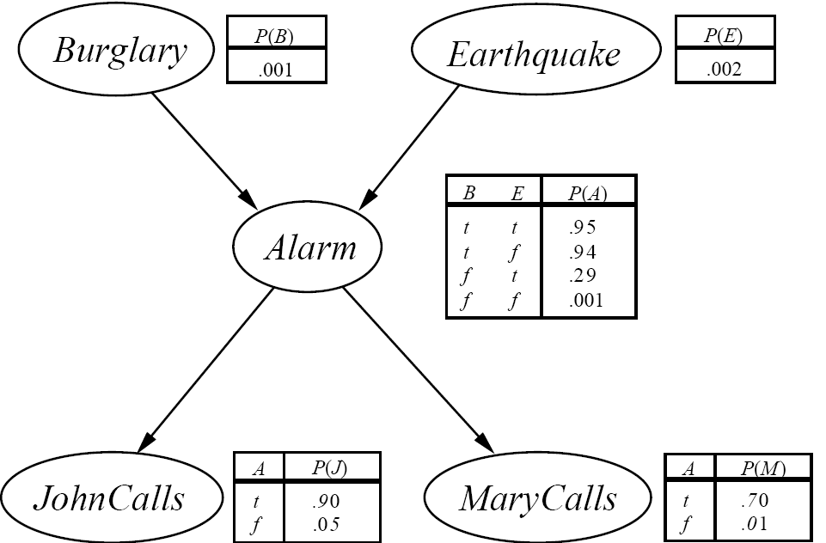
The Resulting Bayesian Network

Slide 17

Constructing this Bayesian Network: Step 2
P(J, M, A, E, B) =
P(J | A) P(M | A) P(A | E, B) P(E) P(B)
There are 3 conditional probability tables (CPDs) to be determined:
P(J | A), P(M | A), P(A | E, B)
  Requiring 2 + 2 + 4 = 8 probabilities
And 2 marginal probabilities P(E), P(B) -> 2 more probabilities
Where do these probabilities come from?
  Expert knowledge
  From data (relative frequency estimates)
  Or a combination of both - see discussion in Section 20.1 and 20.2 (optional)

Slide 18
The Bayesian network

Slide 19
Number of Probabilities in Bayesian Networks
Consider n binary variables
Unconstrained joint distribution requires O(2^{n}) probabilities
If we have a Bayesian network, with a maximum of k parents for any node, then we need O(n 2^{k}) probabilities
Example
  Full unconstrained joint distribution
    n = 30: need 10⁹ probabilities for full joint distribution
  Bayesian network
    n = 30, k = 4: need 480 probabilities

Slide 20
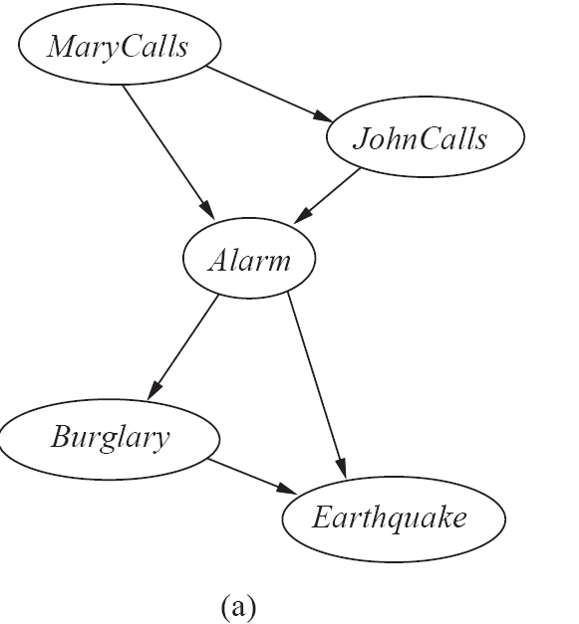
The Bayesian Network from a different Variable Ordering

Slide 21
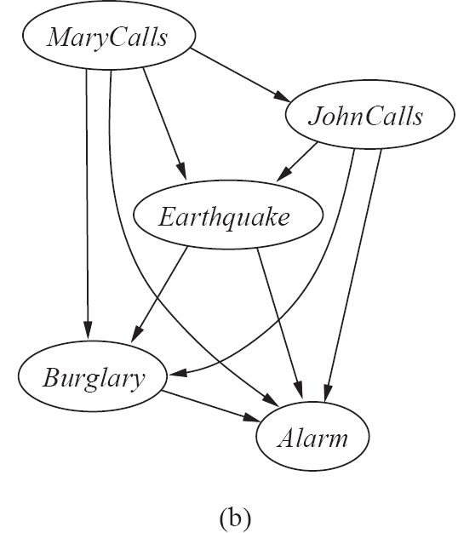
The Bayesian Network from a different Variable Ordering

Slide 22
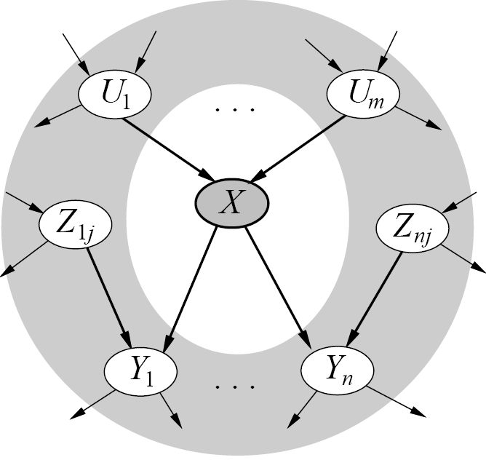
Given a graph, can we “read off” conditional independencies?
A node is conditionally independent
of all other nodes in the network
given its Markov blanket (in gray)

Slide 23
Inference (Reasoning) in Bayesian Networks
Consider answering a query in a Bayesian Network
  Q = set of query variables
  e = evidence (set of instantiated variable-value pairs)
  Inference = computation of conditional distribution P(Q | e)
Examples
  P(burglary | alarm)
  P(earthquake | JCalls, MCalls)
  P(JCalls, MCalls | burglary, earthquake)
Can we use the structure of the Bayesian Network
to answer such queries efficiently? Answer = yes
  Generally speaking, complexity is inversely proportional to sparsity of graph

Slide 24
Example: Tree-Structured Bayesian Network
D
B
E
A
C
F
G
p(a, b, c, d, e, f, g) is modeled as p(a|b)p(c|b)p(f|e)p(g|e)p(b|d)p(e|d)p(d)

Slide 25
Example
D
B
E
A
c
F
g
Say we want to compute p(a | c, g)

Slide 26
Example
D
B
E
A
c
F
g
Direct calculation: p(a|c,g) = Σ_{bdef} p(a,b,d,e,f | c,g)
Complexity of the sum is O(m⁴)

Slide 27
Example
D
B
E
A
c
F
g
Reordering:
Σ_{b} p(a|b) Σ_{d} p(b|d,c) Σ_{e} p(d|e) Σ_{f} p(e,f |g)

Slide 28
Example
D
B
E
A
c
F
g
Reordering:
Σ_{b} p(a|b) Σ_{d} p(b|d,c) Σ_{e} p(d|e) Σ_{f} p(e,f |g)
p(e|g)

Slide 29
Example
D
B
E
A
c
F
g
Reordering:
Σ_{b} p(a|b) Σ_{d} p(b|d,c) Σ_{e} p(d|e) p(e|g)
p(d|g)

Slide 30
Example
D
B
E
A
c
F
g
Reordering:
Σ_{b} p(a|b) Σ_{d} p(b|d,c) p(d|g)
p(b|c,g)

Slide 31
Example
D
B
E
A
c
F
g
Reordering:
Σ_{b} p(a|b) p(b|c,g)
p(a|c,g)
Complexity is O(m), compared to O(m⁴)

Slide 32
General Strategy for inference
Want to compute P(q | e)
Step 1:
  P(q | e) = P(q,e)/P(e) = α P(q,e), since P(e) is constant wrt Q
Step 2:
  P(q,e) = Σ_{a..z} P(q, e, a, b, …. z), by the law of total probability
Step 3:
  Σ_{a..z} P(q, e, a, b, …. z) = Σ_{a..z} Π_{i} P(variable i | parents i)
  (using Bayesian network factoring)
Step 4:
Distribute summations across product terms for efficient computation

Slide 33
Inference Examples
Examples worked on whiteboard

Slide 34
Complexity of Bayesian Network inference
Assume the network is a polytree
  Only a single directed path between any 2 nodes
Complexity scales as O(n m ^{K+1})
    n = number of variables
    m = arity of variables
    K = maximum number of parents for any node
  Compare to O(m^{n-1}) for brute-force method
Network is not a polytree?
  Can cluster variables to render the new graph a tree
  Very similar to tree methods used for
  Complexity is O(n m ^{W+1}), where W = num variables in largest cluster

Slide 35
Real-valued Variables
Can Bayesian Networks handle Real-valued variables?
  If we can assume variables are Gaussian, then the inference and theory for Bayesian networks is well-developed,
    E.g., conditionals of a joint Gaussian is still Gaussian, etc
    In inference we replace sums with integrals
  For other density functions it depends…
    Can often include a univariate variable at the “edge” of a graph, e.g., a Poisson conditioned on day of week
  But for many variables there is little know beyond their univariate properties, e.g., what would be the joint distribution of a Poisson and a Gaussian? (its not defined)
  Common approaches in practice
    Put real-valued variables at “leaf nodes” (so nothing is conditioned on them)
    Assume real-valued variables are Gaussian or discrete
    Discretize real-valued variables

Slide 36
Other aspects of Bayesian Network Inference
The problem of finding an optimal (for inference) ordering and/or clustering of variables for an arbitrary graph is NP-hard
  Various heuristics are used in practice
  Efficient algorithms and software now exist for working with large Bayesian networks
    E.g., work in Professor Rina Dechter’s group
Other types of queries?
  E.g., finding the most likely values of a variable given evidence
  arg max P(Q | e) = “most probable explanation”
  or maximum a posteriori query
  - Can also leverage the graph structure in the same manner as for inference – essentially replaces “sum” operator with “max”

Slide 37
Naïve Bayes Model
Y₁
Y₂
Y₃
Y_{n}
C
P(C | Y₁,…Y_{n}) = α Π P(Y_{i} | C) P (C)
Features Y are conditionally independent given the class variable C
Widely used in machine learning
e.g., spam email classification: Y’s = counts of words in emails
Conditional probabilities P(Yi | C) can easily be estimated from labeled data

Slide 38
Hidden Markov Model (HMM)
Observed
Y₁
Y₂
Y₃
Y_{n}
- - - - - - - - - - - - - - - - - - - - - - - - - - - - - - - - - - - - - - - - - - - - - - - - - - - -
S₃
S_{n}
Hidden
S₁
S₂
Two key assumptions:
1. hidden state sequence is Markov
2. observation Y_{t} is CI of all other variables given S_{t}
Widely used in speech recognition, protein sequence models
Since this is a Bayesian network polytree, inference is linear in n

Slide 39
Summary
Bayesian networks represent a joint distribution using a graph
The graph encodes a set of conditional independence assumptions
Answering queries (or inference or reasoning) in a Bayesian network amounts to efficient computation of appropriate conditional probabilities
Probabilistic inference is intractable in the general case
  But can be carried out in linear time for certain classes of Bayesian networks

Slide 40
Backup Slides
(can be ignored)

Slide 41
Junction Tree
D
B, E
A
C
F
G
Good news: can perform MP algorithm on this tree
Bad news: complexity is now O(K²)

Slide 42
A More General Algorithm
Message Passing (MP) Algorithm
  Pearl, 1988; Lauritzen and Spiegelhalter, 1988
  Declare 1 node (any node) to be a root
  Schedule two phases of message-passing
    nodes pass messages up to the root
    messages are distributed back to the leaves
  In time O(N), we can compute P(….)

Slide 43
Sketch of the MP algorithm in action

Slide 44
Sketch of the MP algorithm in action
1

Slide 45
Sketch of the MP algorithm in action
1
2

Slide 46
Sketch of the MP algorithm in action
1
2
3

Slide 47
Sketch of the MP algorithm in action
1
2
3
4

Slide 48
Graphs with “loops”
D
B
E
A
C
F
G
Network is not a polytree

Slide 49
Graphs with “loops”
D
B
E
A
C
F
G
General approach: “cluster” variables
together to convert graph to a polytree

Slide 50
Junction Tree
D
B, E
A
C
F
G

Slide 51
Junction Tree
D
B, E
A
C
F
G
Good news: can perform MP algorithm on this tree
Bad news: complexity is now O(K²)

