Slide 1
Fixed-point arithmetic
Ognjen Jovanovic

Slide 2


How is DSP typically developed?
Floating-point
Floating-point
C/C++
Fixed-point
HDL
Fixed-point

Slide 3
Pros & Cons
Suitable for specific arithmetic functions
Some operations are faster
Easier to identify the integer and fractional part
Decrease in area
Not for general purpose
Some operations are slower
Decrease in precision
The range is smaller
Not so many built-in functions

Slide 4
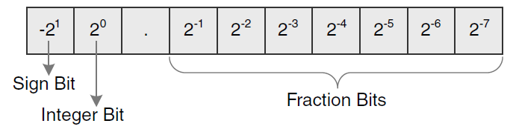
Qn.m fixed-point format
N-bit number, where n-bits is the integer part and m-bits is the fractional part
IMPORTANT – If signed then the sign bit is counted into the n
Signed Qn.m is equivalent to:
Example, signed Q2.7:
n
m

Slide 5
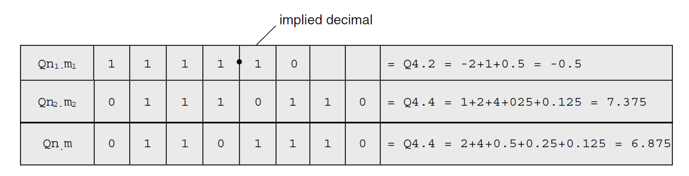
Addition in Qn.m format
Qn₁.m₁+ Qn₂.m₂ = Qmax(n₁, n₂).max(m₁, m₂)
Example (Addition Q2.2 (1110) & Q4.4 (0111_0110)):

Slide 6
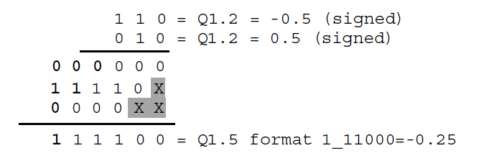
Multiplication in Qn.m format
Qn₁.m₁ * Qn₂.m₂ = Q(n₁ + n₂).(m₁ + m₂)
If signed, then:
Qn₁.m₁ * Qn₂.m₂ = Q(n₁ + n₂ - 1).(m₁ + m₂ + 1)
Example:

Slide 7

Problems! & some solutions
Bit Growth
Overflow
Saturation
Simple Truncation
Rounding followed by truncation
Restrict/Plan
7.4375 -> 7.5
Truncated to Q4.2 gives 0111_10

Slide 8
Fixed-Point Summation theorem
The sum of K J-bit values requires J + ceil(log₂K) bits to maintain precision and avoid if no information is known about the values.
Example:
1000 (Q2.2) + 1000 (Q2.2) = 1 0000 (Q3.2)
How can this be expanded to FIR filters?
K-taps FIR filter with M-bits coefficients and L-bit data values:
L + M + ceil(log₂K)

Slide 9
Coefficient sizing theorem
If we know that we have A bits, but no other information
If no information is known about the data or the coefficients, then the coefficient wordlength M’ must be
M’<=min(M, A - L - ceil(log₂K))
in order to avoid overflow and preserve precision in an K-tap FIR filter output, where M is the maximum coefficient wordlength, and L is the data wordlength.
WARNING: There is a cost associated with this solution: increased coefficient quantization error.

Slide 10
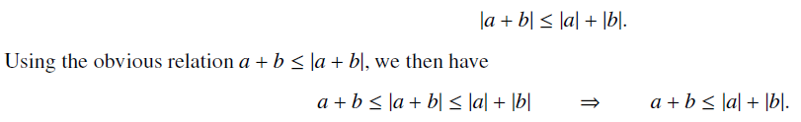


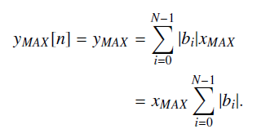


This is not enough!
Triangle inequality:
Convolution:

Slide 11
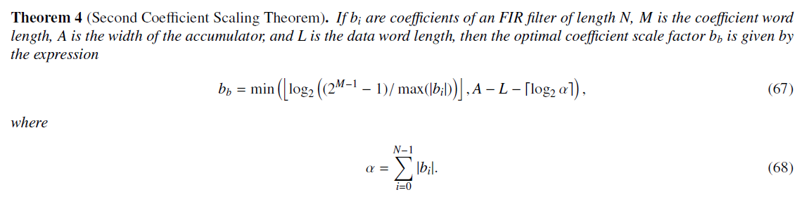
Second Coefficient Scaling Theorem

Slide 12
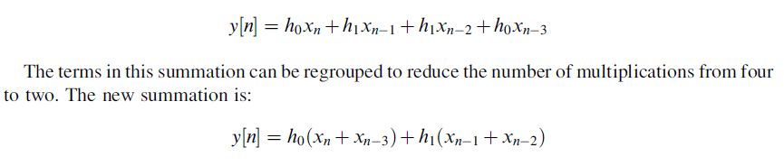
Folded FIR filters
Can be applied to symmetric FIR filters, which is your case!

Slide 13
Questions?
Thank you!

