Slide 1
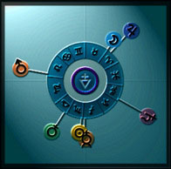
♃
☽︎
♂
♄
♀
☉︎
☿

Slide 2
16 Dec 1964
Groundhog Day
Equinox
May Day
SPRING
♃
☽︎
♂
WINTER
Solstice
SUMMER
Solstice
♄
♀
☉︎
evening
sky
morning
sky
☿
AUTUMN
Halloween
Equinox

