Slide 1
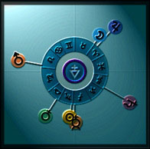
♃
☽︎
♂
♄
♀
☉︎
☿

Slide 2
16 Dec 1964
Groundhog Day
Equinox
May Day
SPRING
♃
☽︎
♂
WINTER
Solstice
SUMMER
Solstice
♄
♀
☉︎
☿
evening
sky
morning
sky
AUTUMN
Halloween
Equinox

Slide 3
Groundhog Day
Equinox
Beltane
WINTER
SPRING
♃
☽︎
♂
Solstice
Solstice
♄
♀
☉︎
☿
AUTUMN
SUMMER
Halloween
Lammas
Equinox

Slide 4
♃
☽︎
♈
♈
♈
♈
♂
♈
♈
♈
♈
♈
♈
♈
♈
♄
♀
☉︎
☿

