Slide 1
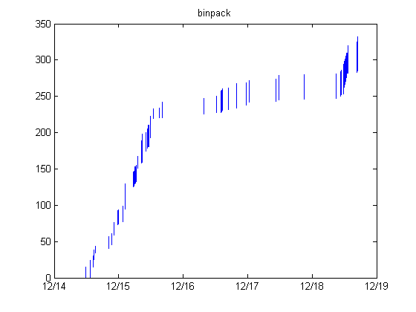
Contest Step Charts
novel
rapid code
turnover
conserved
code mostly
conserved
deleted
transition point
entry
A
entry
B

