Slide 1


SMART INDIA HACKATHON 2026
TITLE PAGE
Problem Statement ID –SIH26018
Problem Statement Title - Intelligent Land Record Digitization and Validation System
Theme - Smart Automation
PS Category- Software
Team ID-
Team Name –CODE RISERS

Slide 2
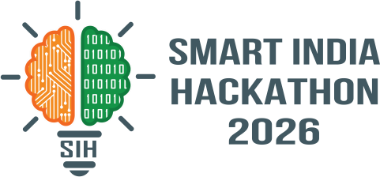
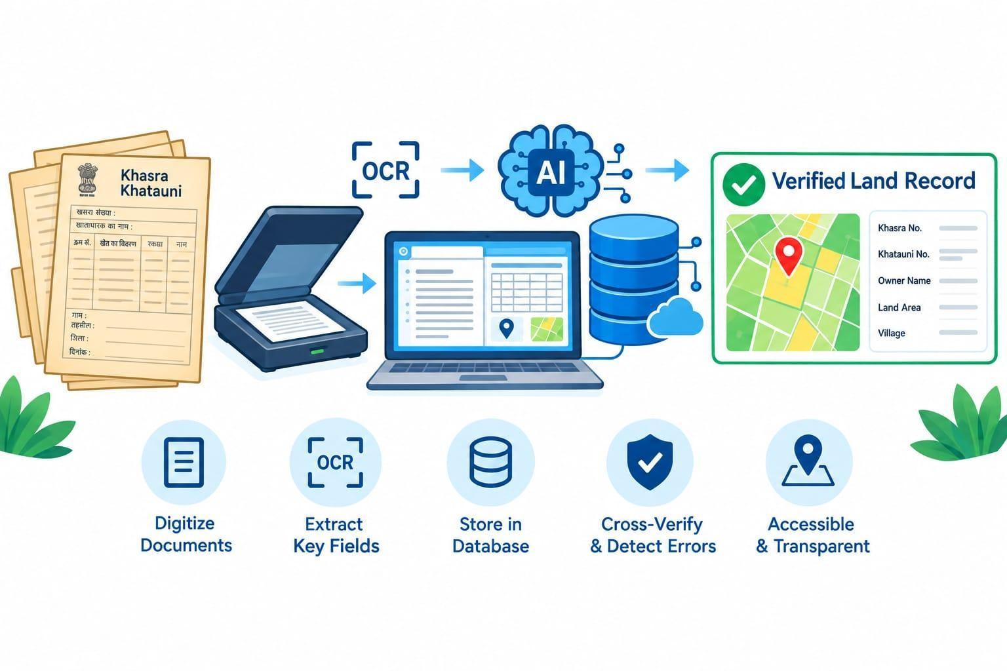
From Digitization to Intelligent Validation
CODE
RISERS
Proposed Solution: AI-based system to digitize and validate land record
DETAILED EXPLANATION
OCR + AI/NLP → extracts key land-record fields
Scans → Structured Digital Records
Documents + Records + GIS cross-checked
Mismatches & missing data automatically detected
Confidence score generated for verification
HOW IT ADDRESSES THE PROBLEM
Faster Verification | Fewer Errors | Multi-source Checking
| Conflict Flagging
INNOVATION & UNIQUENESS
01 Intelligent Extraction — AI field extraction
02 Multi-Level Validation — Document + Record + GIS
03 Explainable Review — Conflicts + confidence score

Slide 3
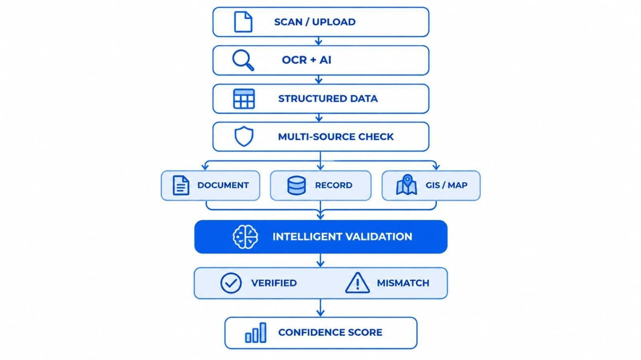

TECHNICAL APPROACH
CODE
RISERS
TECHNOLOGY STACK
Languages: Python • JavaScript • SQL Frontend: React.js • HTML • CSS Backend: FastAPI • REST APIs
AI: OCR • NLP • Machine Learning Database: PostgreSQL • PostGIS GIS: GeoJSON • Map APIs Deployment: Cloud Infrastructure

Slide 4
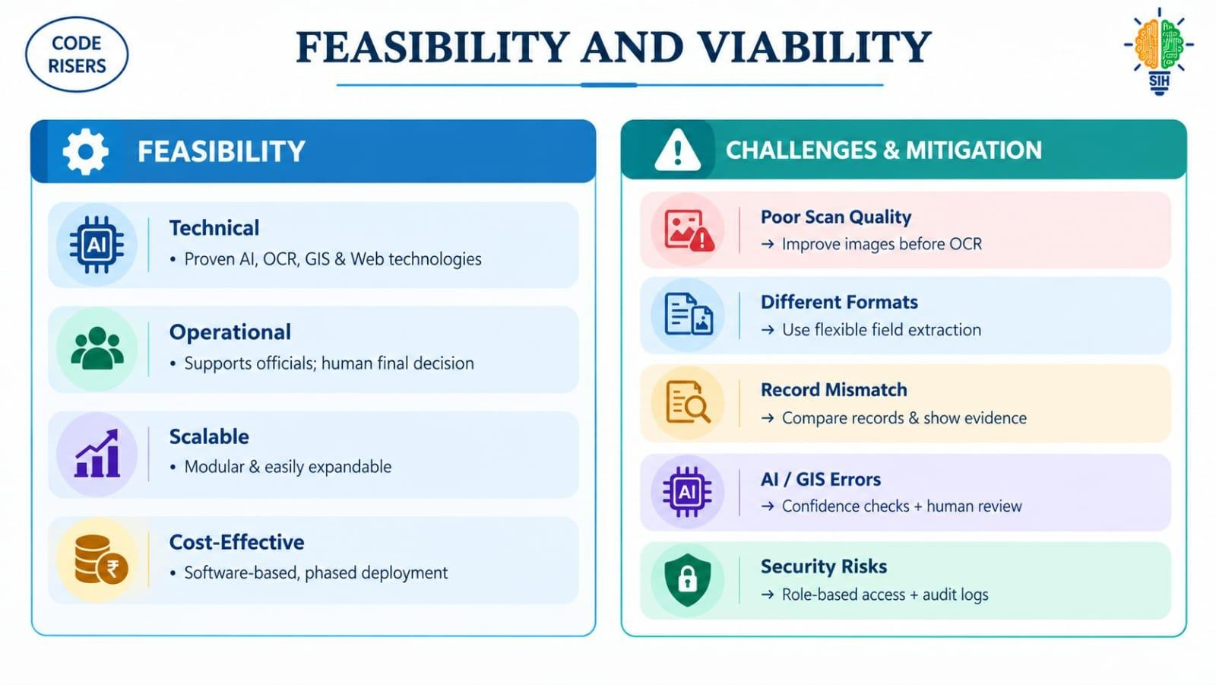


FEASIBILITY AND VIABILITY
CODE
RISERS
FEASIBILITY
Technical: Proven AI, OCR, GIS & Web technologies
Operational: Supports officials; human final decision
Scalable: Modular & easily expandable
Cost-Effective: Software-based, phased deployment
CHALLENGES & MITIGATION
Poor Scan Quality → Improve images before OCR
Different Formats → Use flexible field extraction
Record Mismatch → Compare records & show evidence
AI / GIS Errors → Confidence checks + human review
Security Risks → Role-based access + audit logs

Slide 5










IMPACT AND BENEFITS
CODE
RISERS
TARGET AUDIENCE | BENEFITS
Land Officials Faster verification & reduced manual work | SOCIAL Transparency → Trust → Fewer disputes
Landowners Quicker & clearer record verification | ECONOMIC Lower cost → Faster transactions
Government Accurate data → Better decisions | ENVIRONMENTAL Less paper → Digital records
Legal / Registration Bodies Reliable records → Easier validation | ADMINISTRATIVE Accuracy → Efficiency → Auditability

Slide 6
RESEARCH AND REFERENCES
CODE
RISERS
Digital India Land Records Modernization Programme (DILRMP)
Government of India
dolr.gov.in
MeeBhoomi — Andhra Pradesh Land Records Government of Andhra Pradesh meebhoomi.ap.gov.in
Technical Research Areas
OCR • AI-based Data Extraction • GIS • Data Validation

