Slide 1
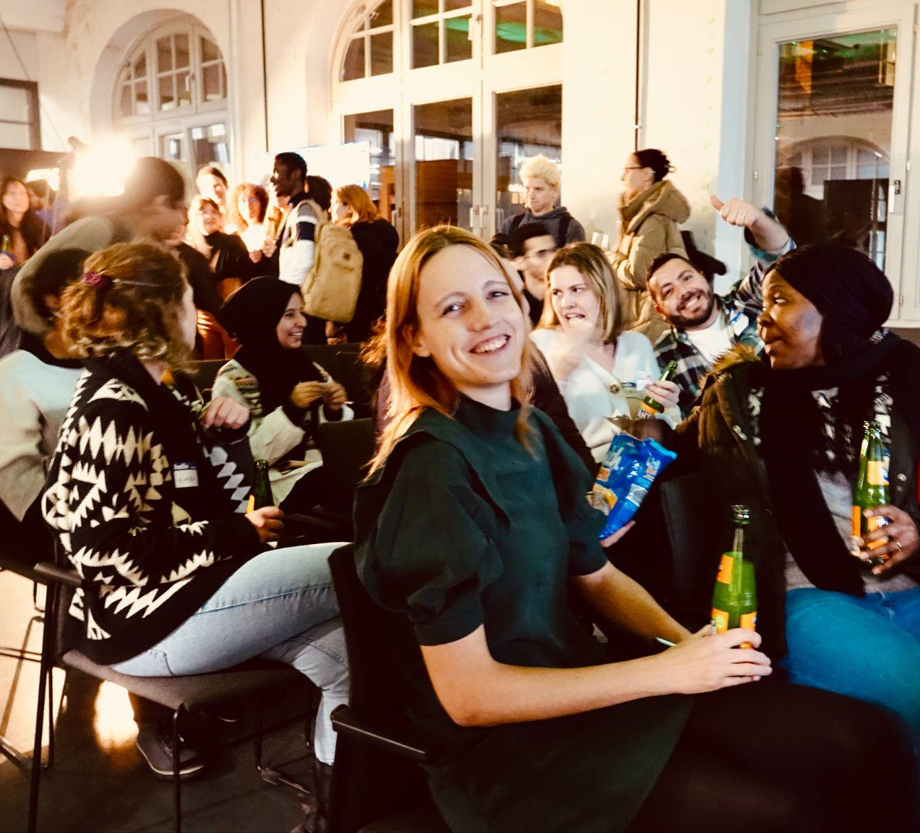

Data Circle 2025
Sprint 1
Project A:
Flu Shots
We use tech to connect human potential and opportunity with dignity & humility
We use tech to connect human potential and opportunity with dignity & humility

Slide 2
Team "Halva" - Project A-
Flu Shot Learning: Predict H1N1 and Seasonal Flu Vaccines

Slide 3
Project Goal
Predict how likely individuals are to receive their H1N1 and seasonal flu vaccines.
Specifically, predicting two probabilities: one for h1n1_vaccine and one for seasonal_vaccine.
Each row in the dataset represents one person from USA who responded to the National 2009 H1N1 Flu Survey.

Slide 4
Objective
Methods
Exploratory analysis of the data
Cleaning and preparing the data for training
Data cleaning
Data transformation
Exploratory data analysis

Slide 5
Data
Data Cleaning
26707 rows - 38 Feature
Target variables: h1n1_vaccine, seasonal_vaccine
Behavioral features
Opinion features
Demographic features
Filling missing Data
Deciding whether to drop seemingly unnecessary columns
Feature encoding

Slide 6
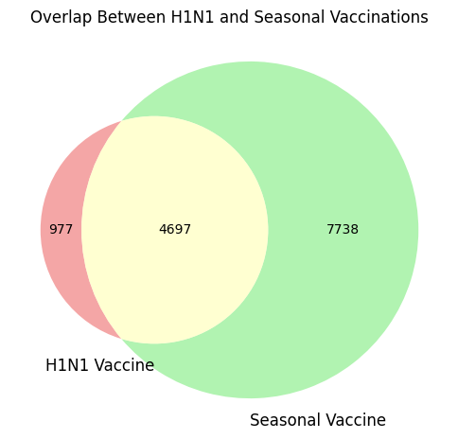
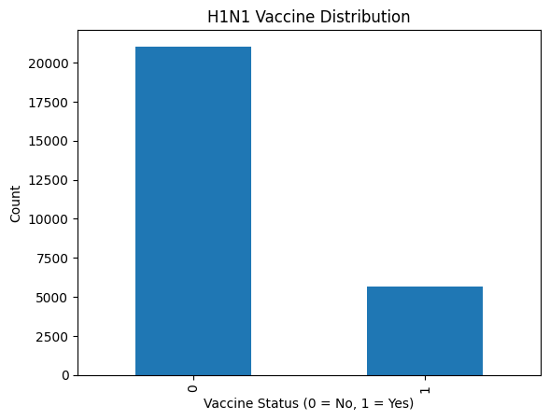
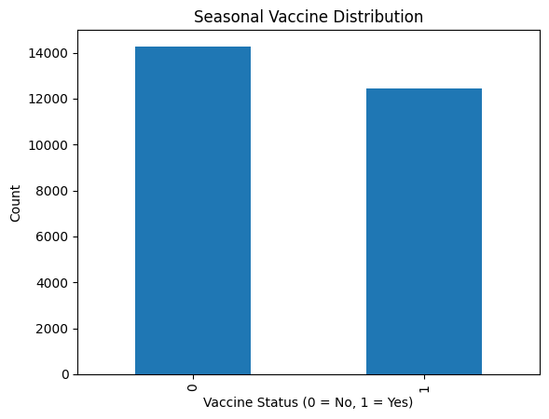
Main Findings
Target variable Distribution

Slide 7
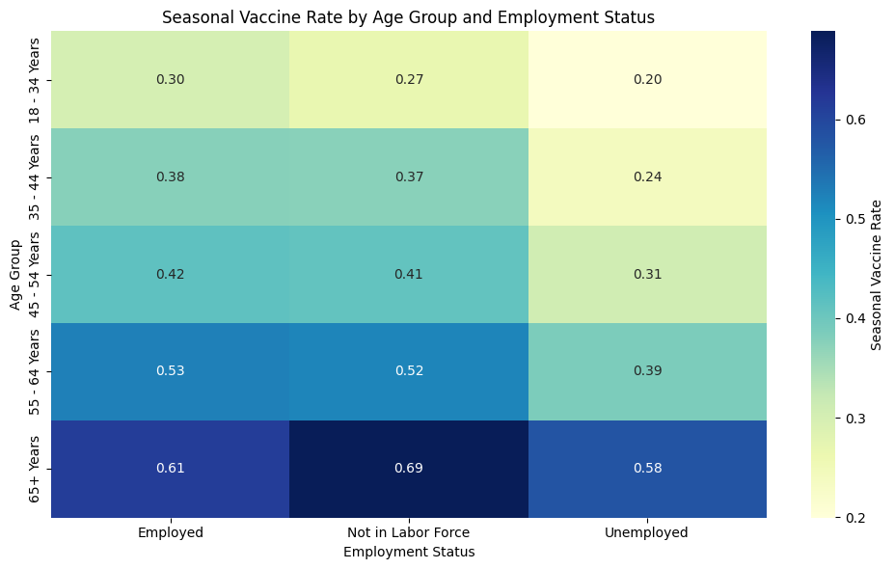
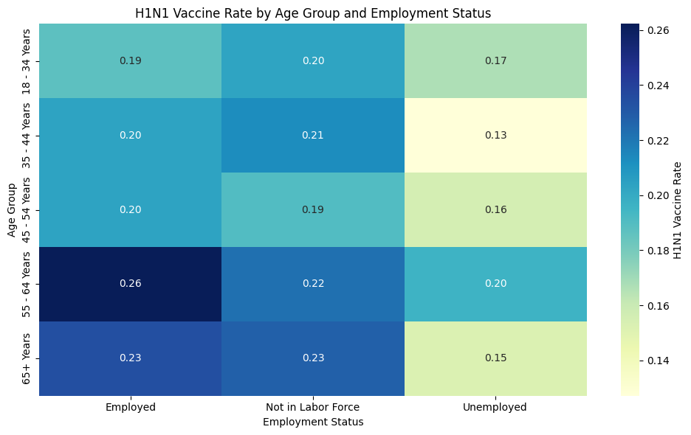
Main Findings
Demographic Influence

Slide 8
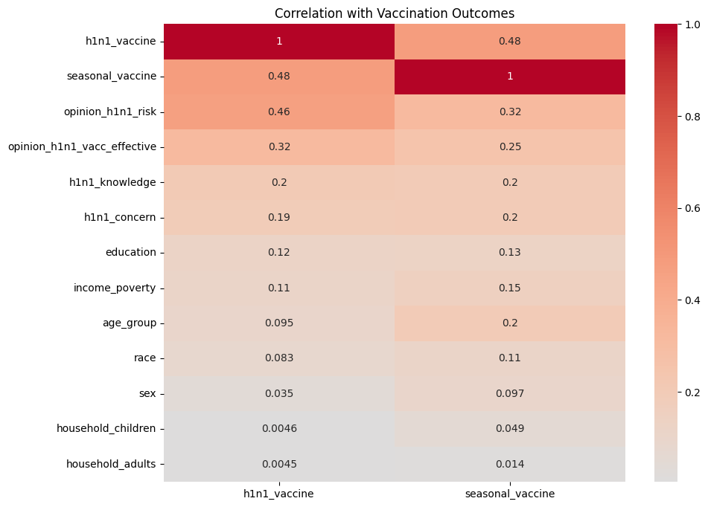
Main Findings
Feature Correlation

Slide 9
Challenges
Difficulties setting up and syncing GitHub
Choosing the correct encoding strategies (label encoder, ordinal encoder )
Plotting encoded features

Slide 10
Conclusion
We have a good understanding of the data and the correlation of the features.
The Data is now clean with no missing values.
The Data is now encoded and ready for training.
Thank you
Notes:
For future research, we plan to use machine learning models to classify pro-Trump and pro-Biden statements more accurately. This could provide even deeper insights into polarization and voter sentiment. Thank you

