Slide 1
Introduction
CENG 201, Data Structures

Slide 2
Welcome to Data Structures!
Introduction and Contact Info
Syllabus
  Goals of the course
  Outline
  Course plan
Start off Chapter 1

Slide 3
My Information
Dr. Aişe Zülal Şevkli
Office Hours:
  Mon 14-15
  Tue 15-16
Office: EA 302
Phone: (212) 866 33 00/ 5512
E-mail: zsevkli@fatih.edu.tr

Slide 4
Course Assistant
Nurbek Temishov
Office:
Phone: (212) 866 33 00/
E-mail:
Office Hours:

Slide 5
Objectives
Provide background in data structures (arrangements of data in memory) and algorithms (methods for manipulating this data)
Why is this important? The answer is there is far more to programming than finding a solution that will work:
  Execution time
  Memory consumption
So by the end of the course, you should be more equipped to not just develop an accurate solution to a problem, but the best solution possible.

Slide 6
Prerequesite
CENG 102
Thus I assume:
  Background in Java
For concepts in the course, I will use the following:
  Pseudocode
  Java

Slide 7
Textbook
Main 1 : M. T. Goodrich and R. Tamassia, Data Structures and Algorithms in Java, 5th edition.
Main 2:Introduction to Java Programming, Tenth Edition, Y. Daniel Liang (chp 20-29)
Supplementary: Robert LaFore. Data Structures and Algorithms in Java: Second Edition. Indianapolis: SAMS Publishing, 2003.
We will cover roughly one chapter per week
Lectures will follow very closely
We will often view examples from this text
Homeworks will sometimes come from this text
Recommend to reading

Slide 8
Lecture
Time: Mon 10:00-11:00, Tue 10:00-12:00
Room: B-203 , B-128
Slides
Prefer interactivity in the lecture

Slide 9
Exams
Midterm Exam - 30%
Final Exam – 50 %
Homework (~5) – 20%
Quiz (~3) – 20%

Slide 10
Topics
1. Abstract Classes and Interface
2. Generics
3. Lists
Lists Implementation using Array
Lists Implementation using Links Data
4. Efficiency of Algorithm
5. Stack
6. Queue , Deque
7. Priority Queue
8. Recursion
9. Trees
10. Maping and Hashing
11. Graph

Slide 11
Each Data Structure
Note that there are a total of eight data structures we’ll cover:
  List, stacks, queues, trees, hash tables, heaps, and graphs
For each of them:
  Motivation
  Operations
  Efficiency
  Java Class Library
  Java Implementation

Slide 12
Grade Breakdown
if avg_grade < 40 letter_grade=FF
NA Not Attended is given to students who do not meet the attendance requirements or fail in completing the necessary requirements in the practical sessions of a course.
  if (attendance requirements < 70% ) OR
  ( avg_homework < 40)
  Letter_Grade =NA

Slide 13
Contingencies
I will continue to upload slides and different sources on moodle
We will continue to follow the syllabus
I will continue to follow the textbooks
Homeworks will continue to be assigned and submissible over moodle system
  As a group of two students (at most)
  You can invited to make demo of your hw by Assistant
Do not hesitate to ask questions
  Assistant
  Instructor

Slide 14
The Honor Code
Which you’ve seen before:
  “On my honor, as an Fatih University student, I pledge not to lie, cheat, or steal, nor to tolerate these behaviors in others.”
Academic dishonesty can count as cheating/plagiarism
  Report will be submitted to registrar
  First offense: Could fail the course
  Second offense: Could be dismissed from the college
Bottom line: You are adults. That means:
  Make your own choices on reading and attendance, but..
  Stay on top of deadlines and be honest.

Slide 15
We Ready? Let’s Start.
In the course description, I mentioned that this class will cover both data structures and algorithms.
Let’s go a little deeper into exactly what we mean…
And show some examples of each.

Slide 16
Definition of a Data Structure
A data structure is an arrangement of data in a computer’s memory (or disk).
Questions to ponder:
  What are some examples of data structures you already know about from your Java course?
  How can the arrangement of data in memory affect performance?

Slide 17
Definition of an Algorithm
An algorithm provides a set of instructions for manipulating data in structures.
Questions to ponder:
  What’s an example of an algorithm?
  How can the design of an algorithm affect performance? How can it affect memory?
Notes:
such as searching for a particular data item and sorting the data

Slide 18
Data Structure or Algorithm?
Linked List
Sort
Search
Stack
Vector

Slide 19
Sort of Problems
What sorts of problems can you solve with a knowledge of these topics?
We might divide the situations into three categories:
  Real-world data storage
  Programmer’s tools
  Modeling

Slide 20
Real World Data Storage
Real-world data: data that describes physical entities external to the computer. Can we think of some examples?
What’s an example of non-computer data storage?
  Addresses and phone #s:
  Book names, titles, ISBNs:
What method do these use?
Notes:
As some examples, a personnel record
describes an actual human being, an inventory record describes an existing car part
or grocery item, and a financial transaction record describes, say, an actual check
written to pay the electric bill.

Slide 21
Real World Data Storage
Say we wanted to convert one of these systems to a computer program, what must we consider?
  Memory consumption:
  Scalability:
  Algorithms (which ones do we care about?):

Slide 22
Important: Data Structures can be HUGE!!!
What are some example scenarios where we need large data structures?
Now the issue of scalability comes into play. Suppose I design a reusable component for (i.e.) sorting an array of records by last name. I’m going to distribute this on the internet. I have to prepare for many more situations now:

Slide 23
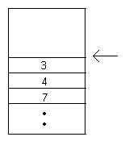
Programmer Tools
Do not store real-world data, but perform some function internal to the machine.
Example - A ‘stack’ of data, where I can only insert or remove elements from the top:
What programmer tool would this be useful for? Hint: Think in terms of a variables in a program.
Notes:
ypically, real-world
data is accessed more or less directly by a program’s user. Some data storage struc-
tures, however, are not meant to be accessed by the user, but by the program itself.
Stacks, queues, and priority queues are often used in this way.

Slide 24
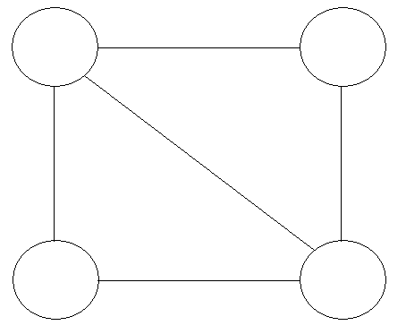
Real World Modeling
Effectively, ‘simulate’ a real-world situation.
For example, what could the following represent:

Slide 25
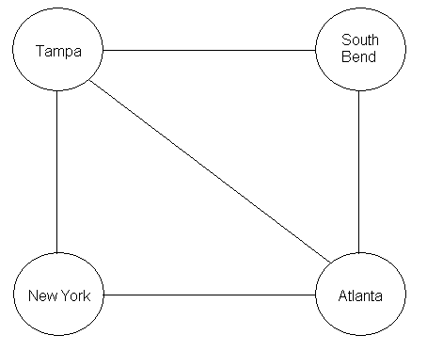
Real World Modeling
How about airline routes?
This type of structure is called an ‘undirected graph’
We’ll cover it!!

Slide 26
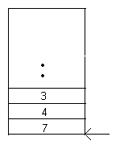
Real World Modeling
How about a ‘queue’ of data, where the first element in is the first element out (termed ‘FIFO’):
Example applications:
  Grocery store lines
  Traffic (Queues are actually used when determining timing of traffic lights!! How? Let’s think about it)

Slide 27
Data Structure Trade-offs
A structure we have dealt with before: arrays
Requirement that is enforced:
  Arrays store data sequentially in memory.
Let’s name the advantages (i.e., when is an array efficient?)
Let’s name the disadvantages
Notes:
Ad : Quick insertion, very fast access if index known.
Dis : Slow search, slow deletion, fixed size.

Slide 28
Overall Costs for Structures We’ll Study
Structure | Access | Search | Insert | Delete | Impl. | Memory
Array | Low | High | Med | High | Low | Low
Ord. Array | Low | Med | High | High | Med | Low
Linked List | High | High | Low | Low | Med | Med
Stack | Med | High | Med | Med | Med | Med
Queue | Med | High | Med | Med | Med | Med
Bin. Tree | Med | Low | Low | Low | High | High
R-B Tree | Med | Low | Low | Low | Very High | High
234 Tree | Med | Low | Low | Low | Very High | High
Hash Table | Med | Med | Low | High | Low | High
Heap | Med | Med | Low | Low | High | High
Graph | High | High | Med | Med | Med | Med
Point that you should be getting: No ‘universal’ data structure!!!

Slide 29
Algorithms We’ll Study
Insertion/Searching/Deletion
Iteration. Java contains data types called iterators which accomplish this.
Sorting. Believe it or not, there LOTS of ways to do this! So much, you get two chapters on it. :p (CENG 305)
Recursion.
  What’s the key attribute of a recursive function in Java?
  This technique will be used to develop some of the afore mentioned algorithms.

Slide 30
Java.util Package
Includes Vector, Stack, Dictionary, and Hashtable. We won’t cover these particular implementations but know they are there and accessible through:
  import java.util.*;
  You may not use these on homeworks unless I explicitly say you can.
Several other third-party libraries available
A central purpose of Java

Slide 31
Review of Object-Oriented Programming
Procedural Programming Languages
  Examples: C, Pascal, early BASIC
  What is the main unit of abstraction?
Object-Oriented Languages:
  Examples: C++, Ada, Java
  What is the main unit of abstraction?
Obviously procedural languages weren’t good enough in all cases. Let’s rediscover why.
Notes:
procedural languages were found to be inadequate for large and complex programs.

Slide 32
Main Limitations of Procedural Programming
1. Poor Real World Modeling. Let’s discuss why.
2. Crude Organization. Let’s discuss why.
Notes:
If you wrote a thermostat control program in a procedural language
two methods, furnace_on() and furnace_off(),
but also two global variables, currentTemp (supplied by a thermometer) and desiredTemp (set by the user).
these methods and variables wouldn’t form any sort of programming unit;
---
Procedural programs were organized by dividing the code into methods.
There weren’t many options when it came to data.
data could be local to a particular method, or it could be
global—accessible to all methods.

Slide 33
Idea of Objects
A programming unit which has associated:
  Variables (data), and
  Methods (functions to manipulate this data).
How does this address the two problems on the previous slide?
  Real World Modeling
  Organization

Slide 34
Idea of Classes (Java, C++)
Objects by themselves can create lots of redundancy. Why?
With a class, we specify a blueprint for one or more objects. For example, in Java
class thermostat {
private float currentTemp;
private float desiredTemp;
public void furnaceOn() {
…
}
}

Slide 35
Instances of a Class
Java creates objects using the new keyword, and stores a reference to this instance in a variable:
thermostat therm1;
therm1 = new thermostat();
thermostat therm2 = new thermostat();
Object creation (or instantiation) is done through the constructor.
Which constructor did we use here?

Slide 36
Invoking Methods of an Object
Parts of the program external to the class can access its methods (unless they are not declared public):
Dot operator:
  therm2.furnace_on();
Can I access data members similarly?
  therm2.currentTemp = 77;
What would I need to change to do so?
  Is this change good programming practice?
  How, ideally, should data members be accessed?

Slide 37
Another Example
If you have your book, look at the BankAccount class on page 18. If you don’t have it, don’t worry I’ll write it on the board.
Look at the output. Let’s go over why this is generated.

Slide 38
Inheritance
Creation of one class, called the base class
Creation of another class, called the derived class
  Has all features of the base, plus some additional features.
Example:

Slide 39
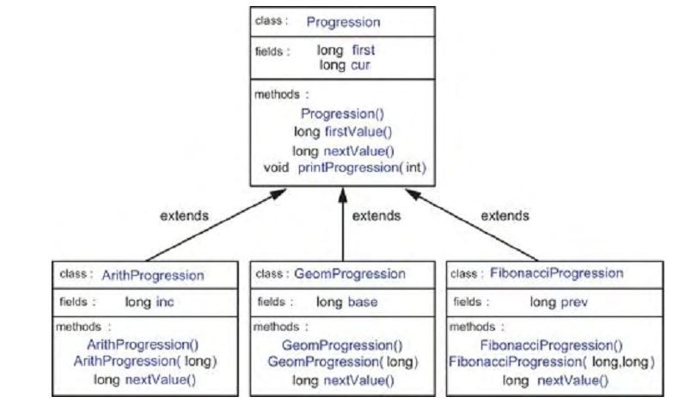

Slide 40
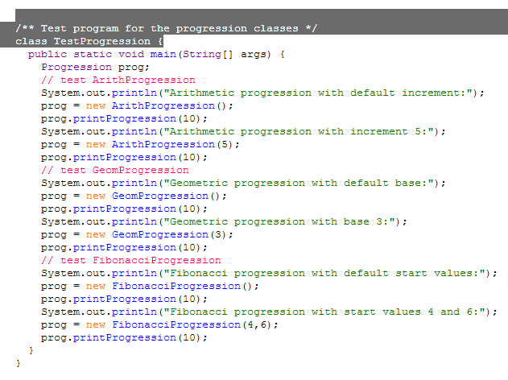
Polymorphism
Idea: Treat objects of different classes in the same way.

Slide 41
Software Engineering
Bigger picture. How do the topics of this course fit relate to software engineering?
The life cycle of a software project consists of the following:
  Specification – purpose of the software, requirements , etc.
  Design – components and interaction of the software
  Verification – individual components and global functionality
  Coding – actual writing of the software
  Testing – validating proper functionality
  Production – distribution to the community
  Maintenance – updating the software (FYI in a poor design, these costs can be high!!)

Slide 42
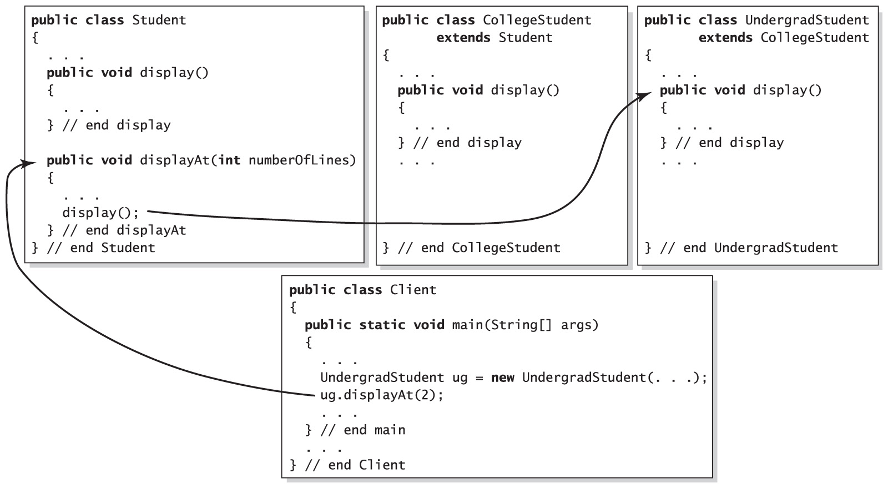

Slide 43
Dynamic Binding
The process that enables different objects to …
  Use different method actions
  For the same method name
Objects know how they are supposed to act
  When an overridden method is used …
  The action is for the method defined in the class whose constructor created the object
Carrano, Data Structures and Abstractions with Java, Second Edition, (c) 2007 Pearson Education, Inc. All rights reserved. 0-13-237045-X

Slide 44
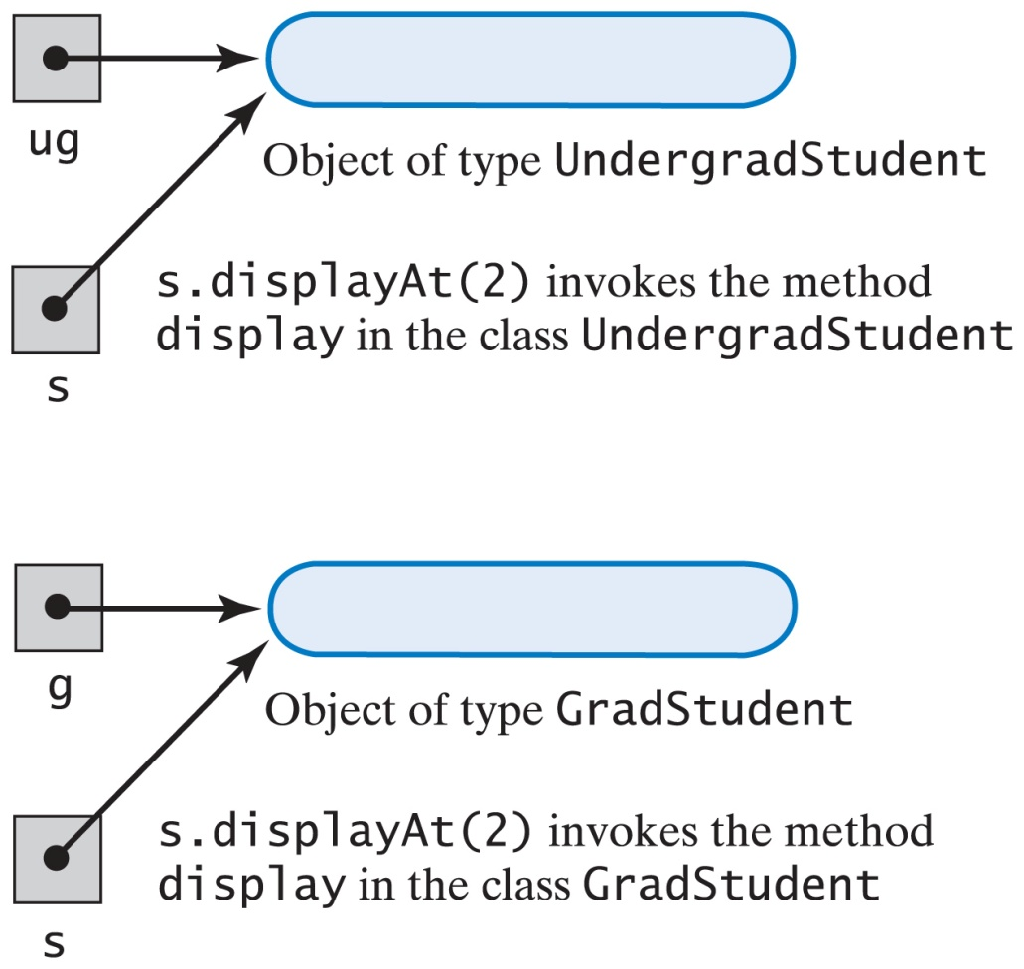
Dynamic Binding
Fig. 2-8 An object, not its name, determines its behavior.

Slide 45
Final Review of some Java Concepts
Difference between a value and a reference:
int intVar;
BankAccount bc1;
Which is a value and which is a reference?
How did the interpreter know to allocate them differently?
What does the address stored in bc1 contain right now?
What must I do before I use bc1?

Slide 46
Java Assignments
What must be noted about the following code snippet:
int intVar1 = 45;
int intVar2 = 90;
BankAccount bc1(72.45);
BankAccount bc2 = bc1;
intVar1 = intVar2;
intVar1 = 33; // Does this modify intVar2?
bc2.withdraw(30.00); // Does this modify object bc1?

Slide 47
Java Garbage Collection
When is the memory allocated to an object reclaimed in Java?
Code like this would leak memory in C++, but does not in Java because of the garbage collector:
while (true) {
Integer tmp = new Integer();
…
}

Slide 48
Passing by Value vs. Reference
Same idea:
void method1() {
BankAccount ba1 = new BankAccount(350.00);
float num = 4;
}
void method2(BankAccount acct) { … }
void method3(float f) { … }
If I change f in method3, does that affect num?
If I change acct in method2, does that affect object ba1?

Slide 49
== vs. equals()
carPart cp1 = new carPart(“fender”);
carPart cp2 = cp1;
// What’s the difference between this:
if (cp1 == cp2)
System.out.println(“Same”);
// And this:
if (cp1. equals(cp2)
System.out.println(“Same”);
Does “Same” print twice, once, or not at all?

Slide 50
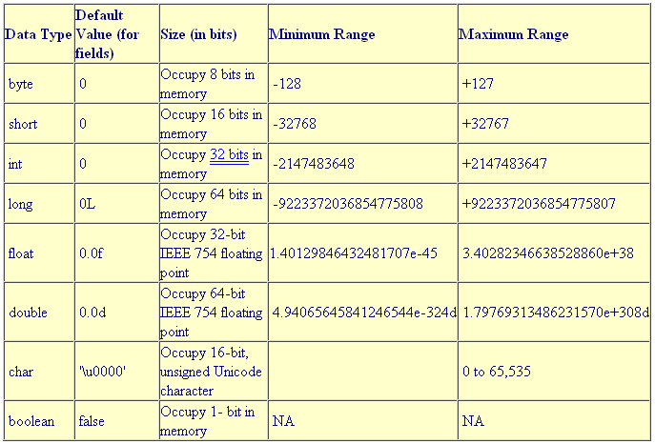
Primitive Sizes and Value Ranges
Source: roseindia.net

Slide 51
Screen Output
System.out is an output stream which corresponds to standard output, which is the screen:
int var = 33;
// What’s do these three statements print?
System.out.print(var);
System.out.println(var);
System.out.println(``The answer is `` + var);

Slide 52
Keyboard Input
Package: java.io
Read a string:
Read a character:
Read an integer:
Read a float:
InputStreamReader isr = new InputStreamReader(System.in);
BufferedReader br = new BufferedReader(isr);
String s = br.readLine();
char c = s.charAt(0);
int i = Integer.parseInt(s);
double d = Double.valueOf(s).doubleValue();

Slide 53
Questions
1. In many data structures you can ________ a single record, _________ it, and _______ it.
2. Rearranging the contents of a data structure into a certain order is called _________
3. In object-oriented programming, an object
a. is a class.
b. may contain data and methods.
c. is a program.
d. may contain classes.

Slide 54
Questions
4. A class
a. is a blueprint for many objects.
b. represents a specific real-world object.
c. will hold specific values in its fields.
d. specifies the type of a method.
5. In Java, a class specification
a. creates objects.
b. requires the keyword new.
c. creates references.
d. none of the above

Slide 55
Questions
6. When an object wants to do something, it uses a ________ .
7. In Java, accessing an object’s methods requires the _____ operator.
8. In Java, boolean and byte are _____________ .

