Slide 1
Chapter 21 Generics

Slide 2
Objectives
To know the benefits of generics (§21.1).
To use generic classes and interfaces (§21.2).
To declare generic classes and interfaces (§21.3).
To understand why generic types can improve reliability and readability (§21.3).
To declare and use generic methods and bounded generic types (§21.4).
To use raw types for backward compatibility (§21.5).
To know wildcard types and understand why they are necessary (§21.6).
To convert legacy code using JDK 1.5 generics (§21.7).
To understand that generic type information is erased by the compiler and all instances of a generic class share the same runtime class file (§21.8).
To know certain restrictions on generic types caused by type erasure (§21.8).
To design and implement generic matrix classes (§21.9).

Slide 3
Why Do You Get a Warning?
public class ShowUncheckedWarning {
public static void main(String[] args) {
java.util.ArrayList list =
new java.util.ArrayList();
list.add("Java Programming");
}
}
To understand the compile warning on this line, you need to learn JDK 1.6 generics.

Slide 4
Fix the Warning
public class ShowUncheckedWarning {
public static void main(String[] args) {
java.util.ArrayList<String> list =
new java.util.ArrayList<String>();
list.add("Java Programming");
}
}
`
No compile warning on this line.

Slide 5
Motivation
It would be nice if we could write a single sort method that could sort the elements in
  an Integer array,
  a String array or
  an array of any type that supports ordering.

Slide 6
What is Generics?
Java Generic methods and generic classes enable programmers to specify, with
  a single method declaration,
  a set of related methods or,
  with a single class declaration,
  a set of related types, respectively.
Generics also provide compile-time type safety that allows programmers to catch invalid types at compile time.

Slide 7
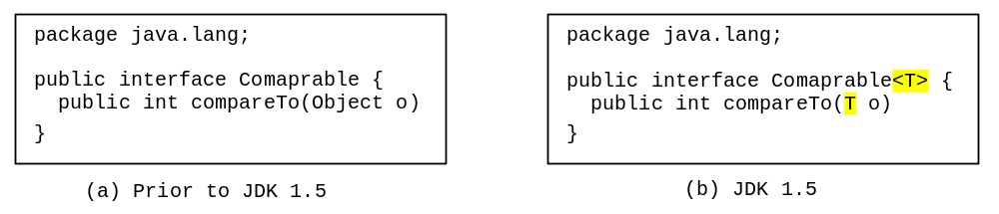
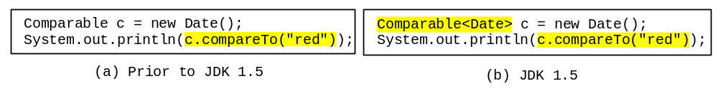
Generic Type
Generic Instantiation
Runtime error
Improves reliability
Compile error

Slide 8
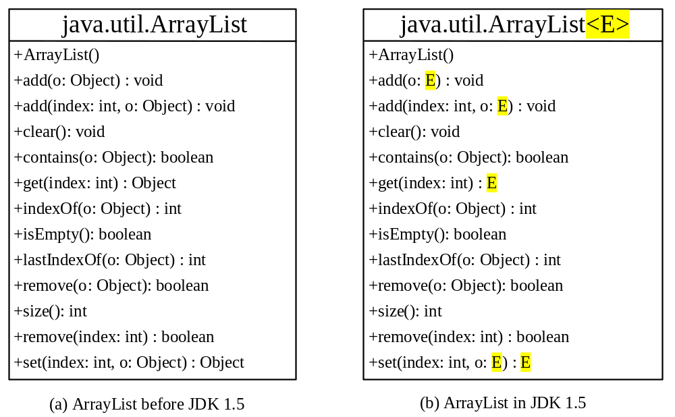
Generic ArrayList in JDK 1.5

Slide 9
No Casting Needed
ArrayList<Double> list = new ArrayList<Double>();
list.add(5.5); // 5.5 is automatically converted to new Double(5.5)
list.add(3.0); // 3.0 is automatically converted to new Double(3.0)
Double doubleObject = list.get(0); // No casting is needed
double d = list.get(1); // Automatically converted to double

Slide 10
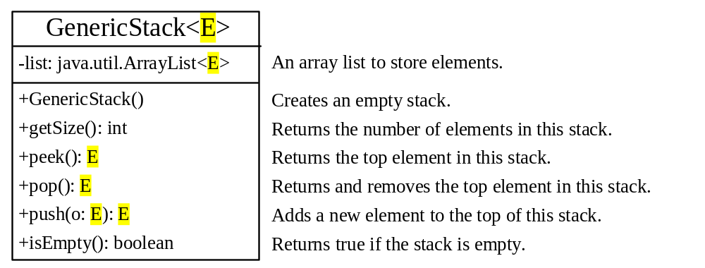
Declaring Generic Classes and Interfaces
GenericStack

Slide 11
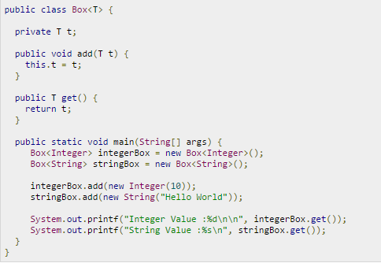


Slide 12
Generic Methods
public static <E> void print(E[] list) {
for (int i = 0; i < list.length; i++)
System.out.print(list[i] + " ");
System.out.println();
}
public static void print(Object[] list) {
for (int i = 0; i < list.length; i++)
System.out.print(list[i] + " ");
System.out.println();
}

Slide 13
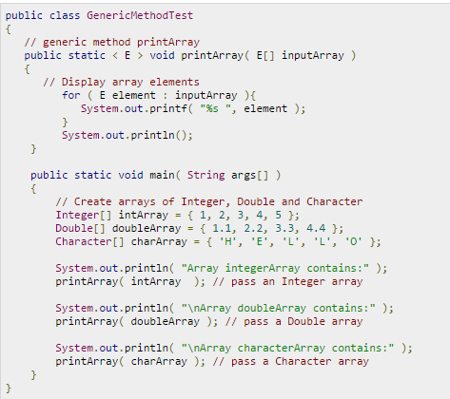

Slide 14
Bounded Generic Type
public static void main(String[] args ) {
Rectangle rectangle = new Rectangle(2, 2);
Circle9 circle = new Circle9(2);
System.out.println("Same area? " + equalArea(rectangle, circle));
}
public static <E extends GeometricObject> boolean
equalArea(E object1, E object2) {
return object1.getArea() == object2.getArea();
}

Slide 15
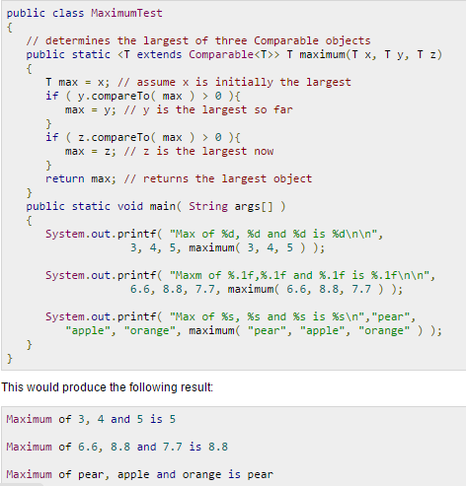

Slide 16
Raw Type and Backward Compatibility
// raw type
ArrayList list = new ArrayList();
This is roughly equivalent to
ArrayList<Object> list = new ArrayList<Object>();

Slide 17
Raw Type is Unsafe
// Max.java: Find a maximum object
public class Max {
/** Return the maximum between two objects */
public static Comparable max(Comparable o1, Comparable o2) {
if (o1.compareTo(o2) > 0)
return o1;
else
return o2;
}
}
Runtime Error:
Max.max("Welcome", 23);

Slide 18
Make it Safe
// Max1.java: Find a maximum object
public class Max1 {
/** Return the maximum between two objects */
public static <E extends Comparable<E>> E max(E o1, E o2) {
if (o1.compareTo(o2) > 0)
return o1;
else
return o2;
}
}
Max.max("Welcome", 23);

Slide 19
Wildcards
Why wildcards are necessary? See this example.
WildCardNeedDemo
? unbounded wildcard
? extends T bounded wildcard
? super T lower bound wildcard
AnyWildCardDemo
SuperWildCardDemo

Slide 20
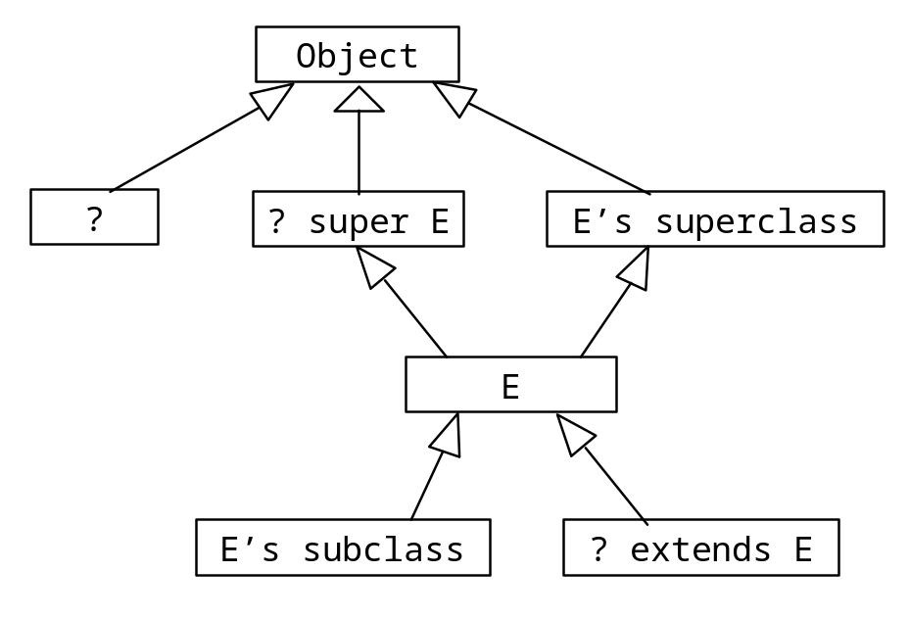
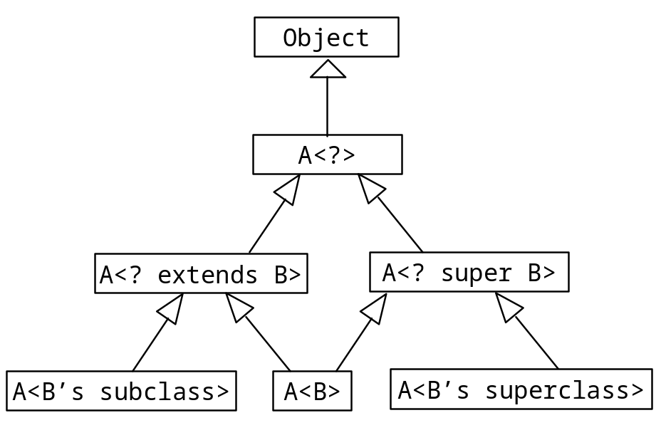
Generic Types and Wildcard Types

Slide 21
Avoiding Unsafe Raw Types
Use
new ArrayList<ConcreteType>()
Instead of
new ArrayList();
TestArrayListNew
Run

Slide 22
Erasure and Restrictions on Generics
Generics are implemented using an approach called type erasure. The compiler uses the generic type information to compile the code, but erases it afterwards. So the generic information is not available at run time. This approach enables the generic code to be backward-compatible with the legacy code that uses raw types.

Slide 23
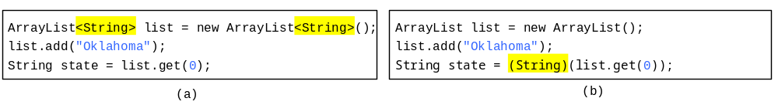
Compile Time Checking
For example, the compiler checks whether generics is used correctly for the following code in (a) and translates it into the equivalent code in (b) for runtime use. The code in (b) uses the raw type.

Slide 24
Important Facts
It is important to note that a generic class is shared by all its instances regardless of its actual generic type.
  GenericStack<String> stack1 = new GenericStack<String>();
  GenericStack<Integer> stack2 = new GenericStack<Integer>();
Although GenericStack<String> and GenericStack<Integer> are two types, but there is only one class GenericStack loaded into the JVM.

Slide 25
Restrictions on Generics
Restriction 1: Cannot Create an Instance of a Generic Type. (i.e., new E()).
Restriction 2: Generic Array Creation is Not Allowed. (i.e., new E[100]).
Restriction 3: A Generic Type Parameter of a Class Is Not Allowed in a Static Context.
Restriction 4: Exception Classes Cannot be Generic.

Slide 26
Designing Generic Matrix Classes
Objective: This example gives a generic class for matrix arithmetic. This class implements matrix addition and multiplication common for all types of matrices.
GenericMatrix

Slide 27
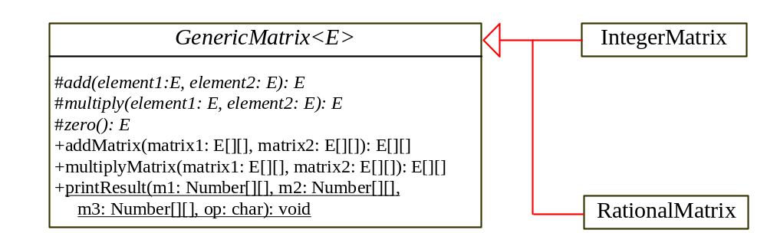
UML Diagram

Slide 28
Source Code
Objective: This example gives two programs that utilize the GenericMatrix class for integer matrix arithmetic and rational matrix arithmetic.
IntegerMatrix
Run
TestIntegerMatrix
RationalMatrix
TestRationalMatrix
Run

