Slide 1
Stacks and Queues
CENG 201, Data Structures

Slide 2
New Structures
Stack
Queue
Priority Queue
What’s “new”?
  Contrast with arrays
  Usage
  Access
  Abstraction

Slide 3
Usage
Arrays are conducive for databases
  Data which will be accessed and modified
  Easy operations for insertion, deletion and searching
    Although some of these are time consuming
Stacks and queues are good for programming tools
  Data will not be touched by the user
  Used and then discarded

Slide 4
Access
Arrays allow immediate access to any element
  Takes constant time
  Very fast
Stacks and queues only allow access to one element at a time
  Much more restricted

Slide 5
Abstraction
A bit higher than arrays. Why?
  When a user indexes an array, they specify a memory address
    Indirectly, because they say:
    Array name -> address of the first element
    Index -> offset from that address * size of array elements
  With stacks and queues, everything is done through methods
    User has no idea what goes on behind the scenes
    Also no initial size needed
  BIGGEST THING
    Stacks, queues and priority queues can use arrays as their underlying structure
    Or linked lists…
    From the user’s perspective, they are one and the same

Slide 6
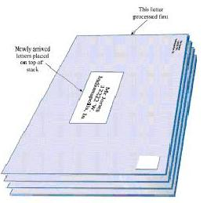
Stack
A stack only allows access to the last item inserted
To get the second-to-last, remove the last
Analogy: US Postal Service
If we receive a stack of mail, we typically open the top one first, pay the bill or whatever, then get rid of it and open the second

Slide 7
Performance Implication
Note what we can already infer about stack performance!
It is critical that we are able to process mail efficiently
Otherwise what happens to the letters on the bottom?
In other words, what happens to the bills on the bottom if we never get to them? ☺
A stack is what is known as a Last-In, First-Out (LIFO) structure
  We can only insert to the top (push)
  We can only access the element on top (peek)
  We can only delete from the top (pop)

Slide 8
Applications
Compilers
  Balancing parentheses, braces, brackets
  Symbol tables
Parsing arithmetic expressions
Traversing nodes of trees and graphs
Invoking methods
Pocket calculators

Slide 9
The ‘push’ operation
Pushing involves placing an element on the top of the stack
Analogy: Workday
  You’re given a long-term project A (push)
  A coworker interrupted for temporary help with project B (push)
  Someone in accounting stops by for a meeting on project C (push)
  Emergency call for help on project D (push)
At any time, you’re working on the project most recently pushed

Slide 10
The ‘pop’ operation
Popping involves removing the top element from the stack
Analogy: Workday
  Finish the emergency call with project D (pop)
  Finish the meeting on project C (pop)
  Finish the help on project B (pop)
  Complete the long-term project A (pop)
When everything is popped off the stack, it is considered an empty stack
Stacks are always initially empty

Slide 11
The ‘peek’ operation
Peek allows you to view the element on top of the stack without removing it.
Side note: Stack sizes often do not need to be too large
This is because in the applications where stacks will be used, in most cases you can just discard data after you use it

Slide 12
Stack Class
Java implementation, page 120
Let’s go through it
Note, we have to pick our internal data structure
  For now we’ll stick with what we know: The Array
And analyze the main()

Slide 13
Stack class methods
Constructor:
  Accepts a size, creates a new stack
  Internally allocates an array of that many slots
push()
  Increments top and stores a data item there
pop()
  Returns the value at the top and decrements top
  Note the value stays in the array! It’s just inaccessible (why?)
peek()
  Return the value on top without changing the stack
isFull(), isEmpty()
  Return true or false

Slide 14
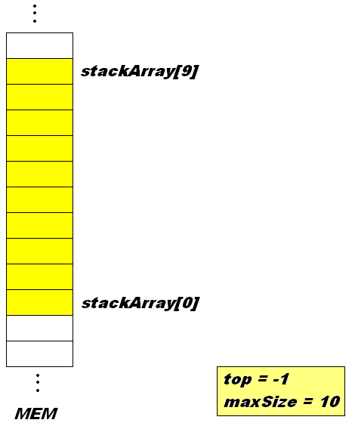
Pictorally, let’s view the execution of main()
StackX theStack =
new StackX(10);

Slide 15
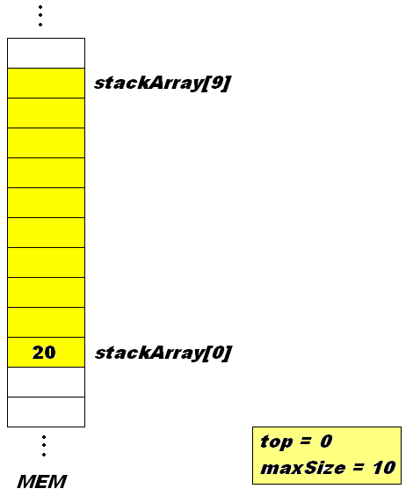
Push
theStack.push(20);
top gets bumped up
20 gets stored in the
slot with index top

Slide 16
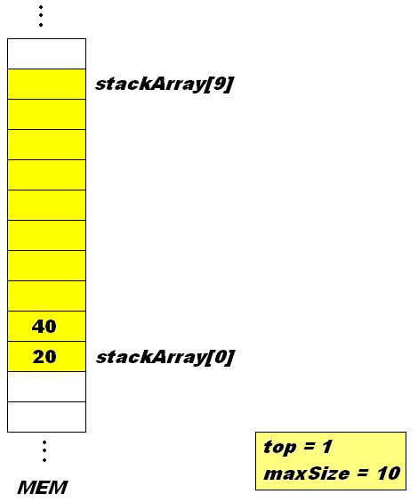
theStack.push(40);
top gets bumped up
40 gets stored in the
slot with index top

Slide 17
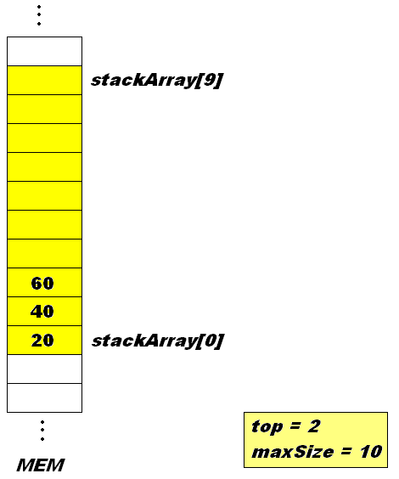
theStack.push(60);
top gets bumped up
60 gets stored in the
slot with index top

Slide 18

theStack.push(80);
top gets bumped up
80 gets stored in the
slot with index top

Slide 19
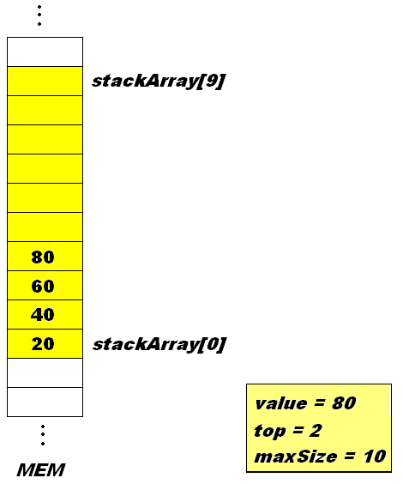
Pop
while (!theStack.isEmpty())
{
long value = theStack.pop()
…
The element indexed by top
is stored in value
top is decremented by 1

Slide 20
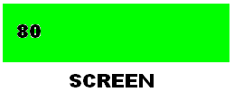
Print
while (!theStack.isEmpty())
{
…
System.out.print(value)
System.out.print(“”)

Slide 21

Pop
while (!theStack.isEmpty())
{
long value = theStack.pop()
…
The element indexed by top
is stored in value
top is decremented by 1

Slide 22
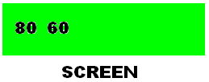
Print
while (!theStack.isEmpty())
{
…
System.out.print(value)
System.out.print(“”)

Slide 23

Pop
while (!theStack.isEmpty())
{
long value = theStack.pop()
…
The element indexed by top
is stored in value
top is decremented by 1

Slide 24
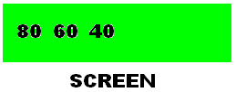
Print
while (!theStack.isEmpty())
{
…
System.out.print(value)
System.out.print(“”)

Slide 25

Pop
while (!theStack.isEmpty())
{
long value = theStack.pop()
…
The element indexed by top
is stored in value
top is decremented by 1

Slide 26
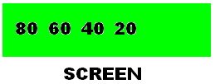
Print
while (!theStack.isEmpty())
{
…
System.out.print(value)
System.out.print(“”)

Slide 27
Error Handling
When would it be responsible to perform error handling in the case of the stack?
What function would we add it?
And how would we do it?

Slide 28
Example Application: Word Reversal
Let’s use a stack to take a string and reverse its characters
  How could this work? Let’s look.
Reminder of the available operations with Strings:
If I have a string s
  s.charAt(j) <- Return character with index j
  s + “…” <- Append a string (or character to s)
  What would we need to change about our existing stack class?
Reverser, page 125

Slide 29
Example Application: Delimiter Matching
This is done in compilers!
Parse text strings in a computer language
Sample delimiters in Java:
  {, }
  [, ]
  (, )
All opening delimiters should be matched by closing ones
Also, later opening delimiters should be closer before earlier ones
  See how the stack can help us here?

Slide 30
Example Strings
c[d]
a{b[c]d}e
a{b(c]d}e
a[b{c}d]e}
a{b(c)
Which of these are correct?
Which of these are incorrect?

Slide 31
Algorithm
Read each character one at a time
If an opening delimiter, place on the stack
If a closing delimiter, pop the stack
  If the stack is empty, error
  Otherwise if the opening delimiter matches, continue
  Otherwise, error
If the stack is not empty at the end, error

Slide 32
Example
Let’s look at a stack for a{b(c[d]e)f}
Character Stack Action
a x
{ { push ‘{‘
b { x
( {( push ‘(‘
c {( x
[ {([ push ‘[‘
d {([ x
] {( pop ‘[‘, match
e {( x
) { pop ‘(‘, match
f { x
} pop ‘{‘, match

Slide 33
Example
Let’s do one that errors: a[b{c}d]e}
Together on the board

Slide 34
Java Implementation
Let’s implement the checker together
  Page 129
We’ll write a function which accepts a string input
And returns true or false depending on if the string has all delimiters matching
We can use the Stack class where the internal array held characters

Slide 35
Stacks: Evaluation
For the tools we saw: reversing words and matching delimiters, what about stacks made things easier?
  i.e. What would have been difficult with arrays?
  Why does using a stack make your program easier to understand?
Efficiency
  Push -> O(1) (Insertion is fast, but only at the top)
  Pop -> O(1) (Deletion is fast, but only at the top)
  Peek -> O(1) (Access is fast, but only at the top)

Slide 36
Queues
British for “line”
Somewhat like a stack
  Except, first-in-first-out
  Thus this is a FIFO structure.

Slide 37

Analogy:
Line at the movie theatre
Last person to line up is the last person to buy

Slide 38
Applications
Graph searching
Simulating real-world situations
  People waiting in bank lines
  Airplanes waiting to take off
  Packets waiting to be transmitted over the internet
Hardware
  Printer queue
  Keyboard strokes
    Guarantees the correct processing order

Slide 39
Queue Operations
insert()
  Also referred to as put(), add(), or enque()
  Inserts an element at the back of the queue
remove()
  Also referred to as get(), delete(), or deque()
  Removes an element from the front of the queue
peekRear()
  Element at the back of the queue
peekFront()
  Element at the front of the queue

Slide 40
Question
In terms of memory now, what about the queue do we need to worry about?
  That we did not have to worry about with the stack
  Hint: Think in terms of the low-level representation

Slide 41
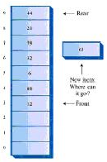
Insert and remove occur at opposite ends!!!
Whereas with a stack, they occurred at the same end
  That means that if we remove an element we can reuse its slot
With a queue, you cannot do that
Unless….

Slide 42
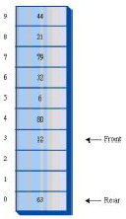
Circular Queue
Indices ‘wraparound’

Slide 43
Java Implementation
Page 137-138 in textbook, which again uses an internal array representation
We’ll construct that class
Then analyze the main function pictorally

Slide 44
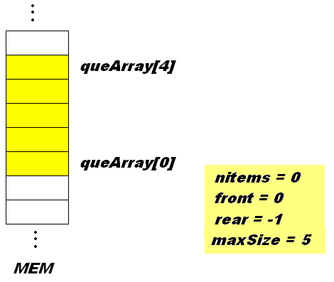
Queue theQueue = new Queue(5);

Slide 45
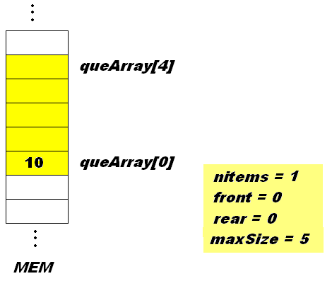
theQueue.insert(10);

Slide 46
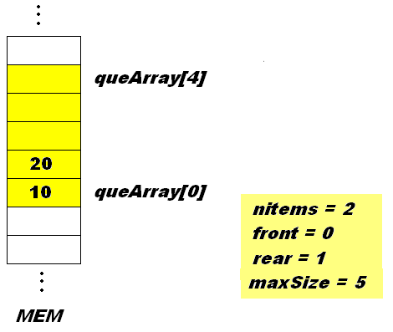
theQueue.insert(20);

Slide 47
theQueue.insert(30);

Slide 48
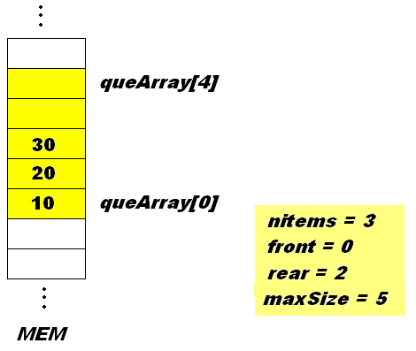
theQueue.insert(30);

Slide 49
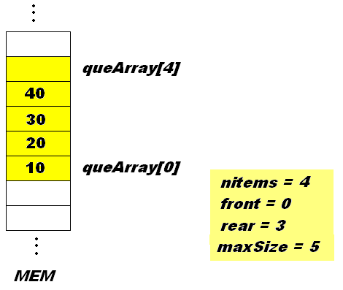
theQueue.insert(40);

Slide 50
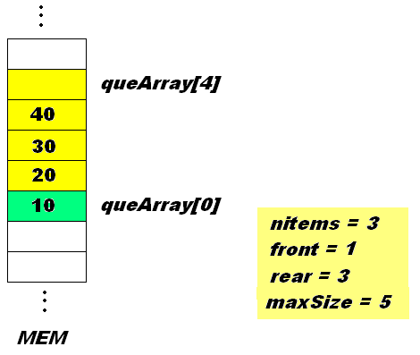
theQueue.remove();

Slide 51
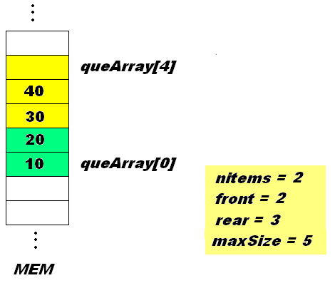
theQueue.remove();

Slide 52
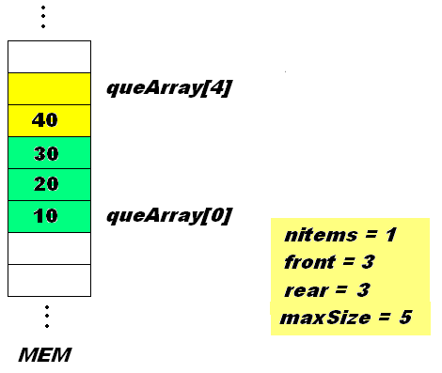
theQueue.remove();

Slide 53

theQueue.insert(50);

Slide 54
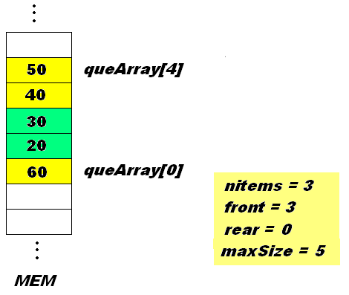
theQueue.insert(60);

Slide 55
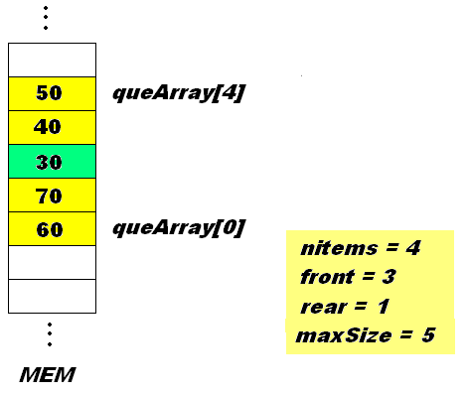
theQueue.insert(70);

Slide 56
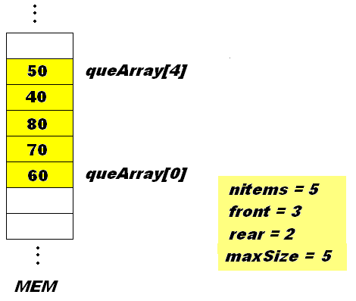
theQueue.insert(80);

Slide 57
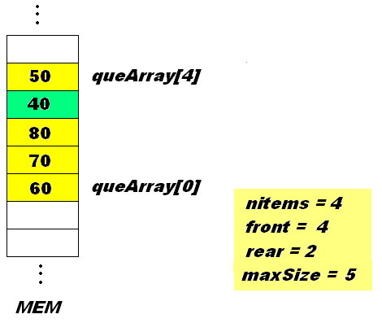
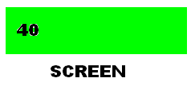
Remove and print…
while (!theQueue.isEmpty())
long n = theQueue.remove();
System.out.print(n);

Slide 58
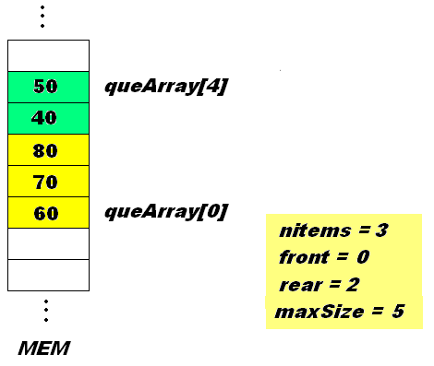
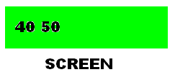
Remove and print…
while (!theQueue.isEmpty())
long n = theQueue.remove();
System.out.print(n);

Slide 59
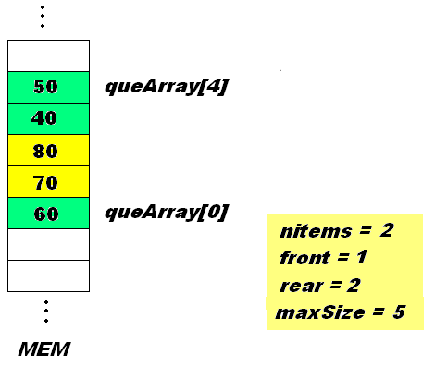
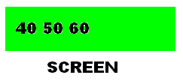
Remove and print…
while (!theQueue.isEmpty())
long n = theQueue.remove();
System.out.print(n);

Slide 60
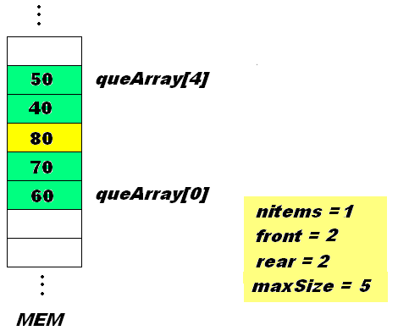
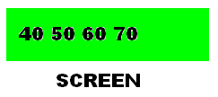
Remove and print…
while (!theQueue.isEmpty())
long n = theQueue.remove();
System.out.print(n);

Slide 61
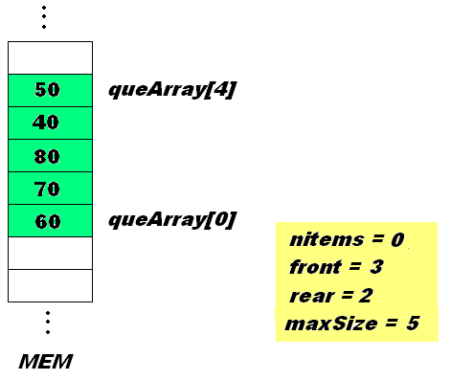
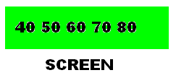
Remove and print…
while (!theQueue.isEmpty())
long n = theQueue.remove();
System.out.print(n);

Slide 62
Queues: Evaluation
Some implementations remove nItems
  Allow front and rear indices to determine if queue is full or empty, or size
    Queue can appear to be full and empty (why?)
    Additional overhead when determining size (why?)
    Can remedy these by making array one size larger than the max number of items
Efficiency
  Same as stack:
    Push: O(1) only at the back
    Pop: O(1) only at the front
    Access: O(1) only at the front

Slide 63
Priority Queues
Like a Queue
  Has a front and a rear
  Items are removed from the front
Difference
  No longer FIFO
  Items are ordered
We have seen ordered arrays. A priority queue is essentially an ‘ordered queue’
Mail analogy: you want to answer the most important first

Slide 64
Priority Queue Implementation
Almost NEVER use arrays. Why?
Usually employs a heap (we’ll learn these later)
Application in Computing
  Programs with higher priority, execute first
  Print jobs can be ordered by priority
Nice feature: The min (or max) item can be found in O(1) time

Slide 65
(Time Pending) Java Implementation
Page 147
Biggest difference will be the insert() function
Analysis
  delete() - O(1)
  insert() - O(n) (again, since arrays are used)
  findMin() - O(1) if arranged in ascending order
  findMax() – O(1) if arranged in descending order

Slide 66
Parsing Arithmetic Expressions
A task that must be performed by devices such as computers and calculators
Parsing is another word for analyzing, that is, piece by piece
For example, given the expression 2*(3+4)
We have to know to first evaluate 3+4
Then multiple the result by 2

Slide 67
How it’s done…
1. Transform the arithmetic expression into postfix notation
  Operators follow their two operands, i.e.
  3+4 = 34+ (in postfix)
  2*(3+4) = 234+* (in postfix)
  May seem silly, but it makes the expression easier to evaluate with a stack
2. Use a stack and evaluate

Slide 68
Some practice
Convert the following to postfix:
3*5
3+8*4 (remember the rules of precedence!)
(3+4)*(4+6)

Slide 69
Translating infix to postfix
Think conceptually first. How do we evaluate something like: 2*(3+4) to get 14?
  Read left to right
  When we’ve read far enough to evaluate two operands and an operator - in the above case, 3+4
    Evaluate them: 3+4=7
    Substitute the result: 2*7 = 14
  Repeat as necessary

Slide 70
Parsing in our Heads
2*(3+4)
We have to evaluate anything in parentheses before using it
Read Parsed
2 2
2* 2*
2*( 2*(
2*(3 2*(3
2*(3+ 2*(3+
2*(3+4) 2*(3+4)
2*7
14

Slide 71
Precedence
3+4*5
Note here we don’t evaluate the ‘+’ until we know what follows the 4 (a ‘*’)
So the ‘parsing’ proceeds like this:
  Read Parsed
  3 3
  + 3+
  4 3+4
  * 3+4*
  5 3+4*5
  3+20
  23

Slide 72
Summary
We go forward reading operands and operators
When we have enough information to apply an operator, go backward and recall the operands, then evaluate
Sometimes we have to defer evaluation based on precedence
Think about this when we do the conversion

Slide 73
Infix to Postfix: Algorithm
Start with your infix expression, and an empty postfix string
  Infix: 2*(3+4) Postfix:
Go through the infix expression character-by-character
For each operand:
  Copy it to the postfix string
For each operator:
  Copy it at the ‘right time’
  When is this? We’ll see

Slide 74
Example: 2*(3+4)
Read Postfix Comment
2 2 Operand
* 2 Operator
( 2 Operator
3 23 Operand
+ Operator
4 234 Operand
) 234+ Saw ), copy +
234+* Copy remaining ops

Slide 75
Example: 3+4*5
Read Postfix Comment
3 3 Operand
+ 3 Operator
4 34 Operand
* 34 Operator
5 345 Operand
345* Saw 5, copy *
345*+ Copy remaining ops

Slide 76
Rules on copying operators
You cannot copy an operator to the postfix string if:
  It is followed by a left parenthesis ‘(‘
  It is followed by an operator with higher precedence (i.e., a ‘+’ followed by a ‘*’)
If neither of these are true, you can copy an operator once you have copied both its operands
We can use a stack to hold the operators before they are copied. Here’s how:

Slide 77
How can we use a stack?
Suppose we have our infix expression, empty postfix string and empty stack S. We can have the following rules:
  If we get an operand, copy it to the postfix string
  If we get a ‘(‘, push it onto S
  If we get a ‘)’:
    Keep popping S and copying operators to the postfix string until either S is empty or the item popped is a ‘(‘
  Any other operator:
    If S is empty, push it onto S
    Otherwise, while S is not empty and the top of S is not a ‘(‘ or an operator of lower precedence, pop S and copy to the postfix string
    Push operator onto S
  To convince ourselves, let’s try some of the expressions

Slide 78
Example: 3+4*5
Read Postfix Stack

Slide 79
Evaluating postfix expressions
If we go through the trouble of converting to postfix, there’s got to be a reason, right?
Well, there is! The resulting expression is much easier to evaluate, once again using a stack
Take one example: 345*+
  For every operand push it onto a stack
  Everytime we encounter an operator, apply it to the top two items and pop them, then push the result on the stack
  We’re done when we have a result and the stack is empty
  Let’s do some examples!

Slide 80
Example: 234*+
Read Stack Comment
2 2 Operand
3 2 3 Operand
4 2 3 4 Operand
* 2 12 Apply * to 3 and 4
push result
+ 24 Apply * to 2 and 12
push result

Slide 81
Why easier?
It is clear what operators go with which operands
  Order of operations is enforced – removed from our concern
  No parentheses to worry about

Slide 82
Java Implementations
Infix->Postfix, 161-165
Postfix Evaluator, 169-172
Time pending, let’s check them out
Otherwise, please read through them

