Slide 1
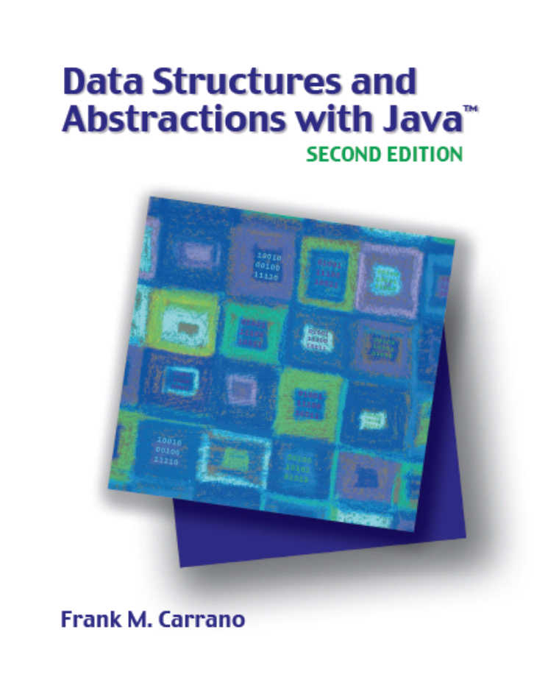

Stacks
Chapter 21
Slides by Steve Armstrong
LeTourneau University
Longview, TX
© 2007, Prentice Hall

Slide 2
Chapter Contents
Specifications of the ADT Stack
Using a Stack to Process Algebraic Expressions
  Checking for Balanced Parentheses, Brackets, and Braces in an Infix Algebraic Expression
  Transforming an Infix Expression to a Postfix Expression
  Evaluating Postfix Expressions
  Evaluating Infix Expressions

Slide 3
Chapter Contents
The Program Stack
  Recursive Methods
Using a Stack Instead of Recursion
  An Iterative Binary Search
Java Class Library: The Class Stack

Slide 4
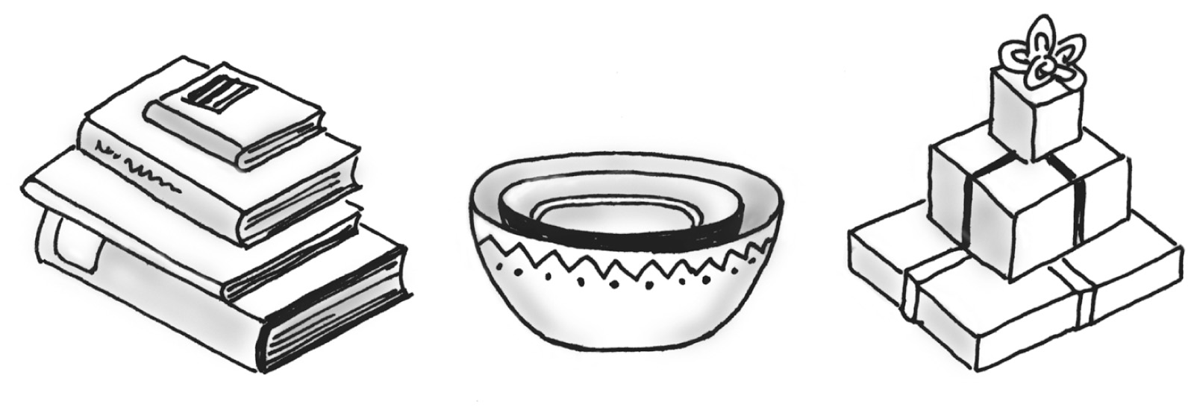
Specifications of the ADT Stack
Organizes entries according to order in which added
Additions are made to one end, the top
The item most recently added is always on the top
Fig. 21-1 Some familiar stacks.

Slide 5
Specifications of the ADT Stack
Abstract Data Type Stack – operations
  push(newEntry)
  pop()
  peek()
  isEmpty()
  clear()
View interface

Slide 6
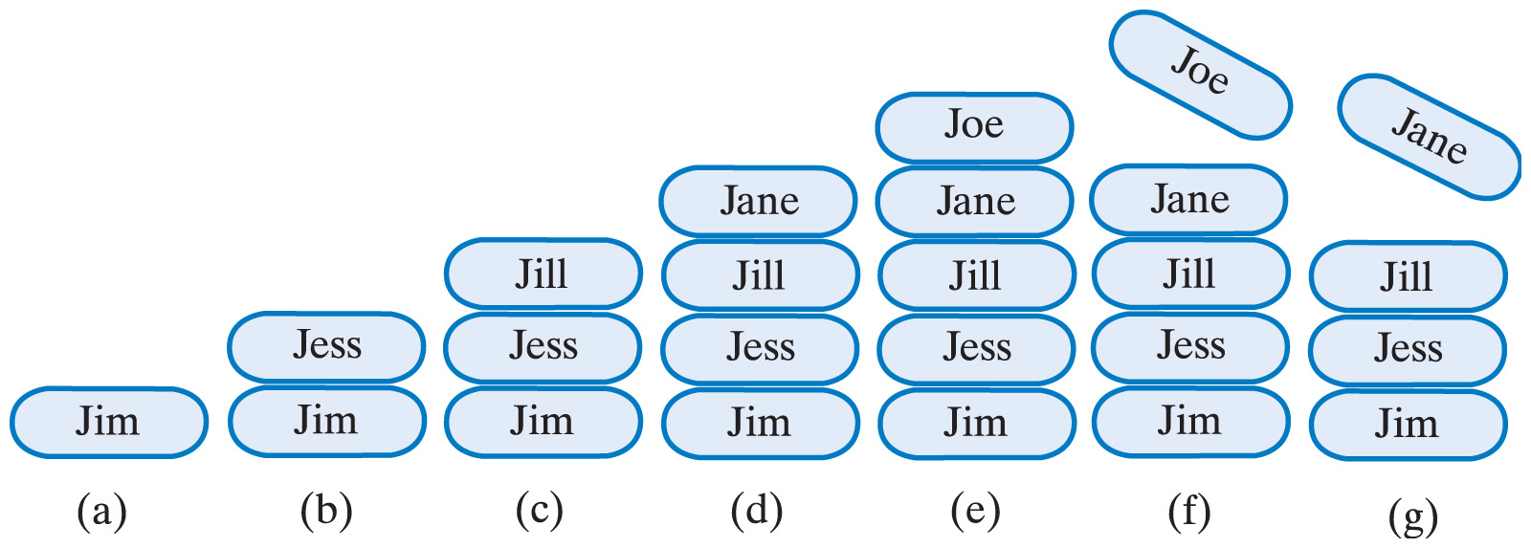
Specifications of the ADT Stack
Fig. 21-2 A stack of strings after (a) push adds Jim;
(b) push adds Jess; (c) push adds Jill; (d) push adds Jane; (e) push adds Joe; (f) pop retrieves and removes Joe; (g) pop retrieves and removes Jane

Slide 7
Using a Stack to Process Algebraic Expressions
Infix expressions
  Binary operators appear between operands
  a + b
Prefix expressions
  Binary operators appear before operands
  + a b
Postfix expressions
  Binary operators appear after operands
  a b +
  Easier to process – no need for parentheses nor precedence

Slide 8
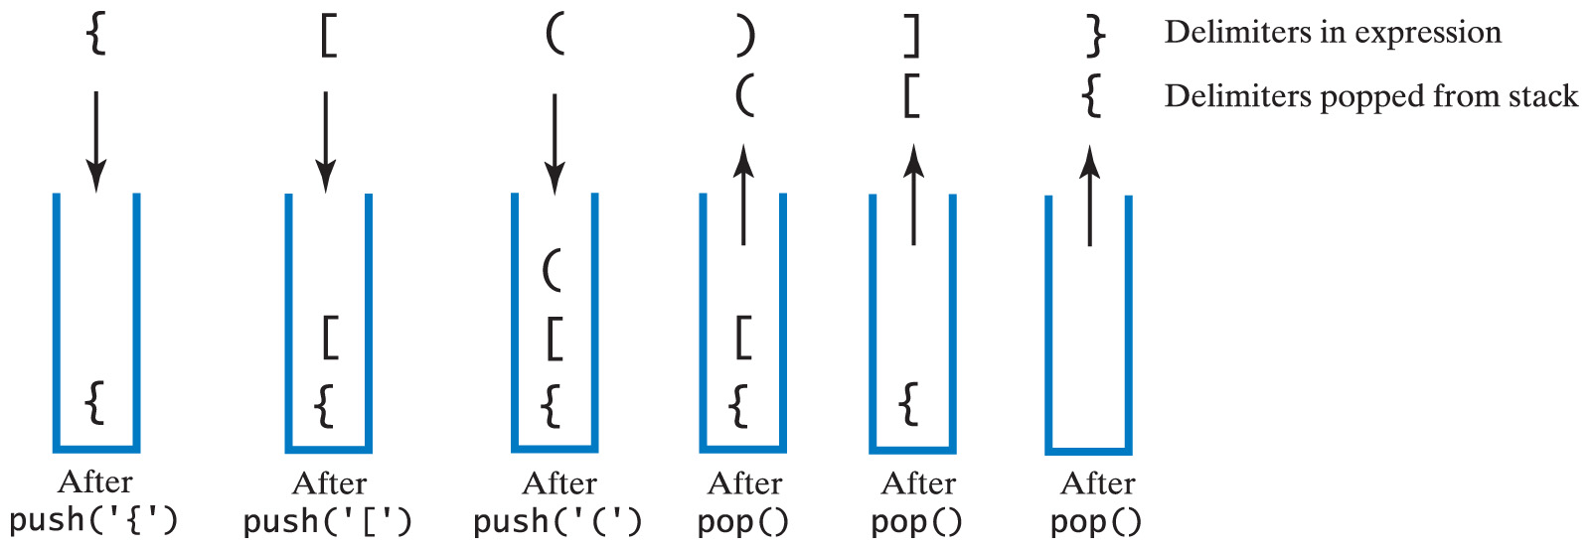
Checking for Balanced (), [], {}
Fig. 21-3 The contents of a stack during the scan of an expression that contains the balanced delimiters {[()]}

Slide 9
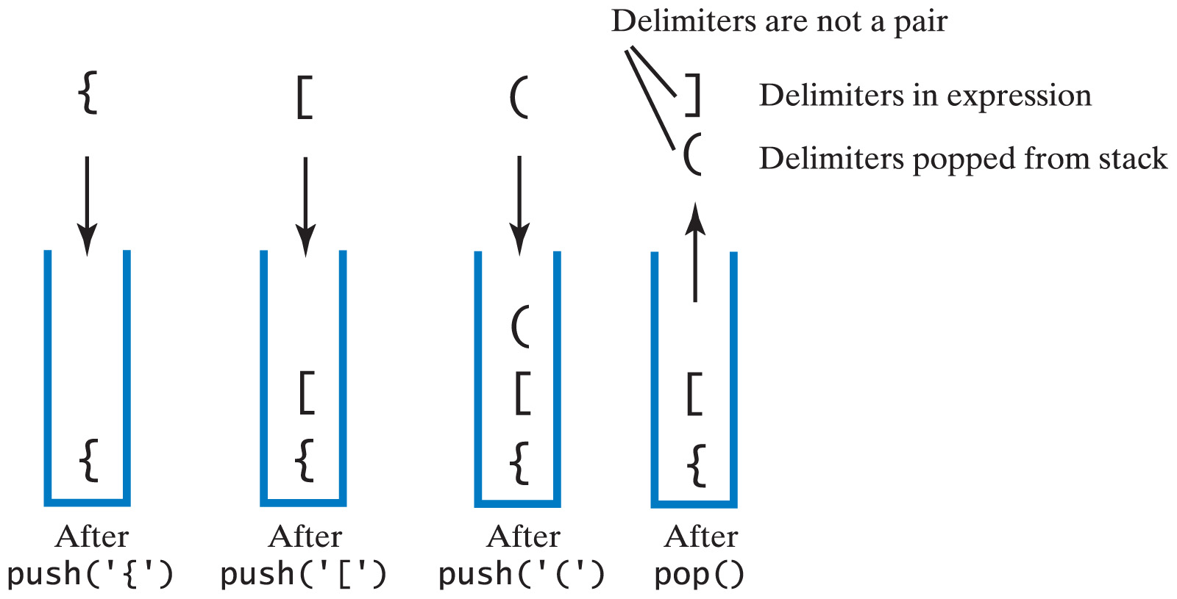
Checking for Balanced (), [], {}
Fig. 21-4 The contents of a stack during the scan of an expression that contains the unbalanced delimiters {[(])}

Slide 10
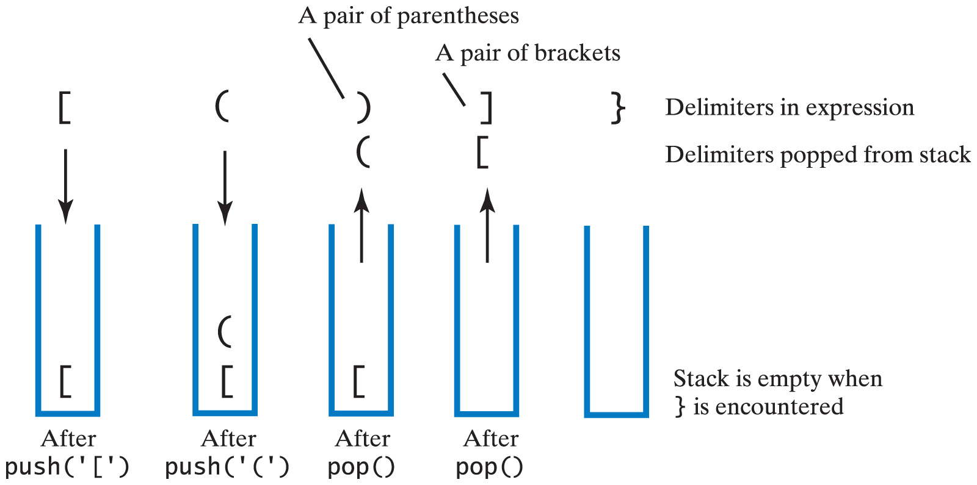
Checking for Balanced (), [], {}
Fig. 21-5 The contents of a stack during the scan of an expression that contains the unbalanced delimiters [()]}

Slide 11
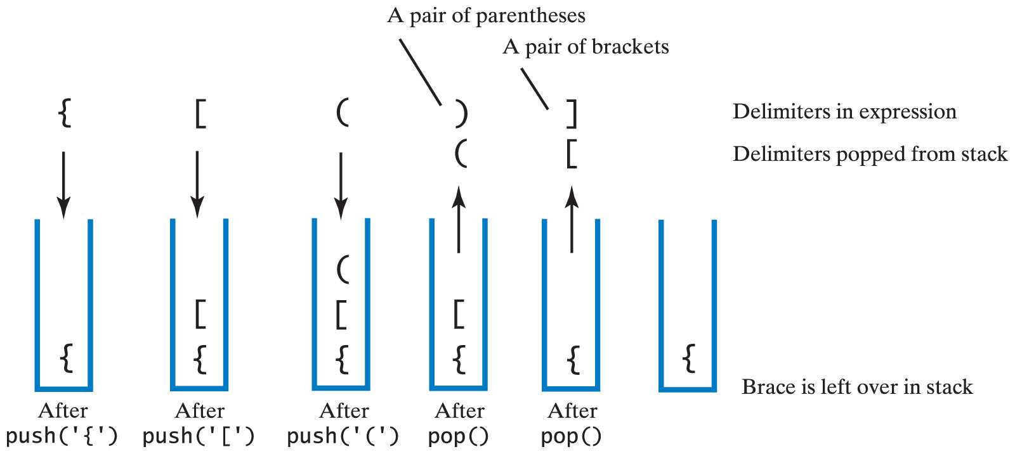
Checking for Balanced (), [], {}
Fig. 21-6 The contents of a stack during the scan of an expression that contains the unbalanced delimiters {[()]

Slide 12
Checking for Balanced (), [], {}
View algorithm for balanced parentheses, brackets, braces
View Java implementation of class BalanceChecker
Note private method, isPaired

Slide 13
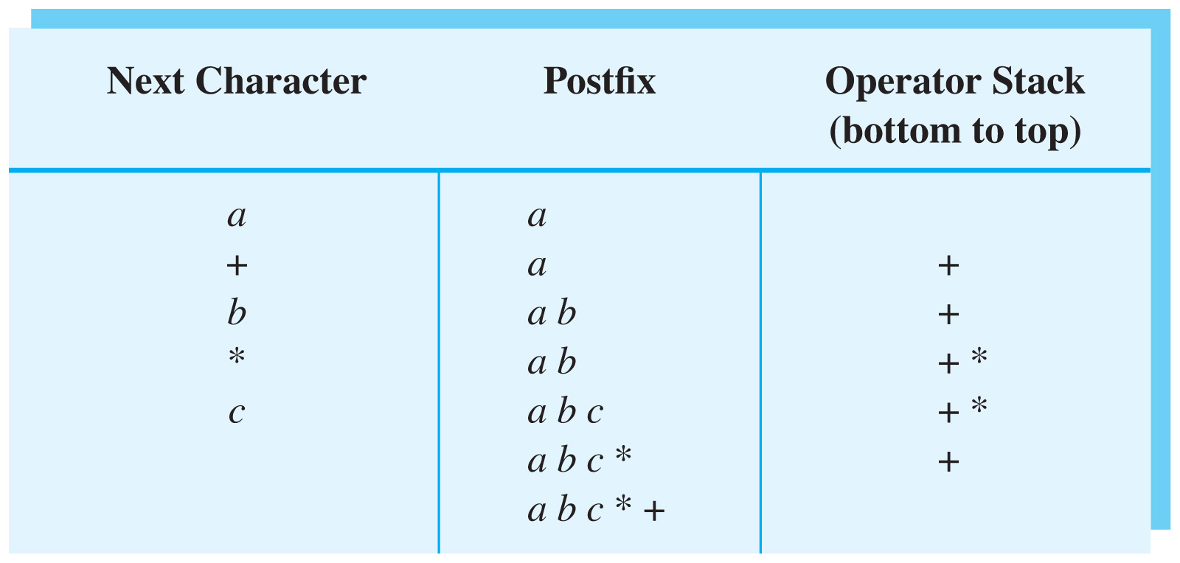
Transforming Infix to Postfix
Fig. 21-7 Converting the infix expression
a + b * c to postfix form

Slide 14
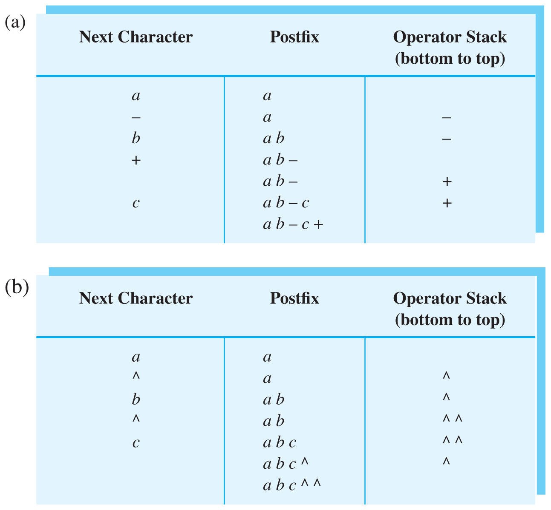
Transforming Infix to Postfix
Fig. 21-8(a) Converting infix expression to postfix form: a – b + c

Slide 15
Transforming Infix to Postfix
Fig. 21-8(b) Converting infix expression to postfix form: a ^ b ^ c

Slide 16
Infix-to-Postfix Algorithm
Symbol in Infix | Action
Operand | Append to end of output expression
Operator ^ | Push ^ onto stack
Operator +,-, *, or / | Pop operators from stack, append to output expression until stack empty or top has lower precedence than new operator. Then push new operator onto stack
Open parenthesis | Push ( onto stack
Close parenthesis | Pop operators from stack, append to output expression until we pop an open parenthesis. Discard both parentheses.

Slide 17
Infix-to-Postfix Algorithm
View algorithm for converting from infix to post fix
View Java implementation of the class Postfix
Note private methods
  getPrecedence
  isVariable

Slide 18
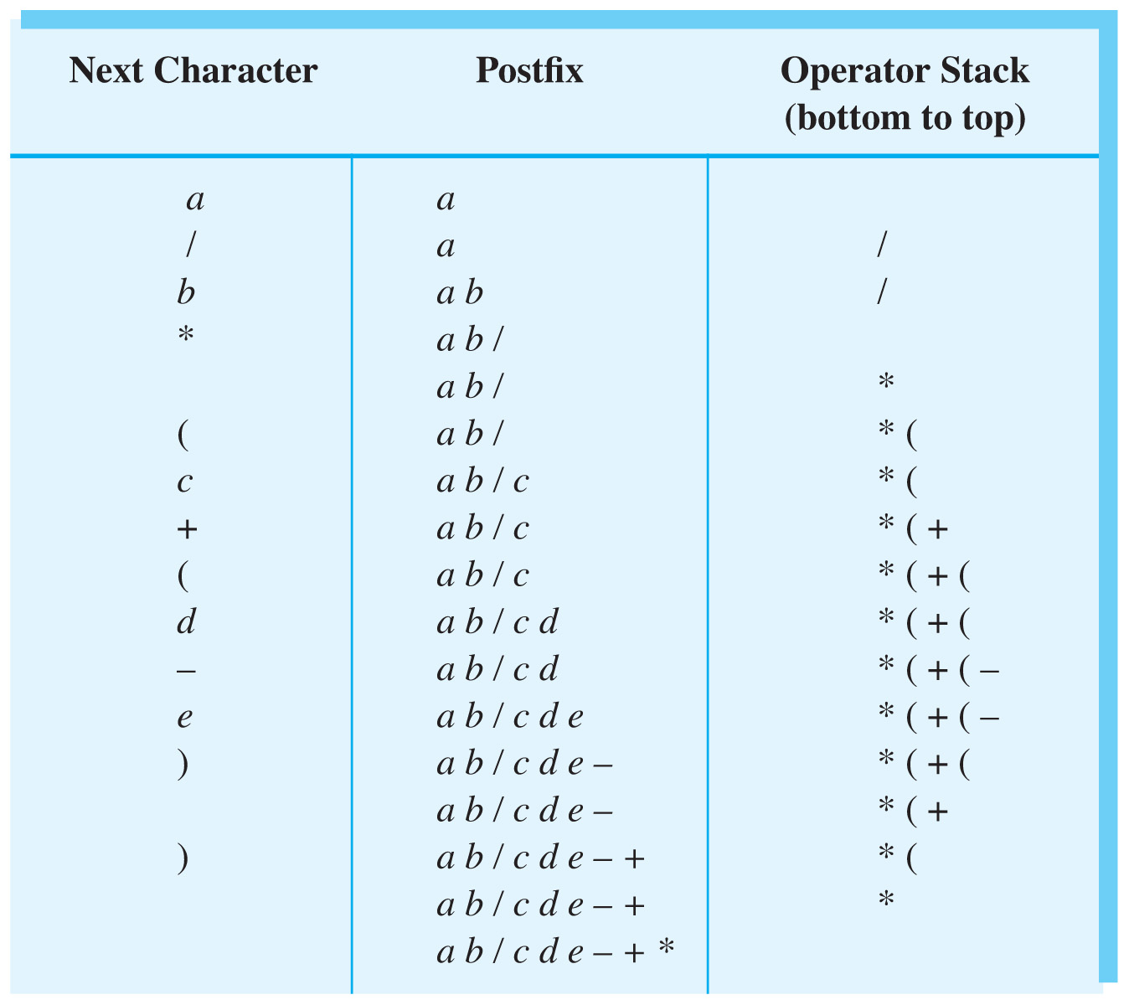
Transforming Infix to Postfix
Fig. 21-9 Steps to convert the infix expression
a / b * ( c + ( d – e ) ) to postfix form.

Slide 19
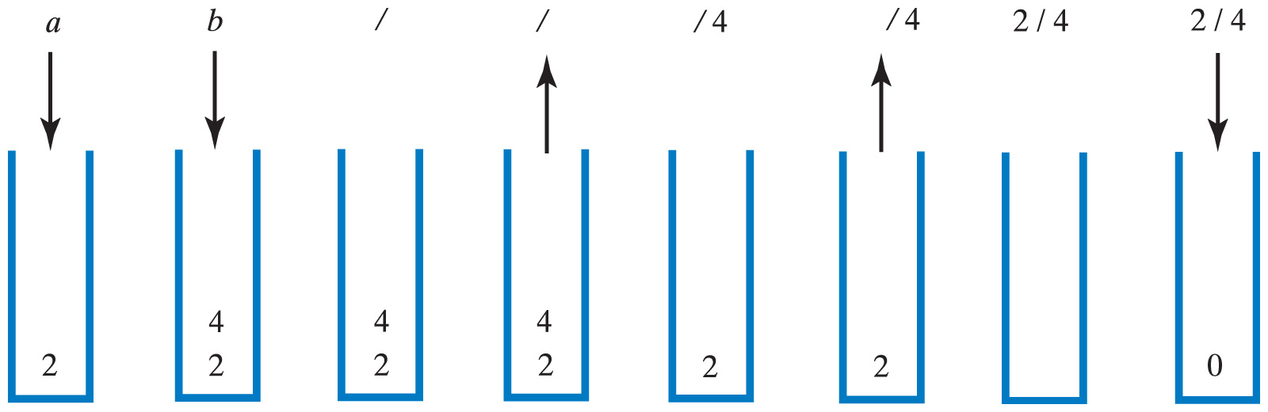
Evaluating Postfix Expression
Fig. 21-10 The stack during the evaluation of the postfix expression a b / when a is 2 and b is 4

Slide 20
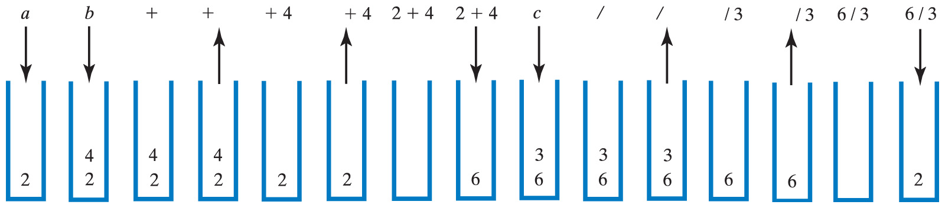
Evaluating Postfix Expression
Fig. 21-11 The stack during the evaluation of the postfix expression a b + c / when a is 2, b is 4 and c is 3
Click to view postfix evaluation algorithm

Slide 21
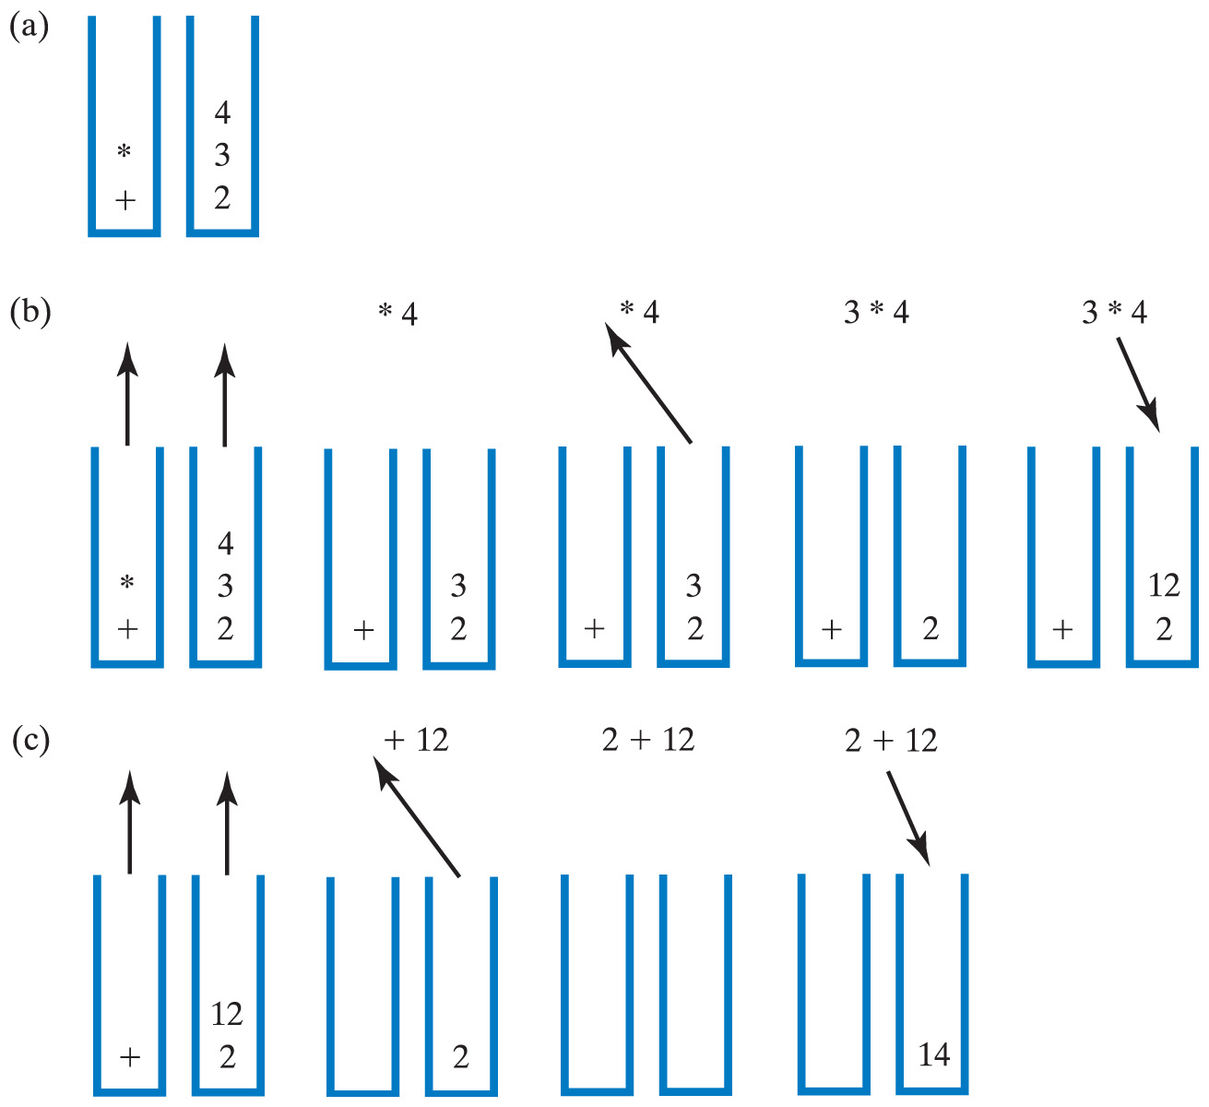
Evaluating Infix Expressions
Click to view algorithm for evaluating infix
Fig. 21-12 Two stacks during evaluation of a + b * c when
a = 2, b = 3, c = 4; (a) after reaching end of expression;
(b) while performing multiplication;
(c) while performing the addition

Slide 22
The Program Stack
When a method is called
  Runtime environment creates activation record
  Shows method's state during execution
Activation record pushed onto the program stack (Java stack)
  Top of stack belongs to currently executing method
  Next method down is the one that called current method

Slide 23
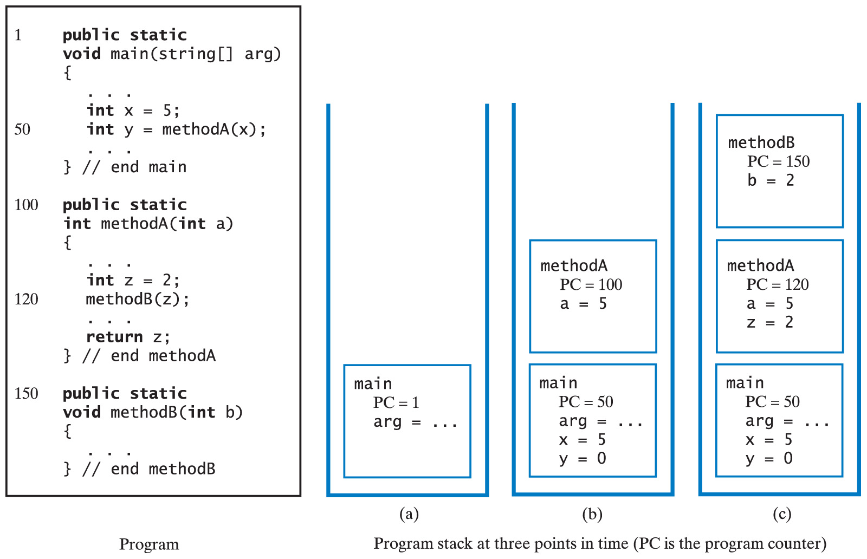
The Program Stack
Fig. 21-13 The program stack at 3 points in time; (a) when main begins execution; (b) when methodA begins execution, (c) when methodB begins execution.

Slide 24
Recursive Methods
A recursive method making many recursive calls
  Places many activation records in the program stack
  Thus the reason recursive methods can use much memory
Possible to replace recursion with iteration by using a stack

Slide 25
Using a Stack Instead of Recursion
Possible to replace recursion with iteration
  Simulate program stack
Recall sorted list ADT from chapter 13
  Binary search possible when array is used
View methods for using stack, not recursion
  We hide detail of array indices with method contains
  Recursive version of binarySearch
  Private class Record
  Iterative version of binarySearch

Slide 26
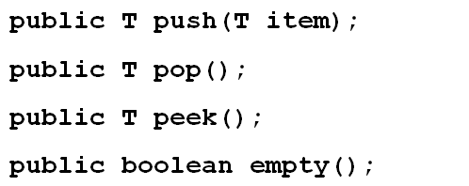
Java Class Library: The Class Stack
Methods in class Stack in java.util
View additional methods for searching, traversing stack

