Slide 1
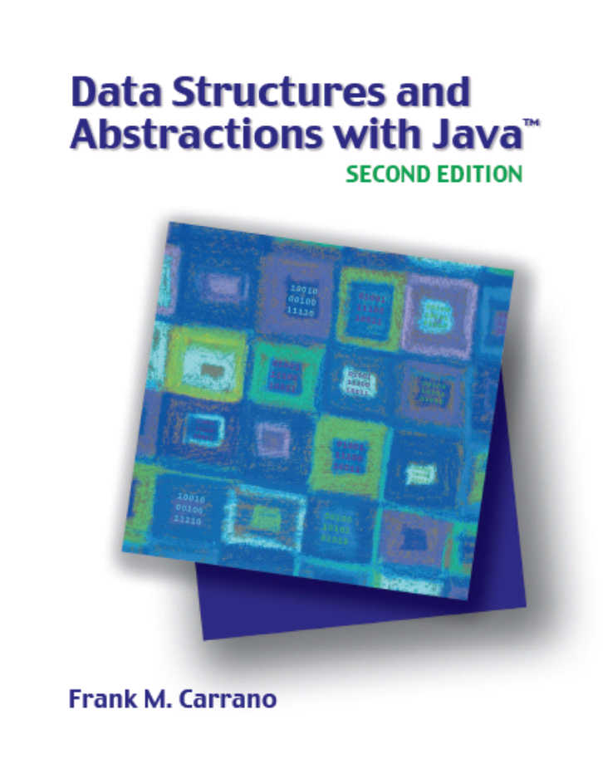

Stack Implementations
Chapter 22
Slides by Steve Armstrong
LeTourneau University
Longview, TX
© 2007, Prentice Hall

Slide 2
Chapter Contents
A Linked Implementation
An Array-Based Implementation
A Vector-Based Implementation

Slide 3
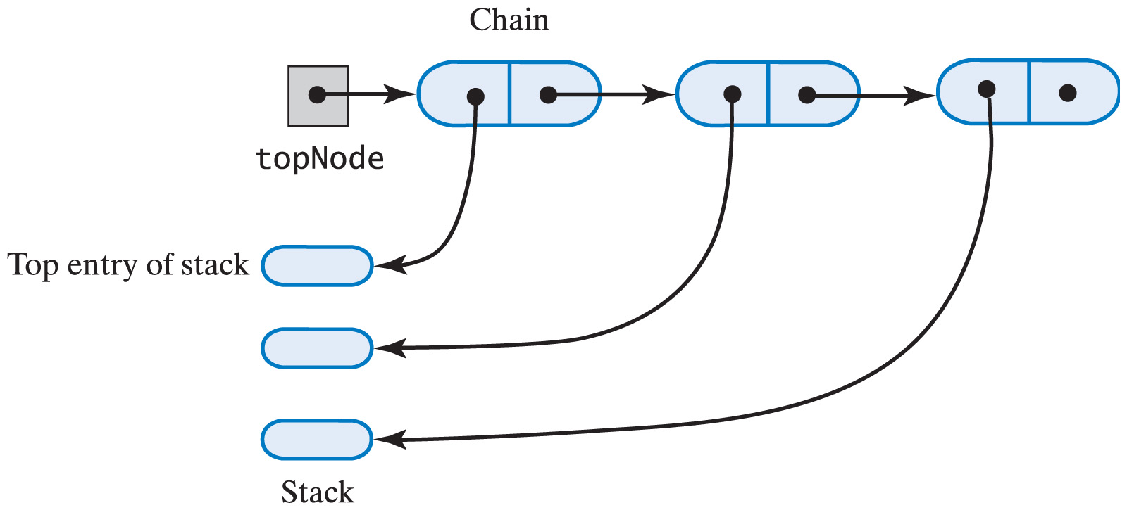
A Linked Implementation
When using a chain of linked nodes to implement a stack
  The first node should reference the stack's top
Fig. 22-1 A chain of linked nodes that implements a stack.

Slide 4
A Linked Implementation
View source code of class for stack implemented by linked list
Note methods
  push
  peek
  pop
  isEmpty
  clear

Slide 5
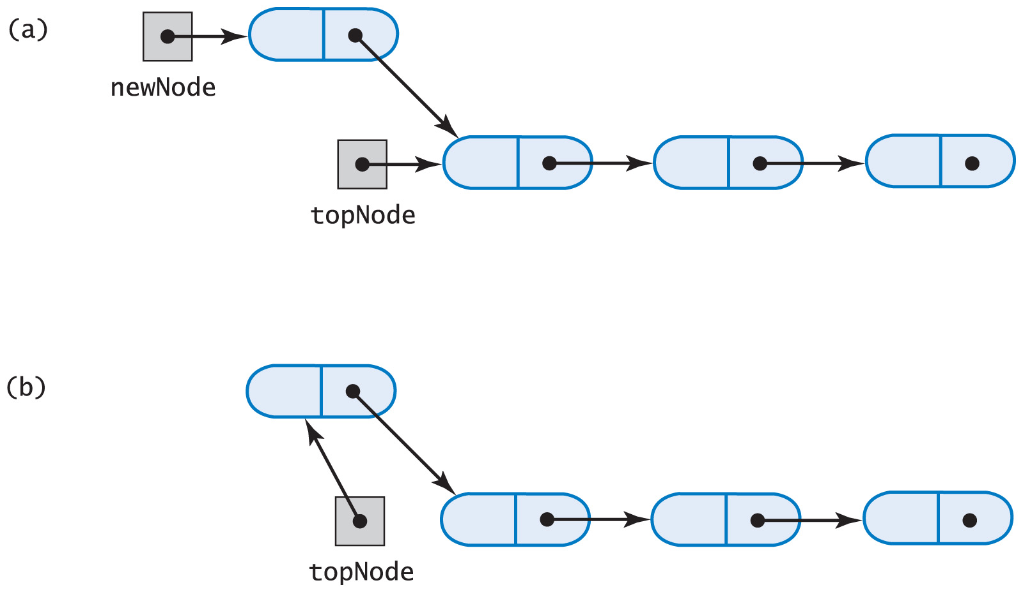
A Linked Implementation
Fig. 22-2 (a) A new node that references the top of the stack; (b) the new node is now at the top of the stack.

Slide 6
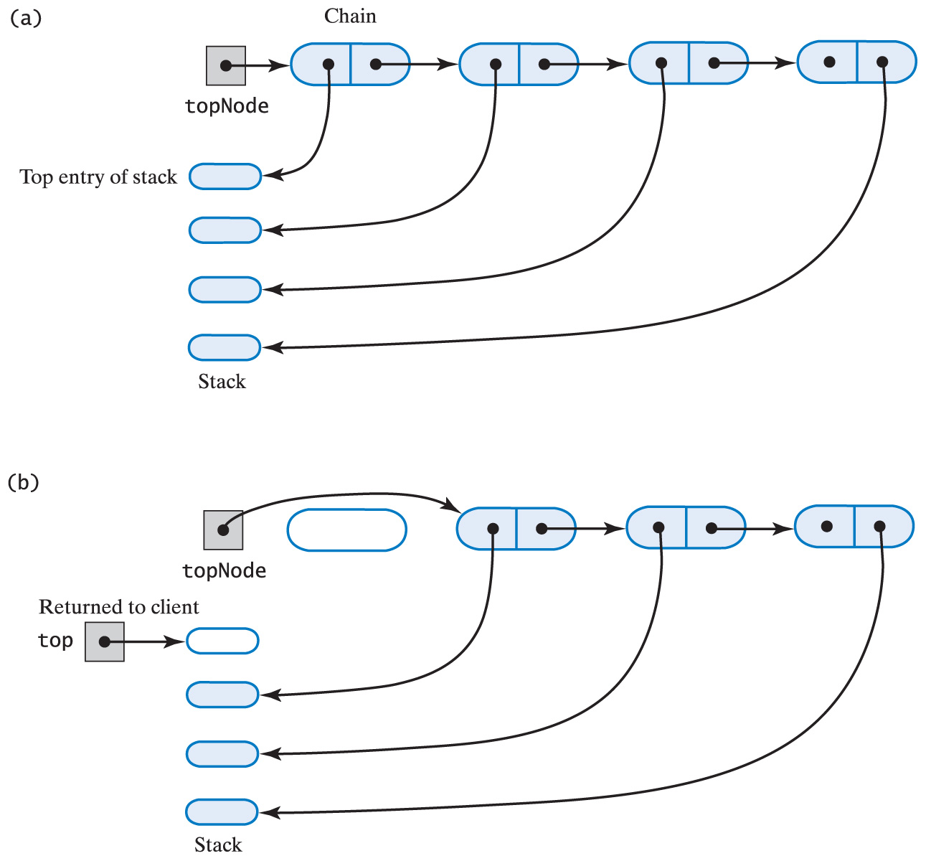
A Linked Implementation
Fig. 22-3 The stack (a) before the first node in the chain is deleted

Slide 7
A Linked Implementation
Fig. 22-3 The stack (b) after the first node in the chain is deleted

Slide 8
An Array-Based Implementation
When using an array to implement a stack
  The array's first element should represent the bottom of the stack
  The last occupied location in the array represents the stack's top
This avoids shifting of elements of the array if it were done the other way around

Slide 9
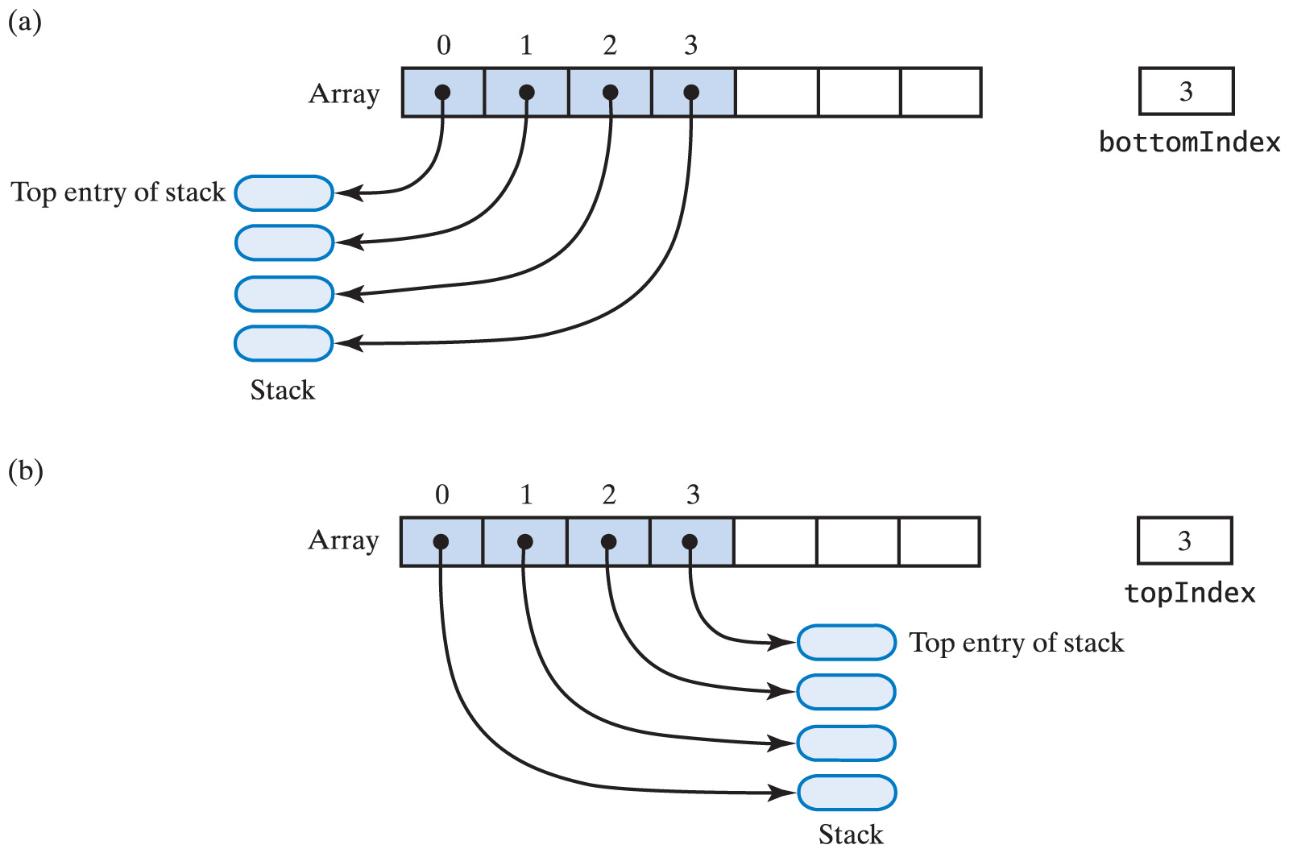
An Array-Based Implementation
Fig. 22-4 An array that implements a stack; its first location references (a) the top of the stack; (b) the bottom of the stack

Slide 10
An Array-Based Implementation
View source code for array-based implementation of the ADT stack
Note methods
  push
  peek
  pop
  isEmpty

Slide 11
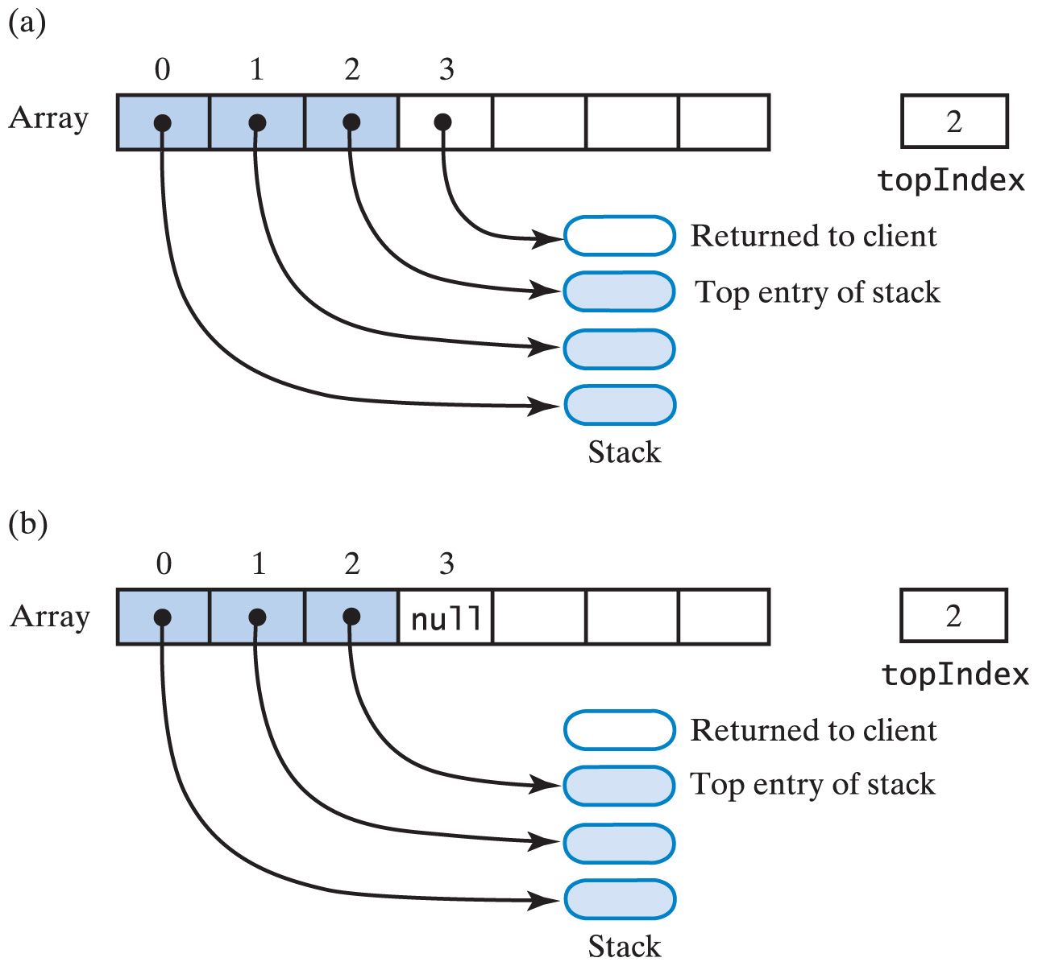
An Array-Based Implementation
Fig. 21-5 Another array-based stack after top removed by (a) decrementing topIndex;

Slide 12
An Array-Based Implementation
Fig. 22-5 Another array-based stack after top removed by (b) setting stack[topIndex]=null and then decrementing topIndex

Slide 13
A Vector-Based Implementation
When using a vector to implement a stack
  Vector's first element should represent the bottom of the stack
  Last occupied location in the vector represents the stack's top
Based on an array that can be expanded dynamically
  Performance similar to array-based implementation

Slide 14
A Vector-Based Implementation
View source code for vector-based implementation of the ADT stack
Note methods
  push
  peek
  pop
  isEmpty
  clear

