Slide 1
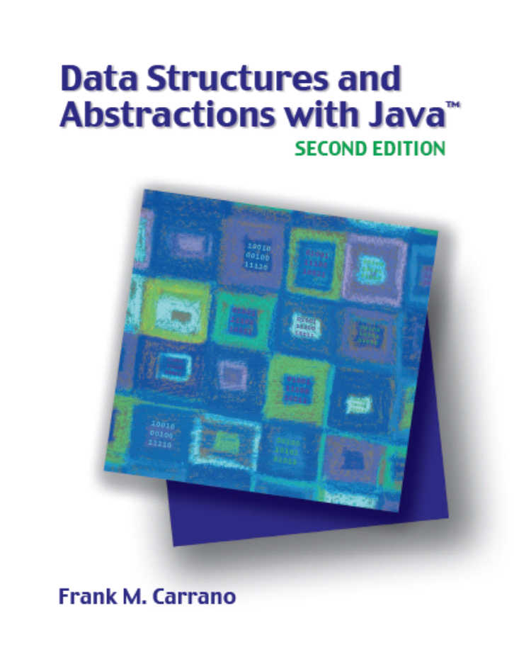

Queue, Deque, and Priority Queue Implementations
Chapter 24
Slides by Steve Armstrong
LeTourneau University
Longview, TX
© 2007, Prentice Hall

Slide 2
Chapter Contents
A Linked List Implementation of a Queue
An Array-Based Implementation of a Queue
  A Circular Array
  A Circular Array with One Unused Location
A Vector-Based Implementation of a Queue
Circular Linked Implementations of a Queue
  A Two-Part Circular Linked Chain
Carrano, Data Structures and Abstractions with Java, Second Edition, (c) 2007 Pearson Education, Inc. All rights reserved. 0-13-237045-X

Slide 3
Chapter Contents
Java Class Library: The Class AbstractQueue
A Doubly Linked Implementation of a Queue
Possible Implementations of a Priority Queue
Java Class Library: The Class PriorityQueue
Carrano, Data Structures and Abstractions with Java, Second Edition, (c) 2007 Pearson Education, Inc. All rights reserved. 0-13-237045-X

Slide 4
A Linked Implementation of a Queue
Use chain of linked nodes for the queue
  Two ends at opposite ends of chain
  Accessing last node inefficient
  Could keep a reference to the tail of the chain
Place front of queue at beginning of chain
Place back of queue at end of chain
  With references to both
Carrano, Data Structures and Abstractions with Java, Second Edition, (c) 2007 Pearson Education, Inc. All rights reserved. 0-13-237045-X

Slide 5
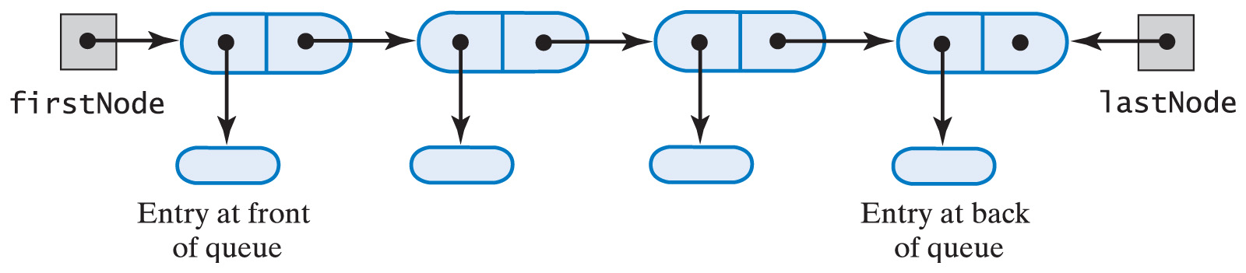
A Linked Implementation of a Queue
Fig. 24-1 A chain of linked nodes that implements a queue.
Carrano, Data Structures and Abstractions with Java, Second Edition, (c) 2007 Pearson Education, Inc. All rights reserved. 0-13-237045-X

Slide 6
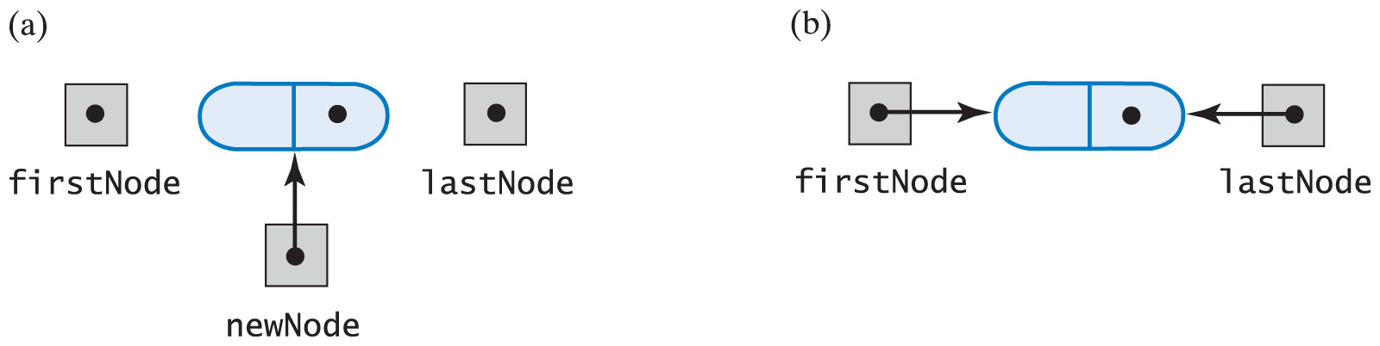
A Linked Implementation of a Queue
Fig. 24-2 (a) Before adding a new node to an empty chain; (b) after adding to it.
Carrano, Data Structures and Abstractions with Java, Second Edition, (c) 2007 Pearson Education, Inc. All rights reserved. 0-13-237045-X

Slide 7
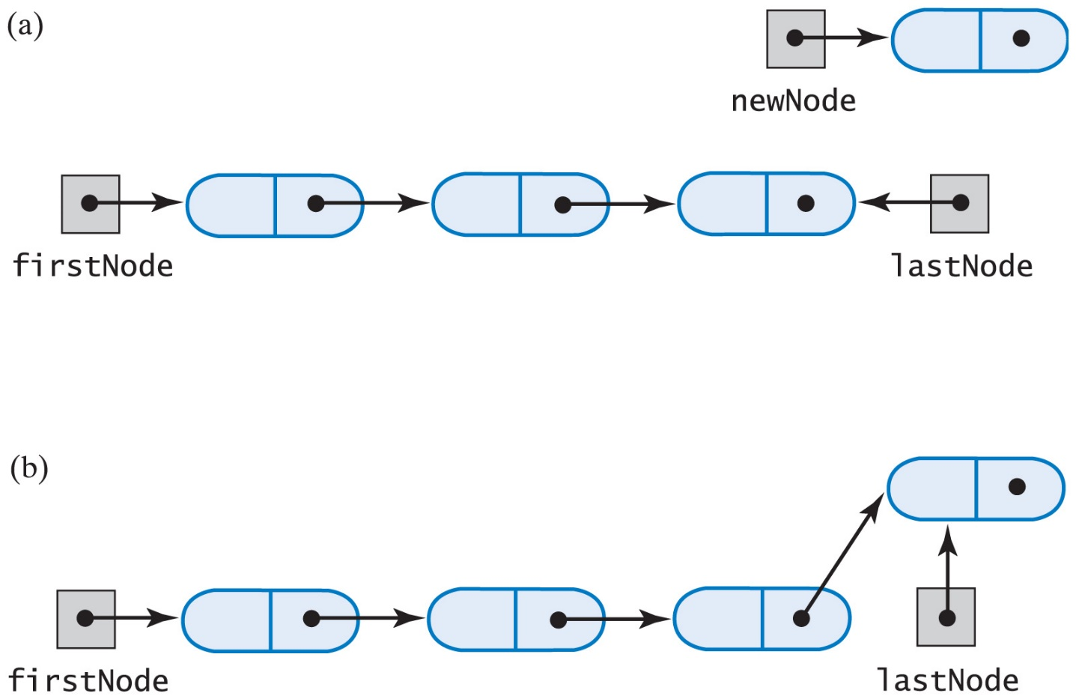
A Linked Implementation of a Queue
Fig. 24-3 (a) Before adding a new node to the end of a chain; (b) after adding it.
Carrano, Data Structures and Abstractions with Java, Second Edition, (c) 2007 Pearson Education, Inc. All rights reserved. 0-13-237045-X

Slide 8
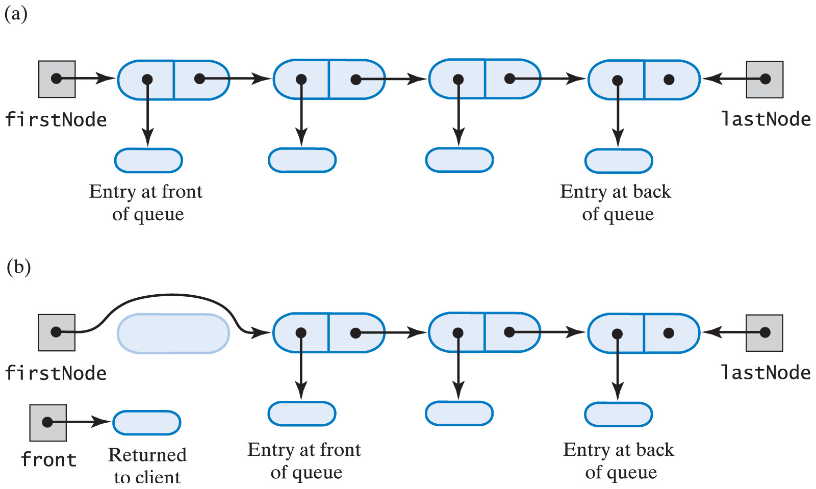
A Linked Implementation of a Queue
Fig. 24-4 (a) A queue of more than one entry;
(b) after removing the queue's front.
Carrano, Data Structures and Abstractions with Java, Second Edition, (c) 2007 Pearson Education, Inc. All rights reserved. 0-13-237045-X

Slide 9
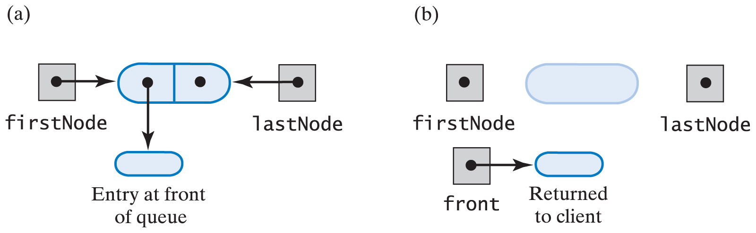
A Linked Implementation of a Queue
Fig. 24-5 (a) A queue of one entry;
(b) after removing the queue's front.
Carrano, Data Structures and Abstractions with Java, Second Edition, (c) 2007 Pearson Education, Inc. All rights reserved. 0-13-237045-X

Slide 10
A Linked Implementation of a Queue
View source code of linked implementation of the ADT queue
Note methods
  enqueue
  getFront
  dequeue
  isEmpty
  clear
  private class Node
Carrano, Data Structures and Abstractions with Java, Second Edition, (c) 2007 Pearson Education, Inc. All rights reserved. 0-13-237045-X

Slide 11
Array-Based Implementation of a Queue
Let queue[0] be the front
  frontIndex, backIndex are indices of front and back
If we insist queue[0] is front
  Must shift entries when we remove the front
Instead move frontIndex
  Problem then is array can become full
  But now beginning of array could be empty and available for use
Carrano, Data Structures and Abstractions with Java, Second Edition, (c) 2007 Pearson Education, Inc. All rights reserved. 0-13-237045-X

Slide 12
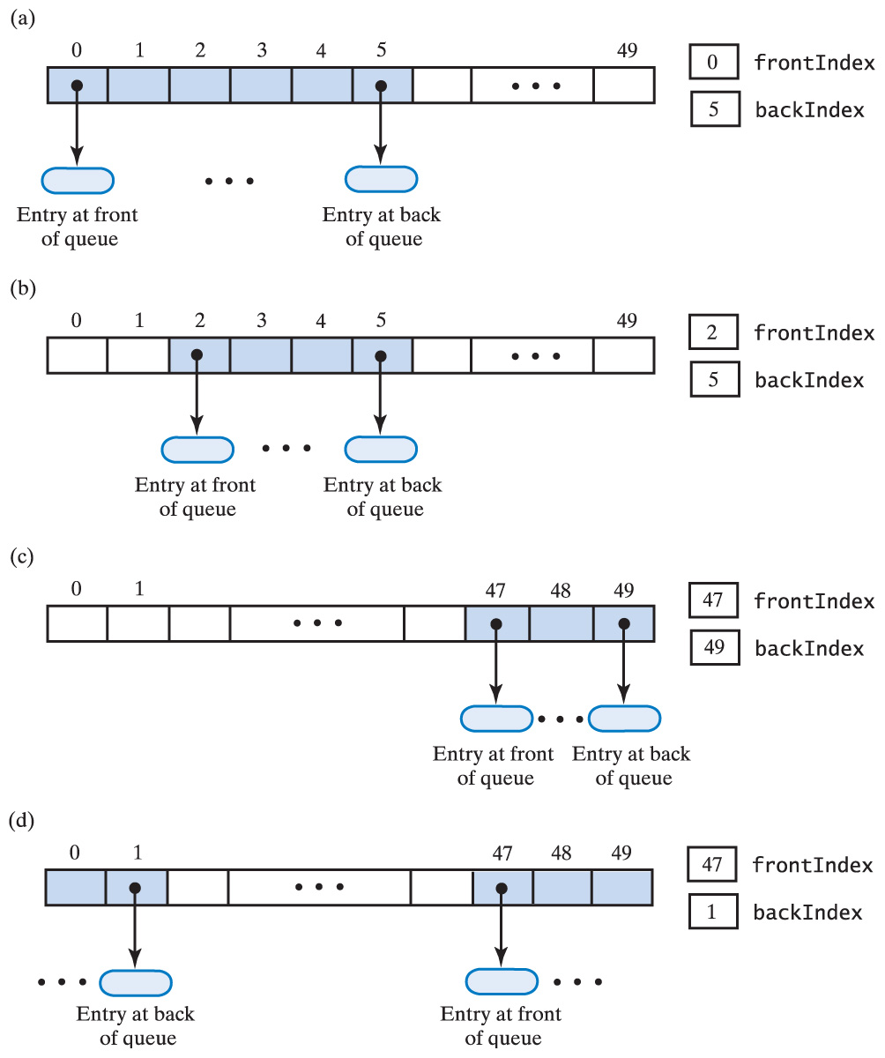
Array-Based Implementation of a Queue
Fig. 24-6 An array that represents a queue without shifting its entries: (a) initially; (b) after removing the front twice;
Carrano, Data Structures and Abstractions with Java, Second Edition, (c) 2007 Pearson Education, Inc. All rights reserved. 0-13-237045-X

Slide 13
Array-Based Implementation of a Queue
Fig. 24-6 An array that represents a queue without shifting its entries: (c) after several more additions & removals; (d) after two additions that wrap around to the beginning of the array
Carrano, Data Structures and Abstractions with Java, Second Edition, (c) 2007 Pearson Education, Inc. All rights reserved. 0-13-237045-X

Slide 14
A Circular Array
When queue reaches end of array
  Add subsequent entries to beginning
Array behaves as though it were circular
  First location follows last one
Use modulo arithmetic on indices
backIndex = (backIndex + 1) % queue.length
Note: with circular array
frontIndex == backIndex + 1
both when queue is empty and when full
Carrano, Data Structures and Abstractions with Java, Second Edition, (c) 2007 Pearson Education, Inc. All rights reserved. 0-13-237045-X

Slide 15
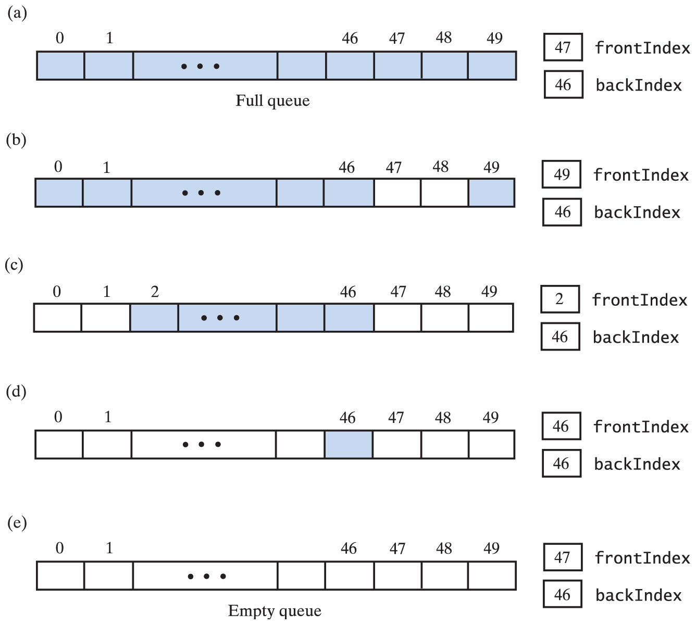
A Circular Array
Fig. 24-7 A circular array that represents a queue: (a) when full; (b) after removing 2 entries; (c) after removing 3 more entries;
Carrano, Data Structures and Abstractions with Java, Second Edition, (c) 2007 Pearson Education, Inc. All rights reserved. 0-13-237045-X

Slide 16
A Circular Array
Fig. 24-7 A circular array that represents a queue:
(d) after removing all but one entry;
(e) after removing remaining entry.
Carrano, Data Structures and Abstractions with Java, Second Edition, (c) 2007 Pearson Education, Inc. All rights reserved. 0-13-237045-X

Slide 17
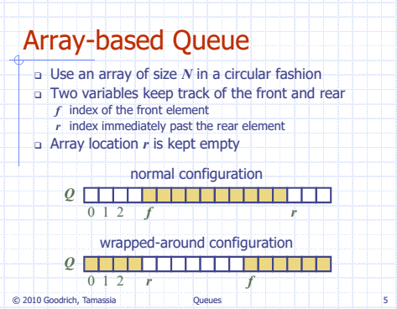
Carrano, Data Structures and Abstractions with Java, Second Edition, (c) 2007 Pearson Education, Inc. All rights reserved. 0-13-237045-X

Slide 18
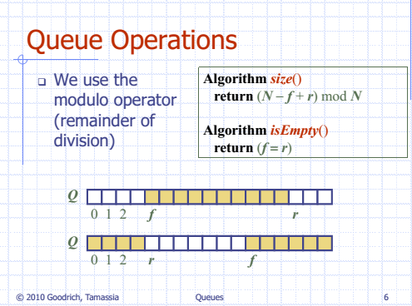
Carrano, Data Structures and Abstractions with Java, Second Edition, (c) 2007 Pearson Education, Inc. All rights reserved. 0-13-237045-X

Slide 19
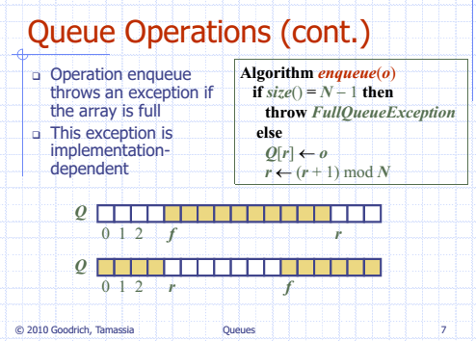
Carrano, Data Structures and Abstractions with Java, Second Edition, (c) 2007 Pearson Education, Inc. All rights reserved. 0-13-237045-X

Slide 20
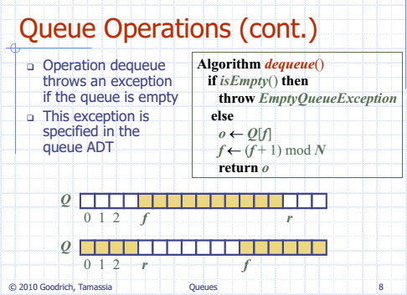
Carrano, Data Structures and Abstractions with Java, Second Edition, (c) 2007 Pearson Education, Inc. All rights reserved. 0-13-237045-X

Slide 21
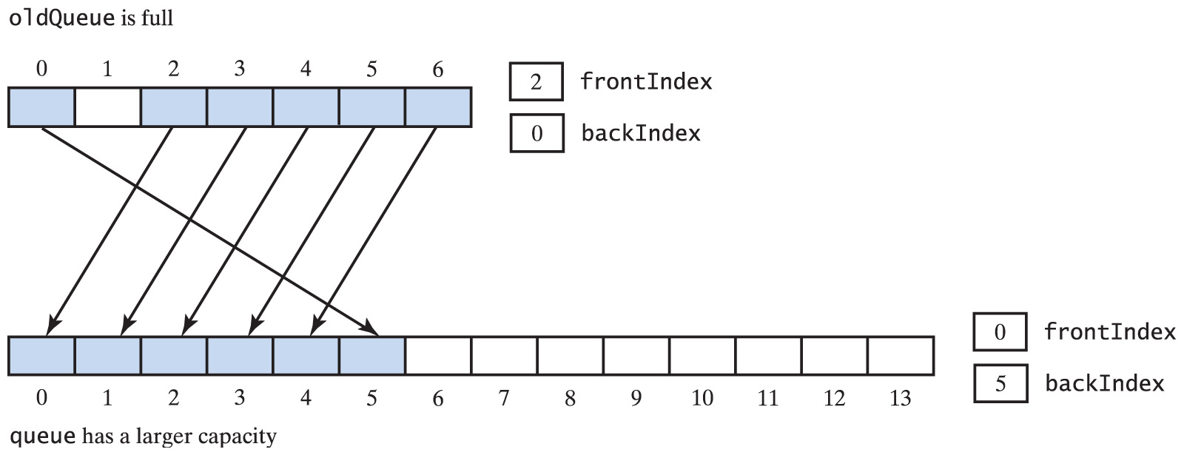
Array-Based
Implementation of a Queue
Fig. 24-10 Doubling the size of an array-based queue
Carrano, Data Structures and Abstractions with Java, Second Edition, (c) 2007 Pearson Education, Inc. All rights reserved. 0-13-237045-X

Slide 22
Vector-Based Implementation of a Queue
Maintain front of queue at beginning of vector
Use addElement method to add entry at back
  Vector expands as necessary
When remove front element, remaining elements move so new front is at beginning of vector
  Indexes at front and back not needed
Carrano, Data Structures and Abstractions with Java, Second Edition, (c) 2007 Pearson Education, Inc. All rights reserved. 0-13-237045-X

Slide 23
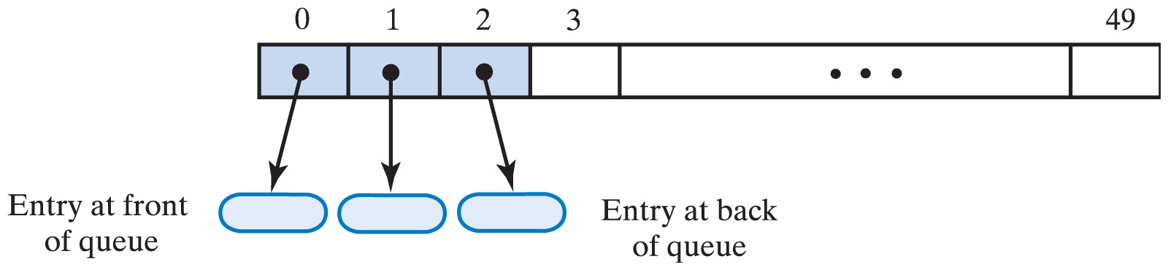
Vector-Based Implementation of a Queue
Fig. 24-11 A vector that represents a queue.
Click to view source code of vector-based implementation of ADT queue
Carrano, Data Structures and Abstractions with Java, Second Edition, (c) 2007 Pearson Education, Inc. All rights reserved. 0-13-237045-X

Slide 24
Circular Linked Implementations of a Queue
Last node references first node
  Now we have a single reference to last node
  And still locate first node quickly
No node contains a null
When a class uses circular linked chain for queue
  Only one data item in the class
  The reference to the chain's last node
Carrano, Data Structures and Abstractions with Java, Second Edition, (c) 2007 Pearson Education, Inc. All rights reserved. 0-13-237045-X

Slide 25
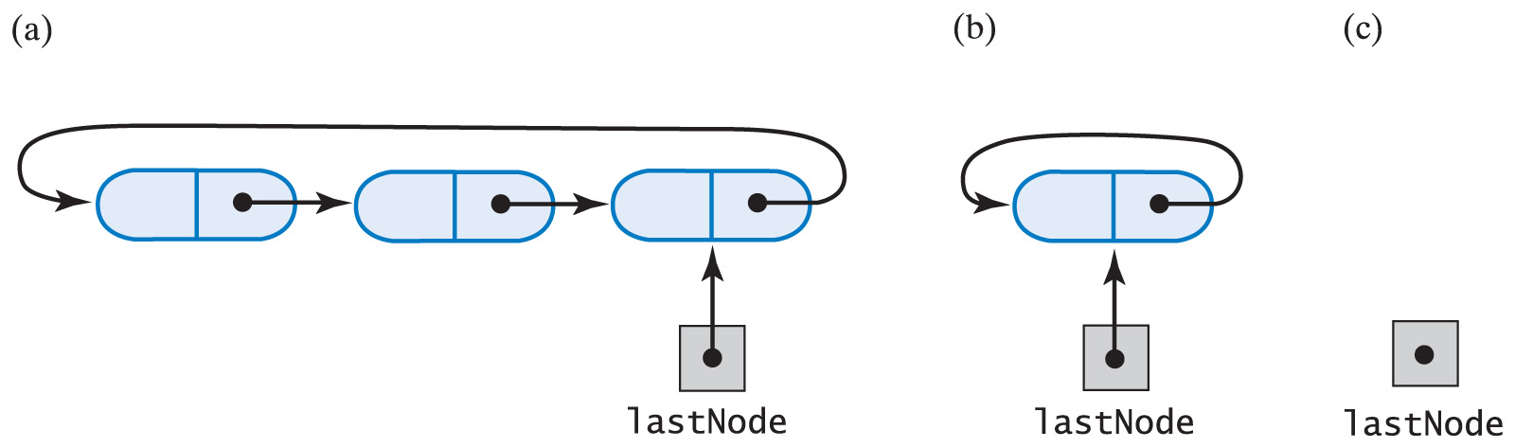
Circular Linked Implementations of a Queue
Fig. 24-12 A circular linked chain with an external reference to its last node that (a) has more than one node;
(b) has one node; (c) is empty.
Carrano, Data Structures and Abstractions with Java, Second Edition, (c) 2007 Pearson Education, Inc. All rights reserved. 0-13-237045-X

Slide 26
A Doubly Linked Implementation of a Deque
Chain with head reference enables reference of first and then the rest of the nodes
Tail reference allows reference of last node but not next-to-last
We need nodes that can reference both
  Previous node
  Next node
Thus the doubly linked chain
Carrano, Data Structures and Abstractions with Java, Second Edition, (c) 2007 Pearson Education, Inc. All rights reserved. 0-13-237045-X

Slide 27
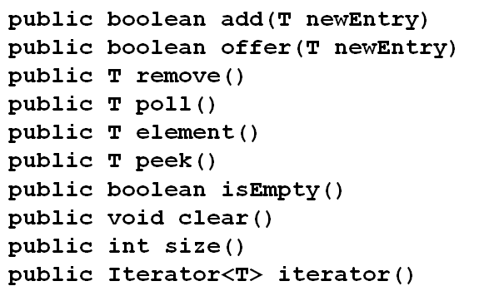
Java Class Library: The Class AbstractQueue
Methods provided by this class
Carrano, Data Structures and Abstractions with Java, Second Edition, (c) 2007 Pearson Education, Inc. All rights reserved. 0-13-237045-X

Slide 28
A Doubly Linked Implementation of a Deque
Fig. 24-17 A doubly linked chain with head and tail references
Click to view source code of linked implementation of ADT deque
Carrano, Data Structures and Abstractions with Java, Second Edition, (c) 2007 Pearson Education, Inc. All rights reserved. 0-13-237045-X

Slide 29
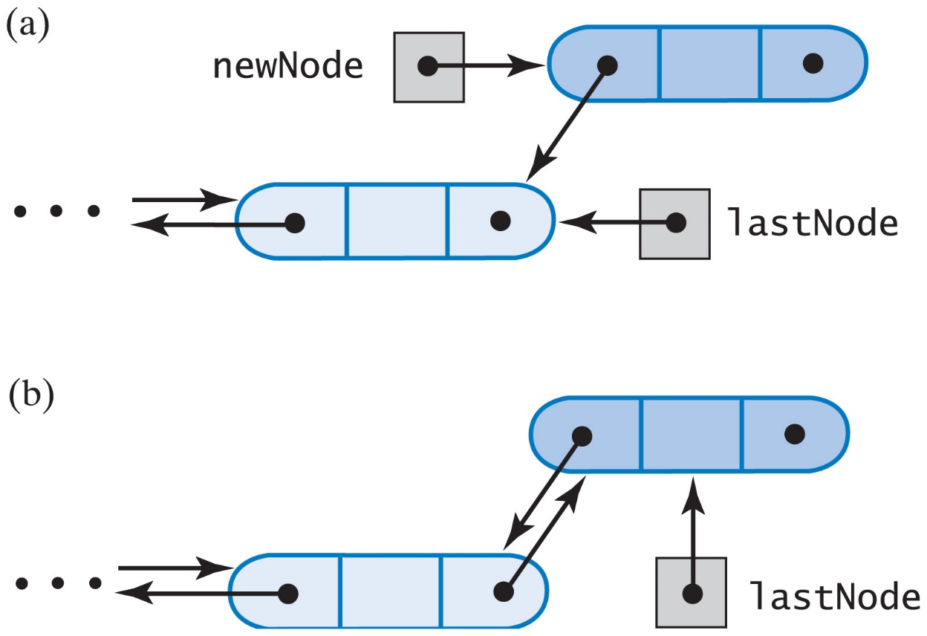
A Doubly Linked
Implementation of a Deque
Fig. 24-18 Adding to the back of a non empty deque:
(a) after the new node is allocated;
(b) after the addition is complete.
Carrano, Data Structures and Abstractions with Java, Second Edition, (c) 2007 Pearson Education, Inc. All rights reserved. 0-13-237045-X

Slide 30
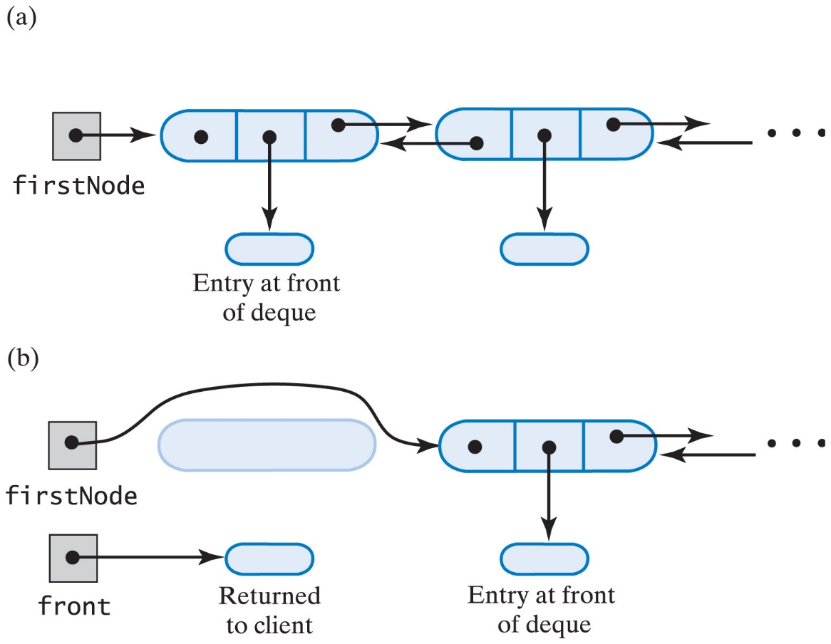
A Doubly Linked
Implementation of a Deque
Fig. 24-19 (a) a deque containing at least two entries; (b) after removing first node and obtaining reference to the deque's first entry.
Carrano, Data Structures and Abstractions with Java, Second Edition, (c) 2007 Pearson Education, Inc. All rights reserved. 0-13-237045-X

Slide 31
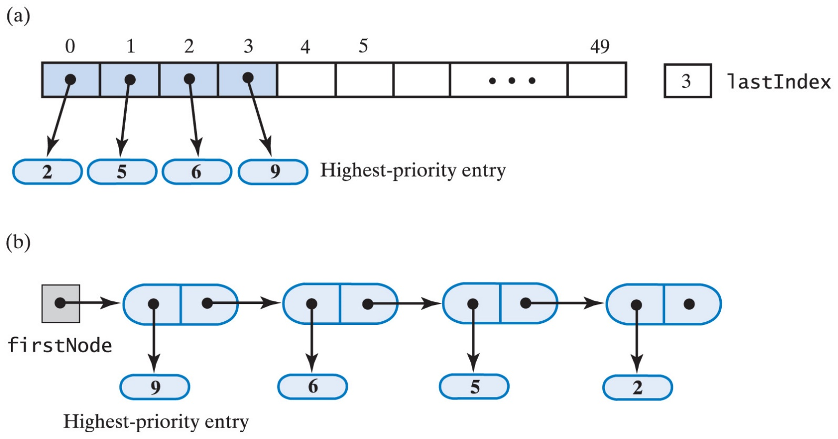
Possible Implementations of a Priority Queue
Fig. 24-20 Two possible implementations of a priority queue using (a) an array; (b) a chain of linked nodes.
Carrano, Data Structures and Abstractions with Java, Second Edition, (c) 2007 Pearson Education, Inc. All rights reserved. 0-13-237045-X

Slide 32
Java Class Library: The Class PriorityQueue
Extends java.util.AbstractQueue
Implements methods in java.util.Queue
  They adhere to specs of priority queue
View methods specified
Carrano, Data Structures and Abstractions with Java, Second Edition, (c) 2007 Pearson Education, Inc. All rights reserved. 0-13-237045-X

