Slide 1
Chapter 22 Lists, Stacks, Queues, and Priority Queues

Slide 2
Java Collection Framework hierarchy
A collection is a container object that holds a group of objects, often referred to as elements. The Java Collections Framework supports three types of collections, named sets, lists, and maps.

Slide 3
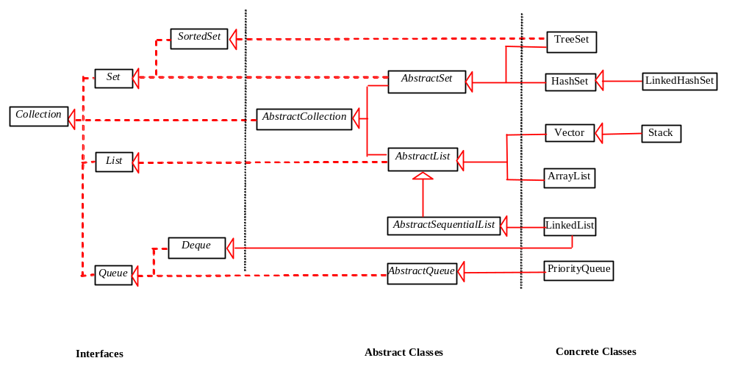
Java Collection Framework hierarchy, cont.
Set and List are subinterfaces of Collection.

Slide 4
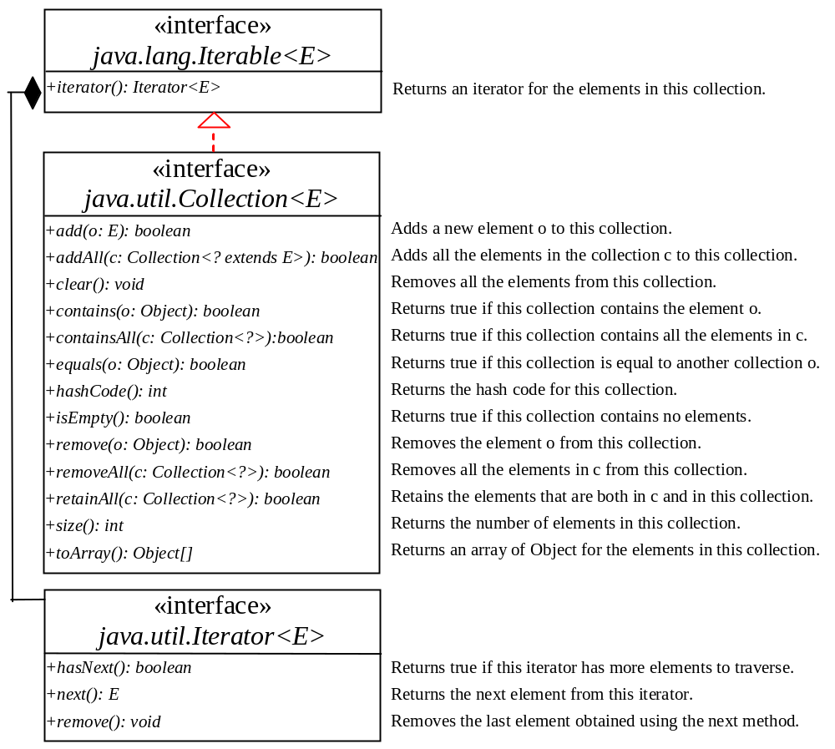
The Collection Interface
The Collection interface is the root interface for manipulating a collection of objects.

Slide 5
The List Interface
A set stores non-duplicate elements. To allow duplicate elements to be stored in a collection, you need to use a list. A list can not only store duplicate elements, but can also allow the user to specify where the element is stored. The user can access the element by index.

Slide 6
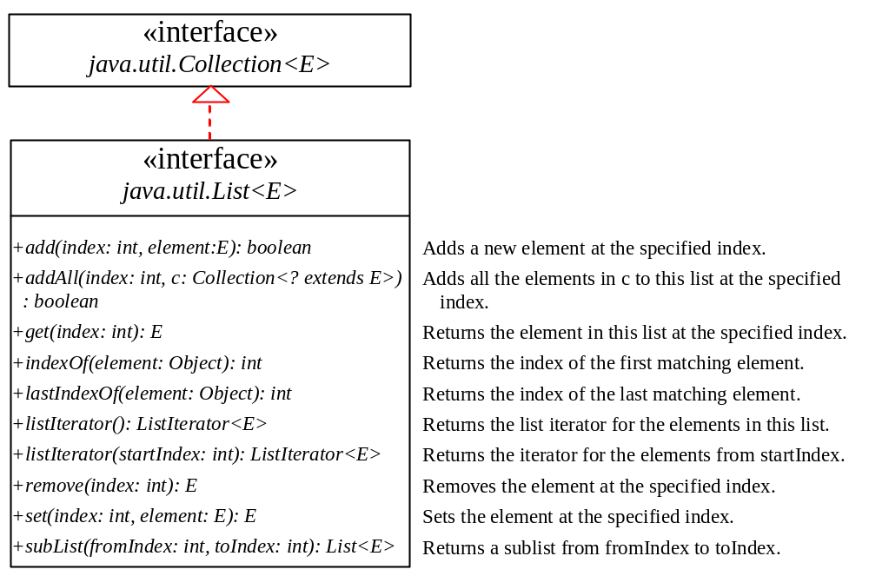
The List Interface, cont.

Slide 7
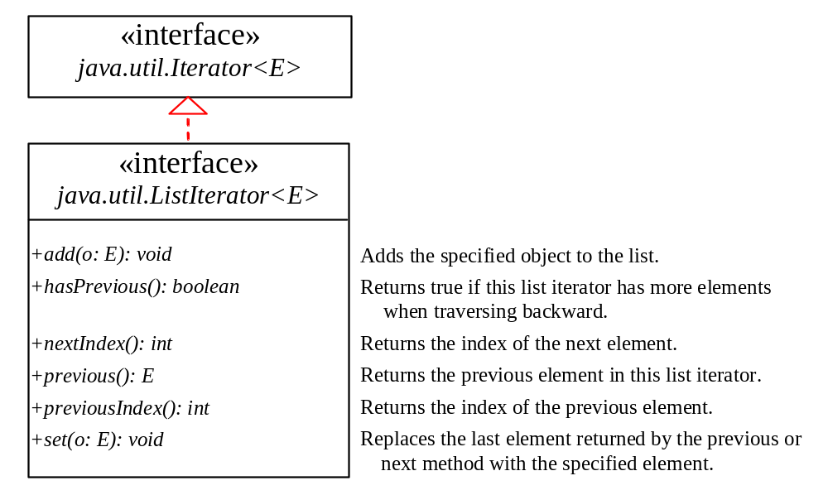
The List Iterator

Slide 8
ArrayList and LinkedList
The ArrayList class and the LinkedList class are concrete implementations of the List interface. Which of the two classes you use depends on your specific needs. If you need to support random access through an index without inserting or removing elements from any place other than the end, ArrayList offers the most efficient collection. If, however, your application requires the insertion or deletion of elements from any place in the list, you should choose LinkedList. A list can grow or shrink dynamically. An array is fixed once it is created. If your application does not require insertion or deletion of elements, the most efficient data structure is the array.

Slide 9
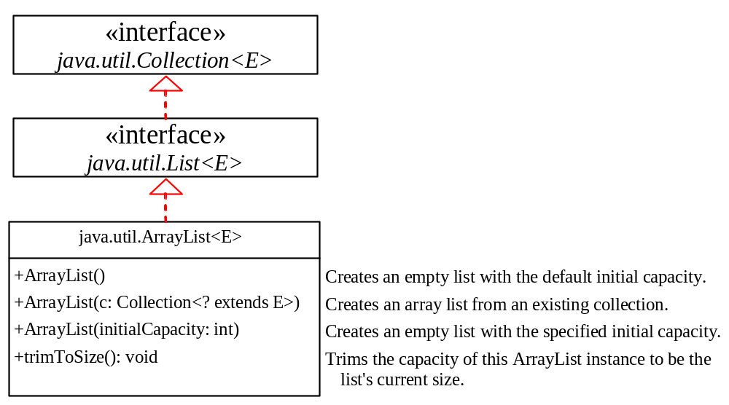
java.util.ArrayList

Slide 10
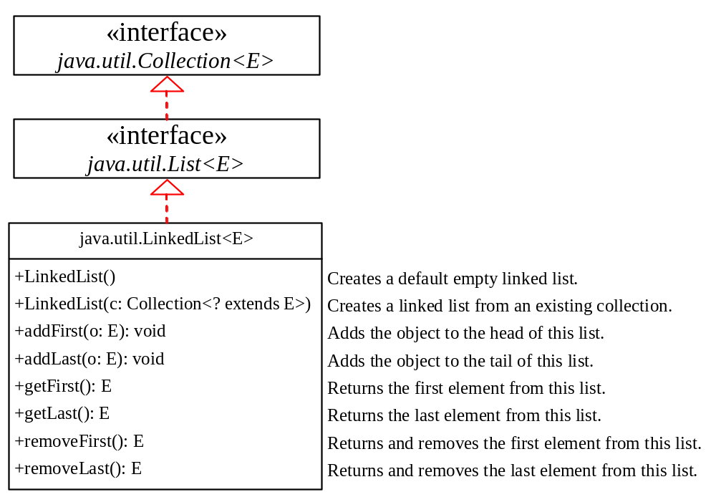
java.util.LinkedList

Slide 11
Example: Using ArrayList and LinkedList
This example creates an array list filled with numbers, and inserts new elements into the specified location in the list. The example also creates a linked list from the array list, inserts and removes the elements from the list. Finally, the example traverses the list forward and backward.

Slide 12
The Comparator Interface
Sometimes you want to insert elements of different types into a tree set. The elements may not be instances of Comparable or are not comparable. You can define a comparator to compare these elements. To do so, create a class that implements the java.util.Comparator interface. The Comparator interface has two methods, compare and equals.

Slide 13
The Comparator Interface
public int compare(Object element1, Object element2)
Returns a negative value if element1 is less than element2, a positive value if element1 is greater than element2, and zero if they are equal.
public boolean equals(Object element)
Returns true if the specified object is also a comparator and imposes the same ordering as this comparator.

Slide 14
The Collections Class
The Collections class contains various static methods for operating on collections and maps, for creating synchronized collection classes, and for creating read-only collection classes.

Slide 15
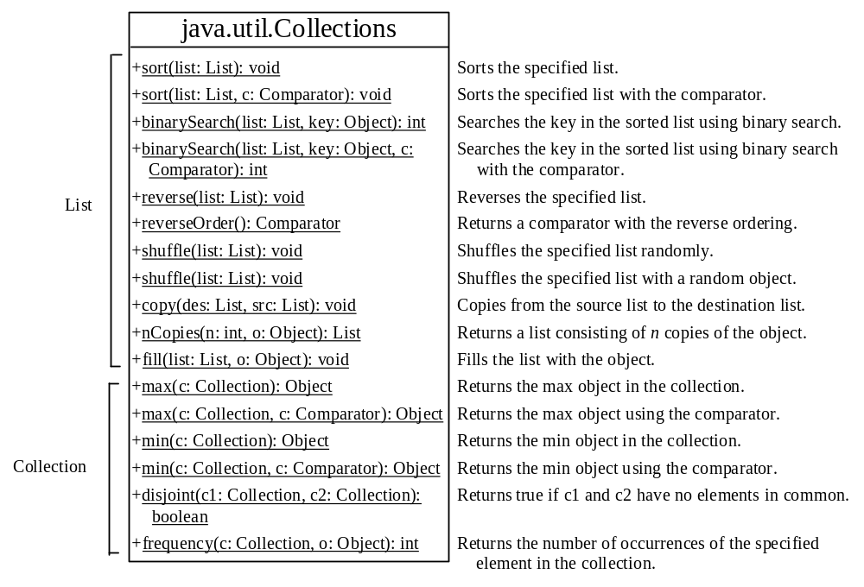
The Collections Class UML Diagram

Slide 16
The Vector and Stack Classes
The Java Collections Framework was introduced with Java 2. Several data structures were supported prior to Java 2. Among them are the Vector class and the Stack class. These classes were redesigned to fit into the Java Collections Framework, but their old-style methods are retained for compatibility. This section introduces the Vector class and the Stack class.

Slide 17
The Vector Class
In Java 2, Vector is the same as ArrayList, except that Vector contains the synchronized methods for accessing and modifying the vector. None of the new collection data structures introduced so far are synchronized. If synchronization is required, you can use the synchronized versions of the collection classes. These classes are introduced later in the section, “The Collections Class.”

Slide 18
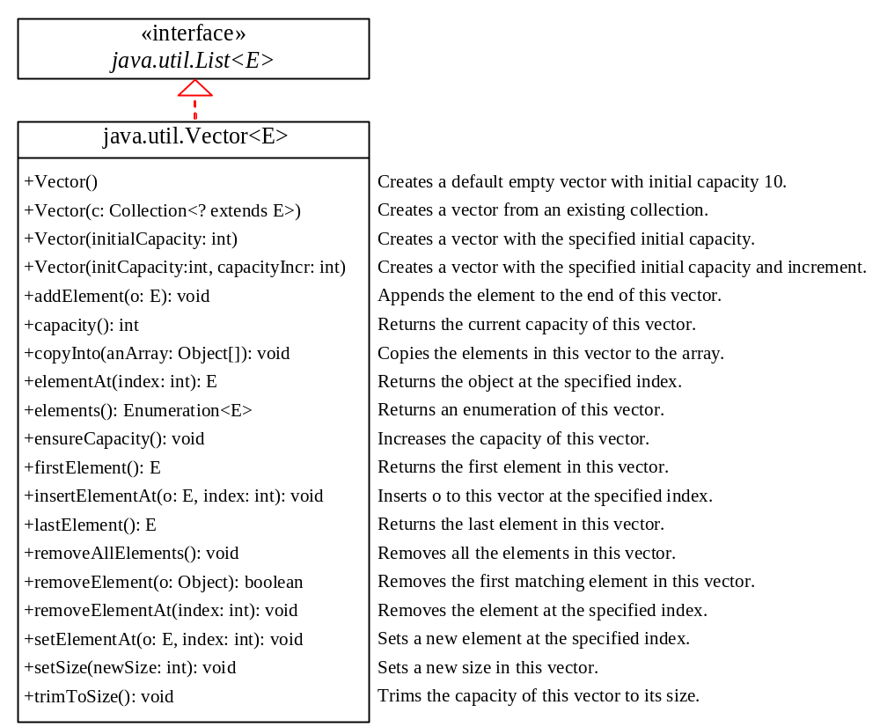
The Vector Class, cont.

Slide 19
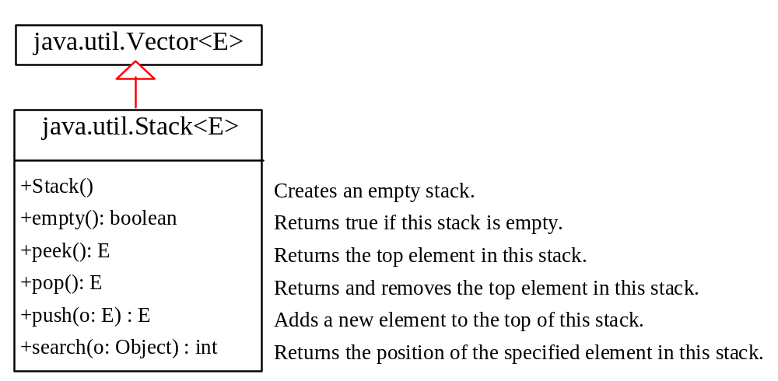
The Stack Class
The Stack class represents a last-in-first-out stack of objects. The elements are accessed only from the top of the stack. You can retrieve, insert, or remove an element from the top of the stack.

Slide 20
Queues and Priority Queues
A queue is a first-in/first-out data structure. Elements are appended to the end of the queue and are removed from the beginning of the queue. In a priority queue, elements are assigned priorities. When accessing elements, the element with the highest priority is removed first.

Slide 21
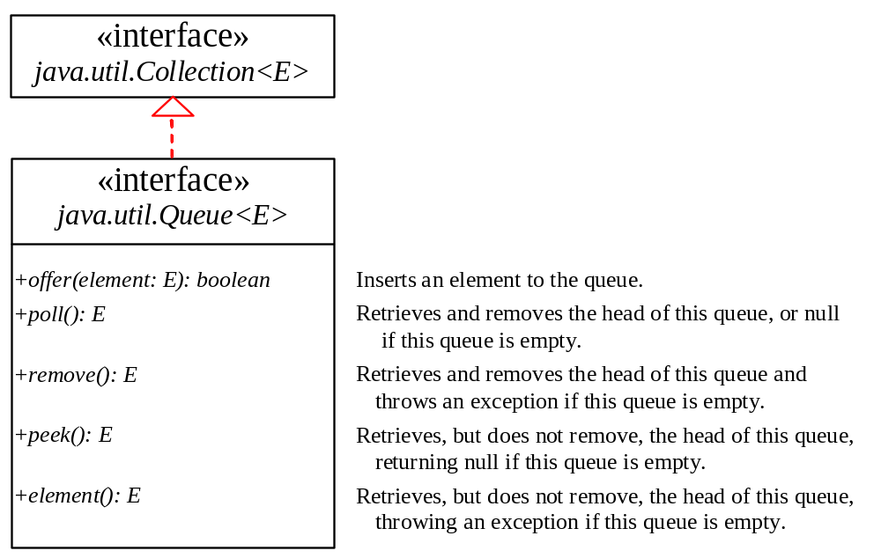
The Queue Interface

Slide 22
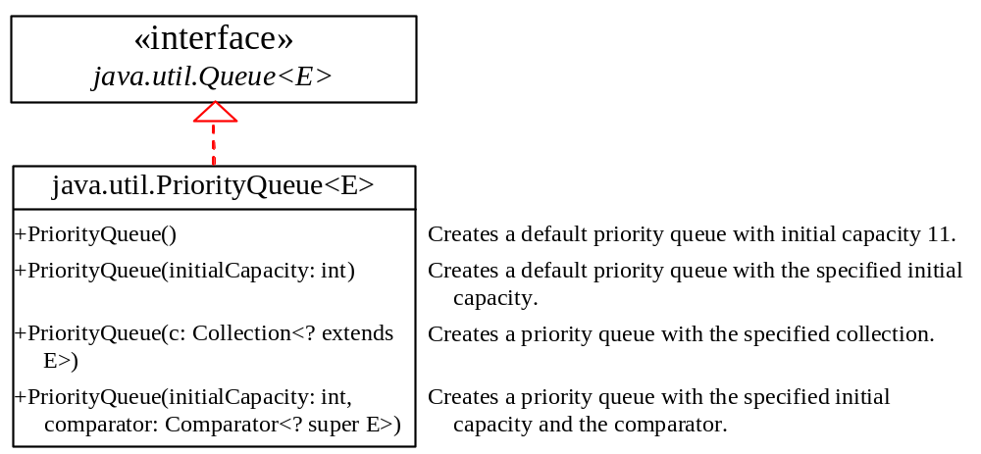
The PriorityQueue Class
PriorityQueueDemo
Run

Slide 23
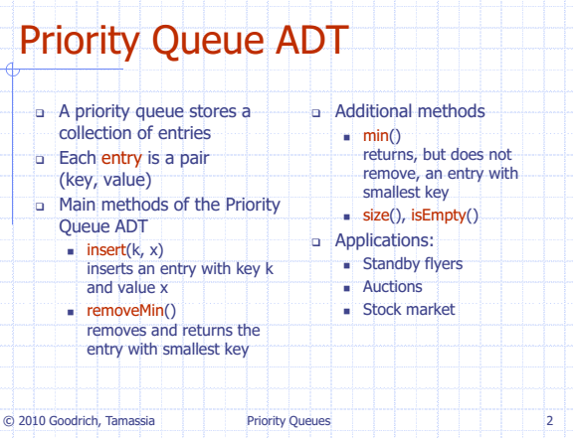


Slide 24
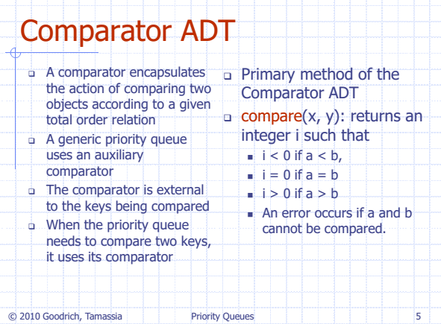

Slide 25
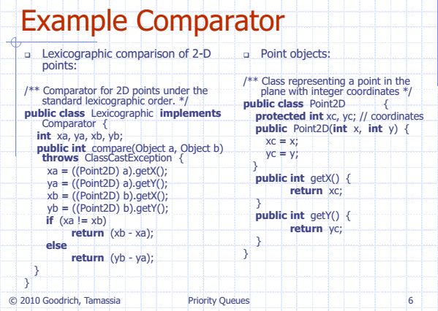

Slide 26
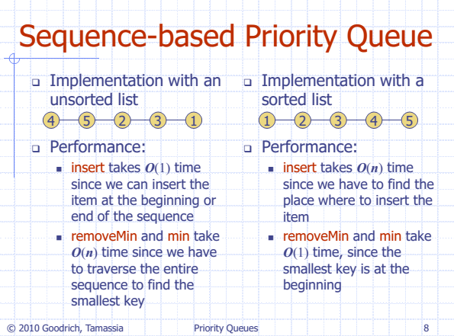

Slide 27
The PriorityQueue Class
The generic class being put in PriorityQueue Object must have implemented either comparators or provide comparables objects to PriorityQueue.
Failing to provide this(sorting mechanism) may lead to ClassCastException.
Care should be taken while designing the comparators and comparables to avoid silent integer overflows, which may lead the program to exhibit non-deterministic behaviour.
In case of ties for priority, the tasks are arbitrarily chosen.

