Slide 1
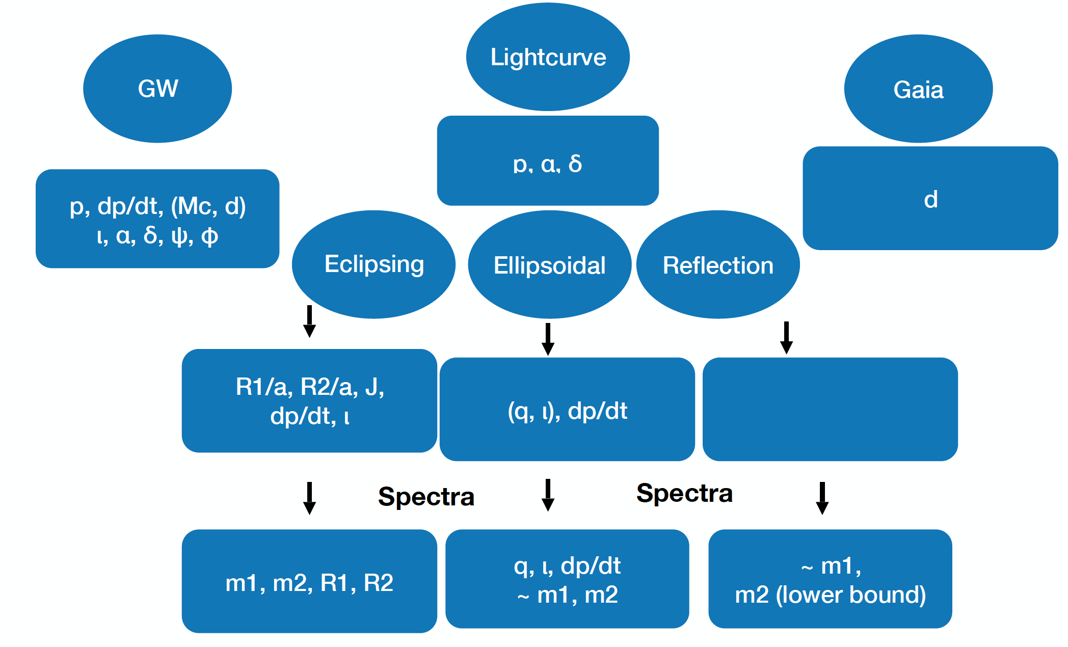
EM + GW: What synergies exist between individual WDBs studied in optical and GWs
Michael Coughlin Thomas Kupfer Tyson Littenberg Maria Jose Bustamante Rosell Greg Ashton

Slide 2
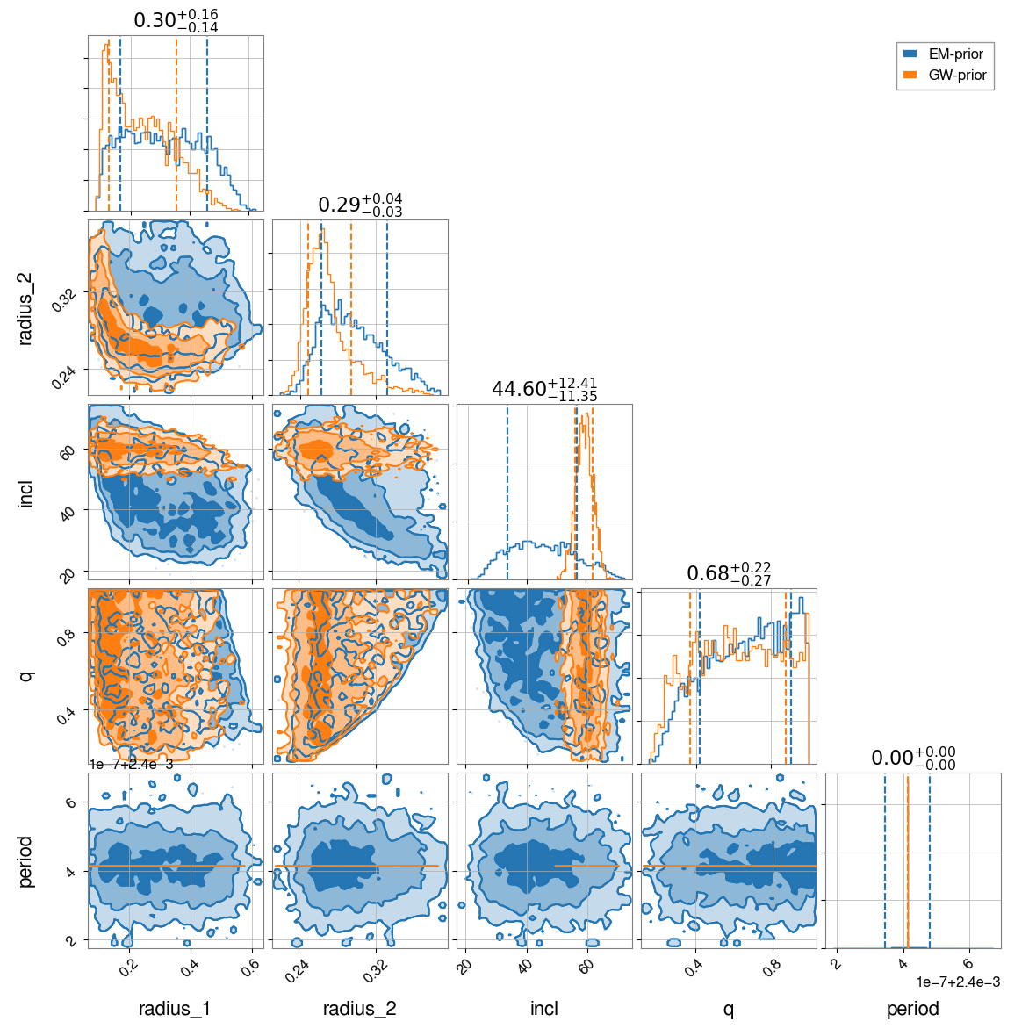
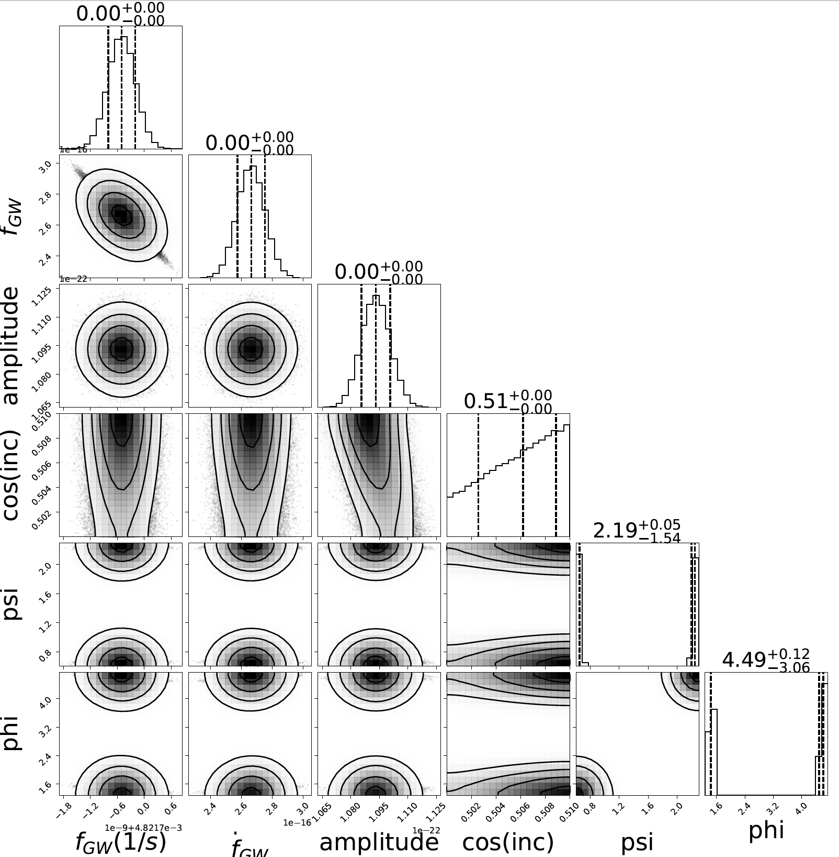
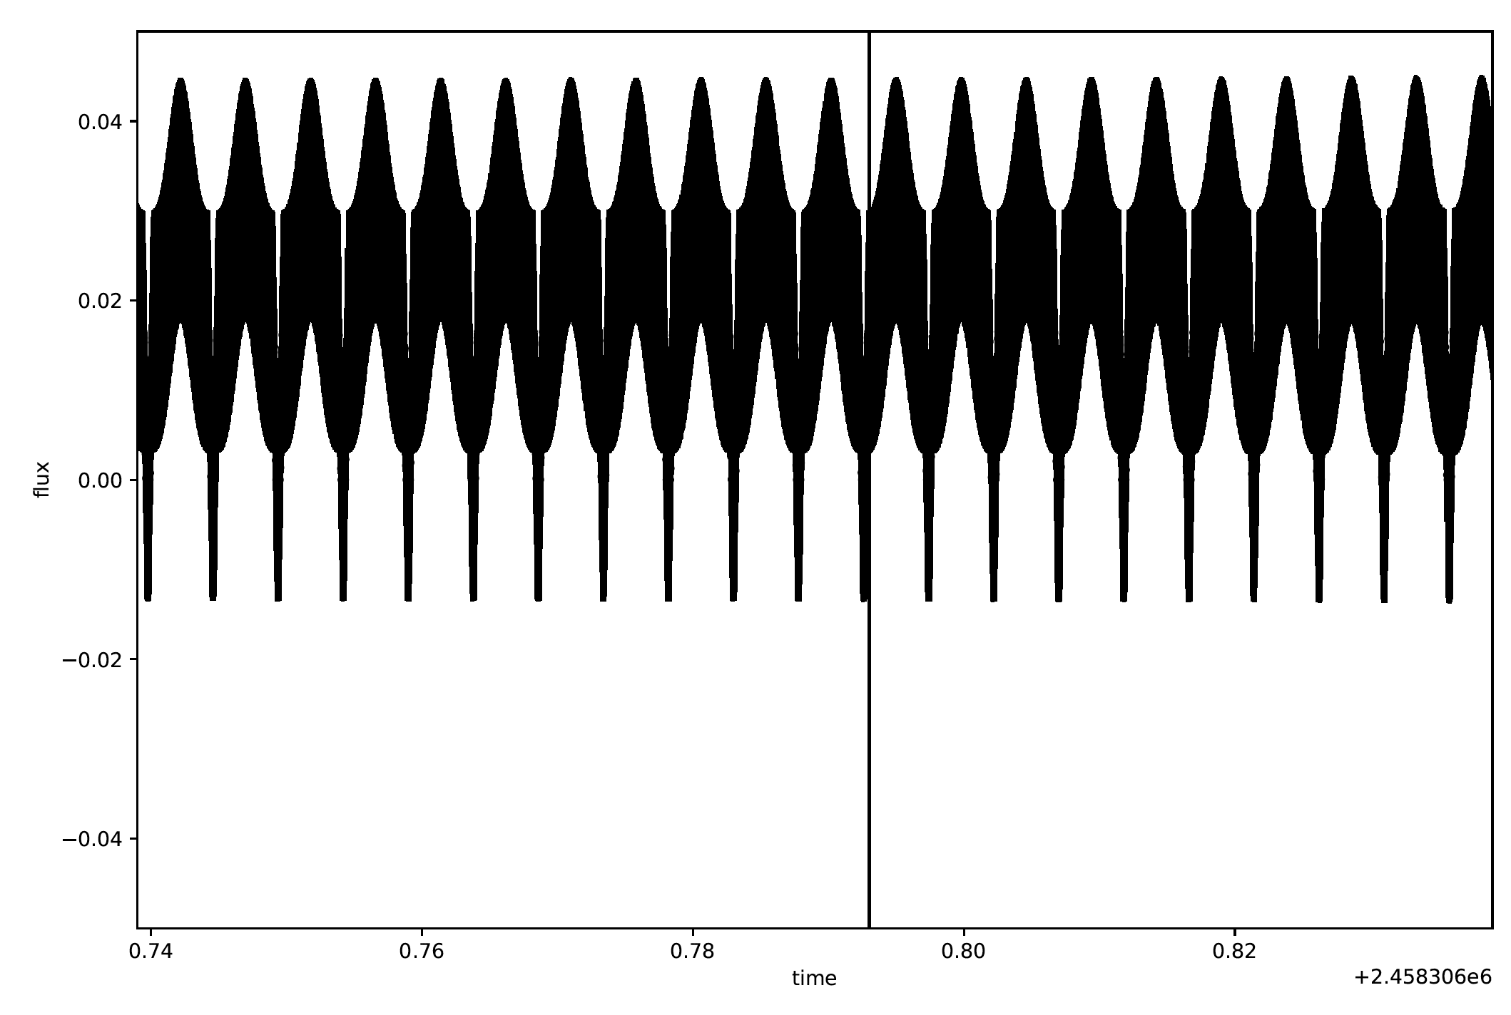
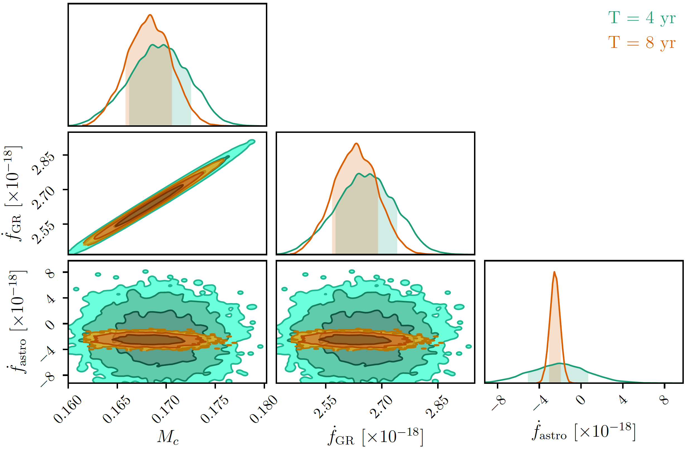
EM-GW
LISA
Optical
https://github.com/mcoughlin/gwemlisa

Slide 3
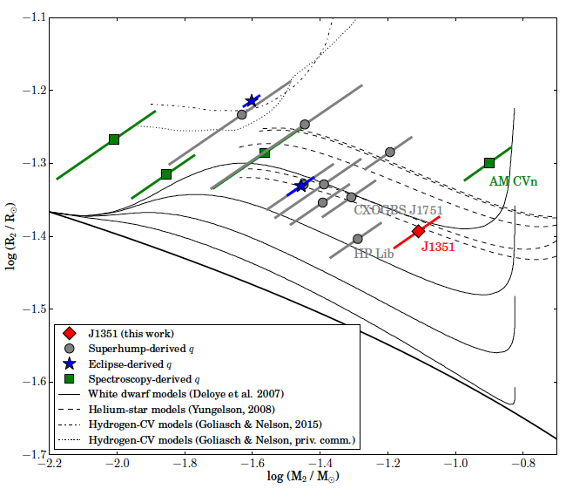
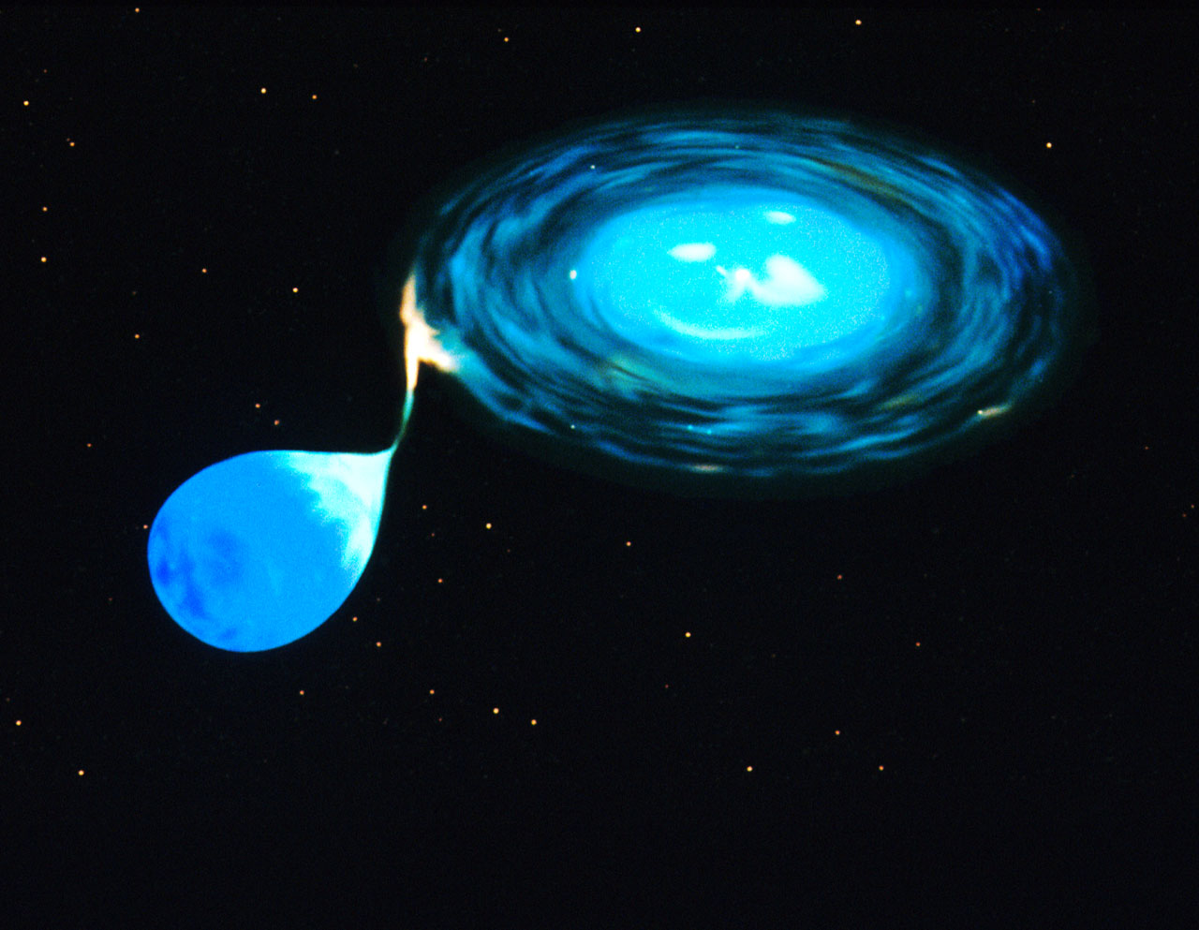
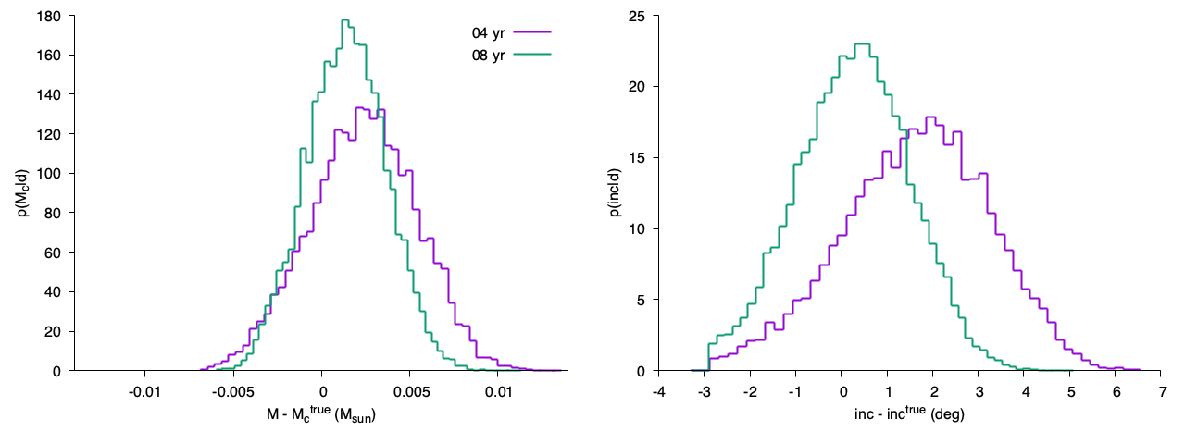
Thomas, Kyle,
Katie, Tyson,
Michael,
Maria Jose

Slide 4
Thomas, Kyle,
Katie, Tyson,
Michael,
Maria Jose
Chirp mass difference ~0.02 Msun
-> That is possible with a good distance

