Slide 1
TIER A COURSE PROJECT
SentinelLite SIEM
49
sample log events
15
A lightweight security monitoring system with rule-based detection, ML anomaly scoring, email alerts, and report-ready evidence.
alert groups
Gulraiz Dilawar | F2023376392 | Information Security (D1)

Slide 2
Problem Statement
Small labs generate logs but lack an affordable, explainable SIEM workflow.
Operational Pain
Security Risk
Project Response
- Apache, syslog, firewall, and Windows logs are scattered
- Manual review is slow and inconsistent
- Enterprise SIEMs are heavy for a student lab
- Brute-force bursts can be missed
- Reconnaissance probes blend into normal traffic
- Endpoint events need quick triage
- Normalize logs into one schema
- Explain every alert with evidence
- Score anomalies with Isolation Forest

Slide 3
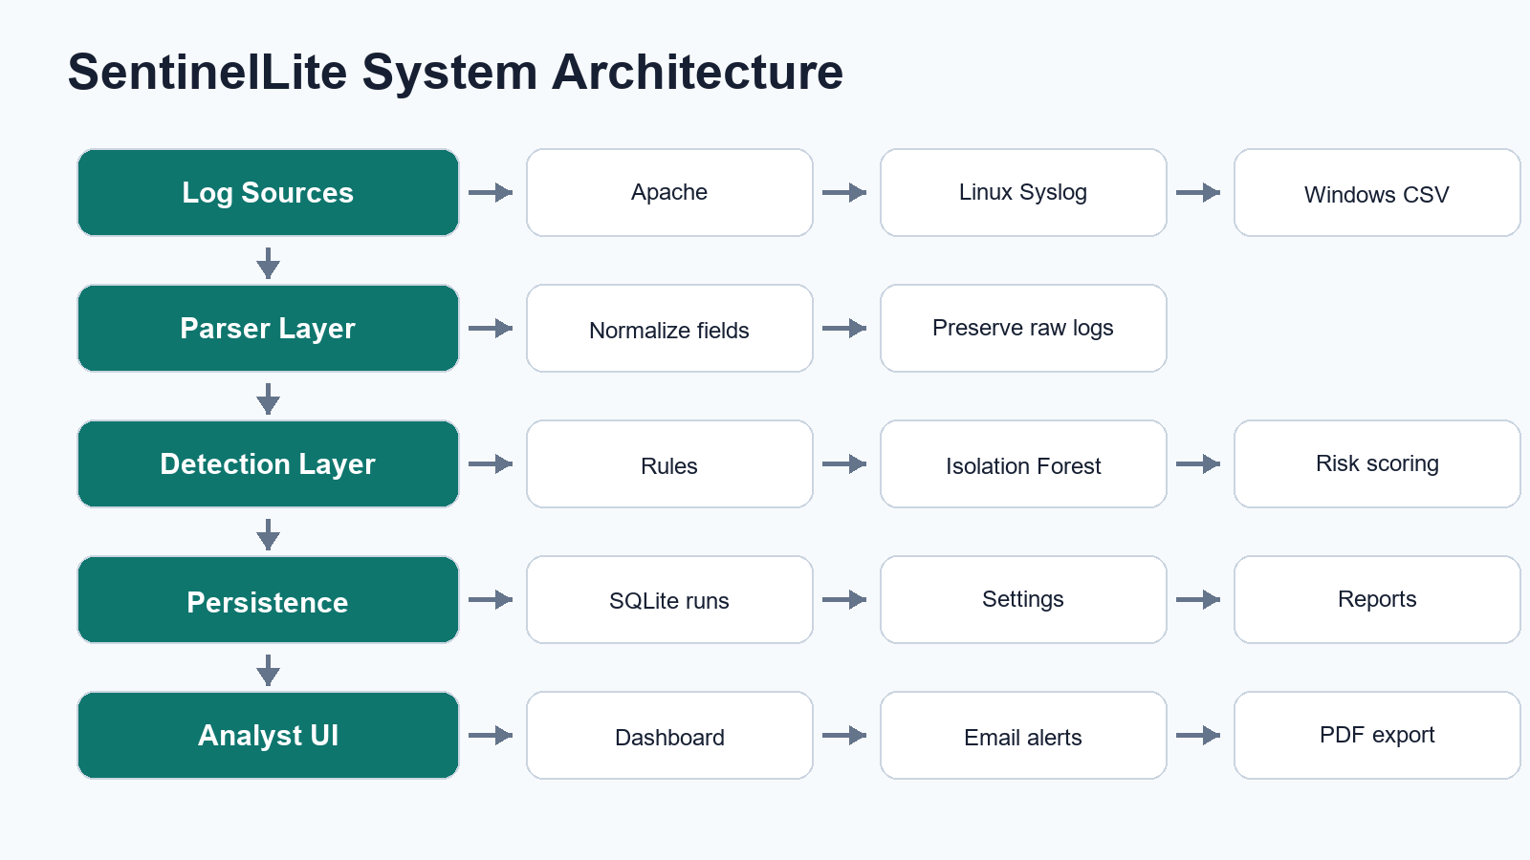
System Architecture
Separated components make the project easier to test and defend.

Slide 4
Data Sources and Normalization
All parsers preserve raw logs while extracting common investigation fields.
Inputs
Normalized Fields
Outputs
- Apache combined access logs
- Linux auth and syslog
- Firewall UFW-style syslog
- Windows Event CSV
- timestamp, source file, log type
- source IP, user, event type
- method, path, status code
- raw evidence message
- Rule alerts
- Anomaly windows
- SQLite history
- PDF and email reports

Slide 5
Rule-Based Detection
Known attack patterns are mapped to severity, evidence, response, and MITRE ATT&CK.
Brute force burst
SQL injection probe
Port scan pattern
PowerShell execution
Audit log cleared
T1110
T1190
T1046
T1059.001
T1070
Evidence + response recommendation
Evidence + response recommendation
Evidence + response recommendation
Evidence + response recommendation
Evidence + response recommendation
URL-encoded attack strings are decoded before matching. Repeated scanner user agents are grouped per source window to reduce noisy duplicates.

Slide 6
ML Anomaly Detection
Isolation Forest flags unusual source-IP behavior without needing a large labeled dataset.
Feature Window
Why Isolation Forest?
- 15-minute source-IP grouping
- request count
- failed login count
- HTTP error count
- unique path count
- scanner UA and firewall block count
- Unsupervised: useful when labels are scarce
- Efficient for a lab-scale prototype
- Produces anomaly score for analyst triage
- Works alongside explainable rules

Slide 7
Dashboard Experience
Designed as a compact security operations console, not a static demo page.
Overview
Investigation
Outputs
- Risk posture
- severity mix
- top sources
- timeline
- alert filters
- related logs
- MITRE mapping
- recommendations
- evaluation metrics
- PDF report
- SMTP digest
- run history

Slide 8
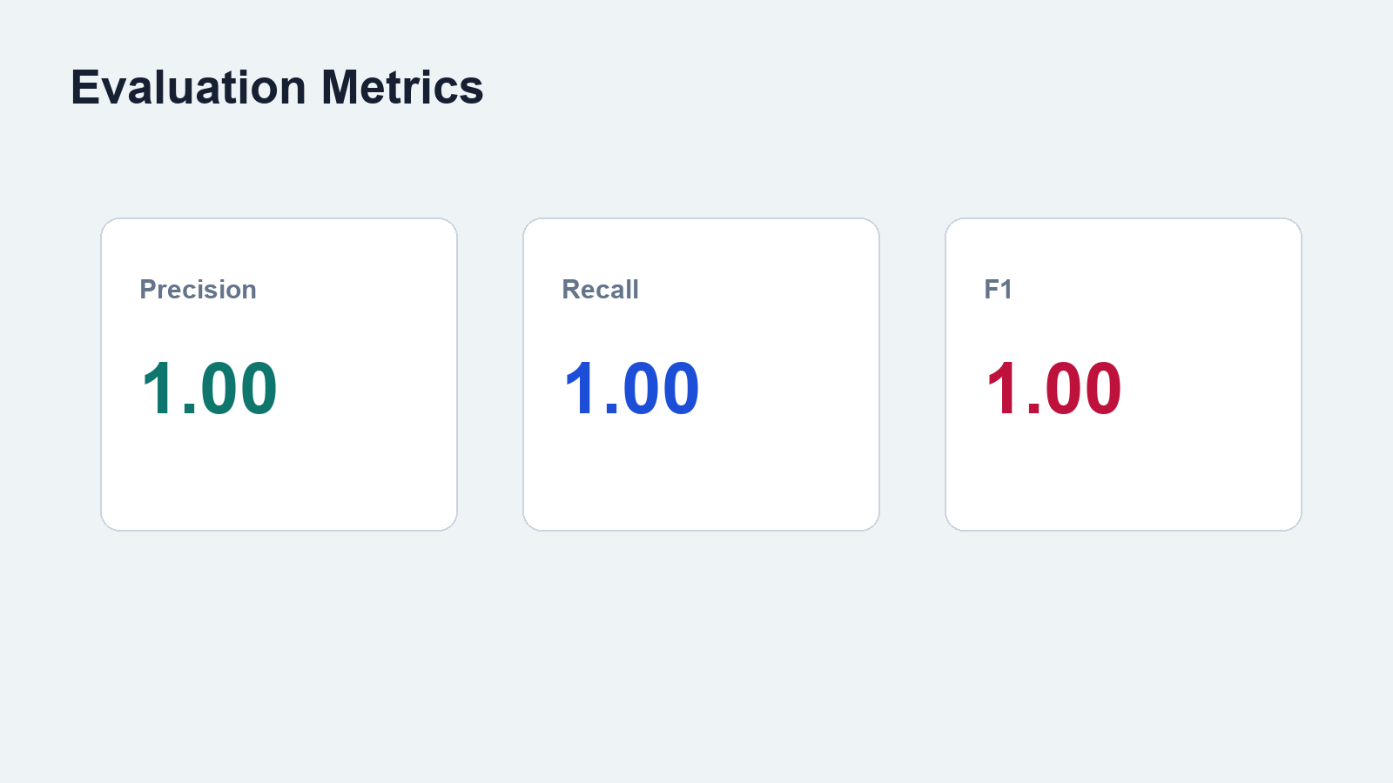
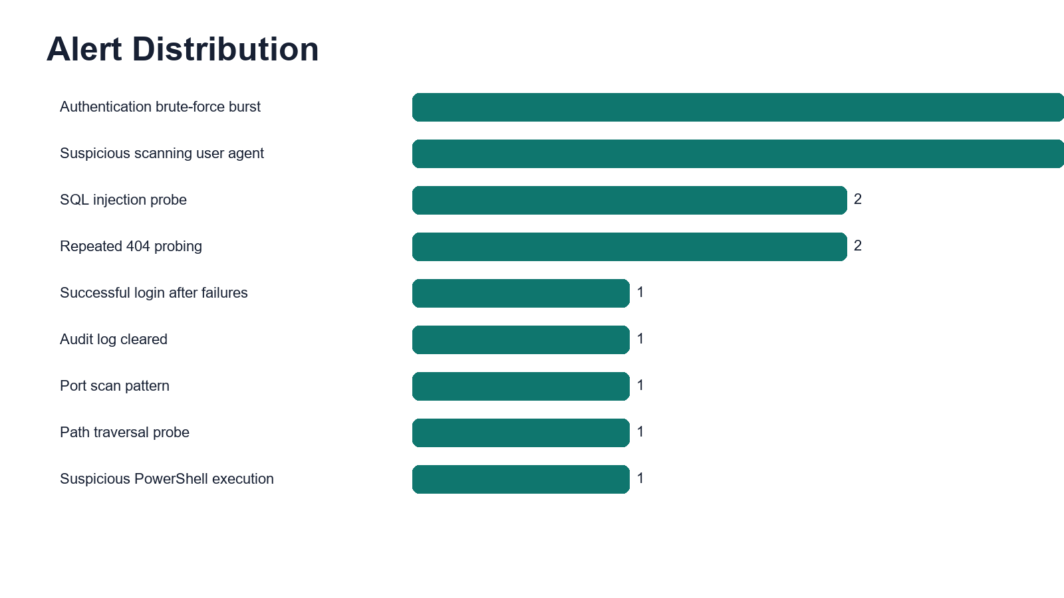
Testing Results
The included safe dataset has explicit expected-alert labels.
Smoke test: 49 parsed events, 15 alert groups, 3 anomaly windows. Evaluation: precision 1.00, recall 1.00, F1 1.00 on the labeled sample set.

Slide 9
Live Demo Flow
A 10-minute viva demo can be completed from one dashboard.
Demo Steps
Panel Questions Covered
- Run sample logs
- Open Alerts and explain evidence
- Open Anomalies and explain features
- Search raw logs for sqlmap / DPT= / Failed password
- Generate report and show email digest
- Why these rules?
- What if ML is wrong?
- What are false positives?
- What does the system not defend against?
- What would be improved next?

Slide 10
Security Mechanisms
The project emphasizes transparent controls and defensible reasoning.
Detection
Evidence
Operational Safety
- signature-like rules
- time-window aggregation
- anomaly scoring
- raw log preservation
- related-log drilldown
- PDF report
- safe sample logs
- no payload execution
- email password not stored

Slide 11
Comparison and Limitations
SentinelLite is intentionally lightweight and honest about its boundary.
Compared With Full SIEM
Known Limitations
- lower setup cost
- easy to understand
- not built for enterprise scale
- no distributed agents
- small evaluation dataset
- threshold tuning required
- cannot detect attacks that leave no logs
- future work: scheduled ingestion and larger datasets

Slide 12
Conclusion and Future Work
SentinelLite fulfills the selected Tier A project requirements.
Completed
Next Steps
- multi-source ingestion
- rule detections
- Isolation Forest anomalies
- dashboard
- SQLite
- PDF report
- SMTP email alerts
- testing evidence
- push GitHub repo
- record demo video
- test larger public datasets
- add Telegram and scheduled scans
- extend MITRE reporting

Slide 13
References
Key sources used in the report and design.
[1] NIST SP 800-92, Guide to Computer Security Log Management
[2] Liu, Ting, Zhou, Isolation Forest, IEEE ICDM 2008
[3] LogLead, arXiv:2311.11809
[4] MITRE ATT&CK T1110, T1046, T1190, T1059.001, T1070
[5] Web Traffic Anomaly Detection Using Isolation Forest, Information, 2024
Project files include full report, literature review, test plan, demo script, and readiness checklist.

