Slide 1
Decision Trees- ID3
Dr.Muhammad.Shahbaz@gmail.com
© M. Shahbaz – 2012

Slide 2
Decision Tree
Decision tree is one of the most popular classification type of algorithm used by data miners.
Classification is done by tree like structures that have different test criteria for a variable at each of the nodes
New leaves are generated based on the results of the tests at the nodes
Decision Tree is a supervised learning system in which classification rules are constructed from the decision tree
Dr.Muhammad.Shahbaz@gmail.com
© M. Shahbaz – 2012

Slide 3
Decision Trees
Decision trees represent attribute-based descriptions of concepts:
  We assume a universe of objects of interest (e.g. the set of all animals)
  A “concept” is defined by the subset of objects which satisfy it (e.g. the concept of a “fox”, as defined by the set of all foxes)
  Each object has a number of attributes, or properties (e.g. “colour”, “has_fur”, “eats_meat”, etc.)
  The decision tree defines the concept in terms of the values of these attributes that an example must have
Often, decision trees define Boolean Functions: Input to the tree is an object described by a set of properties; output is “Yes/No”
Dr.Muhammad.Shahbaz@gmail.com
© M. Shahbaz – 2012

Slide 4
Decision Trees
Each internal node in the tree corresponds to a test of
the value of one attribute, with branches to each of the
possible values of that test.
Each leaf node specifies the Boolean output of the tree
if that point is reached.
The aim is to learn a definition of the goal predicate for
the problem at hand.
  The goal predicate can be seen as a logical rule
  defining the concept – equivalent to the decision
  tree.
Dr.Muhammad.Shahbaz@gmail.com
© M. Shahbaz – 2012

Slide 5
Example – Restaurant Problem
Should we wait for a table at a restaurant?
Input Attributes:
  Alternate – Suitable alternative restaurant nearby?
  Bar – Is there one to wait in?
  Fri/Sat – Is it Friday or Saturday?
  Hungry – Are we?
  Patrons – How many (None, Some, Full)?
  Price – How pricey is this place?
  Raining – Is it?
  Reservation – Have we made one?
  Type – Of food (French, Italian, Burger, . . . ).
  WaitEstimate – How long, estimated by the host.
Determine output attribute: WillWait.
Dr.Muhammad.Shahbaz@gmail.com
© M. Shahbaz – 2012

Slide 6
Some Training Examples
Example | Attributes |  |  |  |  |  |  |  |  |  | Goal WillWait?
 | Alt | Bar | Fri | Hun | Pat | Price | Rain | Res | Type | Est
X1 | Yes | No | No | Yes | Some | $$$ | No | Yes | French | 0-10 | Yes
X2 | Yes | No | No | Yes | Full | $ | No | No | Thai | 30-60 | No
X3 | No | Yes | No | No | Some | $ | No | No | Burger | 0-10 | Yes
X4 | Yes | No | Yes | Yes | Full | $ | No | No | Thai | 10-30 | Yes
X5 | Yes | No | Yes | No | Full | $$$ | No | Yes | French | >60 | No
X6 | No | Yes | No | Yes | Some | $$ | Yes | Yes | Italian | 0-10 | Yes
X7 | No | Yes | No | No | None | $ | Yes | No | Burger | 0-10 | No
X8 | No | No | No | Yes | Some | $$ | Yes | Yes | Thai | 0-10 | Yes
X9 | No | Yes | Yes | No | Full | $ | Yes | No | Burger | >60 | No
X10 | Yes | Yes | Yes | Yes | Full | $$$ | No | Yes | Italian | 10-30 | No
X11 | No | No | No | No | None | $ | No | No | Thai | 0-10 | No
X12 | Yes | Yes | Yes | Yes | Full | $ | No | No | Burger | 30-60 | Yes
We need a collection of example objects (rows in a table), each with values for all the attributes and the values of the “output class”
Positive (Yes) and Negative (No) examples are needed
Dr.Muhammad.Shahbaz@gmail.com
© M. Shahbaz – 2012

Slide 7
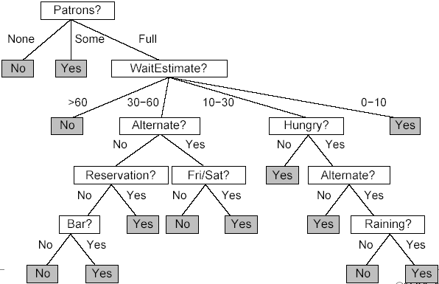
Possible Decision Tree
Dr.Muhammad.Shahbaz@gmail.com
© M. Shahbaz – 2012

Slide 8
How to Construct a Decision Tree
Given a table of positive & negative examples, each with an output class, how do we produce a decision tree for this training data set?
Observe that each non-leaf node of the tree gives a test on one of the attributes in the dataset.
Any example will satisfy only one of the options given.
Therefore, the tree splits the training dataset between the branches of the tree according to attribute values.
So, we start at the root node with all the training examples, and choose an attribute to split on.
Each of the daughter nodes gives a subset of the training set.
Then we can do exactly the same thing with each daughter node, until the examples remaining are all “Yes” or all “No”, or we run out of attributes.
Dr.Muhammad.Shahbaz@gmail.com
© M. Shahbaz – 2012

Slide 9
Information Content
This is the quantity of information that we gain when we find out for sure what the class of the test object actually is.
e.g. If we toss an unbiased coin, the information content of the outcome is one bit.
If the coin is biased, the information content is less.
Calculate the information content in general from the probability distribution on possible outcomes (i.e. non-zero probabilities). . .
Dr.Muhammad.Shahbaz@gmail.com
© M. Shahbaz – 2012

Slide 10
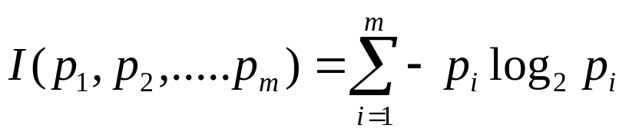
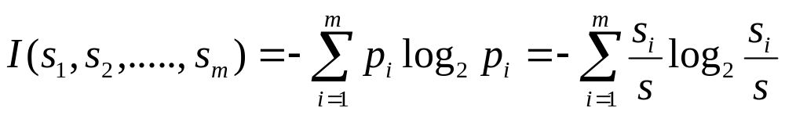
Information Content
If there are m different answers, v_{i}, each one having a probability p_{i}, then the information content, I, of the actual answer is
If we have a decision tree node associated with a set of s examples, S, where the class label has m values defining classes C_{i}, with s_{i} examples of each class (i = 1, …., m) we estimate the information content as:
Dr.Muhammad.Shahbaz@gmail.com
© M. Shahbaz – 2012

Slide 11
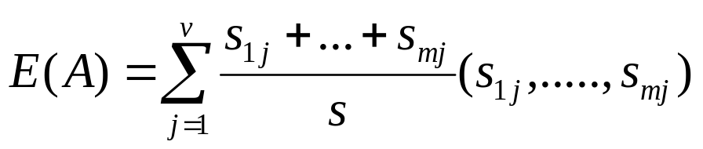
Information Gain
Suppose that attribute A has v different values, {a₁, a₂, …, a_{v}}. Suppose that we use attribute A to partition the set of examples, S, into subsets {S₁, S₂, …,S_{V}}, where S_{j} contains the examples from S which have the value a_{j} for A.
Let s_{ij}, be the number of examples of class C_{i} in subset S_{j}. Expected information based on partitioning using A:
Expected Information = (Probability of choosing a branch)*(Information content of branch), summed over all v available branches
Dr.Muhammad.Shahbaz@gmail.com
© M. Shahbaz – 2012

Slide 12
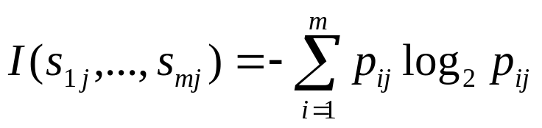
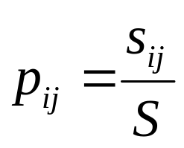
Information Gain
In the above
Where
Information Gain by branching on A, is:
Gain(A) = I(s₁,s₂,…,s_{m}) - E(A)
Find Gain value for each attribute, then choose the attribute with the highest value as the test attribute for the current node
Dr.Muhammad.Shahbaz@gmail.com
© M. Shahbaz – 2012

Slide 13
Example
Consider the following database defining a concept
Ex Attribute Attribute Attribute Concept
No. Size Colour Shape Satisfied
1 medium blue brick yes
2 small red wedge no
3 small red sphere yes
4 large red wedge no
5 large green pillar yes
6 large red pillar no
7 large green pillar yes
Dr.Muhammad.Shahbaz@gmail.com
© M. Shahbaz – 2012

Slide 14
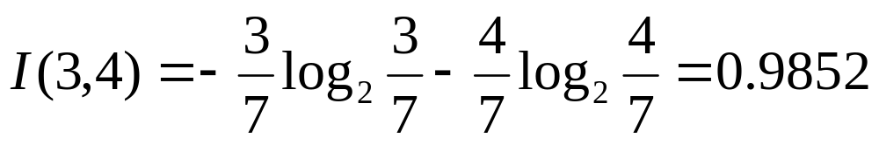
Example
Starting at the root node we have examples {1, 2, 3, 4, 5, 6, 7 }, with information content:
Consider choosing to split on Shape
{1, 2, 3, 4, 5, 6, 7}
Shape
Brick
{1}
Yes
Wedge
{2, 4}
No
Sphere
{3}
Yes
Pillar
{5, 6, 7}
?
This is a pretty good choice, What is the information gain?
Dr.Muhammad.Shahbaz@gmail.com
© M. Shahbaz – 2012

Slide 15
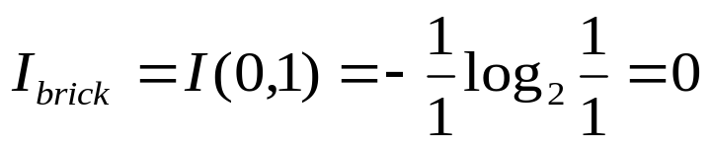
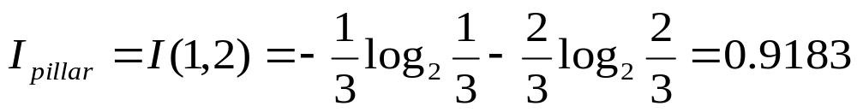
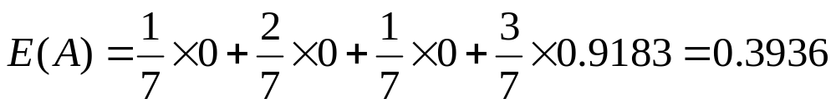
Example
Information content of each of the resulting nodes:
For Brick, Wedge and Sphere, all examples are of the same class in the same node (all yes or all no).
For these, information contents is 0, e.g.:
For pillar, we have 2 yes and 1 no examples:
Expected information content of daughter node:
Brick
Wedge
Sphere
Pillar
Dr.Muhammad.Shahbaz@gmail.com
© M. Shahbaz – 2012

Slide 16
Example
So, information Gain for choosing Shape is:
Gain(Shape) = 0.9852 – 0.3936 = 0.5916
For others:
E(Size) = 0.8571,
Gain(Size) = 0.1281
Calculate E(Colour) and Gain(Colour)….?
E(Colour)=0.4636,
Gain(Colour) = 0.5216
Check these for yourself
So, we choose to split on Shape first.
Dr.Muhammad.Shahbaz@gmail.com
© M. Shahbaz – 2012

Slide 17
Over Fitting
What is over fitting?
What is its disadvantage? Or why it should be avoided
Generalization become difficult with overfitting
How can we tackle over fitting problems
What is the difference between Discrete and Continuous variables?
Dr.Muhammad.Shahbaz@gmail.com

Slide 18
Tree Pruning
Many Branches of the built tree shows anomalies due to Noise or Outliers
Overfitting can also be a problem in DTs
Statistical methods are used to remove the least reliable branches
Two common strategies for tree pruning are,
    Pre pruning
    Post pruning
Dr.Muhammad.Shahbaz@gmail.com

Slide 19
Pre Pruning
In Pre Pruning technique tree is pruned by halting its construction early
This is done by giving a stopping criterion
Further split of the node is halted
Upon halting the node becomes a leaf
The leaf may hold the most frequent class among the subset sample or the probability distribution of those samples
Dr.Muhammad.Shahbaz@gmail.com

Slide 20
Pre Pruning - Stopping Criterion
Choice of an appropriate threshold is difficult
A higher value of threshold would result in oversimplified tree
A lower threshold value give very little simplification
Dr.Muhammad.Shahbaz@gmail.com

Slide 21
Post Pruning
In post pruning branches are removed from a fully grown tree
The lowest unpruned node becomes leaf and is labeled with the most frequent class among its former branches
For each non-leaf node, post pruning algorithm calculates the expected error rate if pruning is done
Also the expected error rate is calculated if pruning is not done using the error rate for each branch
Pruning is done if the weighted expected error is less with pruning otherwise branch is not pruned
Dr.Muhammad.Shahbaz@gmail.com

Slide 22
Post Pruning
Post pruning requires more computation but have more reliable and accurate results
Some times practitioners combined both techniques to get good results with comparatively less computation
Dr.Muhammad.Shahbaz@gmail.com

Slide 23
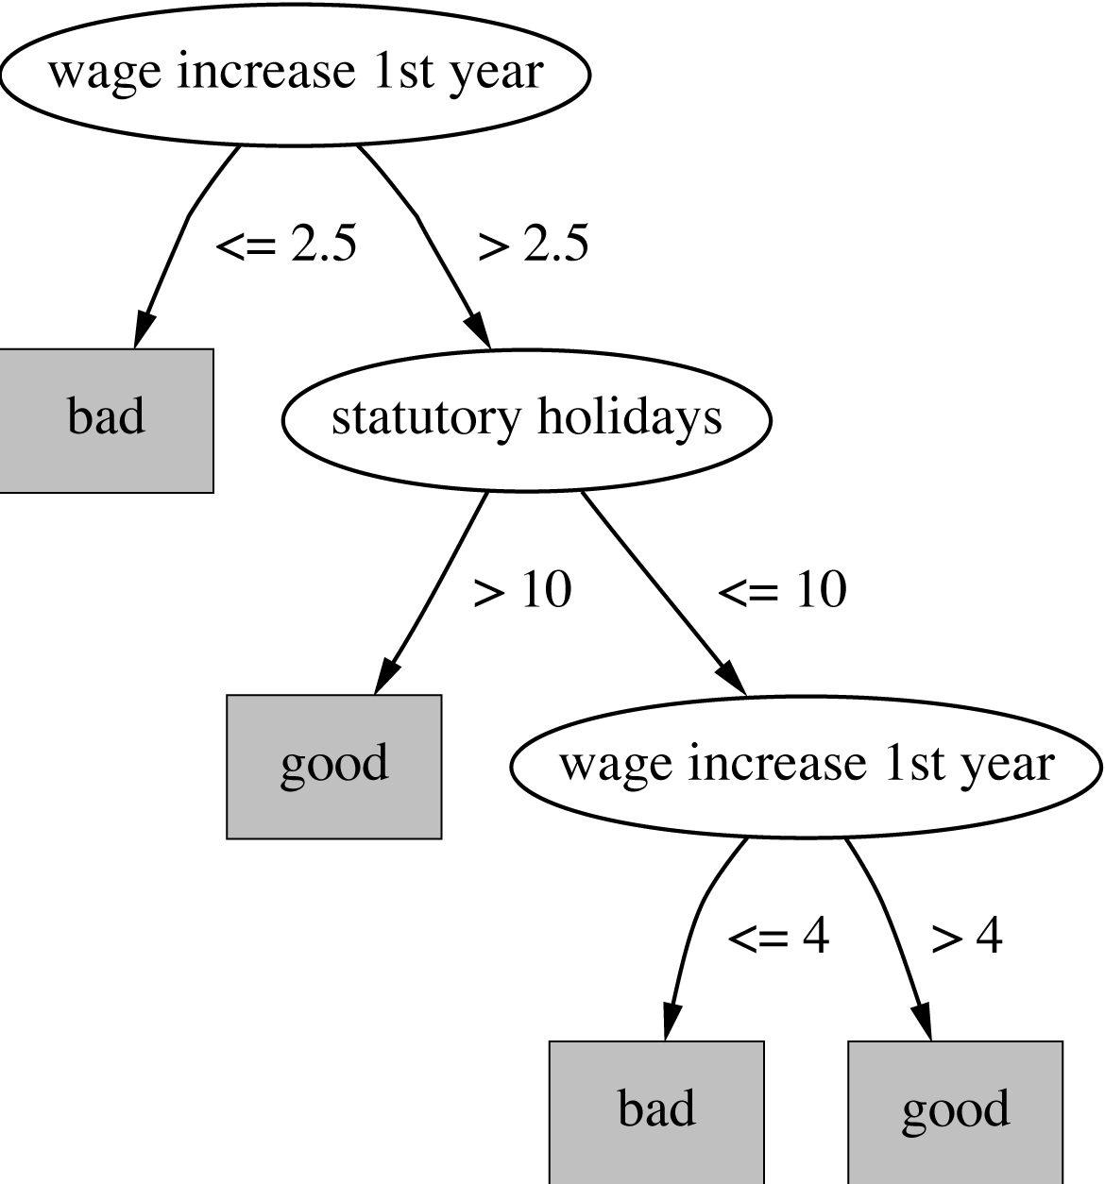
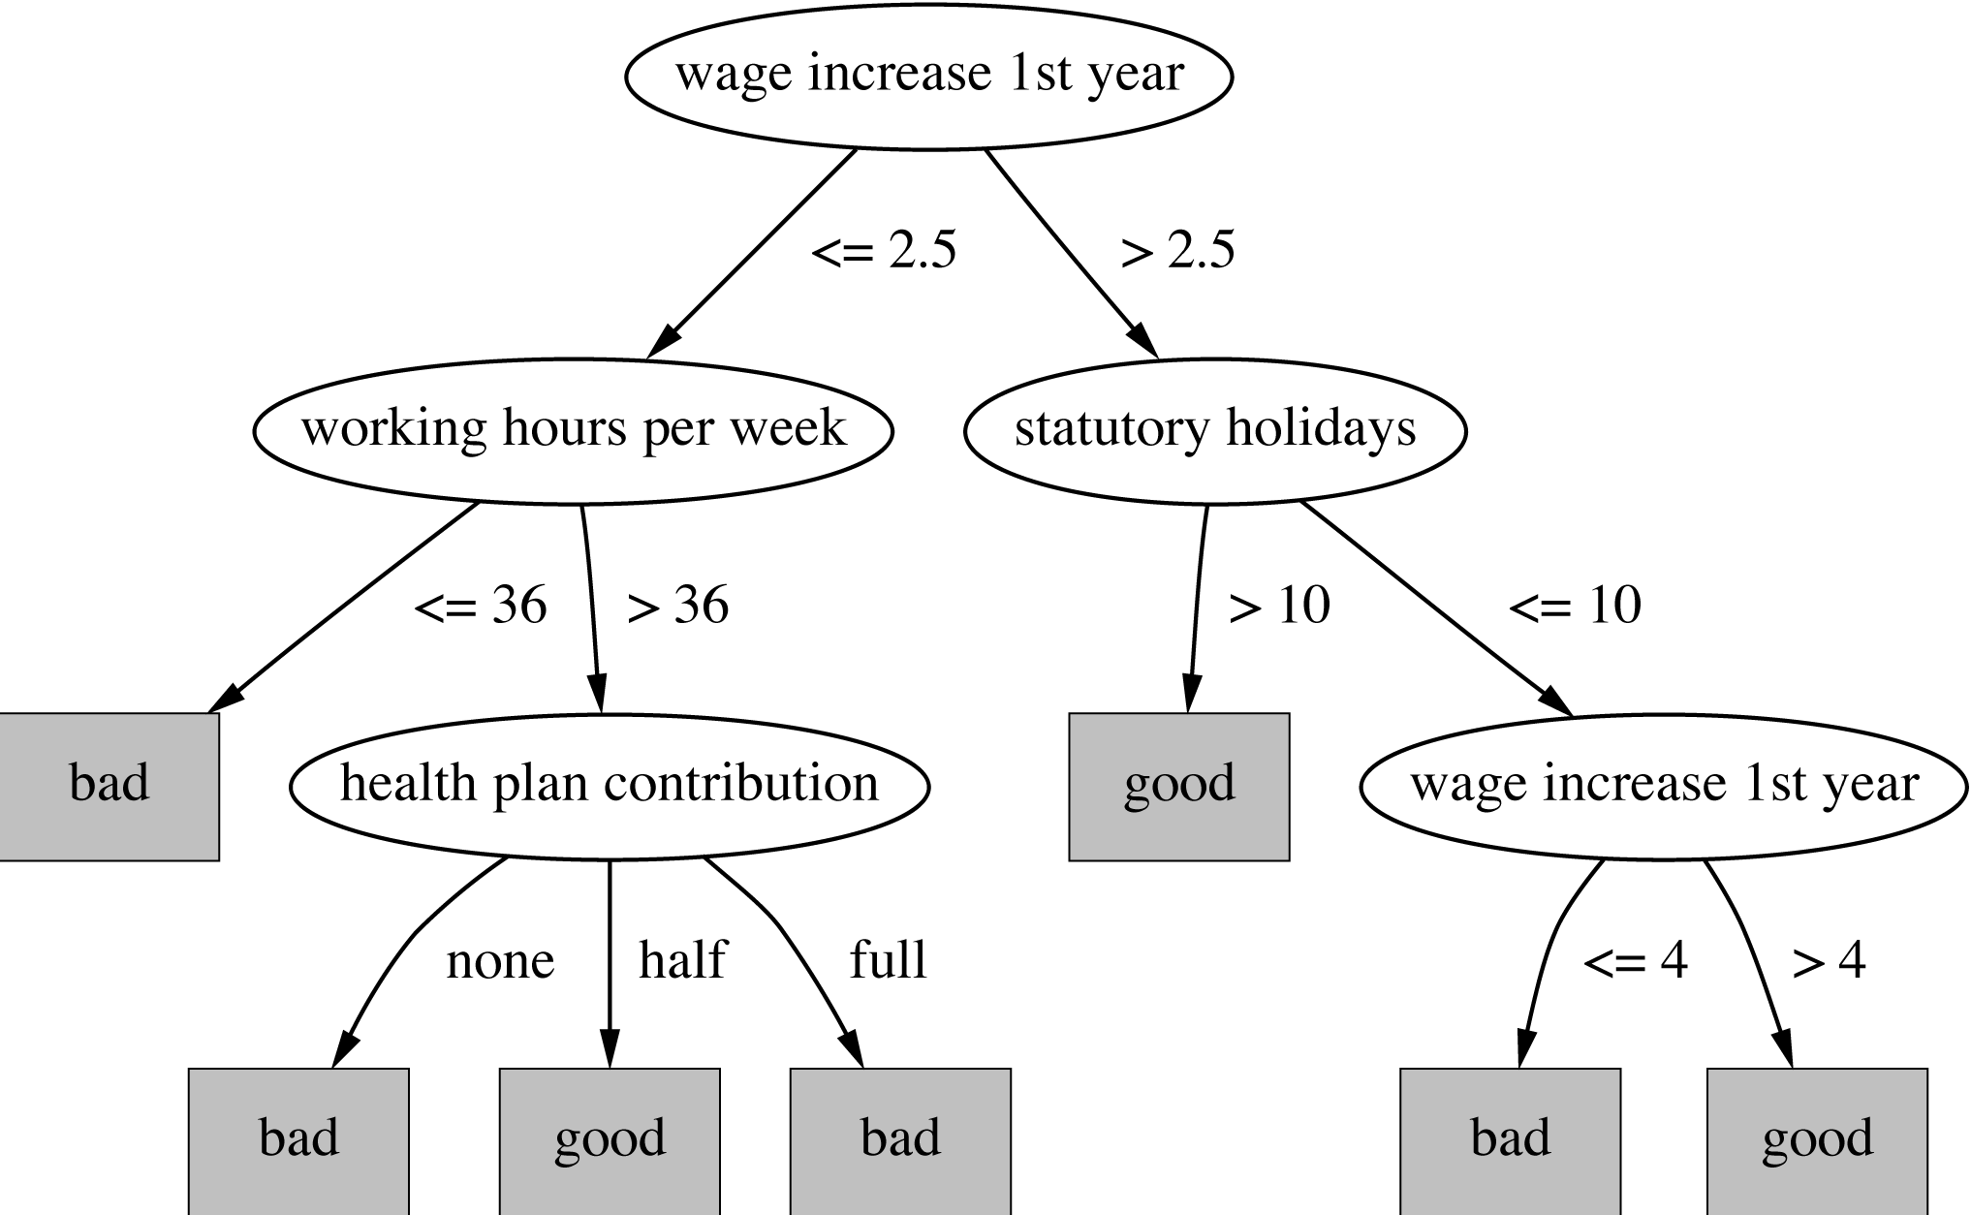
Post Pruning
Dr.Muhammad.Shahbaz@gmail.com

Slide 24
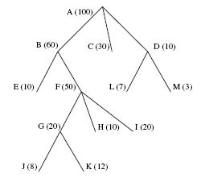
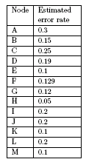
Post Pruning
Dr.Muhammad.Shahbaz@gmail.com

Slide 25
Questions
?

