Slide 1
Lecture 6: Training Neural Networks,
Part I
Lecture 6 -
1
Fei-Fei Li & Justin Johnson & Serena Yeung Lecture 6 - April 20, 2017

Slide 2
Mini-batch SGD
Where we are now...
Loop:
Sample a batch of data
Forward prop it through the graph (network), get loss
Backprop to calculate the gradients
Update the parameters using the gradient
Lecture 6 -
2

Slide 3
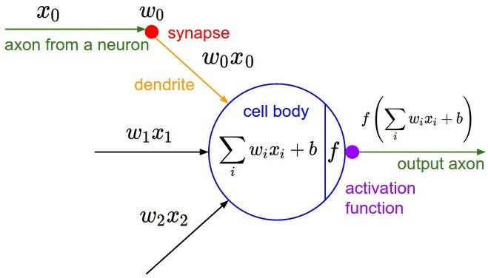
Activation Functions
Fei-Fei Li & Justin Johnson & Serena Yeung Lecture 6 - April 20, 2017

Slide 4
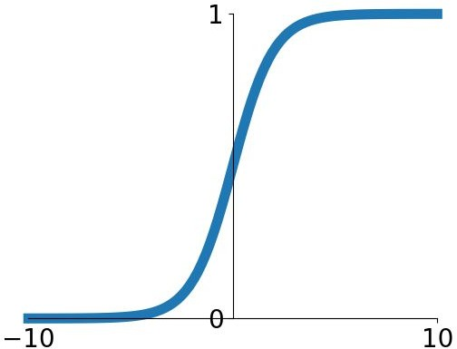
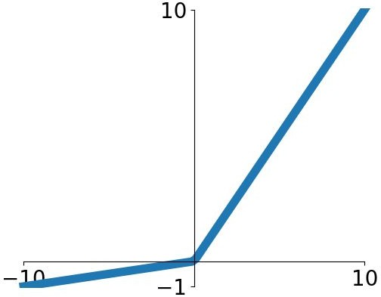


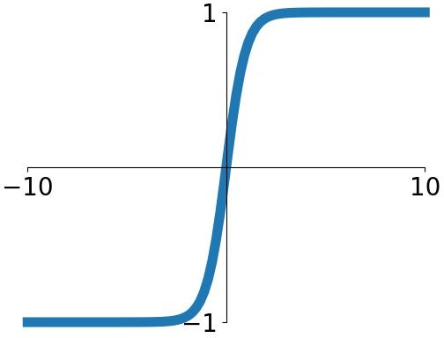


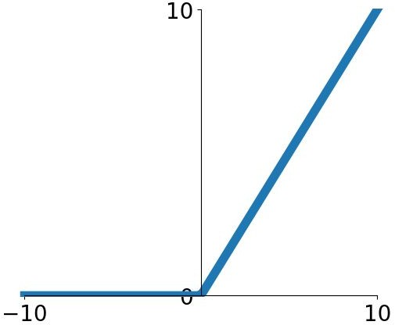
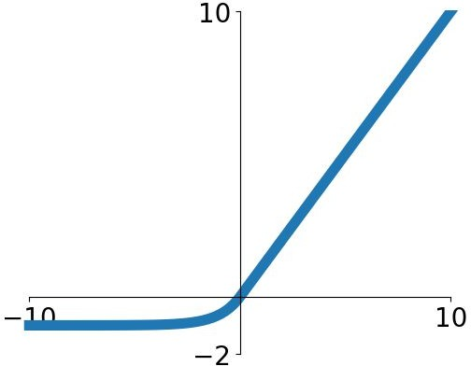
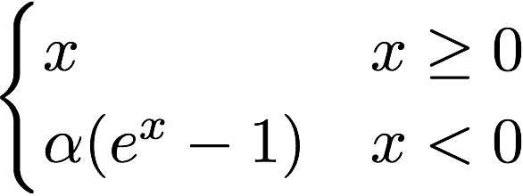

Activation Functions
Sigmoid
tanh
Leaky ReLU
Maxout
ReLU
ELU
Fei-Fei Li & Justin Johnson & Serena Yeung Lecture 6 - April 20, 2017

Slide 5

Activation Functions
Squashes numbers to range [0,1]
Historically popular since they have nice interpretation as a saturating “firing rate” of a neuron
Sigmoid
Fei-Fei Li & Justin Johnson & Serena Yeung Lecture 6 - April 20, 2017

Slide 6
Activation Functions
Squashes numbers to range [0,1]
Historically popular since they have nice interpretation as a saturating “firing rate” of a neuron
3 problems:
1. Saturated neurons “kill” the gradients
Sigmoid
Fei-Fei Li & Justin Johnson & Serena Yeung Lecture 6 - April 20, 2017

Slide 7
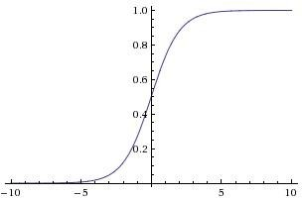



sigmoid gate
x
What happens when x = -10? What happens when x = 0?
What happens when x = 10?
Fei-Fei Li & Justin Johnson & Serena Yeung Lecture 6 - April 20, 2017

Slide 8
Activation Functions
Squashes numbers to range [0,1]
Historically popular since they have nice interpretation as a saturating “firing rate” of a neuron
3 problems:
Saturated neurons “kill” the gradients
Sigmoid outputs are not zero-centered
Sigmoid
Fei-Fei Li & Justin Johnson & Serena Yeung Lecture 6 - April 20, 2017

Slide 9
Weight Initialization
Fei-Fei Li & Justin Johnson & Serena Yeung Lecture 6 - April 20, 2017

Slide 10
- First idea: Small random numbers
(gaussian with zero mean and 1e-2 standard deviation)
Fei-Fei Li & Justin Johnson & Serena Yeung Lecture 6 - April 20, 2017

Slide 11
- First idea: Small random numbers
(gaussian with zero mean and 1e-2 standard deviation)
Works ~okay for small networks, but problems with deeper networks.
Fei-Fei Li & Justin Johnson & Serena Yeung Lecture 6 - April 20, 2017

Slide 12
Hyperparameter Optimization
Fei-Fei Li & Justin Johnson & Serena Yeung Lecture 6 - April 20, 2017

Slide 13
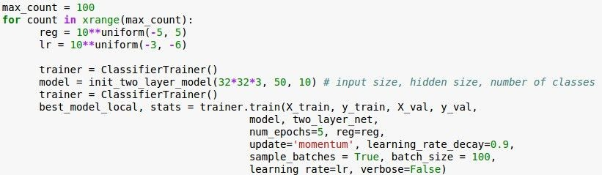

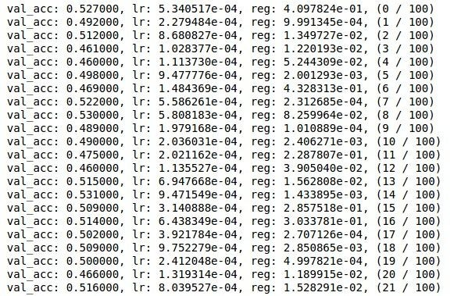
Now run finer search...
adjust range
53% - relatively good for a 2-layer neural net with 50 hidden neurons.
Fei-Fei Li & Justin Johnson & Serena Yeung Lecture 6 - April 20, 2017

Slide 14
Now run finer search...
adjust range
53% - relatively good for a 2-layer neural net with 50 hidden neurons.
But this best
cross-validation result is worrying. Why?
Fei-Fei Li & Justin Johnson & Serena Yeung Lecture 6 - April 20, 2017

Slide 15
Random Search for
Random Search vs. Grid Search
Hyper-Parameter Optimization
Bergstra and Bengio, 2012
Grid Layout Random Layout
Unimportant Parameter
Unimportant Parameter
Important Parameter
Important Parameter
Illustration of Bergstra et al., 2012 by Shayne Longpre, copyright CS231n 2017
Fei-Fei Li & Justin Johnson & Serena Yeung Lecture 6 - April 20, 2017

Slide 16
Bad initialization a prime suspect
Loss
time
Fei-Fei Li & Justin Johnson & Serena Yeung Lecture 6 - April 20, 2017

