Slide 1
Clustering

Slide 2
Unsupervised learning
Supervised learning
Predict target value (“y”) given features (“x”)
Unsupervised learning
Understand patterns of data (just “x”)
Useful for many reasons
Data mining (“explain”)
Missing data values (“impute”)
Representation (feature generation or selection)
One example: clustering

Slide 3
What is Clustering ?
Cluster: A collection of data objects
Inter-clusters distance ⇒ maximization
Intra-clusters distance ⇒ minimization
Clustering
“Grouping a set of data objects into clusters according to their similarity”[¹]
Clustering is unsupervised classification: no predefined classes

Slide 4
Major Types of Clustering Algorithms
Partitioning:
Partition the database into k clusters which are represented by representative objects of them
Hierarchical:
Decompose the database into several levels of partitioning which are represented by dendrogram

Slide 5
How do we define “similarity”?
Recall that the goal is to group together “similar” data – but what does this mean?
No single answer – it depends on what we want to find or emphasize in the data; this is one reason why clustering is an “art”
The similarity measure is often more important than the clustering algorithm used – don’t overlook this choice!

Slide 6
(Dis)similarity measures
Instead of talking about similarity measures, we often equivalently refer to dissimilarity measures (I’ll give an example of how to convert between them in a few slides…)
Jagota defines a dissimilarity measure as a function f(x,y) such that f(x,y) > f(w,z) if and only if x is less similar to y than w is to z
This is always a pair-wise measure
Think of x, y, w, and z as gene expression profiles (rows or columns)

Slide 7
Euclidean distance
Here n is the number of dimensions in the data vector. For instance:

Slide 8
d_{euc}=0.5846
d_{euc}=1.1345
d_{euc}=2.6115
These examples of Euclidean distance match our intuition of dissimilarity pretty well…

Slide 9
Clustering - Definition
Process of grouping similar items together
Clusters should be very similar to each other but…
Should be very different from the objects of other clusters/ other clusters
We can say that intra-cluster similarity between objects is high and inter-cluster similarity is low
Important human activity --- used from early childhood in distinguishing between different items such as cars and cats, animals and plants etc.

Slide 10
Types of Clustering Algorithms
Clustering has been a popular area of research
Several methods and techniques have been developed to determine natural grouping among the objects
Jain, A. K., Murty, M. N., and Flynn, P. J., Data Clustering: A Survey. ACM Computing Surveys, 1999. 31: pp. 264-323.
Jain, A. K. and Dubes, R. C., Algorithms for Clustering Data. 1988,
Englewood Cliffs, NJ: Prentice Hall. 013022278X

Slide 11
Types of Clustering Algorithms

Slide 12
Classification vs. Clustering
Classification:
Supervised learning:
Learns a method for predicting the instance class from pre-labeled (classified) instances

Slide 13
Clustering
Unsupervised learning:
Finds “natural” grouping of instances given un-labeled data

Slide 14
Clustering Evaluation
Manual inspection
Benchmarking on existing labels
Cluster quality measures
distance measures
high similarity within a cluster, low across clusters

Slide 15
The Distance Function
Simplest case: one numeric attribute A
Distance(X,Y) = A(X) – A(Y)
Several numeric attributes:
Distance(X,Y) = Euclidean distance between X,Y
Are all attributes equally important?
Weighting the attributes might be necessary

Slide 16
Simple Clustering: K-means
Works with numeric data only
Pick a number (K) of cluster centers (at random)
Assign every item to its nearest cluster center (e.g. using Euclidean distance)
Move each cluster center to the mean of its assigned items
Repeat steps 2,3 until convergence (change in cluster assignments less than a threshold)

Slide 17
K-means example, step 1
k₁
Y
Pick 3
initial
cluster
centers
(randomly)
k₂
k₃
X

Slide 18
K-means example, step 2
k₁
Y
k₂
Assign
each point
to the closest
cluster
center
k₃
X

Slide 19
K-means example, step 3
k₁
k₁
Y
Move
each cluster center
to the mean
of each cluster
k₂
k₃
k₂
k₃
X

Slide 20
K-means example, step 4
Reassign
points
closest to a different new cluster center
Q: Which points are reassigned?
k₁
Y
k₃
k₂
X

Slide 21
K-means example, step 4 …
k₁
Y
A: three points with animation
k₃
k₂
X

Slide 22
K-means example, step 4b
k₁
Y
re-compute cluster means
k₃
k₂
X

Slide 23
K-means example, step 5
k₁
Y
k₂
move cluster centers to cluster means
k₃
X

Slide 24
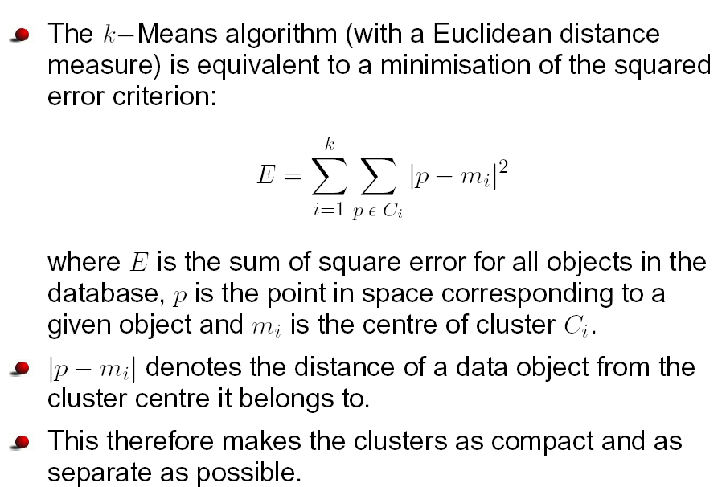
Squared Error Criterion

Slide 25
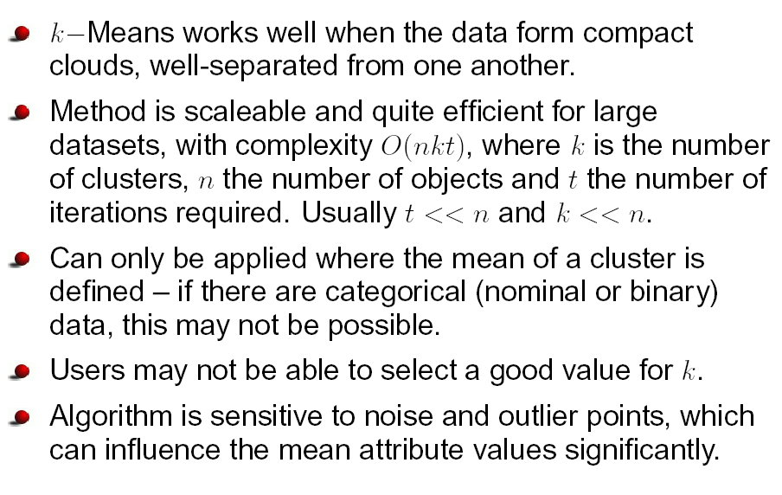
Pros and cons of K-Means

Slide 26
K-means variations
K-medoids – instead of mean, use medians of each cluster
Mean of 1, 3, 5, 7, 9 is
Mean of 1, 3, 5, 7, 1009 is
Median of 1, 3, 5, 7, 1009 is
Median advantage: not affected by extreme values
For large databases, use sampling
5
205
5

Slide 27
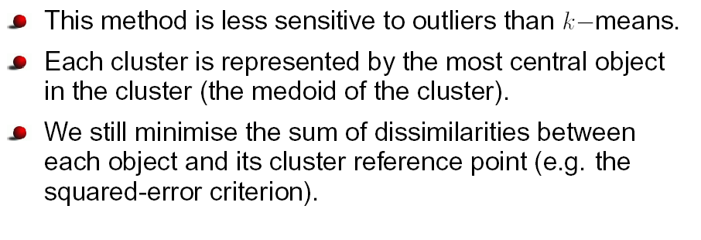
k-Medoids

Slide 28
Hierarchical Agglomerative Clustering
Another simple clustering algorithm
Define a distance between clusters (return to this)
Initialize: every example is a cluster
Iterate:
Compute distances between all clusters (store for efficiency)
Merge two closest clusters
Save both clustering and sequence of cluster operations
“Dendrogram”
Initially, every datum is a cluster

Slide 29
Iteration 1

Slide 30
Iteration 2

Slide 31
Iteration 3
Builds up a sequence of clusters (“hierarchical”)
Algorithm complexity O(N²)
(Why?)
In matlab: “linkage” function (stats toolbox)

Slide 32
Dendrogram

Slide 33
Hierarchical clustering
Agglomerative Clustering
Start with single-instance clusters
At each step, join the two closest clusters
Design decision: distance between clusters
Divisive Clustering
Start with one universal cluster
Find two clusters
Proceed recursively on each subset
Can be very fast
Both methods produce a dendrogram

Slide 34
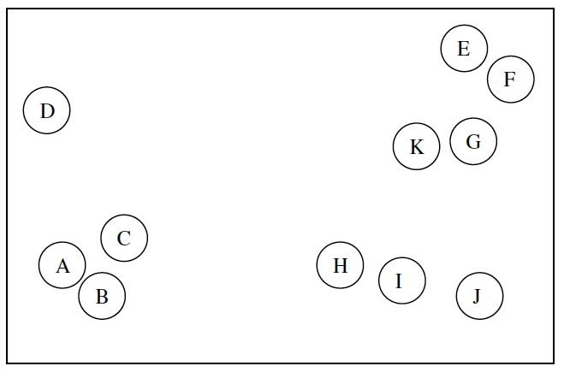
Hierarchical clustering

Slide 35
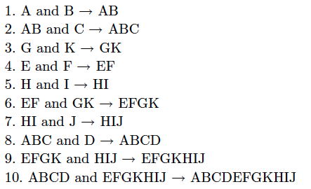
Hierarchical clustering

Slide 36
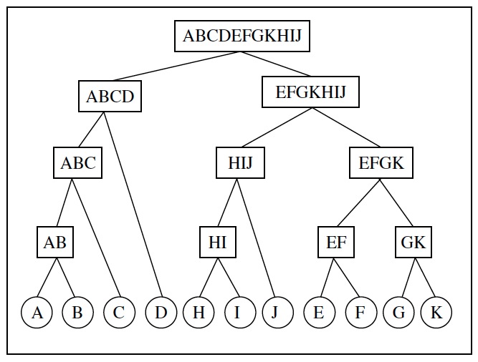
Hierarchical clustering

Slide 37
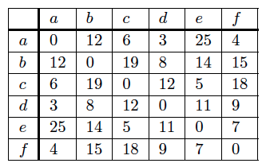
Hierarchical clustering

Slide 38
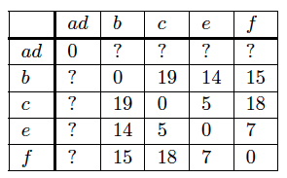
Hierarchical clustering

Slide 39
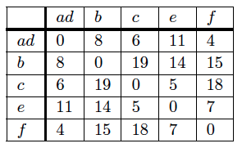
Hierarchical clustering

Slide 40
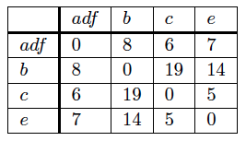
Hierarchical clustering

Slide 41
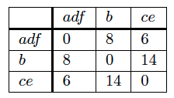
Hierarchical clustering

Slide 42
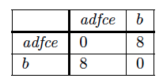
Hierarchical clustering

Slide 43
Research Problems
Effective and Efficient methods of Clustering
Scalability
Handling different types of data
Handling complex multidimensional data
Complex shapes of clusters
Subspace Clustering
Cluster overlapping etc.

Slide 44
Examples of Clustering Applications
Marketing: discover customer groups and use them for targeted marketing and re-organization
Astronomy: find groups of similar stars and galaxies
Earth-quake studies: Observed earth quake epicenters should be clustered along continent faults
Genomics: finding groups of gene with similar expressions
…

Slide 45
Clustering Summary
unsupervised
many approaches
K-means – simple, sometimes useful
K-medoids is less sensitive to outliers
Hierarchical clustering – works for symbolic attributes
Can be used to fill in missing values

Slide 46
Questions
?

