Slide 1
Machine Learning
By Gulraiz Khan

Slide 2

What you will learn in this course
Basic understanding of machine learning
Preprocessing of data
Primary Machine Learning Algorithms
  Logistic regression, Clustering, Nearest Neighbor algorithm, Bayesian methods, Decision trees, SVM
Introduction of basic Deep Learning
  MLP
  CNN
  Loss functions

Slide 3
What is Machine Learning
Study of an algorithm that
  To perform some taks “T”
  To improve performance “P”
  With experience E
Learning task <P,T,E>

Slide 4
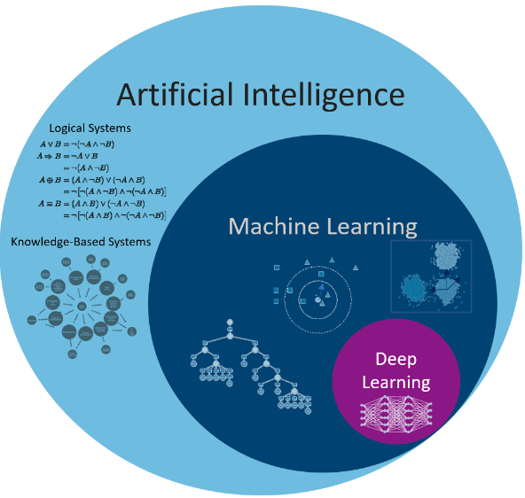
AI vs ML vs DL

Slide 5
Types of Machine Learning Algorithms
Supervised
Semi-Supervised
Unsupervised

Slide 6
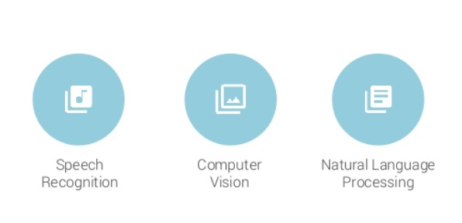
Areas of Machine Learning
© M. Shahbaz – 2013

Slide 7
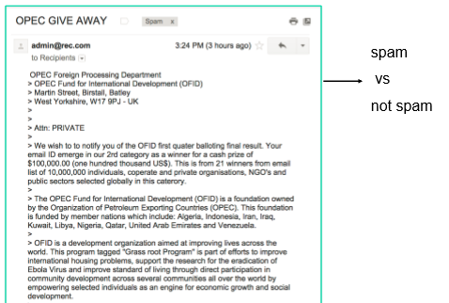
Areas of Machine Learning

Slide 8
Areas of Machine Learning
 | Age | Cal/day | Walk
x1 | 16-30 | 50 | Yes
x2 | 16-30 | 0 | No
x3 | 31-45 | 1-25 | No
x4 | 31-45 | 1-25 | Yes
x5 | 46-60 | 26-49 | No
x6 | 16-30 | 26-49 | Yes
x7 | 46-60 | 26-49 | No

Slide 9
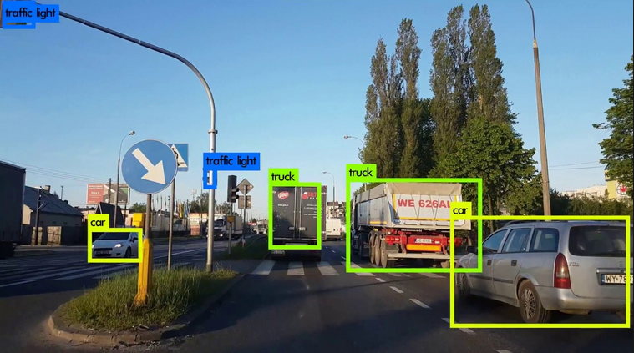
Areas of Machine Learning

Slide 10
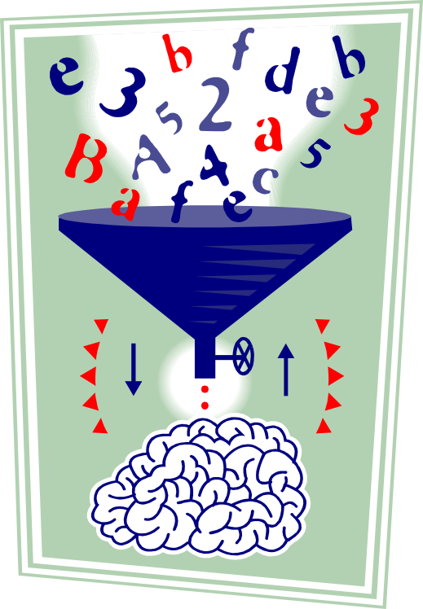
Data Preprocessing
Data Preparation for
training the machine

Slide 11
Data Preprocessing
Why preprocess the data?
Data cleaning
Data integration and transformation
Data reduction
Discretization and concept hierarchy generation
Summary

Slide 12
Why Data Preprocessing?
Data in the real world is dirty most of the time
  incomplete: missing attribute values, lack of certain attributes of interest
    e.g., occupation=“” for age detection
  noisy: containing errors or outliers (Not allowed)
    e.g., Salary=“-10”
  inconsistent: containing discrepancies in codes or names (allowed but logically wrong)
    e.g., Age=“42” Birthday=“03/07/1997”
    e.g., Was rating “1,2,3”, now rating “A, B, C”

Slide 13
Why Is Data Preprocessing Important?
No quality data, no quality results!
  Quality decisions must be based on quality data
    e.g., duplicate or missing data may cause incorrect misleading statistics.
Data preparation, cleaning, and transformation comprises the majority of the work in a data mining application (80%).
Necessary to make data more suitable for data mining and improve the data analysis with respect to time, cost and quality.

Slide 14
Multi-Dimensional Measure of Data Quality
A well-accepted multidimensional view:
  Accuracy
  Completeness
  Consistency (with other records)
  Timeliness (Timely Available)
  Believability (logical)
  Value added (relevant)
  Interpretability (understandable)
  Accessibility

Slide 15
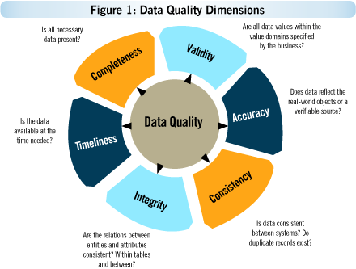
Multi-Dimensional Measure of Data Quality

Slide 16
Major Tasks in Data Preprocessing
Data integration
  Integration of multiple databases, data cubes, or files
Data cleaning
  Fill in missing values, smooth noisy data, identify or remove outliers, and resolve inconsistencies
Data transformation
  Normalization and aggregation
Data reduction
  Obtains reduced representation in volume but produces the same or similar analytical results
Data Discretization
  Part of data reduction but with particular importance, especially for numerical data

Slide 17

Forms of data preprocessing

Slide 18
Data Preprocessing
Why preprocess the data?
Data cleaning
Data integration and transformation
Data reduction
Discretization and concept hierarchy generation
Summary

Slide 19
Data Cleaning
Importance
  “Data cleaning is the number one problem in data warehousing”
Data cleaning tasks – this routine attempts to
  Fill in missing values
  Identify outliers and smooth out noisy data
  Correct inconsistent data
  Resolve redundancy caused by data integration

Slide 20
Missing Data
Data is not always available
  E.g., many tuples have no recorded value for several attributes, such as customer income in sales data
Missing data may be due to
  equipment malfunction
  data not entered due to misunderstanding
  certain data may not be considered important at the time of entry
  not register history or changes of the data

Slide 21
Missing Values Example
Hospital Check-in Database
Name | Age | Gender | Height? | ..
Mary | 25 | F | N
Jane | 27 | F | -
Joey | 30 | M | -
Anna | 2 | F | -
Value may be missing because it is unrecorded or because it is inapplicable

Slide 22
How to Handle Missing Data?
Ignore the tuple: usually done when class label is missing (assuming the tasks in classification—not effective when the percentage of missing values per attribute varies considerably)
Fill in the missing value manually: tedious + infeasible?
Use a global constant to fill in the missing value: e.g., “unknown”, a new class?!
Use the attribute mean to fill in the missing value
Use the most probable value to fill in the missing value: inference

Slide 23
Noisy Data
Noise: random error (Not allowed data)
Incorrect attribute values may be due to
  Instruments fault
  Data entry problems
  Data transmission problems (channel fault)
  Inconsistency in naming convention
Use smoothing mechanism to remove noise

Slide 24
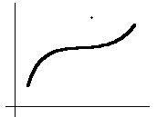
Outlier Removal
Data points inconsistent with the majority of data
Different outliers
  Valid: CEO’s salary,
  Noisy: One’s age = 200, widely deviated points
Remove unwanted records

Slide 25
Data Preprocessing
Why preprocess the data?
Data cleaning
Data integration and transformation
Data reduction
Discretization and concept hierarchy generation
Summary

Slide 26
Data Transformation
Combine data from different sources
  Disks, Databases, servers
Normalization: scaled to fall within a small, specified range such as –1.0 to 1.0 or 0.0 to 1.0
Attribute/feature construction
  New attributes constructed / added from the given ones

Slide 27
Data Preprocessing
Why preprocess the data?
Data cleaning
Data integration and transformation
Data reduction
Discretization and concept hierarchy generation
Summary

Slide 28
Data Reduction Strategies
Data Cube Aggregation (merge multiple tables)
Dimension reduction (Reduce columns)
Feature Selection (select relevant features. skin color for age)
Data compression (Compress the file using different extension)

Slide 29
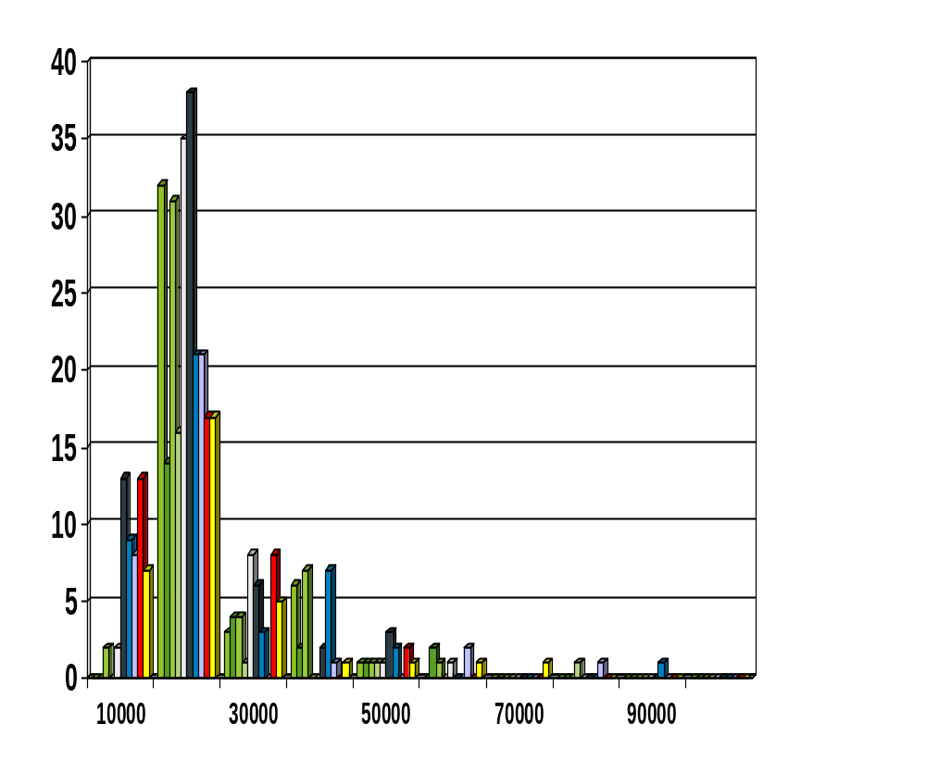
Discretization
Divide data into buckets and sum for each bucket.
Sum all employees with salary = 50000

Slide 30
Summary
Data preparation is a big issue for both warehousing and mining
Data preparation includes
  Data cleaning and data integration
  Data reduction and feature selection
  Discretization
A lot a methods have been developed but still an active area of research

