Slide 1
HCLTech x OpenAI
Agentic Delivery
Risk Copilot
OpenAI API
5 agents
A multi-agent command center that detects project risk, proves it with evidence, drafts recovery actions, and creates Codex-ready remediation guidance.
Evidence-backed
recovery planning
HCLTech x OpenAI Agentic AI Hackathon
1

Slide 2
AGENTIC DELIVERY RISK COPILOT
The Enterprise Delivery Problem
Status is fragmented
Risks are spread across Jira exports, meeting notes, build logs, and emails.
Blockers are found late
Manual reviews miss stale ownership, dependency aging, and technical failure patterns.
Recovery takes too long
PMs still need to draft escalation notes, Jira updates, and executive summaries manually.
HCLTech x OpenAI Agentic AI Hackathon
2

Slide 3
AGENTIC DELIVERY RISK COPILOT
Solution: Multi-Agent Delivery Command Center
The copilot converts raw project artifacts into a prioritized recovery plan with source evidence and ready-to-approve communications.
Detect
Prove
Recover
Find blocked work, stale owners, failed builds, and client escalation signals.
Cite exact artifact, row, and line evidence behind each risk.
Generate escalation emails, Jira comments, and Codex remediation prompts.
HCLTech x OpenAI Agentic AI Hackathon
3

Slide 4
AGENTIC DELIVERY RISK COPILOT
OpenAI Products Used
OpenAI Responses API
Structured JSON
Reasoning over project artifacts and generating structured outputs for the dashboard.
Risk score, evidence, severity, actions, drafts, and remediation plan are returned as strict fields.
Tool-style orchestration
Codex workflow
The app presents the workflow as ingestion, evidence, risk, action, and remediation agents.
The remediation agent produces a Codex-ready prompt for build/code fixes and regression tests.
HCLTech x OpenAI Agentic AI Hackathon
4

Slide 5
AGENTIC DELIVERY RISK COPILOT
Architecture
Artifacts
→
Ingestion
→
Evidence
→
Risk
→
Actions
→
Codex
React frontend
FastAPI backend
OpenAI API
HCLTech x OpenAI Agentic AI Hackathon
5

Slide 6
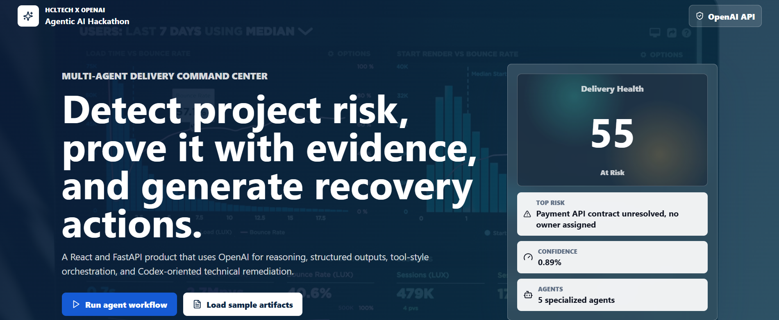
AGENTIC DELIVERY RISK COPILOT
Live Demo Flow
1.
Load Jira export, meeting notes, and build log.
2.
Run the agent workflow.
3.
Show risk score, evidence, actions, drafts, and Codex remediation.
4.
Explain measurable business impact.
HCLTech x OpenAI Agentic AI Hackathon
6

Slide 7
Why This Can Win
3 hrs → 15 min
Same day
Status prep
Blocker detection
5 agents
Ready
Repeatable workflow
Scale across teams
Submission close: an OpenAI-first enterprise product with clear innovation, measurable impact, real-world relevance, technical execution, and scalability.
HCLTech x OpenAI Agentic AI Hackathon
7

