Slide 1
INTERNSHIP REPORT PRESENTATION
Artificial Intelligence
Internship
Codec Technologies Pvt. Ltd. | AICTE & ICAC Approved Program | Google for Education Partner
Gulshan Raj
Roll No. 25SCS1003001289 | B.Tech CSE
Session 2025 – 2029 | IILM University

Slide 2






ABOUT THE STUDENT
Candidate Profile
Roll Number
25SCS1003001289
Gulshan Raj
Institute
IILM University
B.Tech – Computer Science & Engineering
Programme
B.Tech CSE, Session 2025 – 2029
Internship Domain
Artificial Intelligence
Duration
2 Months | 07 June 2026 – 08 August 2026
Google AI-ML Virtual Internship • Gulshan Raj
02

Slide 3


ABOUT THE PROGRAM
Codec Technologies, AICTE & Google for Education
Codec Technologies Pvt. Ltd. runs an AICTE & ICAC approved internship program, offered as a Google for Education partner initiative. This 2-month Artificial Intelligence Intern track gave hands-on, industry-aligned exposure to core AI and machine learning concepts, moving beyond classroom theory into practical, applied learning.
AICTE & ICAC Approved
Codec Technologies
Google for Education
Recognised internship program under national skilling initiatives.
Industry mentorship from Codec Technologies Pvt. Ltd.
Delivered as part of the Google for Education partner network.
Google AI-ML Virtual Internship • Gulshan Raj
03

Slide 4



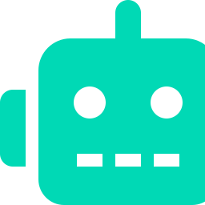
PROBLEM STATEMENT
Bridging Theory and Applied AI
Engineering students often learn the theoretical foundations of Artificial Intelligence and Machine Learning in coursework, but rarely get structured, hands-on practice applying core concepts — like Python-based model building, neural networks, and real-world AI applications — to solve practical problems.
This internship addressed that gap — building a practical, project-based AI workflow:
→
→
→
Learn Python
Understand ML
Build Neural Nets
Apply AI
Google AI-ML Virtual Internship • Gulshan Raj
04

Slide 5
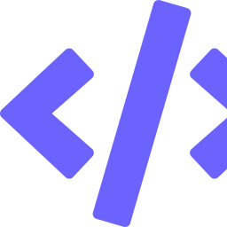


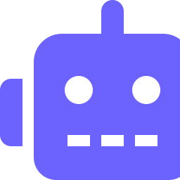


INTERNSHIP OBJECTIVES
What the Internship Set Out to Achieve
Learn Python for AI
Understand Machine Learning
Explore Neural Networks
Build strong Python foundations as the core language for AI & ML development.
Grasp ML fundamentals — supervised/unsupervised learning, and how models learn from data.
Understand the structure and working of neural networks used in modern AI systems.
Apply AI Concepts
Evaluate Models
Complete Assessments
Translate theory into applied AI use-cases and simple real-world problem solving.
Learn to assess model performance and understand accuracy, training & testing basics.
Clear program modules and assessments to earn the internship certification.
Google AI-ML Virtual Internship • Gulshan Raj
05

Slide 6


TECHNOLOGIES & TOOLS
The Toolkit Behind the Internship
Python
Machine Learning
Neural Networks
AI Applications
Core programming language
Core algorithms & concepts
Deep learning fundamentals
Applied, real-world use-cases
Data Handling
Model Building
Libraries & Frameworks
Assessments
Datasets & preprocessing
Training & evaluation basics
Standard Python AI/ML tooling
Module tests & final validation
Google AI-ML Virtual Internship • Gulshan Raj
06

Slide 7
METHODOLOGY
The 2-Month Learning Journey
1
Month 1 — Foundations
Python programming basics, core Machine Learning concepts, and an introduction to how AI systems are trained.
2
Month 1 — Deep Dive
Understanding Neural Networks — structure, layers, and how learning happens inside a model.
3
Month 2 — Application
Applying AI/ML concepts to hands-on exercises and mini practical tasks.
4
Month 2 — Assessment
Module assessments, final evaluation, and successful completion of the internship program.
Google AI-ML Virtual Internship • Gulshan Raj
07

Slide 8

EXPECTED OUTCOMES
Skills & Capabilities Gained
Working knowledge of Python for AI & Machine Learning development
Conceptual and practical understanding of core Machine Learning algorithms
Ability to explain the structure and working of Neural Networks
Exposure to applying AI concepts to real-world style problems
Understanding of how models are trained, tested and evaluated
Successfully completed the 2-month AICTE & ICAC approved AI Internship
Google AI-ML Virtual Internship • Gulshan Raj
08

Slide 9
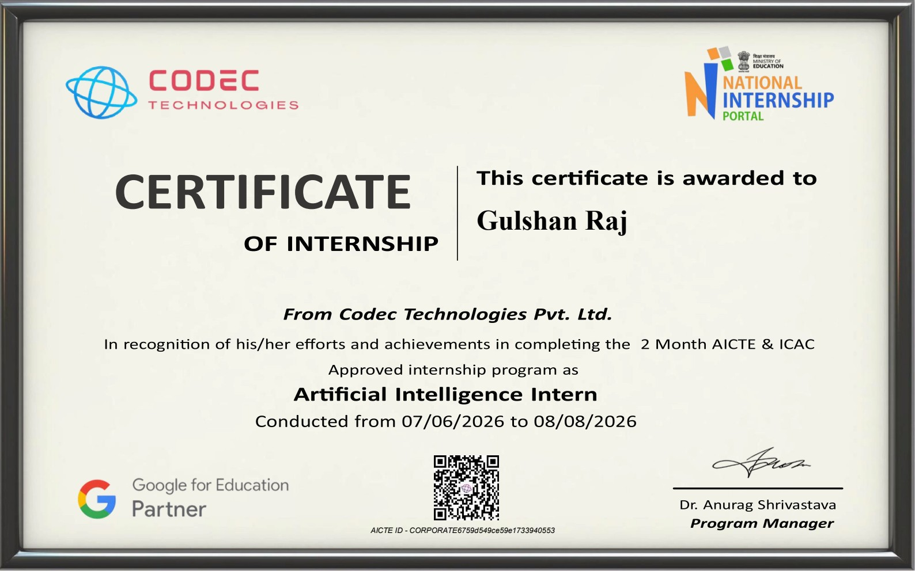




CERTIFICATION
Successfully Completed
Organization
Codec Technologies Pvt. Ltd.
Domain
Artificial Intelligence Intern
Duration
2 Months | 07 Jun 2026 – 08 Aug 2026
Approved By
AICTE & ICAC | Google for Education
Google AI-ML Virtual Internship • Gulshan Raj
09

Slide 10
Thank You
Artificial Intelligence Internship | Codec Technologies Pvt. Ltd.
Gulshan Raj
Roll No. 25SCS1003001289 | IILM University

