Slide 1

INTRODUCTION
THE PROJECT AIMS TO BUILD A JAVA APPLICATION THAT WILL ALLOW THE USERS TO CONVERT UNITS AND CURRENCIES.
IT USES SWING AND JAVA OOP CONCEPT TO GIVE AN DYNAMIC APP

Slide 2
Proposed system
This convertor application allows user to convert unit and currency from one type to another.
The text box allow user to type the magnitude of unit or currency they wants to convert.

Slide 3
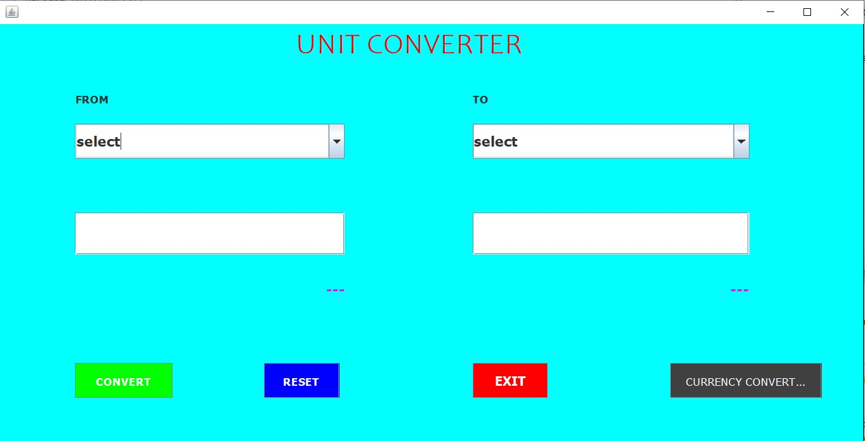
PROPOSED SYSTEM
When the java program will be executed, a UI based model will run and shows the given structure for the convertor.

Slide 4
Convertor menu
AFTER USER RUN THE PROGRAM, THE MENU WILL SHOWS 8 FIELDS WILL BE THERE WITH WHICH A USER CAN INTERACT WITH..
THE FIELDS ARE:
SELECT THE UNIT TO CONVERT AND THE UNIT TO WHICH IT IS GETTING CONVERTED.
TEXT BOX
CONVERT BUTTON
RESET BUTTON
EXIT
CURRENCY CONVERTOR BUTTON

Slide 5
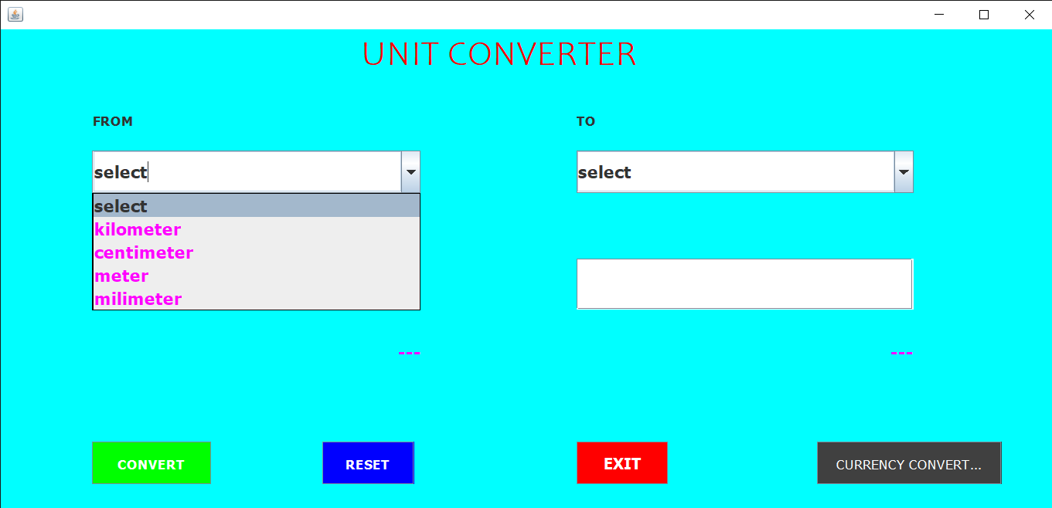
SELECTION OF UNITS
THIS LETS YOU TO SELECT UNITS WHICH ARE NEEDED TO BE CONVERTED.
IN FROM FIELD THE SEVERAL UNITS ARE MENTIONED
KILOMETER,CENTIMETER,METER,MILLIMETER.
USED WILL SELECT A UNIT WHICH IS GETTING CONVERTED
USER HAVE TO SELECT THE NEXT UNIT TO WHICH THE UNIT WILL GET CONVERTED TO.

Slide 6
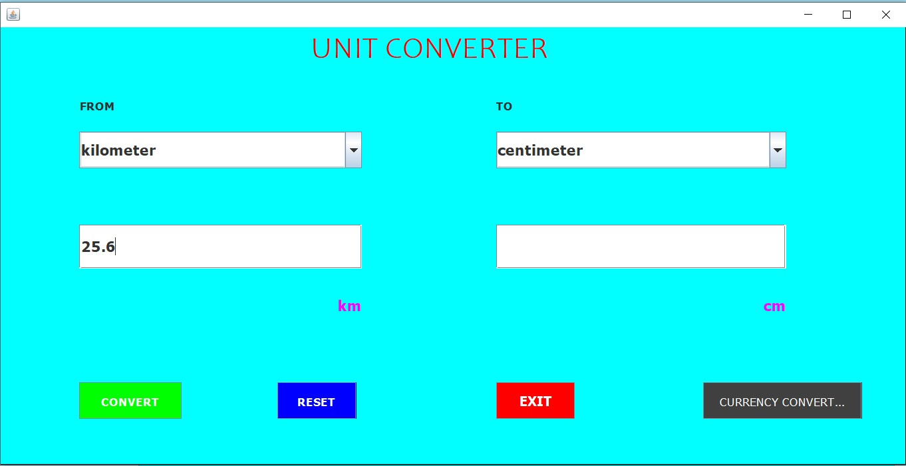
typing OF VALUES
The user will type value which is getting converted

Slide 7
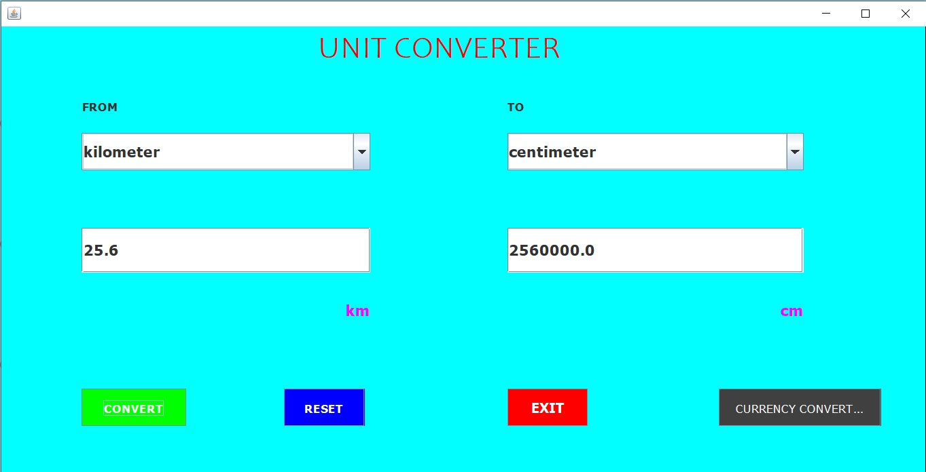

Convert button
THIS LETS YOU convert the typed value.

Slide 8
Reset button
THIS IS to reset the application to its basic initial format.

Slide 9
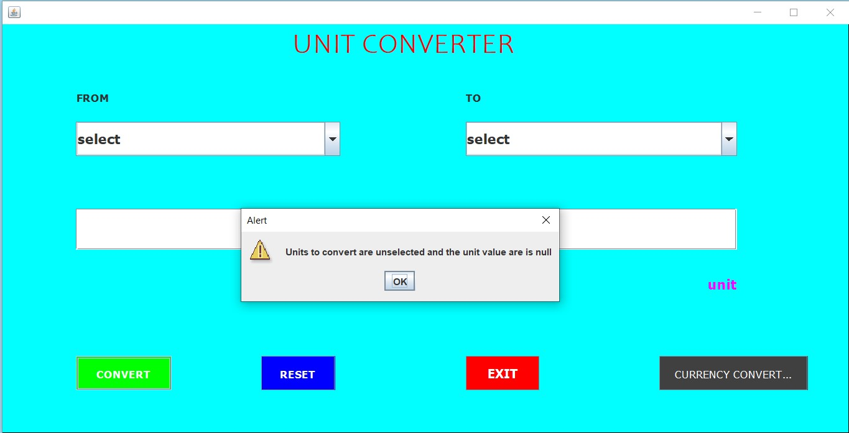
Exception handling
If user don’t provide the required details and clicks to convert, this will show the user a pop up saying the following:

Slide 10
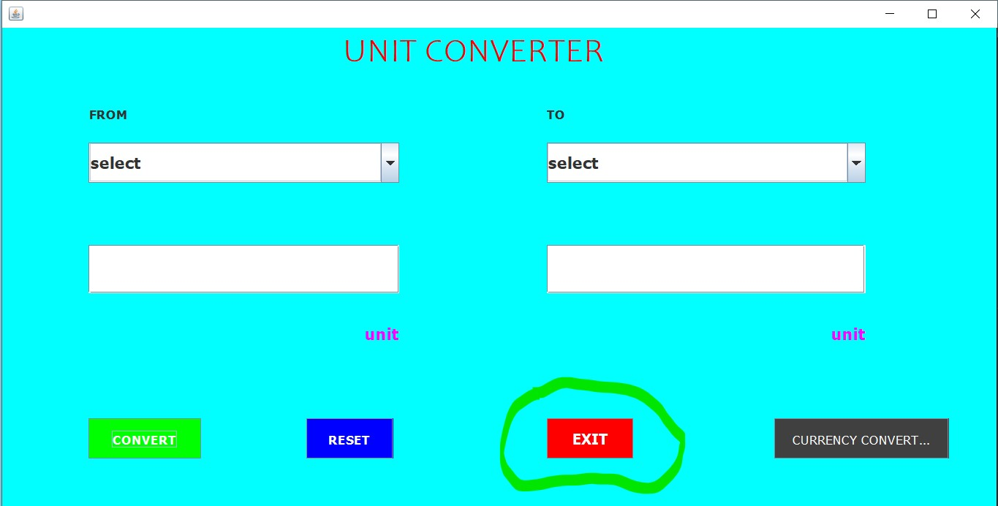
EXIT
This will take the user out of the app.

Slide 11
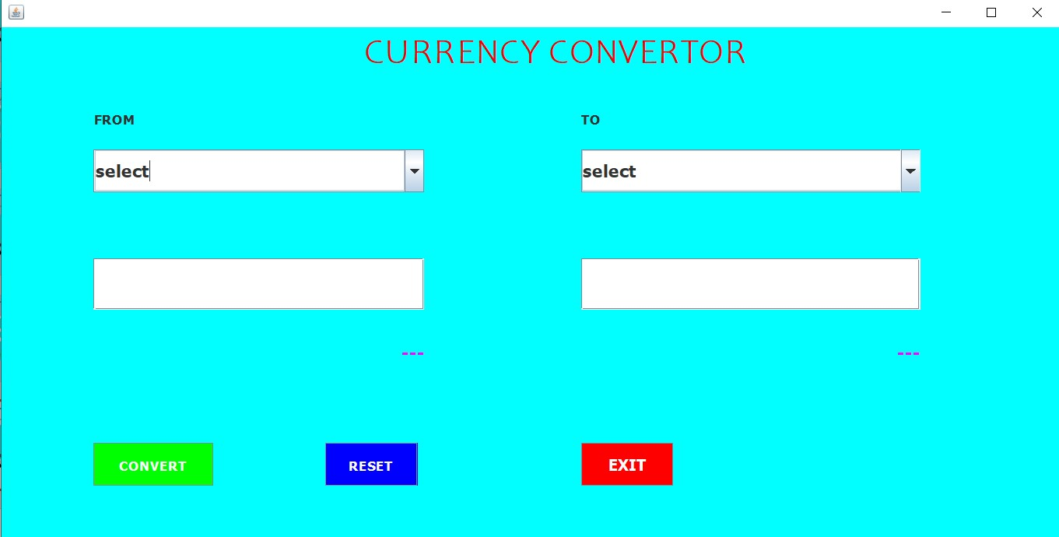
Er diagram
Currency convertor
A currency convertor is created using inheritance, by inheriting the unit convertor methods and variables.
ER DIAGRAM

Slide 12
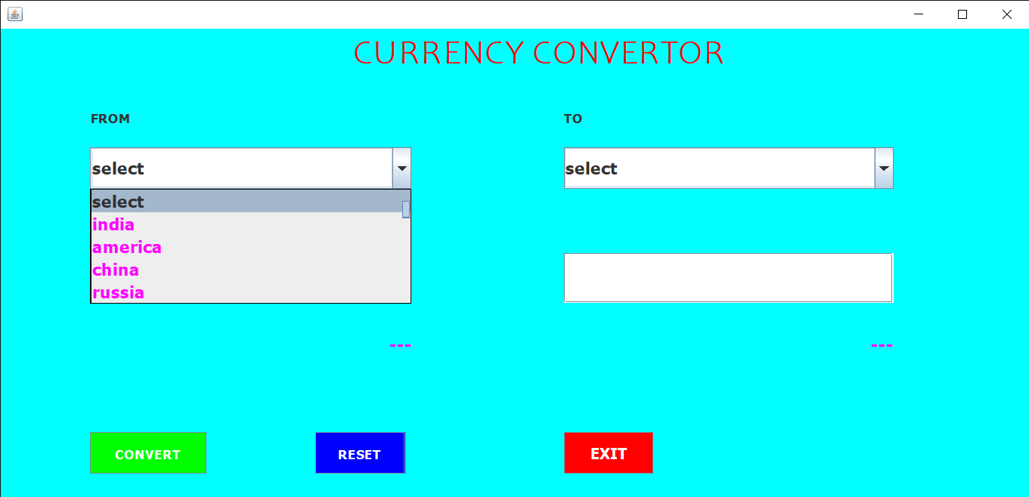
SELECTION OF CURRENCY
THIS LETS YOU TO SELECT CURRENCY WHICH ARE NEEDED TO BE CONVERTED.
IN FROM FIELD THE SEVERAL UNITS ARE MENTIONED
INDIA, AMERICA, CHINA, RUSSIA.
USER WILL SELECT A COUNTRY WHICH IS GETTING CONVERTED
USER HAVE TO SELECT THE NEXT COUNTRY TO WHICH THE UNIT WILL GET CONVERTED TO.

Slide 13
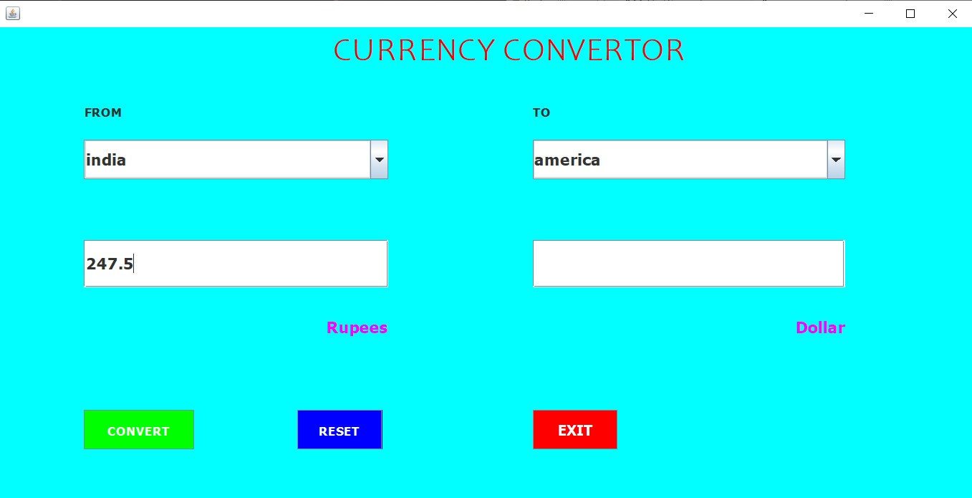
typing OF VALUES
The user will type value which is getting converted

Slide 14
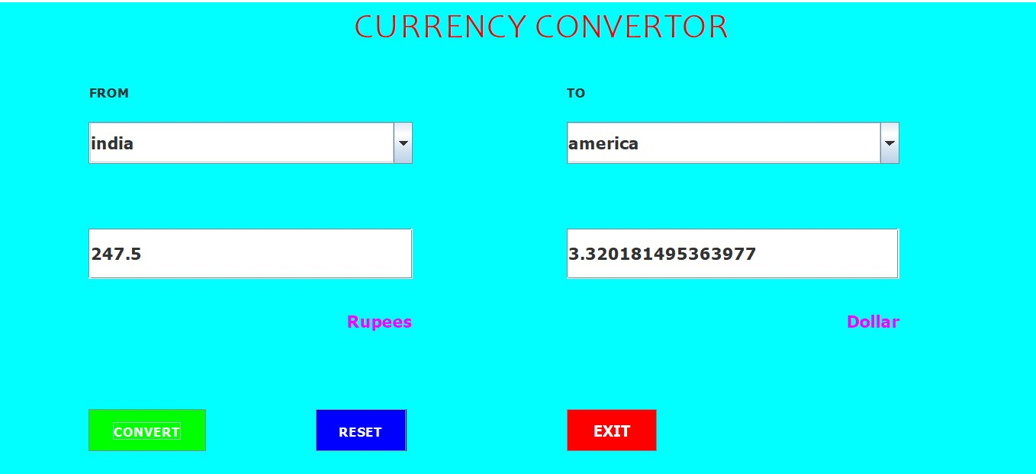
Convert button
THIS LETS YOU convert the typed value.

