Slide 1
Centre for Development of Advanced Computing Hyderabad
PROJECT PRESENTATION
Project title: WediGo
Presented By: Gopchude Pranita Kishan( 200250320044)
Gulshan Kumar Vashisth (200250320043)
Hakeem Sai Sharath(200250320023)

Slide 2
Presentation Outline
INTRODUCTION
OVERALL DESCRIPTION
  Architecture
  Functionality
  Intended Audience
  Constraints
  Assumption and Dependencies
  6. Approach to overcome the existing system
SPECFIC REQUIREMENTS
  Platform
  User Interfaces
SOFTWARE DESIGN
5. DATABASE DESIGN
6. CONCLUSION
7. FUTURE WORK

Slide 3
INTRODUCTION
WediGo is Project that we will develop using above Technology. This Project is about to book appointment which is wedding related things like Wedding Hall, Photographers, and Catering etc.
Basically, User need not go for individual booking .We provide one platform for all user to book such things like wedding hall, Photographers, and Catering etc. within their Budgets.
There is well organized database to store and maintain the record of User and Members (Wedding Hall, Photographers, and Catering etc.)
WediGo can also be used for future as basis for detailed understanding on how project was started. It provides a blueprint to upcoming new developers and maintenance teams to assist in maintaining and modifying this project as per required changeability.

Slide 4
OVERALL DISCRIPTION
  2.1 ARCHITECTURE
MySQL
Spring MVC
&
Hibernate
Client View
fig. Project Architecture
  2.2 FUNCTIONALITY
    Users can register their account.
    Users if they are ever short on content/ideas, they can do booking on a topic that interests like wedding Hall, Photographer etc.
    Member can also register their self.
    Admin can check user and member and also have functionality to delete.

Slide 5
  2.3 INTENDED AUDIENCE
    Member: Member’s sole purpose is to provide the quality customer service. And it is also responsible for the adding, updating and deleting their own areas like wedding hall, photographer etc.
    Admin: Admin has every access to the WediGo system. Admin is solely responsible for managing members as well as customer needs.. Admin can also view any report such as if customer information, booking information, analyze them and take the decision accordingly. Admin is required to have experience on managing such a website, and have base knowledge of database and application server.
    Customer: Customer is vital part of the system. Once customer have register yourself and then by logging it then system ask what the thing want to book then by submitting the required interest then customer have a list of all members related to their interest and if customer budgets allow to book so they can book a particular thing like Wedding hall , Photographer etc.
2.4 ASSUMPTION AND DEPENDENCIES
It is assumed that system developed will work perfectly that is going to be developed under the Windows OS, with MySQL database.
After logging in by default, roles are user and admin.

Slide 6
2.6 APPROACH TO OVERCOME THE EXISTING SYSTEM
In the previous system, Customer are tired for the individual booking in marriage and relating occasions and they also pay extra amount for booking in advance and there is no proof of booking so customer always anxious for their personal events. So to see this such type of problem ,we proposed a system called “WediGo” for online booking of events related things like Wedding Hall, photographer, caterer and DJ system, through our customer is not need to worry about their events and they will not pay extra booking for their individual booking.

Slide 7
SPECIFIC REQUIREMENT
  3.1 PLATFORM
The application has been develop as web-based application.
  3.2 USER INTERFACES
    Front End: HTML, CSS
Libraries/Frameworks used: Bootstrap
    Back End: JAVA EE
Libraries/Frameworks used: Spring MVC, Hibernate
IDE: Eclipse
Database: MySQL

Slide 8
4. SOFTWARE DESIGN
4.1 E.R Diagram
Delete
Wedding Hall
Admin
Name
Member
Photographer
Email
Booking
Delete
Caterer
Price
DJ System
User
Contact
Name
Email
Password
Gender
About
4.2 D.F.D Diagram
Customer
Booking
WediGo
Registration
Member
Registration
Login
Customer Info
delete
Member Info
Admin

Slide 9
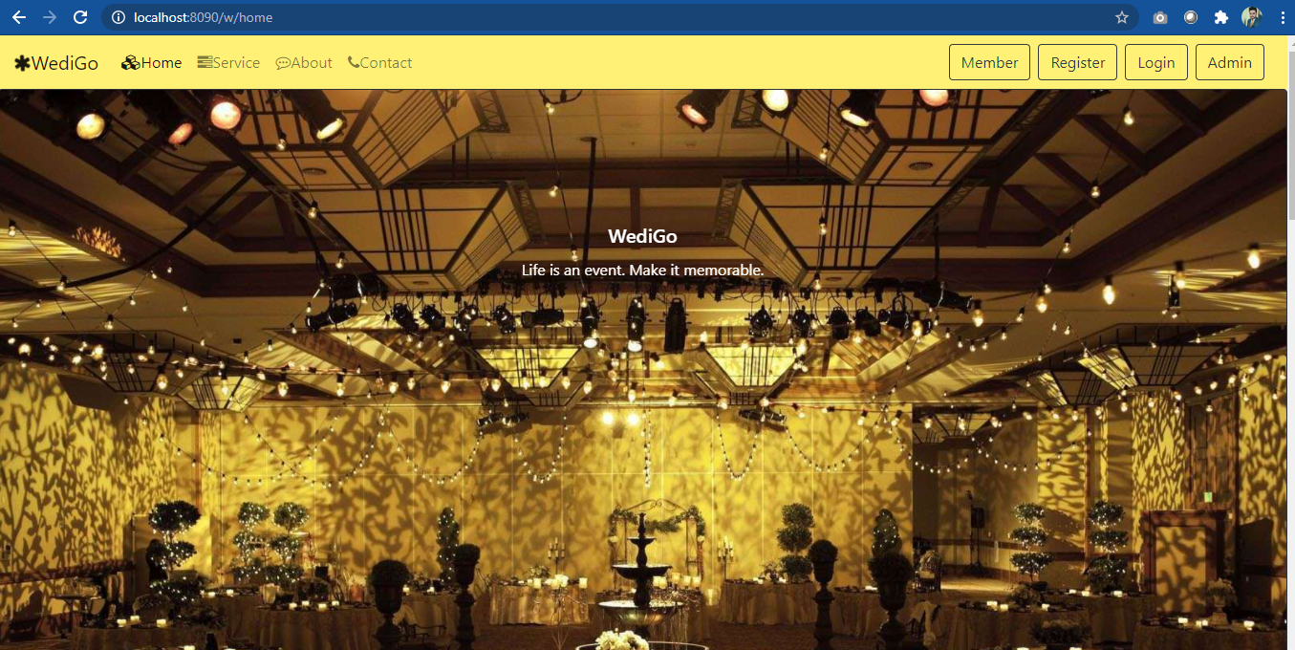
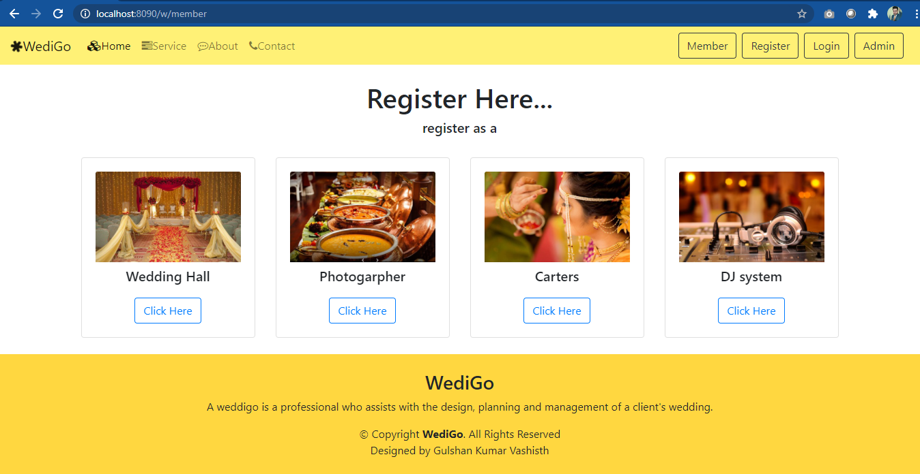
4.3 Screenshot

Slide 10
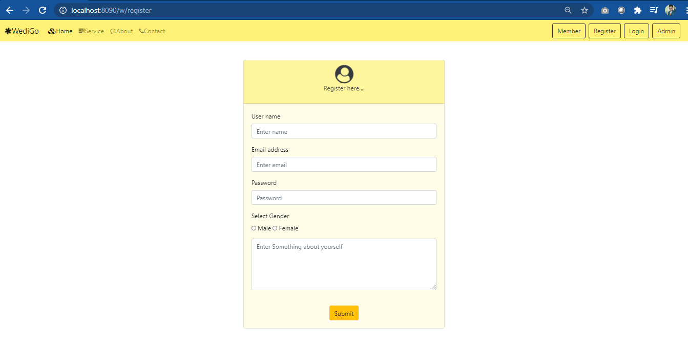
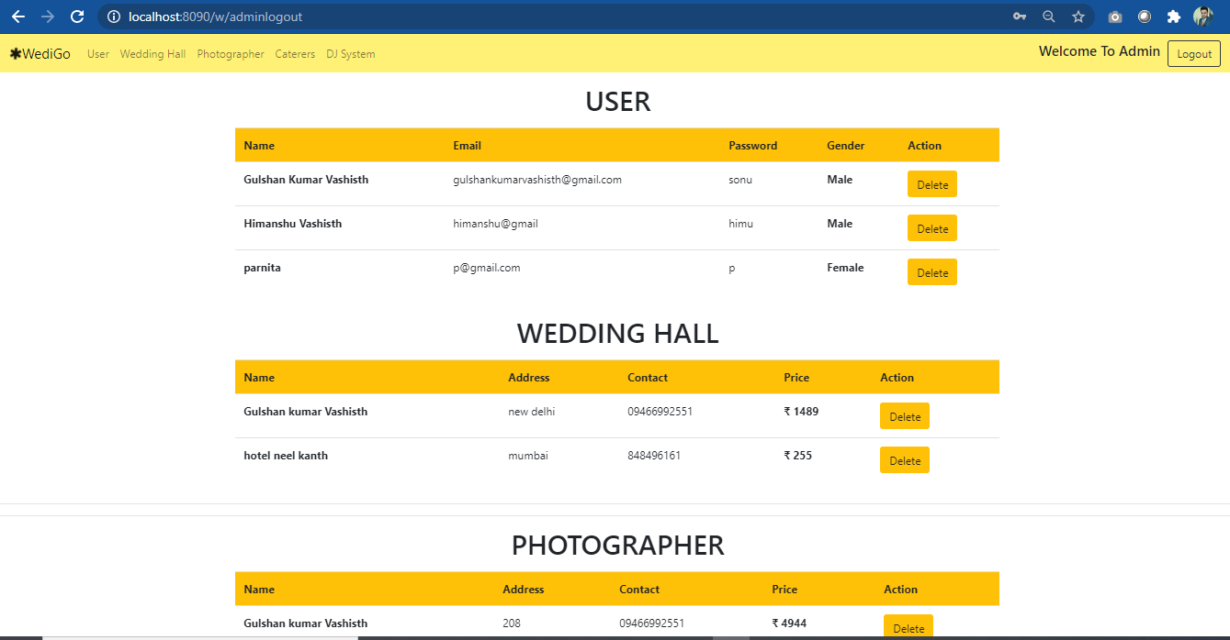

Slide 11
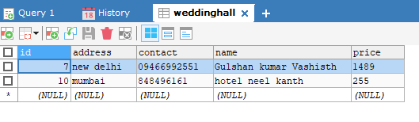
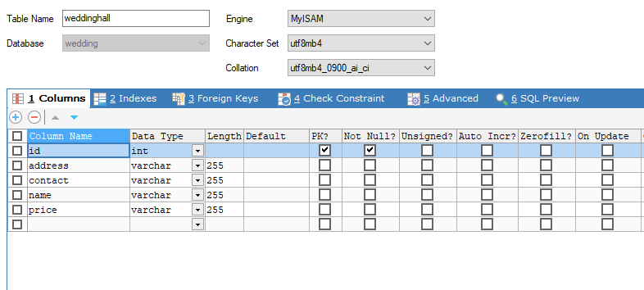
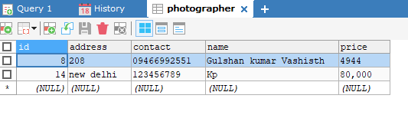
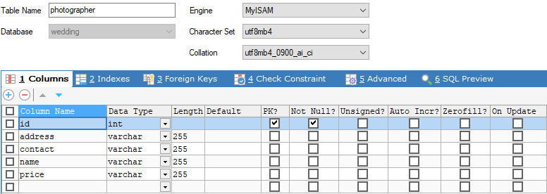
5. DATABASE DESIGN
5.1 Member Database

Slide 12
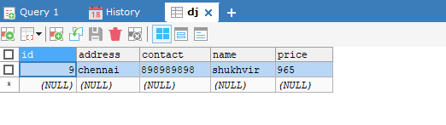
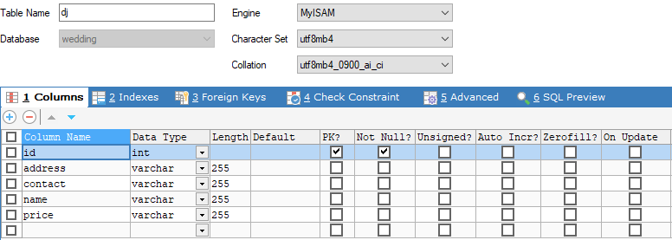
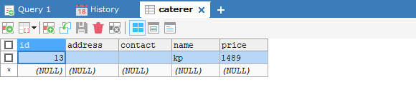


Slide 13
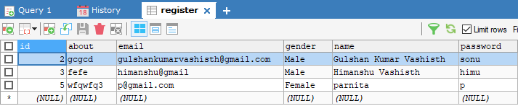
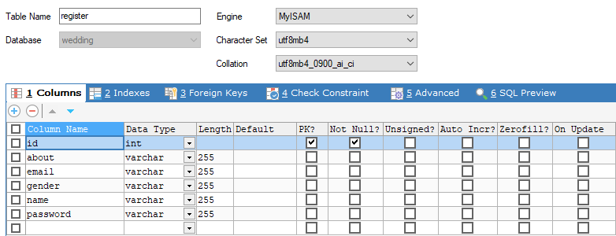
5.2 Customer Database

Slide 14
6. CONCLUSION
  Users and Member should be able to create their account.
  Users should be able to login through their already existing accounts.
  Users should be able booking.
  Admin should view Members as well as Users.
  Admin also delete member and user.
7. FUTURE WORK
We can add following functionality in future:
  Separate login for Member
  Member can post the image.
  Completion of booking with message or email notification

Slide 15


