Slide 1





VIBE-CHECK

Slide 2



TEAM
ULTRAVIOLET
GULSHAN KUMAR PRASAD
MOHAK
SAMYAK JAIN
SHAMIULLAH KHAN

Slide 3


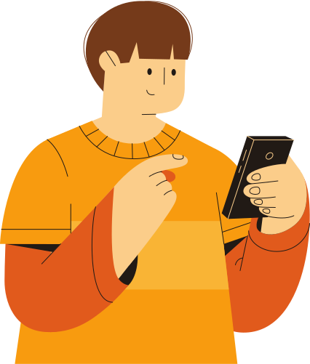
VIBE-CHECK
Vibe-Check is a decentralized social media platform designed to foster connections based on shared vibes and auras. Users upload their photos, and other users can rate their aura and assign relevant vibe tags. If two or more users have matching vibe tags, they can initiate a direct chat.

Slide 4



FEATURES

Slide 5



BLOCKCHAIN
INTEGRATION
Photos, aura points, and vibe tags are stored on a blockchain for transparency, security, and immutability.

Slide 6
XMTP CHAT
A decentralized messaging protocol (XMTP) is used for secure and private communication between matching users.

Slide 7

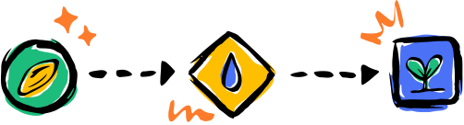
VIBE PLACE
Vibe Tag Purchase: Users can purchase a variety of vibe tags from the marketplace using a cryptocurrency or other digital assets.
Aura Point Purchase: Users can buy additional aura points to increase their attractiveness and chances of matching with other users.
Custom Vibe Tag Creation: Allow users to create and sell their own custom vibe tags, fostering creativity and personalization.

Slide 8
LEADERBOARD
Ranking System: Implement a leader board that ranks users based on the number of vibe tags they have acquired and the total aura points they have received.
Rewards and Incentives: Offer rewards or incentives to top-ranked users, such as exclusive features, discounts, or recognition within the community.

Slide 9

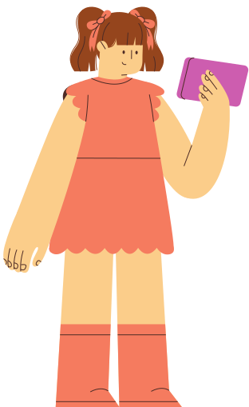
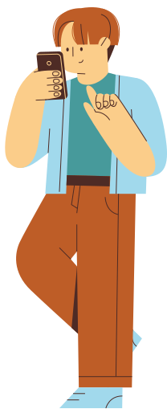
THANK YOU

